Slide 1
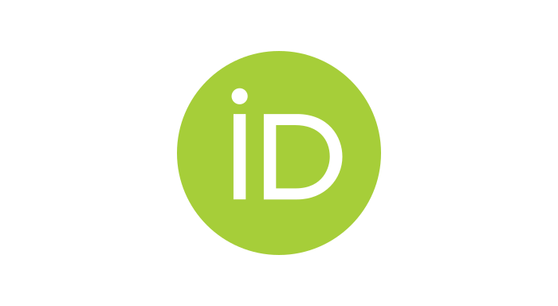
EDictViz: making dictionary content accessible for people with visual impairments eLex 2023, 29 July 2023, Brno, Czech Republic
Geraint Paul Rees (geraintpaul.rees@urv.cat)
Universtitat Rovira I Virgili, Tarragona, Spain
With the support of the BALEAP 2021 funding stream
@ReesGP
0000-0002-9204-8073

Slide 2
Outline
Background
Research on visual accessibility in existing online dictionaries
EDictViz, a possible solution
Design decisions
Development methodology
Evaluation to date
Plans for future evaluation
Implications

Slide 3
Access, accessibility, and lexicography
A good deal of lexicographic research is concerned with accessing lexicographic data.
User behaviour patterns (De Schryver et al., 2006; Laufer and Kimmel, 1997; Lew and Wolfer, 2023)
‘Signposts’ (DeCesaris, 2012; Dziemianko, 2016, 2019a; Nesi and Tan, 2011)
Advertisements in online dictionaries (Dziemianko 2019b, 2020)
Pictures in online dictionaries (Dziemianko 2022, 2023)
Digital typography (Hao et al., 2022)
“Accessibility ... Providing flexibility to accommodate each user's needs and preferences.” (Valdes, 1998)

Slide 4
People with visual impairments
There are an estimated 285 million people worldwide who are blind or have low vision (WHO, 2014).
This group often faces social exclusion e.g., high rates of unemployment and underemployment (National Federation of the Blind, 2019).
This group is growing since many visual impairments are age related and there is global trend of population ageing.

Slide 5
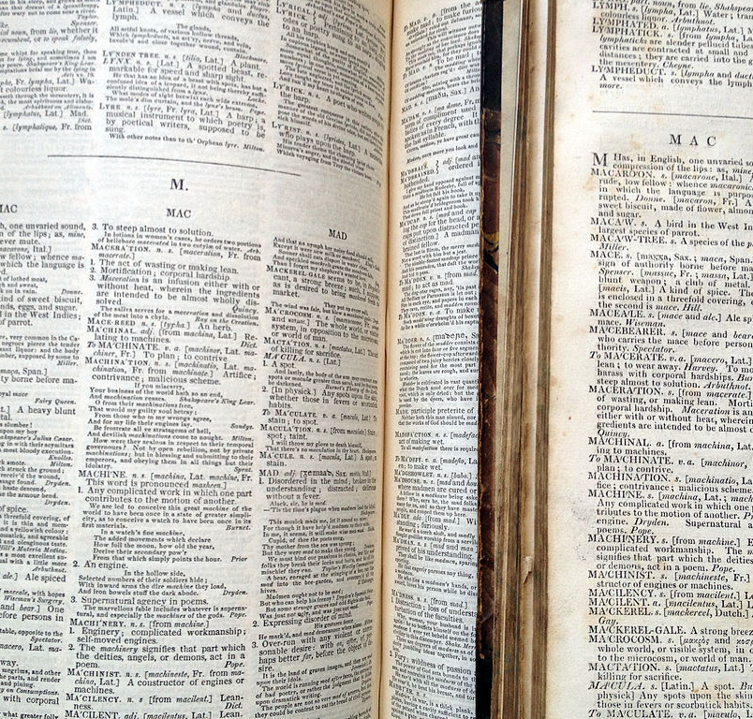
Historical challenges
Making paper dictionaries visually accessible has been a challenge.
How to cram a great deal of information into a limited space?
Small font sizes
Italics
Dashes, dots & tildes
Notes:
Historically, makers of non-specialist dictionaries have sought to include a great deal of information in the limited amount of space available. Consequently, most paper dictionaries are large volumes with small font sizes and numerous dots, dashes, tildes, and other space-saving conventions which are particularly difficult for people with visual impairments to perceive.

Slide 6
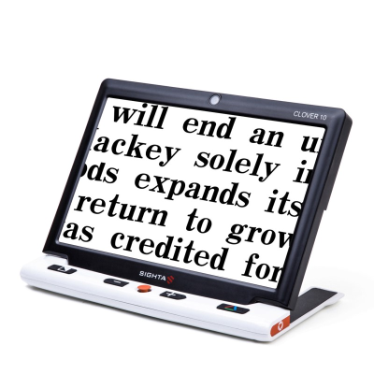
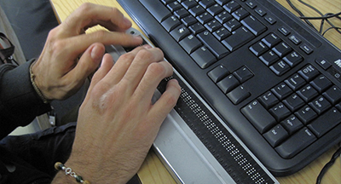
New technology, new opportunities
Online dictionaries have fewer space limitations than traditional resources.
They allow the use of assistive technologies.
Magnifiers
Screen readers
Refreshable braille displays
Notes:
If accessing paper dictionaries has traditionally been problematic, with new technology comes new opportunities for improving accessibility.

Slide 7
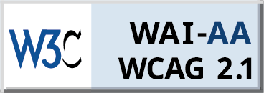
New technology, new opportunities
Initiatives to improve accessibility (e.g., the Web Accessibility Initiative (WAI))
Web Content Accessibility Guidelines (WCAG) - a set of recommendations for making Web content more accessible
Technical solutions to improve accessibility (e.g., Accessible Rich Internet Applications (ARIA)) – code to identify interactive features on websites
Merriam-webster.com June 2022

Slide 8
The Web Content Accessibility Guidelines
A series of 13 guidelines aimed at improving access for people with disabilities to websites and webapps.
They are organised around four key principles:
perceivable (e.g., providing information such as alternative text for images),
operable (e.g., providing interfaces that can be accessed with both keyboard and mouse)
understandable (e.g., identifying the language used on a webpage in order that it can be read correctly by screen reading software)
robust (e.g., ensuring content is compatible with assistive technologies such as screen readers).
Notes:
Information on WPs should be perceivable with more than one sense
Operable by more than one means
Understandable
Not break

Slide 9
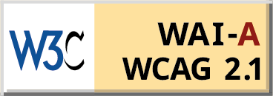
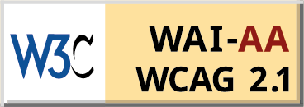
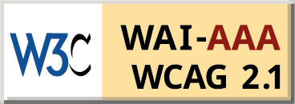
The Web Content Accessibility Guidelines
For each guideline, there are testable success criteria sorted into three conformance levels: A (minimum standard), AA, and AAA (ideal).
The AA level is the goal of many web-development teams and the legally required standard for certain sites (government, banking etc.) in certain jurisdictions (e.g., USA).

Slide 10
Visual accessibility problems in existing online dictionaries

Slide 11
Existing research
Arias-Badia, B., & Torner, S. (forthcoming). Bridging the gap between website accessibility and lexicography: Information access in online dictionaries. Universal Access in the Information Society.
WCAG key principles perceivable, understandable
Dictionary websites
Notes:
Top down

Slide 12
Existing research
Rees, G. P. (2023). Online dictionaries and accessibility for people with visual impairments. International Journal of Lexicography. 36(2), pp. 107–132.
WCAG key principles
Dictionary websites
WCAG success criteria
Notes:
Bottom up

Slide 13
Dictionary websites evaluated
 | Arias-Badia & Torner (2023) | Rees (2023)
Cambridge English Dictionary | X
Collins Dictionary |  | X
Diccionario de la lengua española | X | X
Diccionario fácil | X
Macmillan English Dictionary | X
Merriam-Webster.com Dictionary | X | X
Oxford Learner’s Dictionary | X
Notes:
7 monolingual dictionaries covered

Slide 14
Suggestions for visually accessible dictionaries
Use text labels
Make design adaptable
Take care with colour and contrast
Facilitate efficient navigation for screen reader (keyboard) users
Notes:
Broad strokes…

Slide 15
Use text labels
Like this
DLE June 2023
Collins June 2023
Merriam-webster.com June 2023

Slide 16
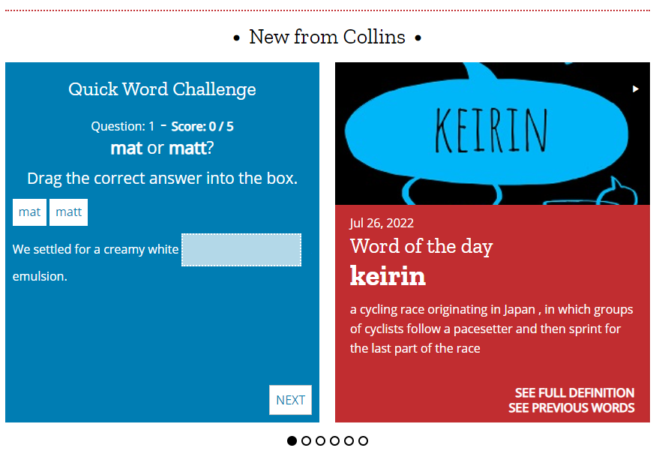
Use text labels
Not like this
Collins June 2022

Slide 17
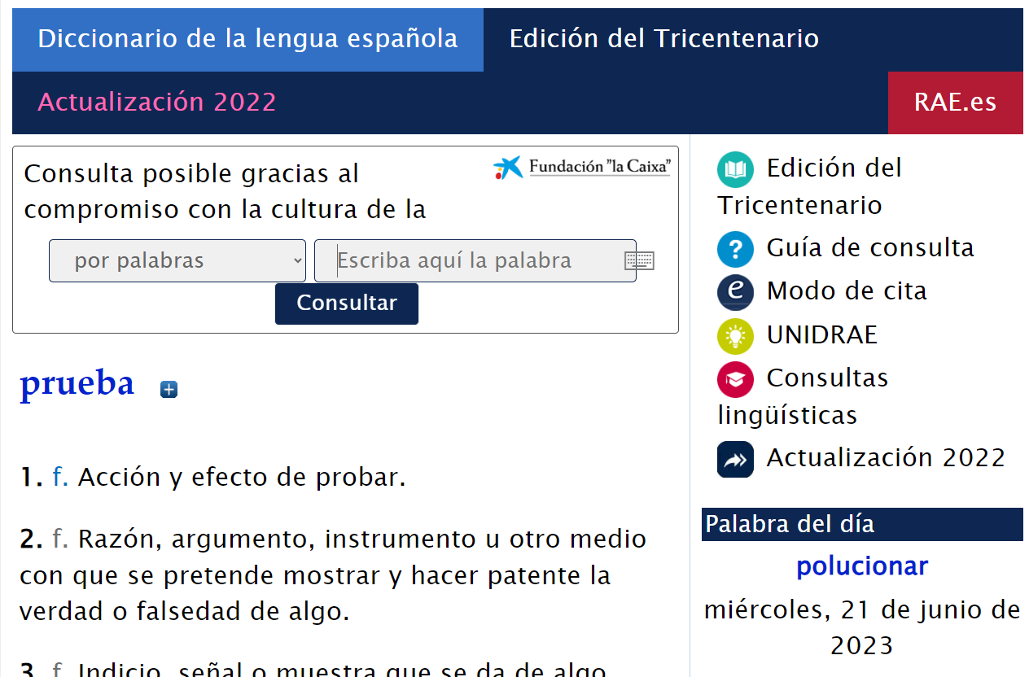
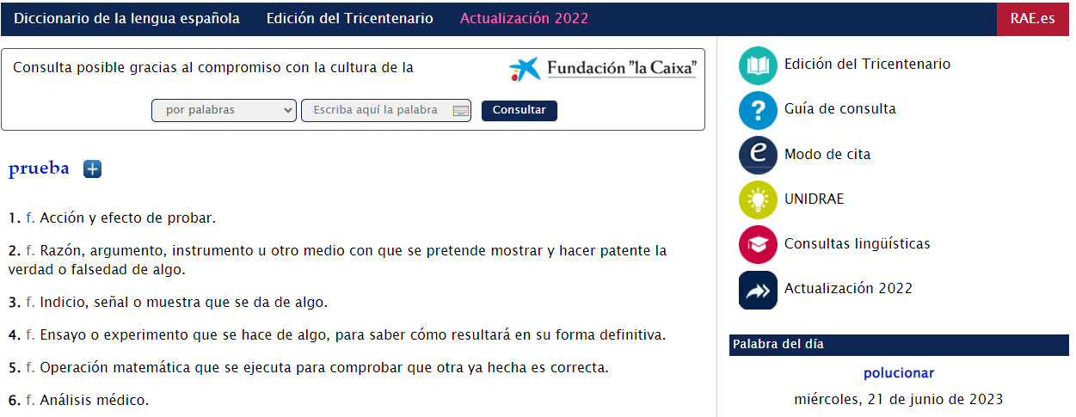
Make design adaptable
More like this…
Text zoom 200 %
DLE June 2023

Slide 18
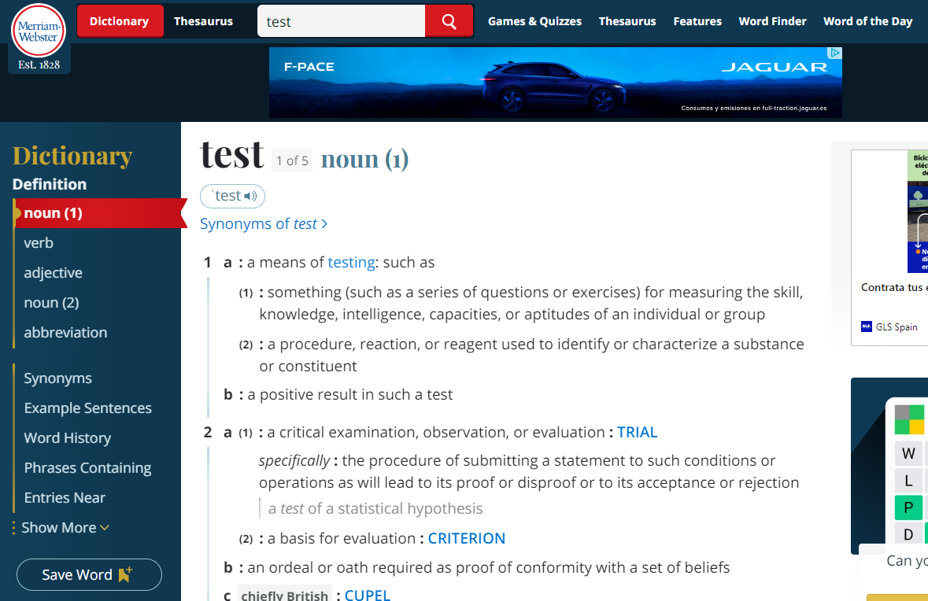
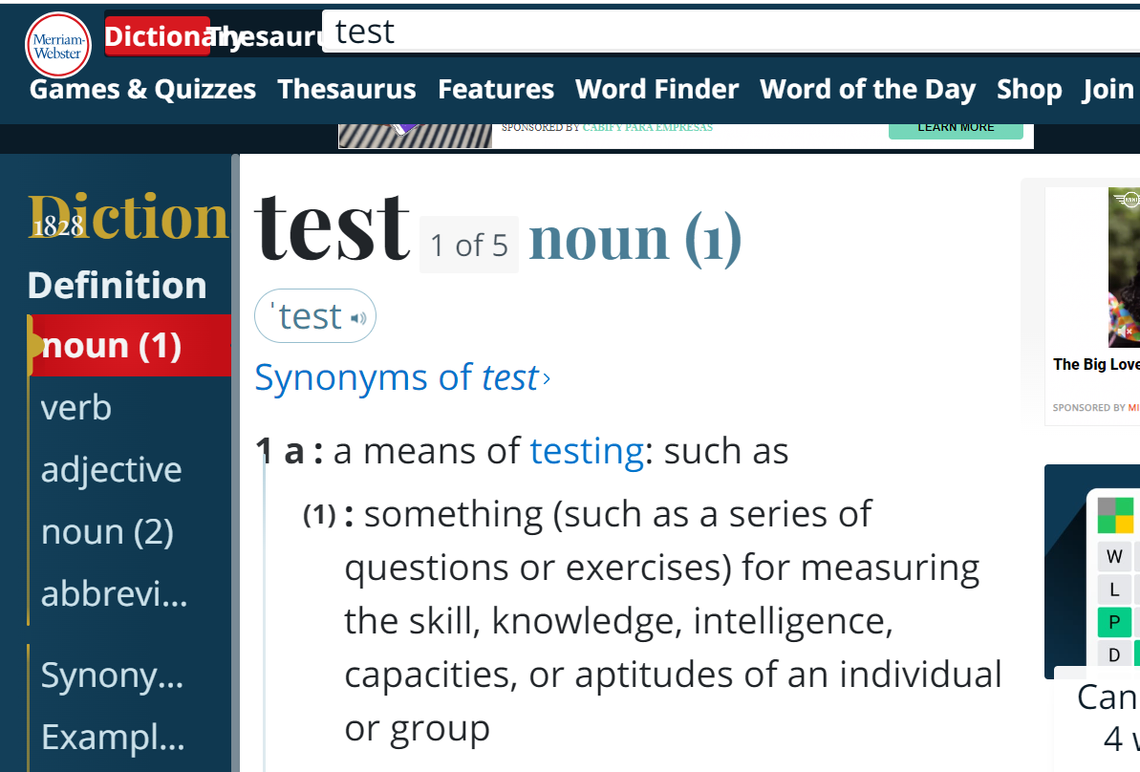
Make design adaptable
…than like this
Text zoom 200 %
merriam-webster.com June 2023

Slide 19
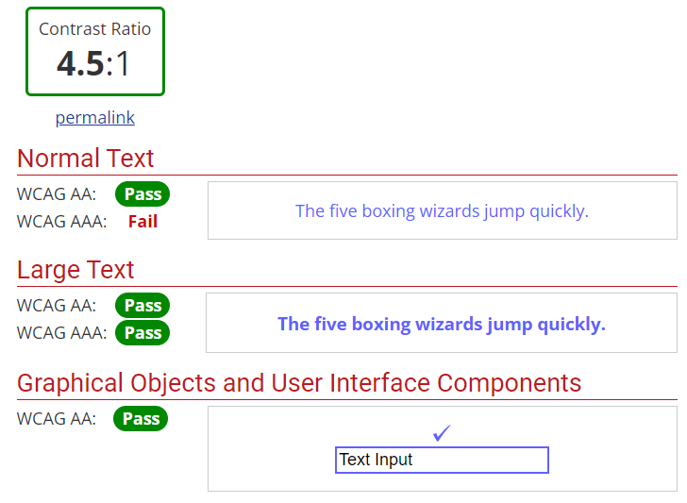
Take care with colour and contrast
At least this
WebAIM. (2021a). Contrast and Color Accessibility—Understanding WCAG 2 Contrast and Color Requirements

Slide 20
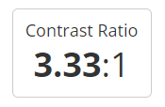
Take care with colour and contrast
Not quite this
merriam-webster.com June 2023

Slide 21
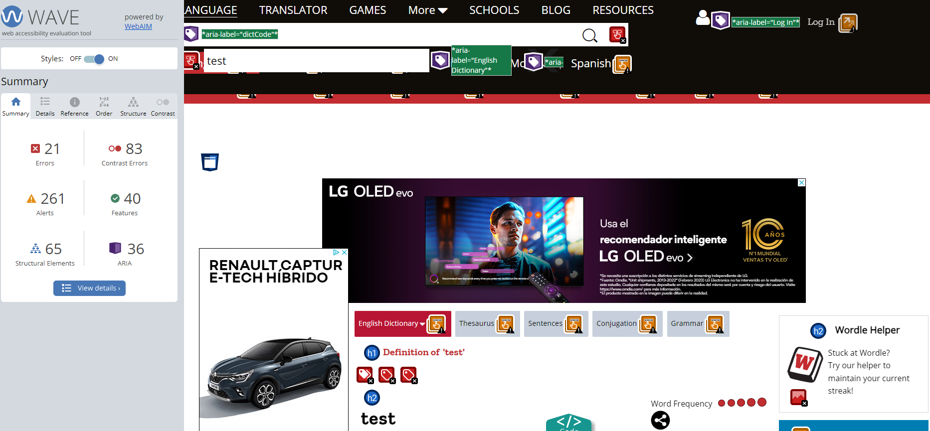
Facilitate navigation for screen reader users
Something like this
Collins June 2023 annotated with WAVE

Slide 22
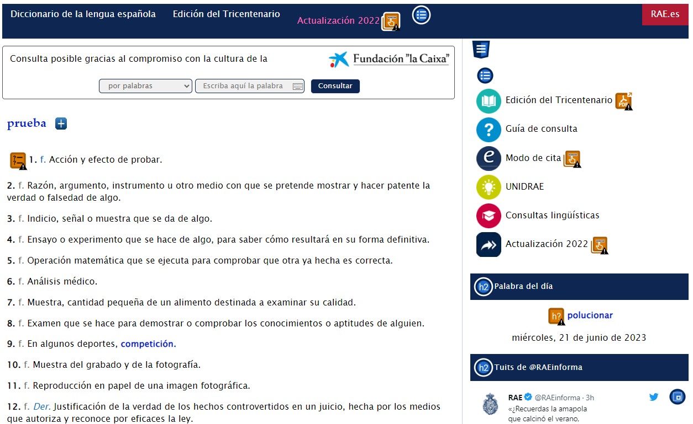
Facilitate navigation for screen reader users
Not like this
DLE June 2023 annotated with WAVE

Slide 23
EDictViz: a possible solution

Slide 24
What is EDictViz?
A visually pared-down dictionary website
Displays content from Merriam-Webster Advanced English Learner’s Dictionary using an API
Notes:
Not enamoured with this dictionary

Slide 25
Design decisions
Not a commercial endeavour

Slide 26
Design decisions
Not a commercial endeavour
e.g., word games, word of the day, mailing lists, blog posts etc. Often increase ‘bounce rate’ of websites = more attractive to advertisers

Slide 27
Design decisions
Issues affecting microstructure. e.g., contrast and colour, text manipulation, abbreviations etc.
Structure of page and site. e.g., the use of headings, labels for regions of page and text inputs, keyboard operability etc.

Slide 28
An Agile development methodology
An iterative process of collaborative development, evaluation and feedback, and further development in response to that feedback (Beck et al., 2001)
Version | Milestone | Achieved
0.1 | Basic working prototype | Yes
0.2 | Pass automated WCAG evaluation | Yes
0.3 | Pass manual WCAG inspection | Yes
0.4 | Usability testing | Pending
0.5 | User testing in language reception and production tasks | Pending

Slide 29
Accessibility evaluation with WCAG
1. Automated evaluation
AChecker – Web Accessibility Checker (IDI, 2022)
MAUVE++ (Broccia et al., 2020)
WAVE – Web Accessibility Evaluation Tool (WebAIM, 2021b)
2. Manual Inspection

Slide 30
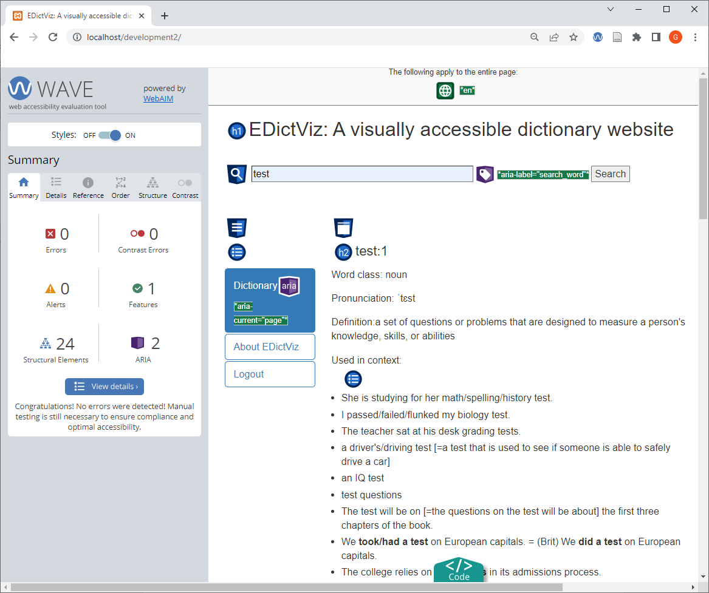
Automated evaluation (Version 0.2)
Evaluation tool | Unmet success criteria | Requiring human verification
Achecker | 1 | 50
Mauve++ | 0 | 27
Wave | 0 | 0
EDictViz V0.2 annotated with WAVE

Slide 31
Manual inspection (Version 0.3)
Only 33 of 53 the success criteria relevant to lexicographic resources are applicable to EDictViz.
One of these is unmet:
2.4.1 Bypass Blocks: Provide a "Skip to Content" link
Notes:
This is an easy fix… we have a WCAG compliant dictionary website. What does this mean in practice? Without empirical testing we cannot say with any certainty. However, to give you some idea

Slide 32
A demo with a screen reader
A screen reader user to look up salve in Collins then EDictViz.
salve (v) is at the 10,000 level of the Vocabulary Levels Test (Schmitt, Schmitt & Clapham, 2001)
The screen reader used was NVDA
For illustrative purposes only.

Slide 33
Collins for a screen reader user
Video here

Slide 34
EDictViz for a screen reader user

Slide 35
Further development and evaluation

Slide 36
Usability study
Regular online MLD vs. EDictViz (N ≈ 10)
A vocabulary look up task followed by the System Usability Scale (SUS) questionnaire (Brooke, 1986).
For some participants, screen recorded think-aloud procedure and follow up interview.

Slide 37
User testing
Regular online MLD vs. EDictViz (N ≈ 12)
Reception Task: participants look up the meaning of two comparable sets of lower-frequency words from the New Academic Wordlist (Coxhead, 2020) in the two conditions.
Production Task: Participants complete two comparable sets of sentence frames containing salient academic collocations (c.f. Rees, 2021).
In both tasks participants self-rate their knowledge of the vocabulary items using the Test of Academic Lexicon (TAL) (Scarcella & Zimmerman, 1998).
Scores calculated using acceptable answers and TAL level in each condition.

Slide 38
Summary
This process has provided:
A panorama of the accessibility of existing online dictionaries
A nascent accessible resource (edictviz.com)
It hopes to provoke debate about:
The best way to make lexicographic resources accessible for disadvantaged users
The challenges of visualizing lexical data in general

Slide 39
Thank you
Check out the prototype at edictviz.com
Send me an email for access! (geraintpaul.rees@urv.cat)

Slide 40
References
Arias-Badia, B., & Torner, S. (forthcoming). Bridging the gap between website accessibility and lexicography: Information access in online dictionaries. Universal Access in the Information Society.
Broccia, G., Manca, M., Paternò, F., & Pulina, F. (2020). Flexible Automatic Support for Web Accessibility Validation. Proceedings of the ACM on Human-Computer Interaction, 4(EICS), 83:1-83:24. https://doi.org/10.1145/3397871
Brooke, J. (1986). SUS: A quick and dirty usability scale. In P. W. Jordan, B. Thomas, B. W. Weerdmeester, & I. L. McClelland (Eds.), Usability Evaluation in Industry (pp. 189–194). Taylor & Francis.
Coxhead, A. (2000). A New Academic Word List. TESOL Quarterly, 34, 213–238.
De Schryver, G.-M., Joffe, D., Joffe, P., & Hillewaert, S. (2006). Do dictionary users really look up frequent words? — On the overestimation of the value of corpus-based lexicography. Lexikos, 16. https://doi.org/10.4314/lex.v16i1.51504
DeCesaris, J. (2012). On the Nature of Signposts. In R. V. Fjeld & J. M. Torjusen (Eds.), Proceedings of the 15th EURALEX International Congress (pp. 532–540). Department of Linguistics and Scandinavian Studies, University of Oslo.

Slide 41
References
Dziemianko, A. (2016). An insight into the visual presentation of signposts in English learners’ dictionaries online. International Journal of Lexicography, 29(4), 490–524. https://doi.org/10.1093/ijl/ecv040
Dziemianko, A. (2019a). Homogeneous or Heterogeneous? Insights into Signposts in Learners’ Dictionaries. International Journal of Lexicography, 32(4), 432–457. https://doi.org/10.1093/ijl/ecz011
Dziemianko, A. (2019b). The role of online dictionary advertisements in language reception, production, and retention. ReCALL, 31(1), 5–22. https://doi.org/10.1017/S0958344018000149
Dziemianko, A. (2020). Smart advertising and online dictionary usefulness. International Journal of Lexicography, 33(4), 377–403. https://doi.org/10.1093/ijl/ecaa017
Dziemianko, A. (2023). (Invisible) pictures in online dictionaries: Shall we see them? eLex 2023 Invisible Lexicography, Brno.
Hao, J., Xu, H., & Hu, H. (2022). A Multimodal Communicative Approach to the Analysis of Typography in Online English Learner’s Dictionaries. International Journal of Lexicography, 35(2), 234–260. https://doi.org/10.1093/ijl/ecab031

Slide 42
References
IDI. (2022). Web Accessibility Checker for WCAG 2.0 AODA Compliance Monitoring. Inclusive Design Institute. https://achecker.achecks.ca/checker/index.php
Laufer, B., & Kimmel, M. (1997). Bilingualised Dictionaries: How learners really use them. System, 25(3), 361–369. https://doi.org/10.1093/ijl/eck006
Lew, R., & Wolfer, S. (2023). The Dark Side of the Dictionary. eLex 2023 Invisible lexicography, Brno.
National Federation of the Blind. (2019). Blindness Statistics. National Federation of the Blind. https://nfb.org/resources/blindness-statistics
Rees, G. P. (2023). Online dictionaries and accessibility for people with visual impairments. International Journal of Lexicography. 36(2), pp. 107–132. https://doi.org/10.1093/ijl/ecac021
Rees, G. P. (2021). Measuring User Workload in e-Lexicography with the NASA Task Load Index. In I. Kosem & M. Cukr (Eds.), Electronic lexicography in the 21st century (eLex 2021): Post-editing lexicography. Book of abstracts (pp. 55–66). Lexical Computing CZ s.r.o.

Slide 43
References
Scarcella, R., & Zimmerman, C. (1998). ACADEMIC WORDS AND GENDER: ESL Student Performance on a Test of Academic Lexicon. Studies in Second Language Acquisition, 20(1), 27–49. https://doi.org/10.1017/S0272263198001028
Valdes, Leo, Accessibility on the Internet, report to the United Nations (16 June 1998, updated 31 March 2004) available [online] at: http://www.un.org/esa/socdev/enable/disacc00.htm, cited in report of the Secretary General, “Implementation of the world programme of action concerning disabled persons”, (United Nations document A/54/388/Add.1).
WebAIM. (2021a). WAVE Evaluation Tool (3.1.6). WebAIM. https://wave.webaim.org/
WebAIM. (2021b). Contrast and Color Accessibility—Understanding WCAG 2 Contrast and Color Requirements. https://webaim.org/articles/contrast/
WHO. (2014). WHO | 10 facts about blindness and visual impairment. https://www.who.int/features/factfiles/blindness/blindness_facts/en/

