Slide 1
Ensuring vocabulary consistency for an under-resourced language with limited data
Sven-Erik Soosaar, Institute of the Estonian Language
Valts Ernštreits, UL Livonian Institute
State Research Rrogramme «Towards Development Of Open And Fair Digital Humanities Ecosystem In Latvia (Dheli, 2022-2025)»
Kindred Peoples’ Programme of Estonia

Slide 2
Consistency of lexicographical sources
When creating multilingual lexicographical sources consistency is an important aspect as it contributes to the even representation of the language, especially it’s lexical core and ontologies.
Consistency is essential, if lexicographical source is used for the language acquisition, especially in the case of endangered or under-documented and uderresourced languages.
Consistency is also crucial, if everyday use of the language is limited in domains and/or language users lack sufficient proficiency in particular domain or in general.

Slide 3
Consistency of lexicographical sources
To ensure consistency of the lexicographical sources for common languages a number of resources, tools and methods from within the language may be used.
Dictionaries of the basic vocabulary provide data on core lemmas needed for the language acquisition.
Frequency dictionaries, corpus statistics provide data of the frequency of lemmas.
For endangered, under-documented and uderresourced languages such resources generally are not available, nevertheless such languages also deserve being represented consistantly.

Slide 4
The Livonian case
Livonian is officially recognized indigenous language of Latvia and one of the most endangered languages in the world.
Being spoken by a limited number of speakers over past centuries (from 2500 in the mid of 19th century till ca 20 today; Laakso, 2022), it is still continued as a living tradition with currently around 20 fluent Livonian speakers, although Livonian community is estimated ca 1000–1500.
There is a rising interest for the acquisition of the Livonian within community, e. g. over 50 children and youth are studing Livonian in the summer school, interest for the language acquisition and use is growing within the community.

Slide 5
The Livonian case
Livonian language belongs to Uralic language family. Closest relatives of Livonian by language are Estonians and Finns.
Through assimilation with ancient Baltic languages of the region Livonian has deeply impacted development of the modern Latvian and Latvian as a main contact language and language of influence has deeply impacted the Livonian.
Access to the Livonian is also important for the proper understanding of the linguistic developments in the Latvia and the region, as well as it is the key for the Livonian intangible cultural heritage.

Slide 7
Livonian lexicography
Livonian is and has been used in limited language domains and documented scarcely and unevenly.
Livonian lexicographical sources are based on fieldwork data (SjW, LW, LELD).
Largest lexicographical source is «Livonian-Estonian-Latvian dictionary» (LELD, 2012) containing ca 12 000 lemmas.
LELD (accessible on the UL Livonian Institute’s digital platform (Livonian.tech) is being instantly updated from the Livonian language corpus during annotation and other sources.

Slide 8
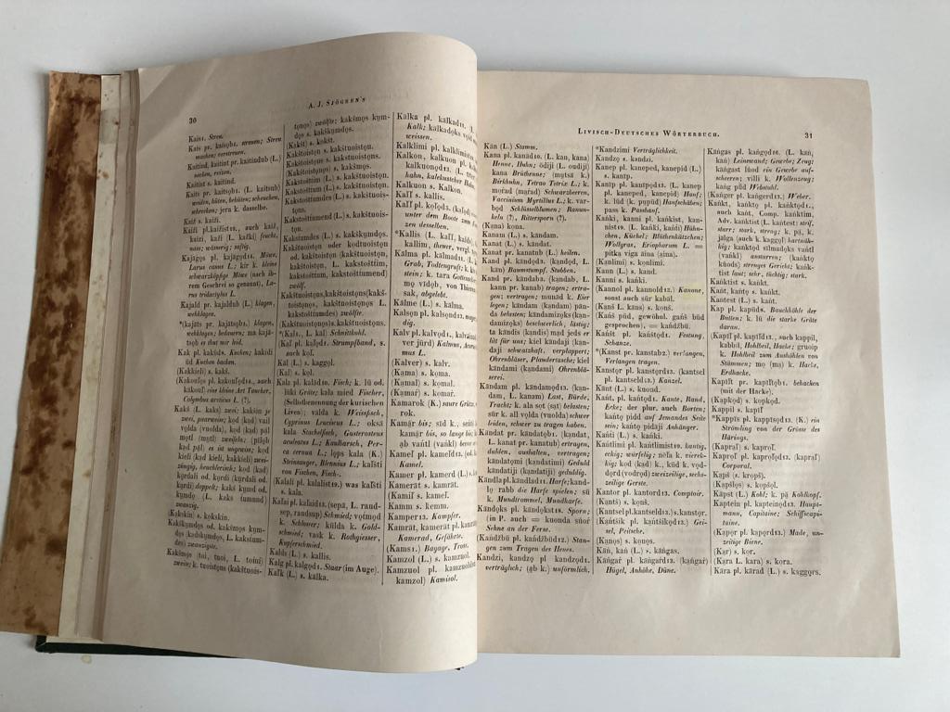
Livonian lexicography
Wiedemann, Ferdinand Johann 1861. Joh. Andreas Sjögren’s Livisch-deutsches und deutsch-livisches Wörterbuch.
Ca 6000 Livonian headwords

Slide 9
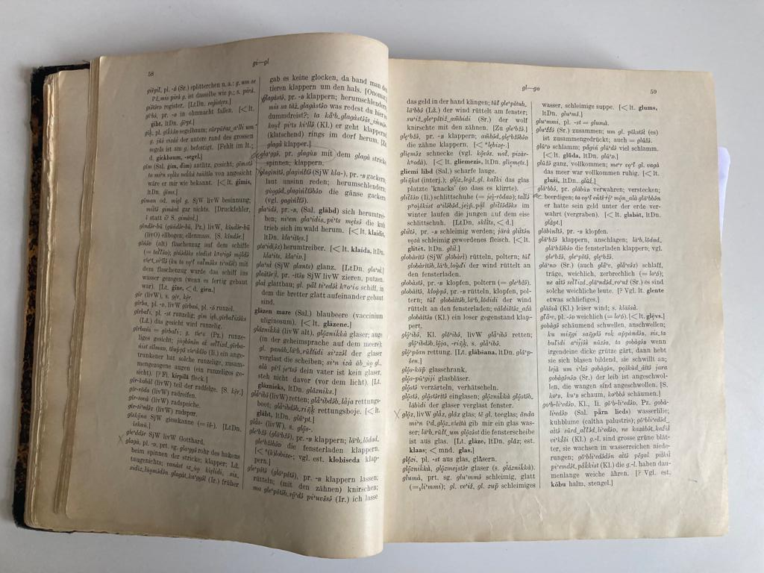
Livonian lexicography
Kettunen, Lauri 1938. Livisches Wörterbuch mit grammatischer Einleitung. Lexica Societatis Fenno-Ugricae V. Helsinki: Suomalais-Ugrilainen Seura.
Ca 8500 Livonian headwords

Slide 10
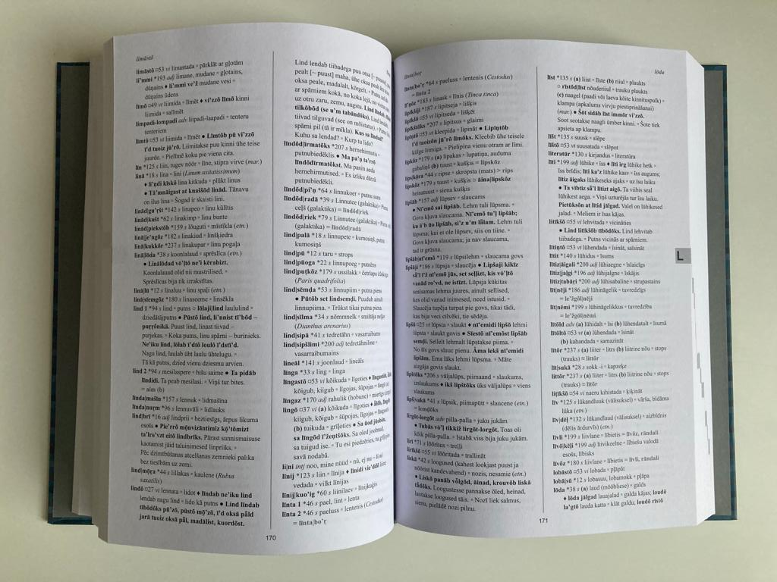
Livonian lexicography
Viitso, T.-R., Ernštreits, V. (2012). Līvõkīel-ēstikīel-lețkīel sõnārōntõz. («Livonian-Estonian-Latvian dictionary») Tartu - Riga
Ca 12 000 Livonian headwords

Slide 11
Livonian lexicography
Being collected from fieldwork data LELD lacks consistency in terms of even basic, everyday use vocabulary, e.g. not all names of motnhs are represented, «please» was missing in the original dictionary etc.
There are no existing data collections or resources for Livonian that can offer an adequate perception of the core vocabulary or vocabulary frequency for the Livonian.
Livonian corpus is heavily disbalanced, e.g. one third of corpus represents religious literature (translation of the New Testament), and another third – fairy tales and legends.

Slide 12
Vocabulary data for consistency
Simpliest and probably most effective way for approaching consistency issues is using frequency data.
Such an example is Estonian-Latvian dictionary (ELD, 2015; 1096 pages;). For this statistical metadata was used from 3 separate sources: list of 5000 lemmas from the core vocabulary; 10 000 lemmas from frequency dictionary; combined with frequency data from balanced corpora (from 5000 – 40 000, divided by 5000).

Slide 13
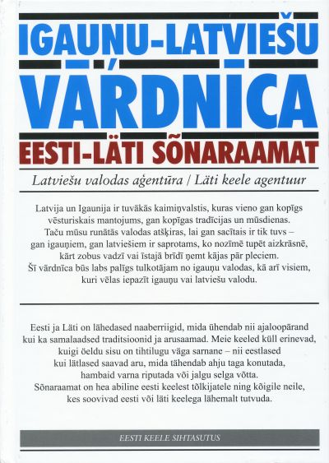
Vocabulary data for consistency
This was done to ensure that the dictionary constantly covers the core of the vocabulary and grows evenly, not sequentially (e.g. by starting letters).
Also other methods (ontologies check, compund components check, manual comparison with the orthography dicitonary) were applied additionally to ensure consistency of the dictionary.

Slide 14
Achieving consistency for the Livonian
Livonian corpus frequency data is distorted due to uneven documentation and sources.
LELD and lexicography database (Livonian.tech) are trilingual (Livonian, Estonian, Latvian), thus frequency and consistancy data of Latvian and Estonian may be used.
Estonian is a Finnic language relatively closely related to the Livonian, Latvian is a main contact and influence language and primary source of loanwords – thus data from both these languages may be used for gaining a perspective on the Livonian, it’s basic vocabulary and frequency of lexical units.

Slide 15
Achieving consistency for the Livonian
For the consistency of the Livonian we are combining 3 sets of data:
frequency and consistency data from Estonian, incl. basic vocabulary, frequency dictionaries, and corpora (ELD, both via Estonian and via Latvian), comparing data with translations in LELS.
frequency data from Latvian using Latvian frequency data from balanced corpus of Latvian texts (https://korpuss.lv/id/LVK2018), comparing data to the Latvian translations.
Frequency data from the Livonian corpora– both processed (annotated) and unprocessed corpus, despite distortions.

Slide 16
Achieving consistency for the Livonian
Livonian lemmas/concepts differ from Estonian and Latvian, but combining data from these languages may provide a dataset that is close to the Livonian actual data.
The general goal is to identify missing vocabulary, so that we can specifically look for that vocabulary from sources.
Currently we have applied a list of 5000 Estonian basic vocabulary (ELD) to the Estonian translations in (Viitso & Ernštreits, 2012) and identified that only 3100 lemmas/concepts are included with 1900 lemmas/concepts necessary for modern Estonian are missing.

Slide 17
Achieving consistency for the Livonian
The types of missing vocabulary:
Basic vocabulary due to inconsistency of sources (e.g. some names of the months).
Words missing for some specific reason (compound verbs or adverbs expressed by other means in Latvian or Livonian, e.g. kurssi viima ‘to inform’; teel ‘by ways’, külla ‘to visit’, keeleoskus ‘command of language’)
Specific Estonian words or concepts, not known or not having precise equivalent in Latvia (e.g. elamisluba ‘residence permit’, saatekiri ‘document for a specialist to accept a patient’ , sepik ‘type of bread’, ujula ‘swimming pool’, veok ‘vehicle for transportation of goods’) sometimes even outdated terms (e.g. haigekassa ‘health insurance fund’ – now called tervisekassa).

Slide 18
Next steps
To build a properly consistant dictionary more data from combined sources will be analysed.
Based on acquired data targeted search for lemmas/concepts will be executed to fill the gaps.
As Livonian vocabulary has been lacking in number of domains, language planning and creation of new lemmas/terms should take place (an establishment of the Livonian language commision is planned in 2023).
Datasets acquired during this research may be used for consistency ensuring purposes for other underresourced languages (as English translations are also being added to the database), but especially those of Finnic origin.

Slide 19
References
Ernštreits, V., Muzikante, M., Grīnberga, M., Ernštreits, M. (2015). Igauņu-latviešu vārdnīca = Eesti-läti sõnaraamat. Latviešu valodas aģentūra. Riia, Tallinn: Eesti Keele Sihtasutus.
Kallas, J., Tiits, M., Tuulik, M. (2014). Eesti keele põhisõnavara sõnastik. Tallinn, Eesti Keele Sihtasutus.
Laakso, J., (2022). The Oxford Guide to the Uralic Languages. Edited by: Bakró-Nagy et al., Oxford University Press.
LW = Kettunen, Lauri 1938. Livisches Wörterbuch mit grammatischer Einleitung. Lexica Societatis Fenno-Ugricae V.Helsinki: Suomalais-Ugrilainen Seura.

Slide 20
References
Mittelholcz, S. (2017). Evaluation of Dictionary Creating Methods for Under-Resourced Languages. In: Ekštein, K., Matoušek, V. (eds) Text, Speech, and Dialogue.
SWb = Wiedemann, Ferdinand Johann 1861. Joh. Andreas Sjögren’s Livisch-deutsches und deutsch-livischesWörterbuch. Joh. Andreas Sjögren’s Gesammelte Schriften. Band II. Theil II. St. Petersburg.
TSD 2017. Lecture Notes in Computer Science(), vol 10415. Springer, Cham.
Viitso, T.-R., Ernštreits, V. (2012 = LELD). Līvõkīel-ēstikīel-lețkīel sõnārōntõz. Tartu Riga.

Slide 21
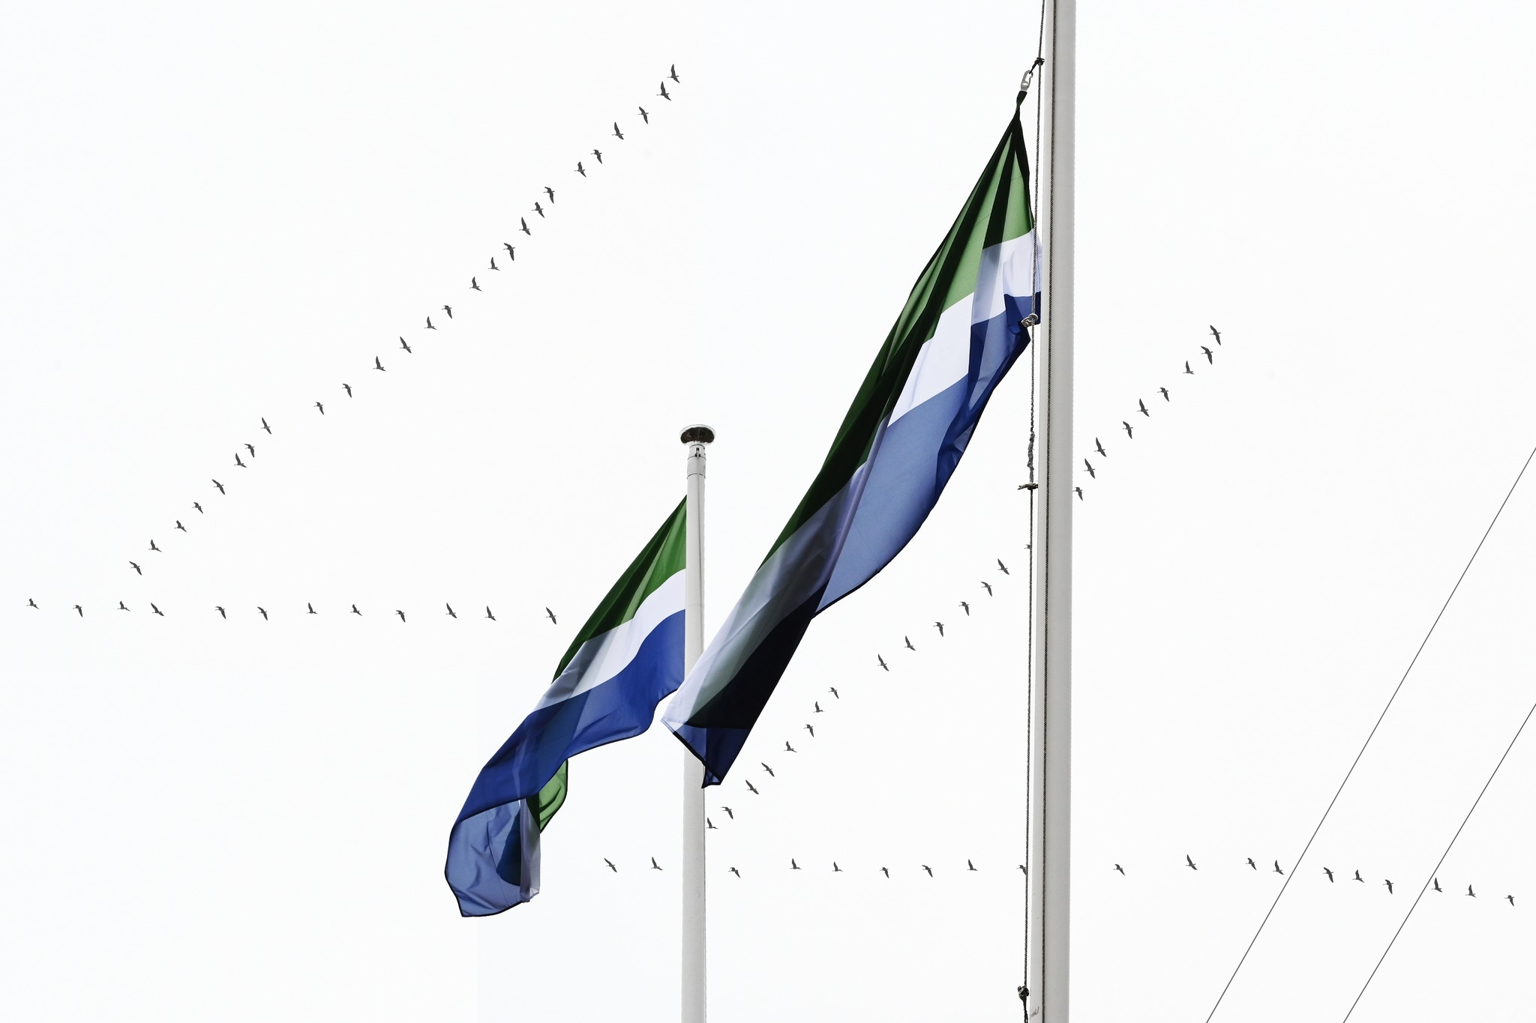
Tänan! | Tienū! | Paldies!

