Slide 1
Meanma – an end-to-end, corpus-to-entry solution for historical lexicography
Mark mcconville & stevie barrett
Glasgow university

Slide 2
Dr Mark McConville
Data Manager, Faclair na Gàidhlig
Meanma Systems Architect
His vision is to provide an end-to-end solution for historical lexicography

Slide 3
Stevie Barrett
Software Developer
Primarily a full-stack LAMP developer
Digital Archive of Scottish Gaelic
Faclair na Gàidhlig …

Slide 4
Faclair na Gàidhlig
The historical dictionary of Scottish Gaelic
The `OED` of Gaelic
An inter-university project based at Sabhal Mòr Ostaig on Skye
Systems team based at the University of Glasgow

Slide 5
Corpus na Gàidhlig
Forms the basis of excerpting for Faclair na Gàidhlig
30 million word corpus of Scottish Gaelic
Represents the history of the Gaelic language
Is currently delivered using Corpus Workbench (CWB) and a heavily customized version of CQPWeb
Is publicly available through DASG at https://dasg.ac.uk/corpus/

Slide 6
The Birth of Meanma
CWB / CQPWeb are fantastic but we could find no way of achieving key functionalities required by historical lexicographers: particularly ordering by date of language
Customization of CQPWeb meant that we were using an increasingly out-of-date version of the software
Corpus searching is only one element of the historical lexicographer’s process – we wanted to provide much more
An end-to-end solution could be customized specifically for historical lexicography and remove the need for different software for each stage of the process

Slide 7
Slips

Slide 8
A Slip

Slide 10
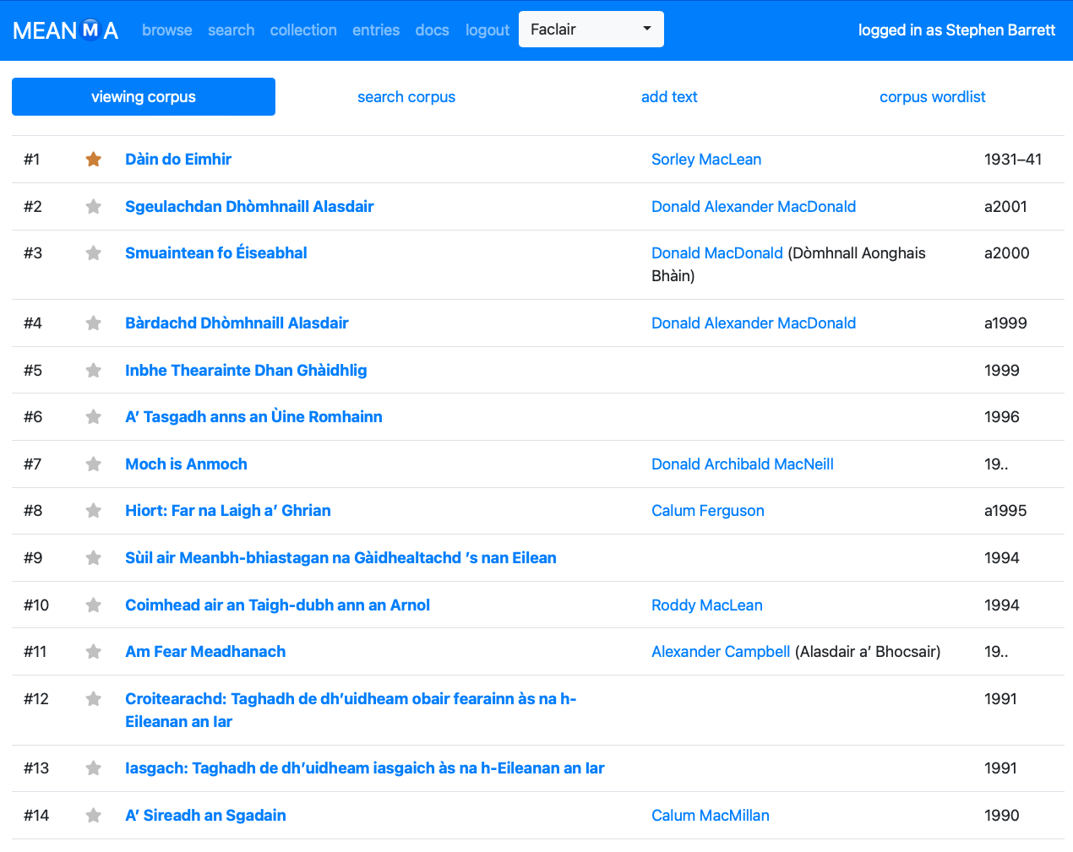

Slide 11
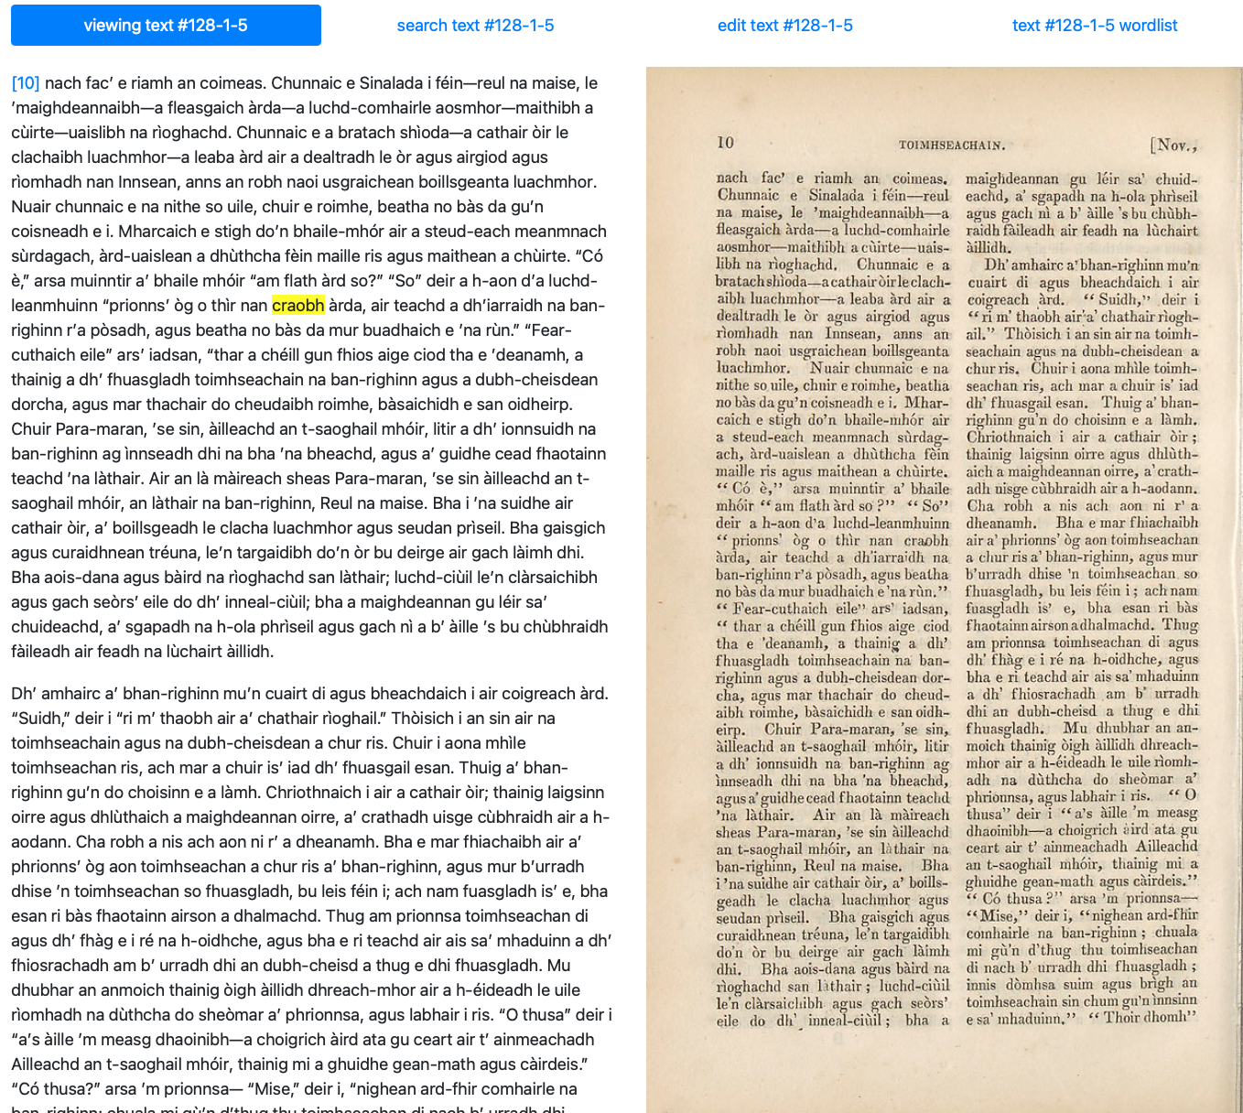

Slide 12
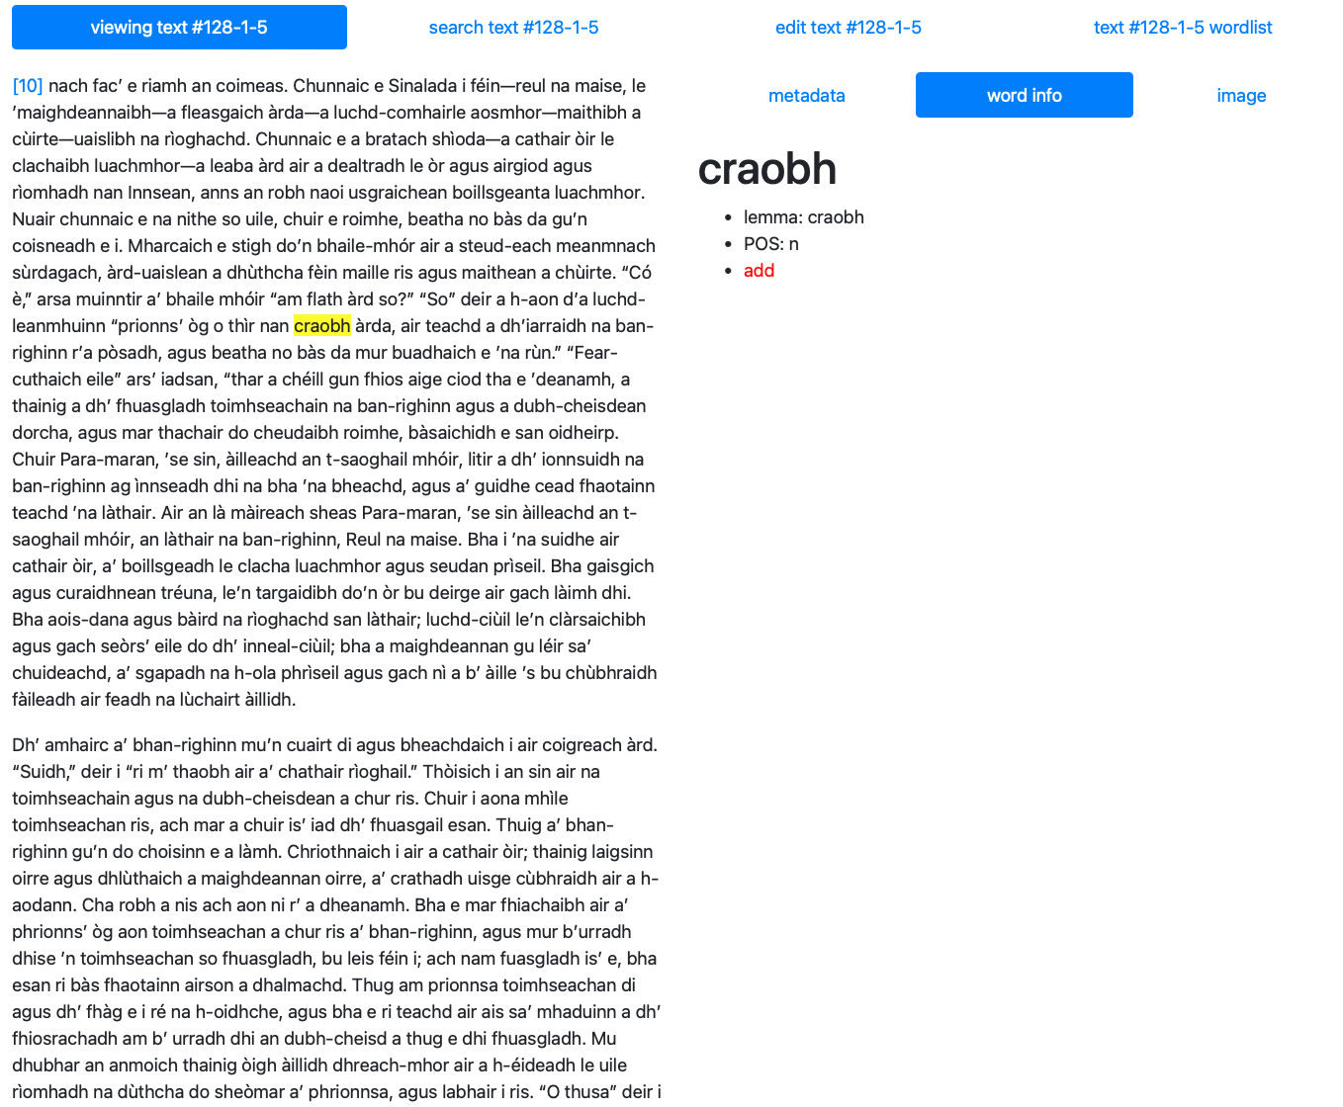

Slide 13
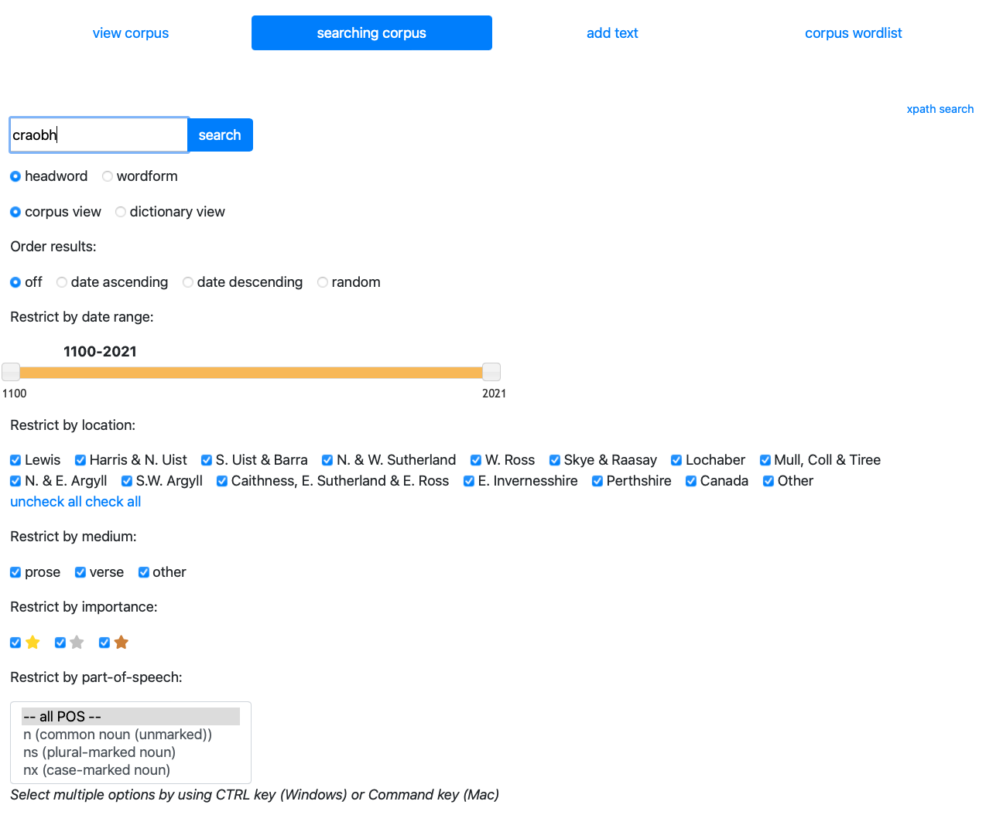

Slide 14
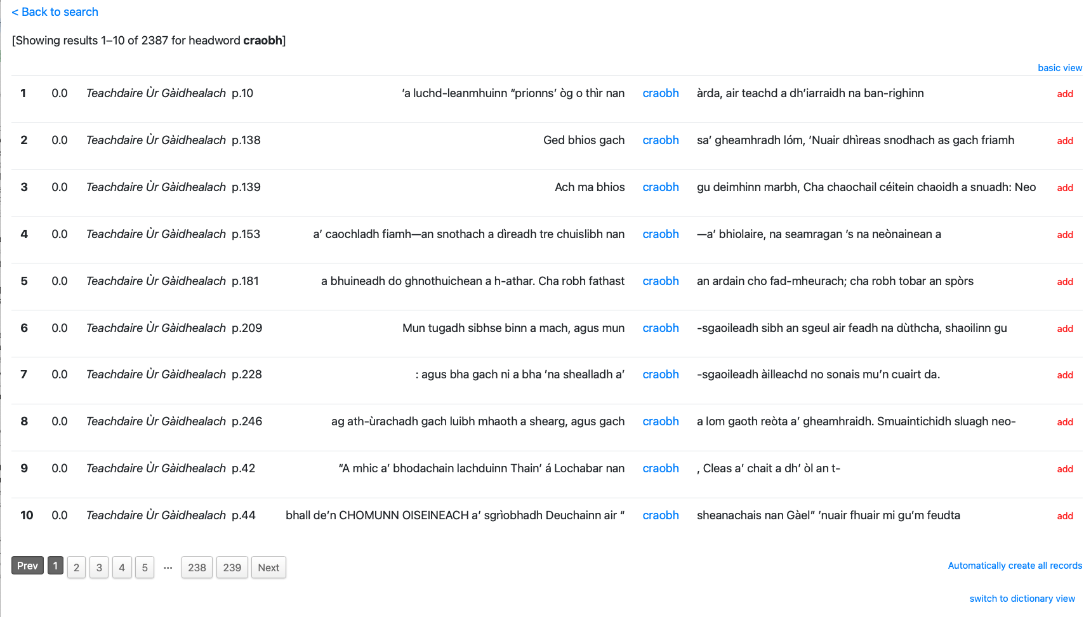

Slide 15
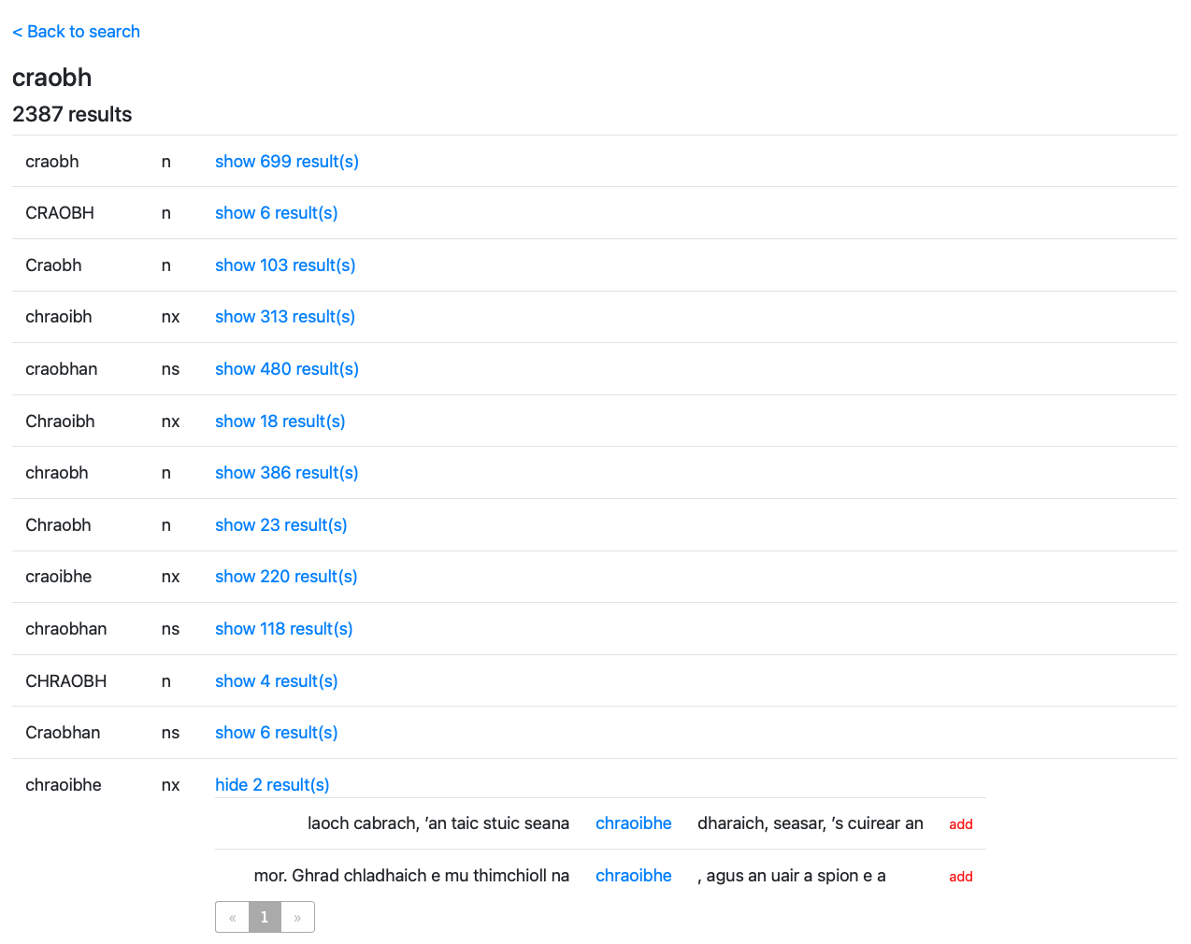

Slide 16
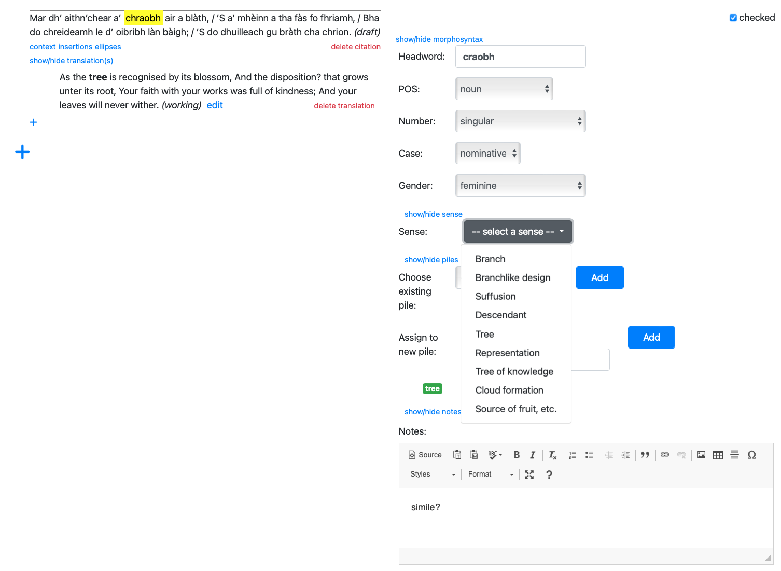

Slide 17
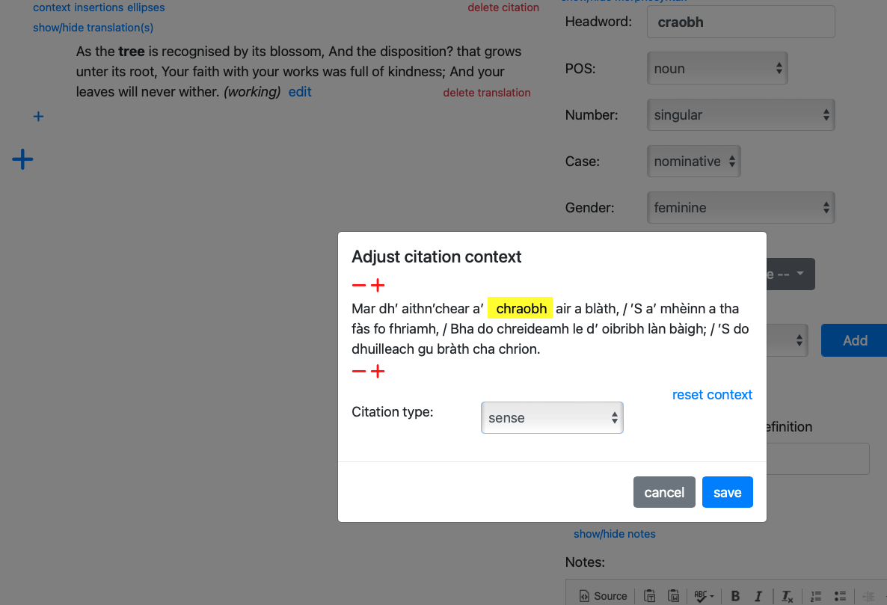

Slide 18
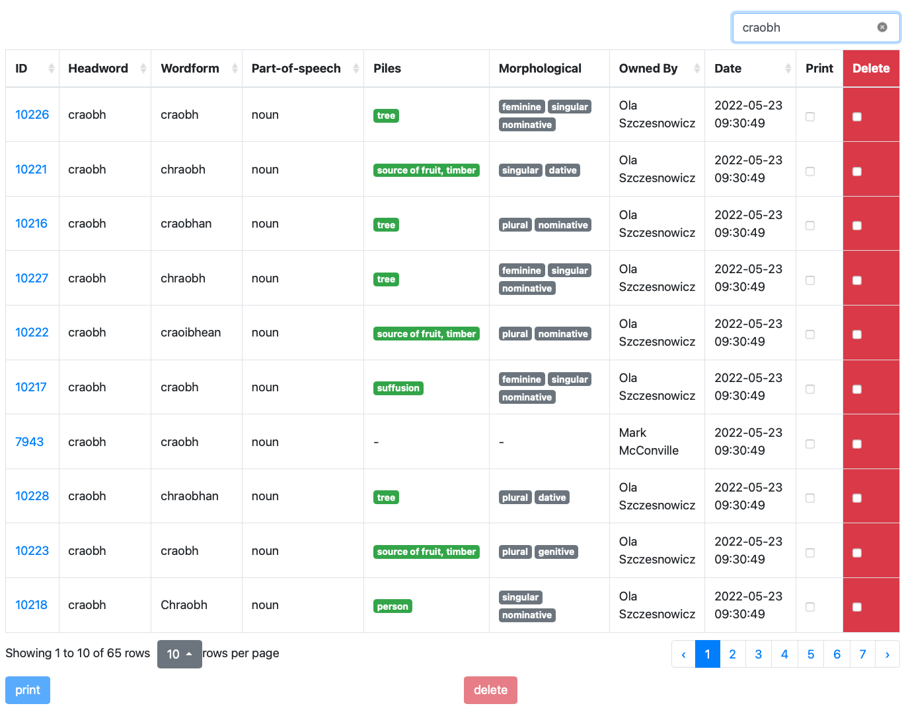

Slide 19
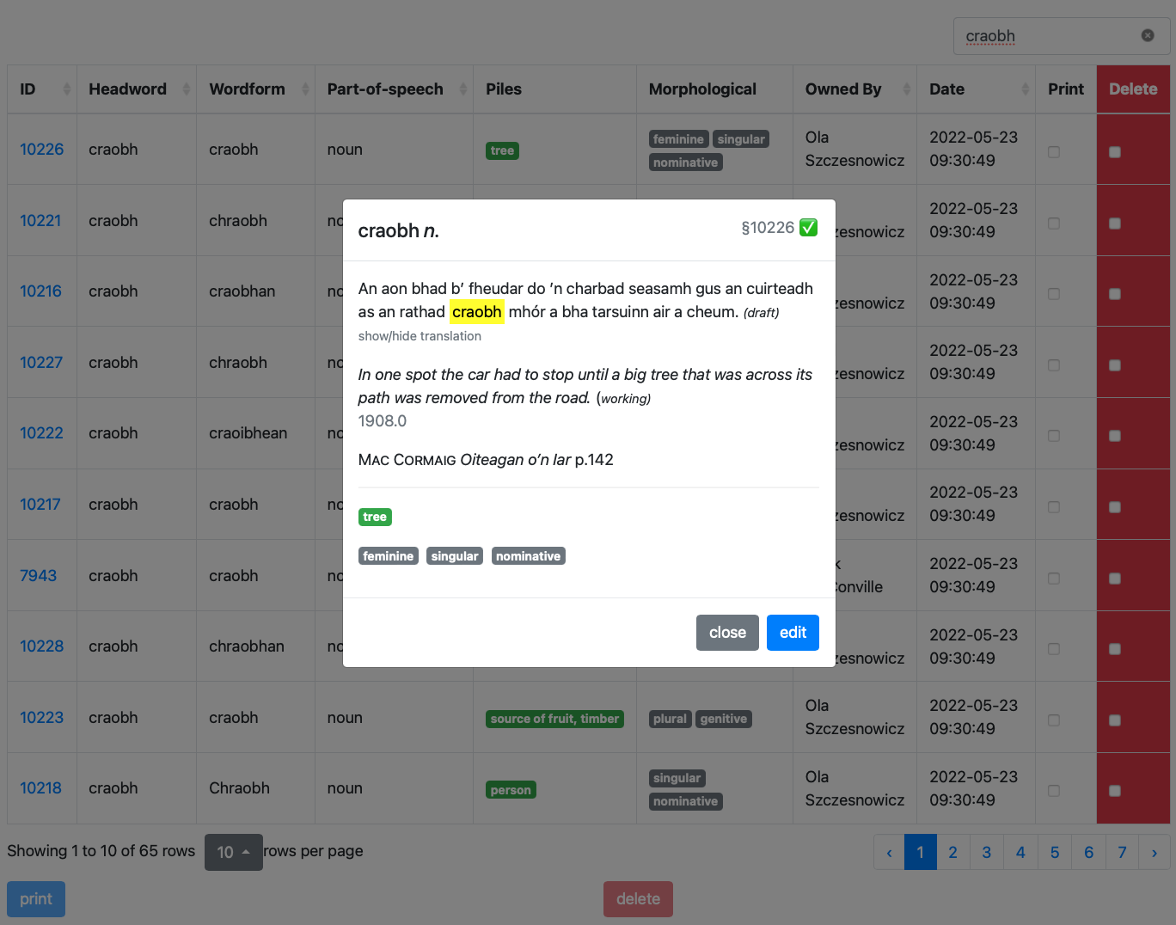

Slide 20
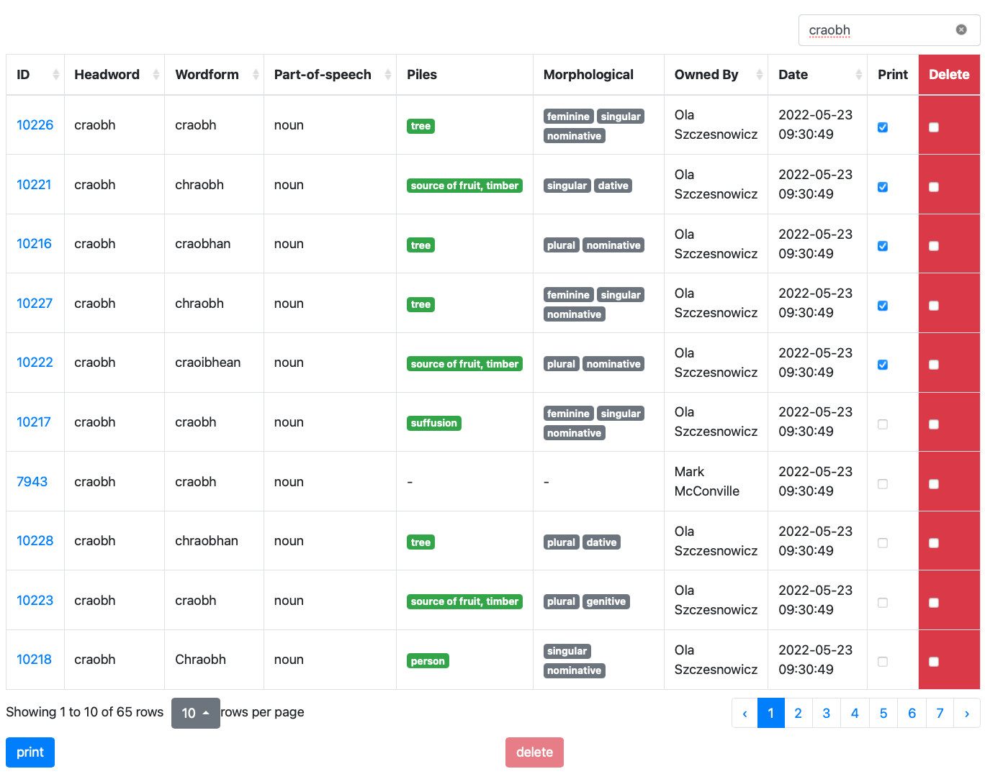

Slide 21
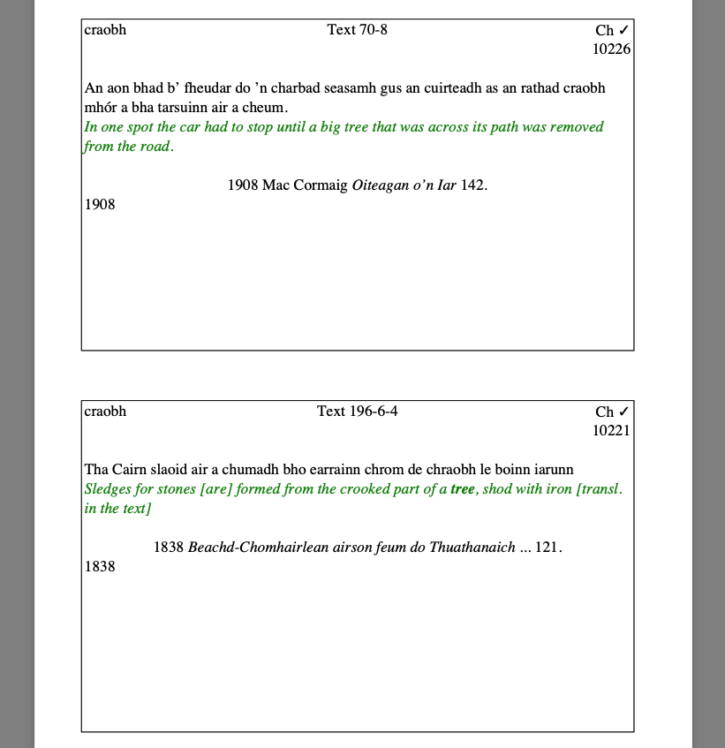

Slide 22
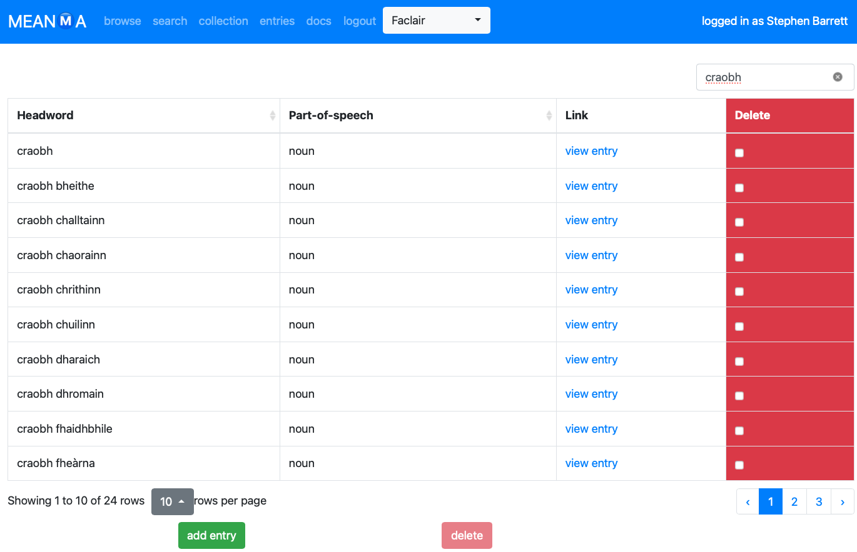

Slide 23
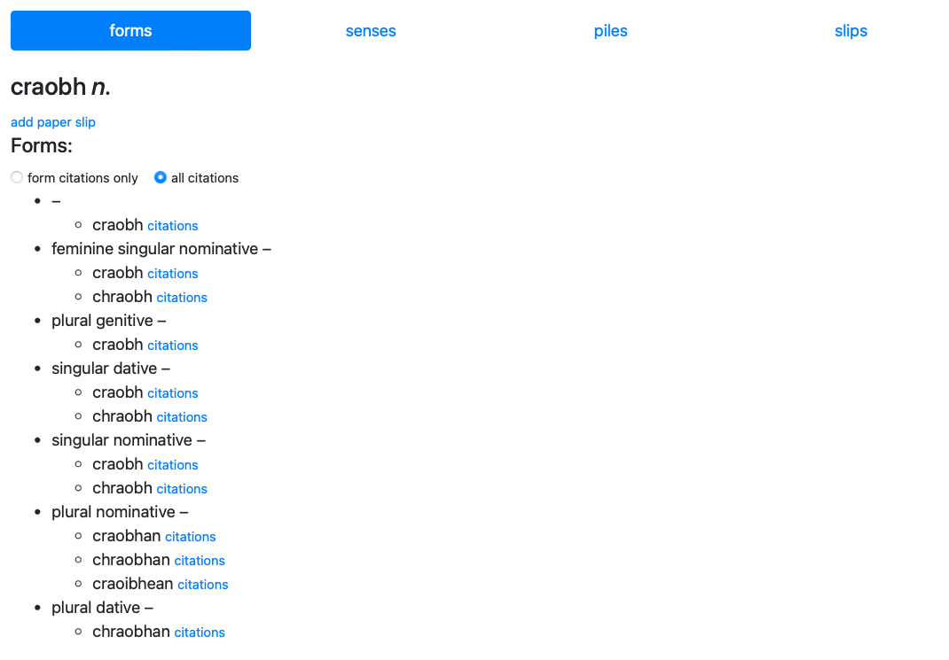

Slide 24
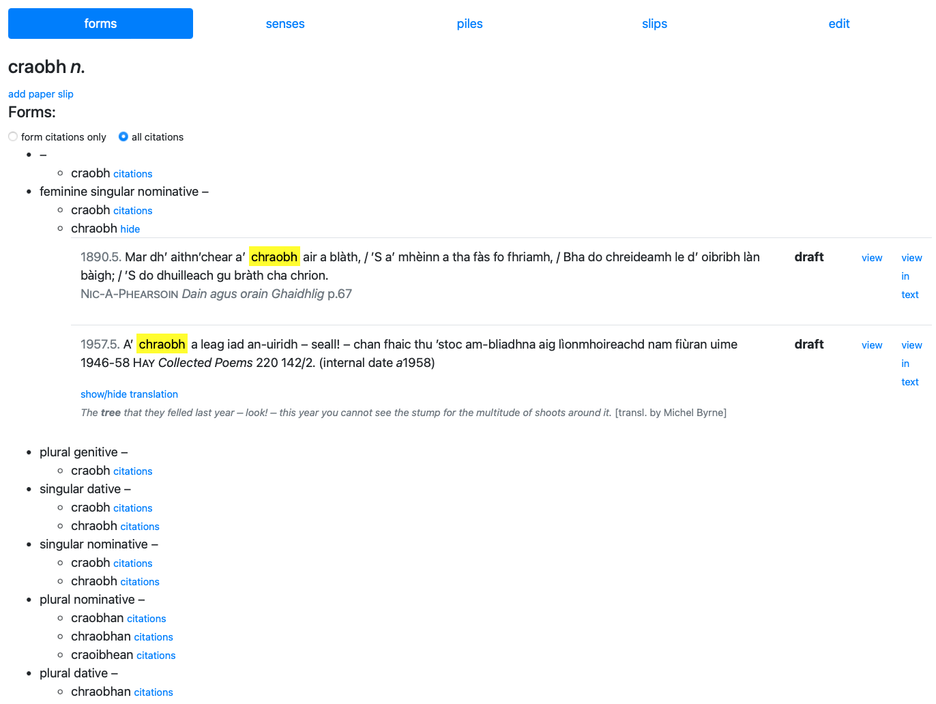

Slide 25
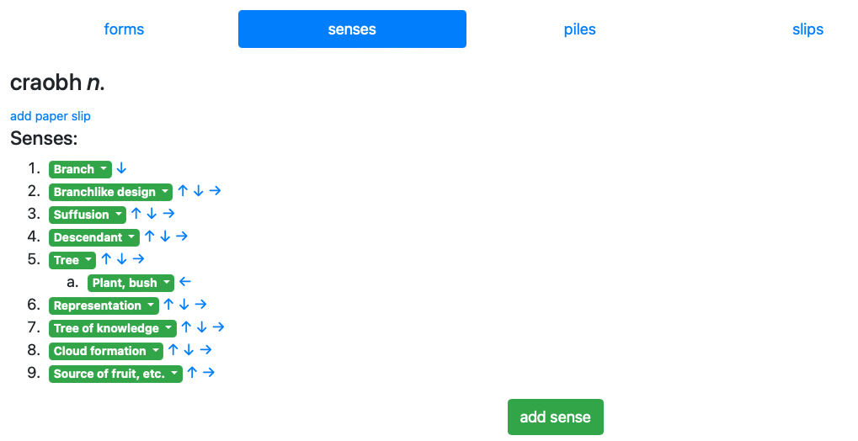

Slide 26
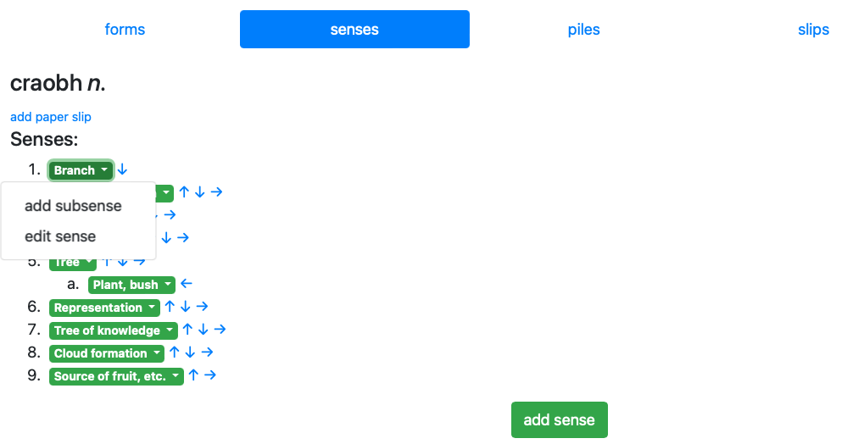

Slide 27
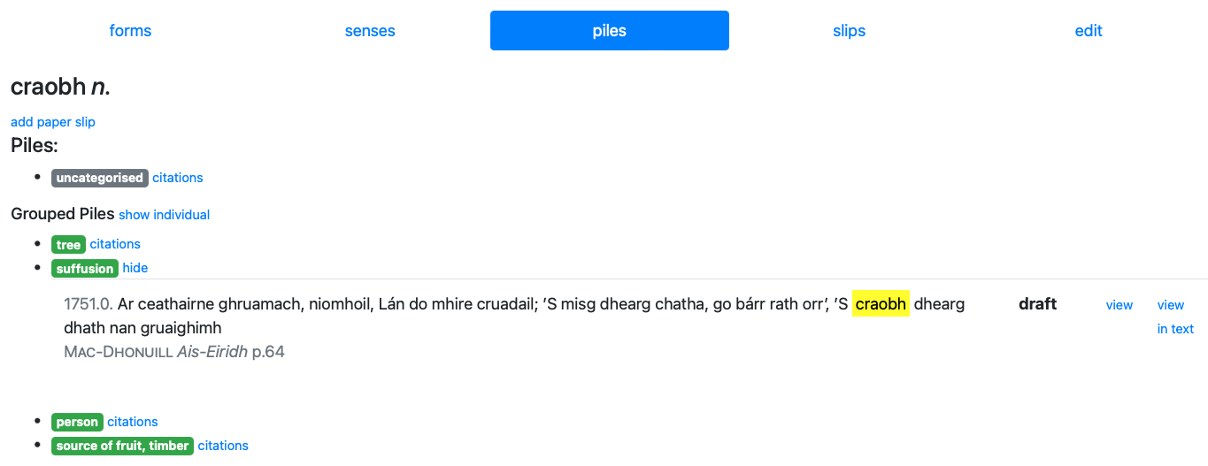

Slide 28
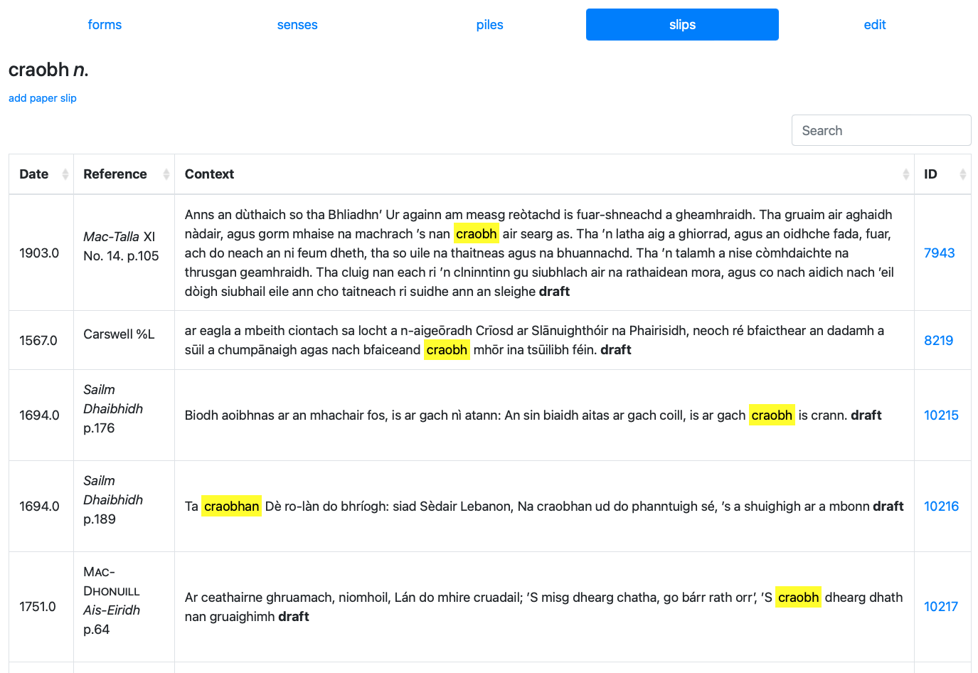

Slide 29
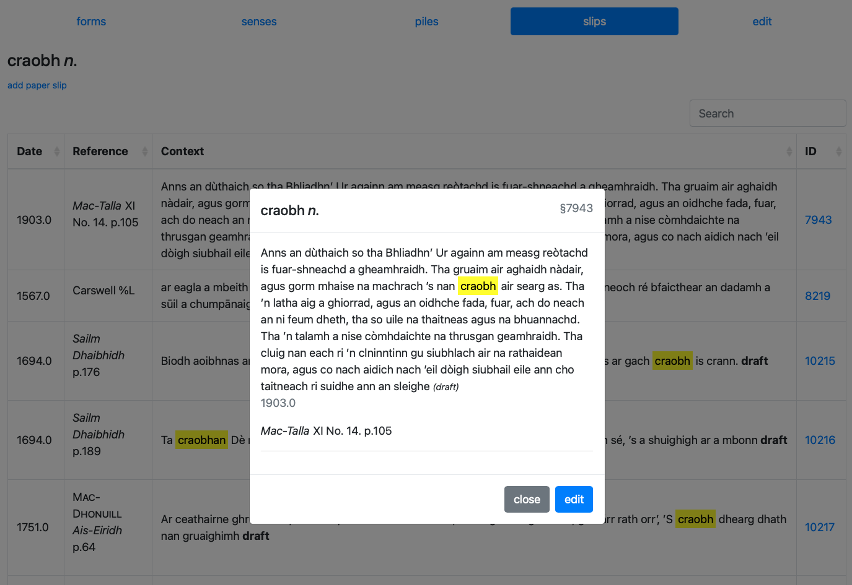

Slide 30
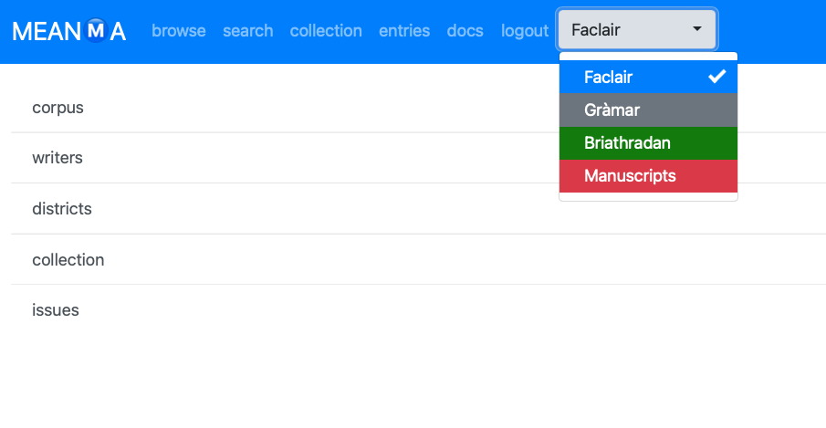

Slide 31
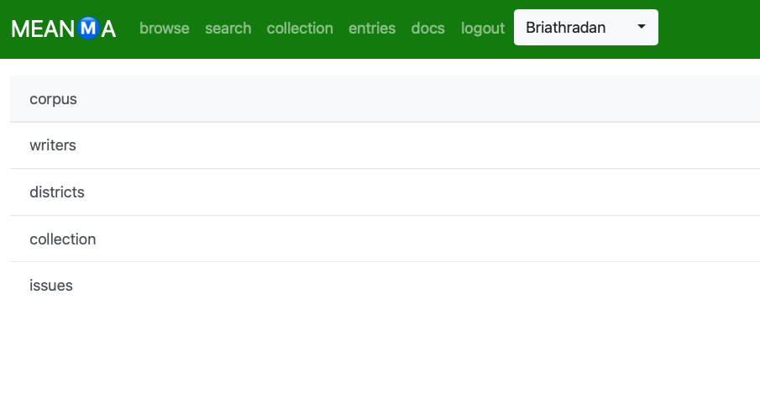

Slide 32
Meanma Prototype
Enthusiastically received by Faclair’s Director of Lexicography and the project’s Advisory Board
Is gradually phasing in as the lexicographers’ preferred corpus search tool
Has generated interest from other historical dictionary projects
Still requires some functionality to be truly end-to-end
Has performance issues with its corpus search

Slide 33
Meanma Beta
The codebase is being completely rewritten using an MVC framework
The existing text corpus is being marked up in light-touch TEI and imported into Meanma
Issues with the prototype’s search speed are being addressed and alternative solutions – eXist DB, Apache Solr, and CWB – are being assessed for use as Meanma’s primary search engine
The full version will deliver dictionary writing tools and the provision to export entries directly to the web
The system will be deployed to the cloud and remodelled as software as a service (SaaS)

Slide 34
Questions
I’ll be here for the rest of the day
Happy to show the system
Or, please do feel free to get in touch: stephen.barrett@glasgow.ac.uk

