Slide 1
Collocations Dictionary of Modern Slovene 2.0
Iztok Kosem ^{1, 2}, Špela Arhar Holdt ¹, Polona Gantar ¹, Simon Krek ^{1, 2}
¹ Faculty of Arts, Centre for Language Resources and Technologies, University of Ljubljana
² Jožef Stefan Institute
eLex 2023 conference, Brno, 27. 6. 2023

Slide 2
Collocations Dictionary of Modern Slovene 1.0
Published in 2018
Dictionary contained:
35,989 headwords
7,717,561 collocations
36,736,168 examples
Inovative interface:
Collocation-oriented
Different filtering options
User voting enabled
Dictionary database available under Creative Commons BY-SA 4.0 licence
Automatic methods for the extraction of lexical information (collocations, examples etc.) from Slovenian corpora (Gantar et al. 2016)
Using Sketch Grammar (POS-tagged data) + GDEX
Sketch Engine API + considerable amount of post-processing

Slide 3
Important developments since 1.0
Two national research projects (Slovenian Research Agency):
Collocations as a Basis for Language Description: Semantic and Temporal Perspectives (2017-2020)
New Grammar of Standard Slovene: Resources and Methods (2017-2020)
International projects:
Estonian Collocations Dictionary (Kallas et al. 2015)
Woordcombinaties (Colman and Tiberius 2018)
Croatian Web Dictionary – Mrežnik (Hudeček and Mihaljević 2020)
A trend of consolidating all language resources into one large database
Digital Dictionary Database for Slovene
Similar efforts in Estonia, Netherlands etc.

Slide 4
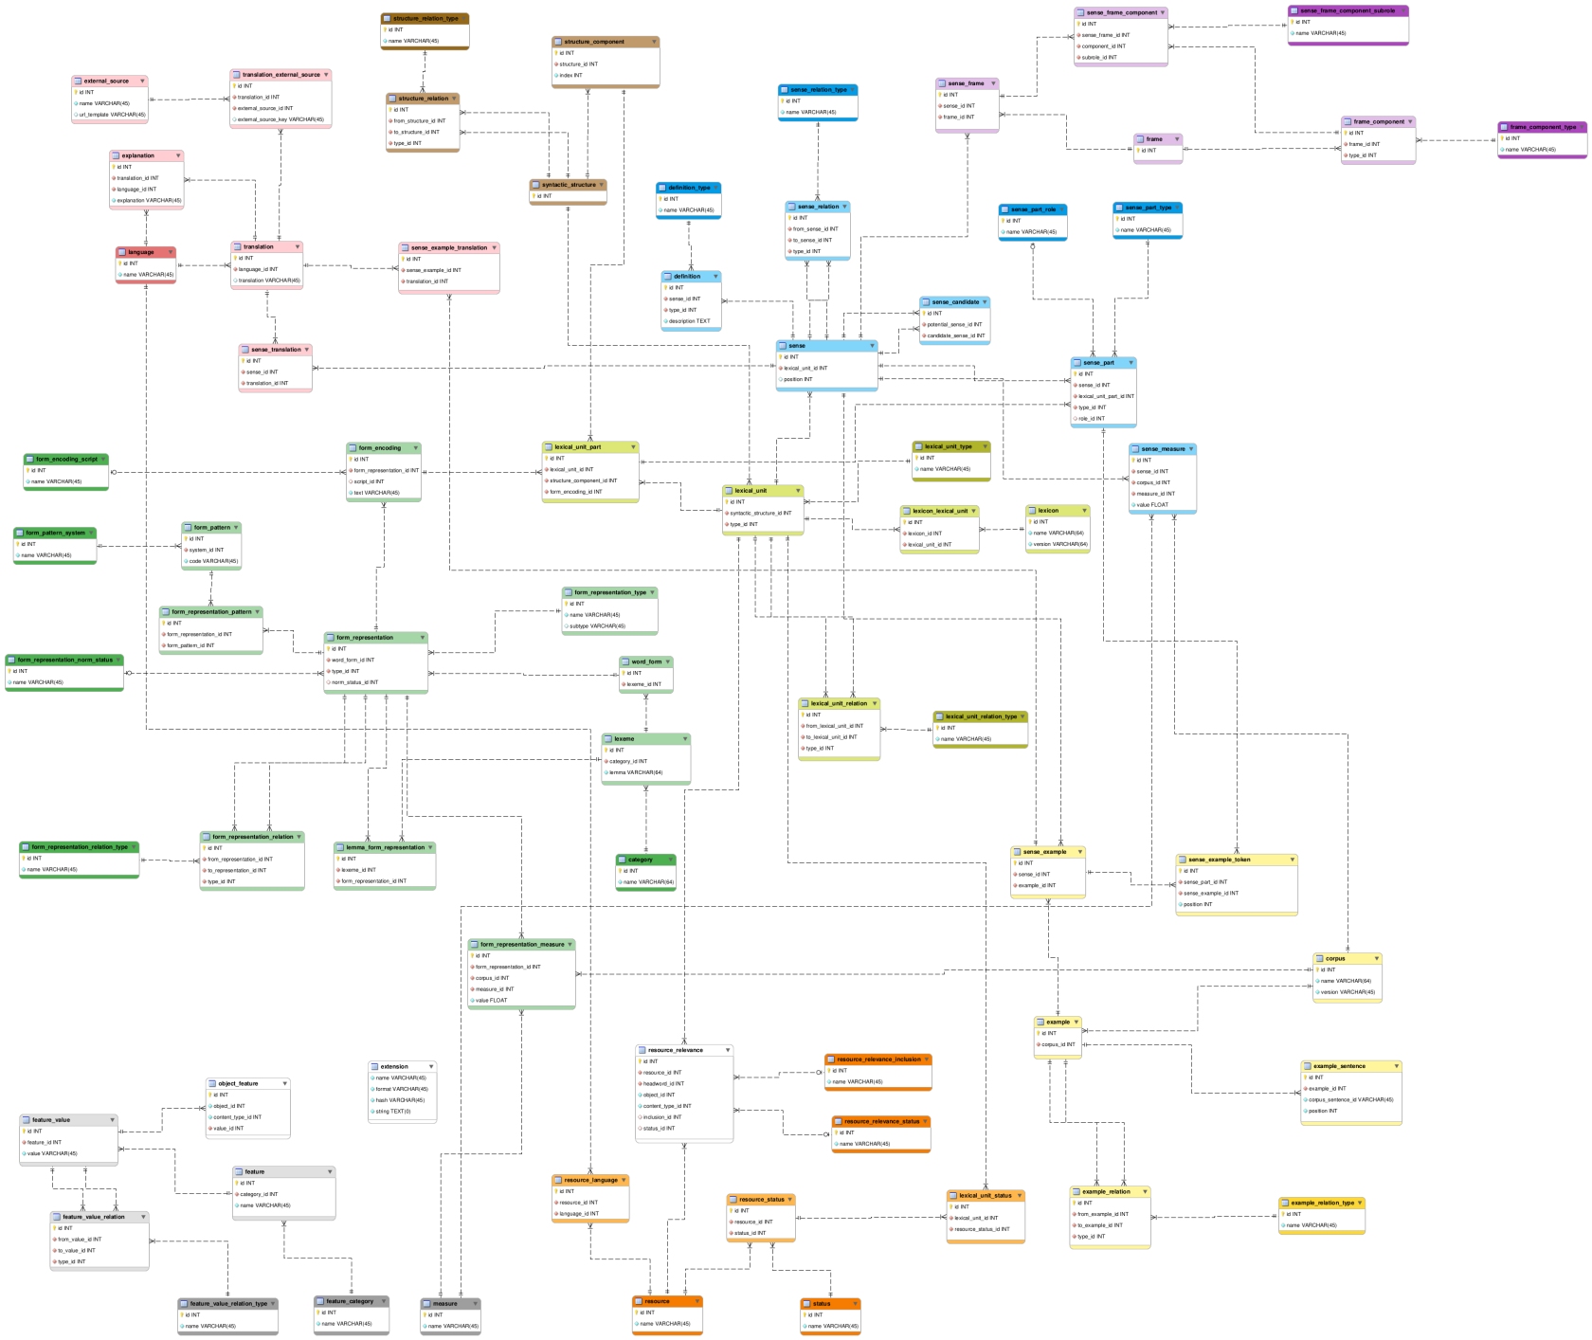
lexical units (olive green)
word forms (forest green)
syntactic structures (brown)
senses (blue)
sense frames (violet)
sense translations (red)
corpus examples (yellow)
resource connections (orange)
generic features (grey)
entity types that reference other entity types via meta-attributes (white)

Slide 5
User studies
Pori et al. (2020; 2021), Arhar Holdt (2021), Pori and Kosem (2021), Arhar Holdt et al. (2021)
Main findings:
Positive attitudes towards automatically extracted collocations (NOTE: users need to be alerted to it; context provided)
Links to corpus data are very important
Preference of ordering collocations by frequency
Mixed opinions on the crowdsourcing feature in the dictionary

Slide 6
In the year 2021
Gigafida 2.0 corpus
Published in 2019
1.2 billion words
Deduplicated
Standard Slovenian
Statistical tagger (≈96%)
neural networks (Stanza parser)
Annotation layers
Lemmatised
POS-tagged
Parsed
JOS tagset
Universal Dependencies
Named Entities
Semantic Role Labels
on JOS dependency labels

Slide 7
New methodology of automatically extracting collocations from corpora
New grammatical formalism for description of collocations
Focused on dependency annotation layer
(to a certain extent) replicates the MWEtoolkit (Ramisch et al.)
Combining restrictions & representation formalism
using corpus annotations on morphological and syntactic levels
82 syntactic structures

Slide 8
Why a new formalism
Typical forms of elements in collocations (representation)
finančna težava → finančne težave (financial + difficulty → financial difficulties)
stresti bonbon → stresti bonbone (drop + candy → drop candies)
dobra možnost → boljše možnosti (good chance → better chances)
Better at identifying difficult relations (e.g. subject and object)
substanca + absorbirati (N_{Nominative} + V) substance absorbs x
absorbirati + substance (V + N_{Acusative}) x absorbs substance
The possibility of including all levels of annotation into the game
“Extended” collocations
From patterns (valency, frames + semantic types), to collocations (excluding phraseology or MWEs)

Slide 9
Collocations Dictionary of Modern Slovene 2.0
SOKOL project (2021-2022) – upgrading Collocations Dictionary and Thesaurus (funded by the Ministry of Culture)
Parameters:
25 collocations for collocationally-productive syntactic structures, 10 for all others
Minimum frequency of a collocation = 4
Collocations extracted for nouns (excluding proper nouns), adjectives, adverbs, and verbs
138,032 candidate headwords
81,445 met the criteria (128 compounds)

Slide 10
Collocations Dictionary of Modern Slovene 2.0
Version 2.0:
81,445 headwords
nearly 4.5 million collocations
more than 17 million examples
4476 entries with sense division (1608 fully completed)
Currently available at https://viri.cjvt.si/kolokacije-beta/
Soon to replace version 1.0 at https://viri.cjvt.si/kolokacije/

Slide 11
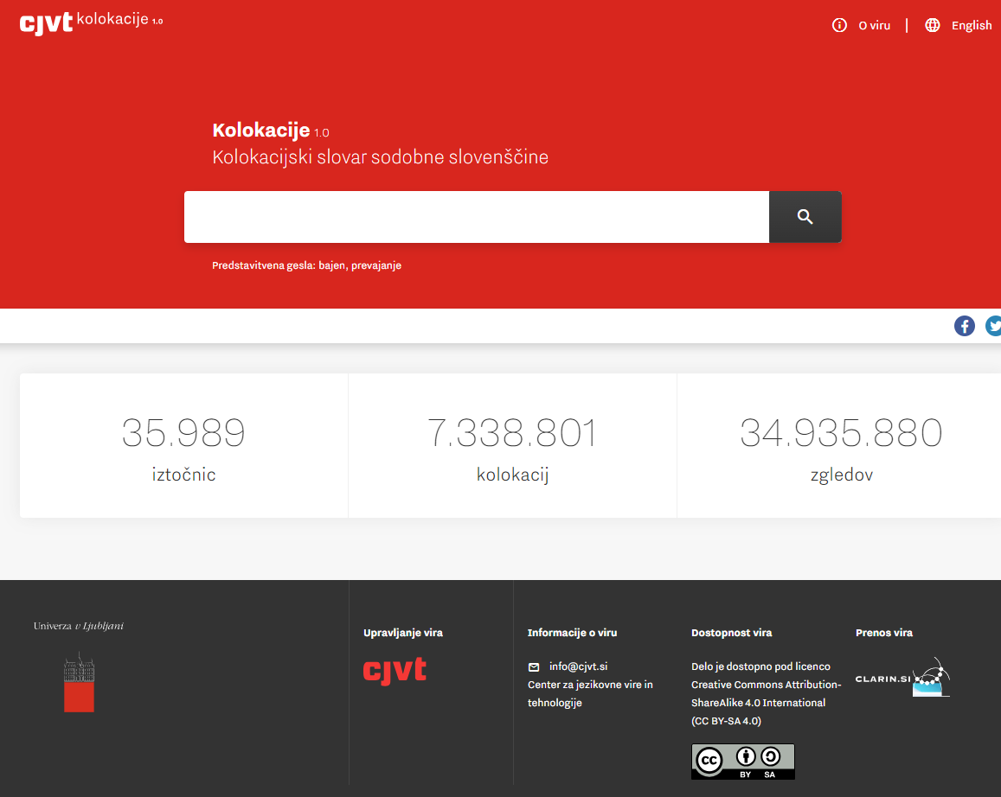
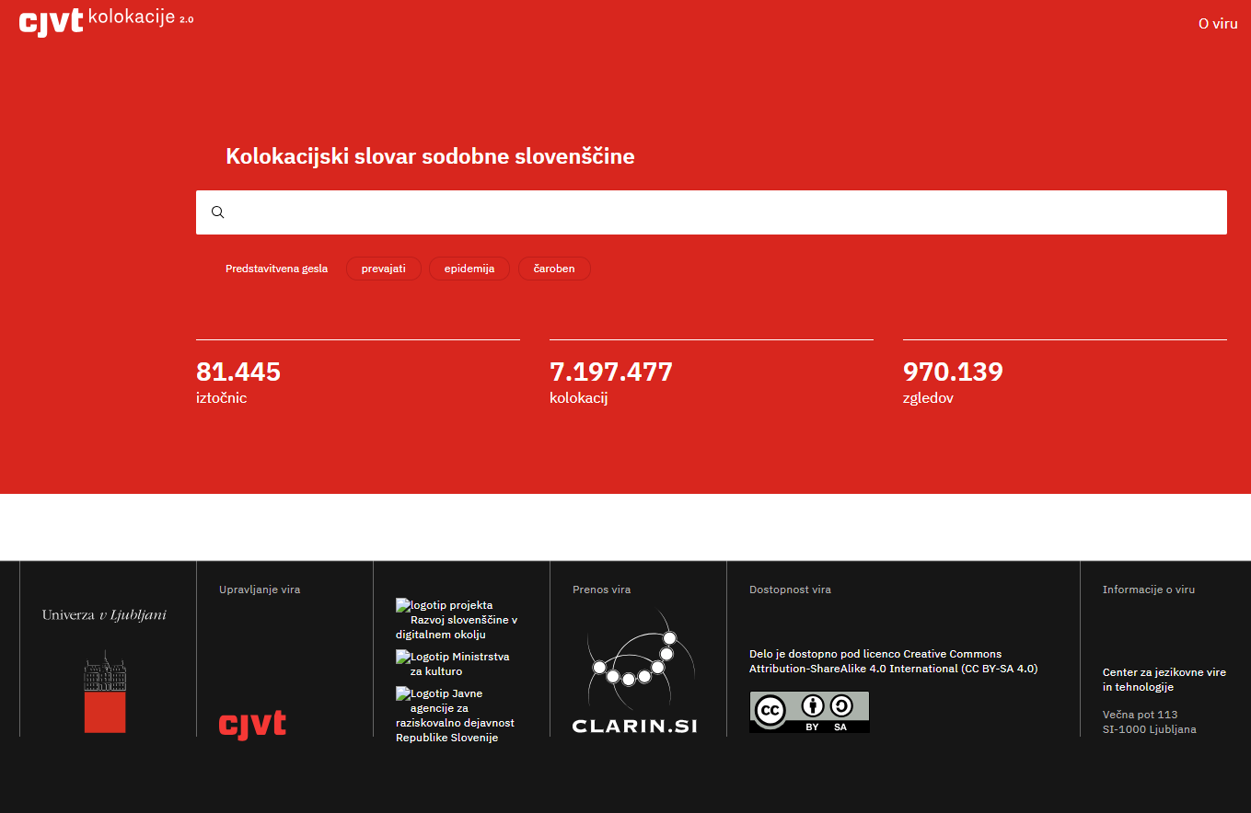
From 1.0
to 2.0

Slide 12
Major interface rewamp
Pokažeš Kolokacije 1.0 (prevajanje)
Poudariš piramido
Prikaz po 4 kolokacije na strukturo
Odpiranje veliko kolokacij
Glasovanje
Filtri pri strani
Kolokacije 2.0 (prevajati)
Nov izgled
Prikaz vsega (možnost filtra Manj – iztočnica z veliko kolokacijami)
Prikaz filtrov, zgledov, nastanitev

Slide 13
Three types of entries (1)
Type 1: Completed entry
Senses
Examined collocations
Automatically extracted examples
Notes:
Akrobat – neuporabljeni pomeni

Slide 14
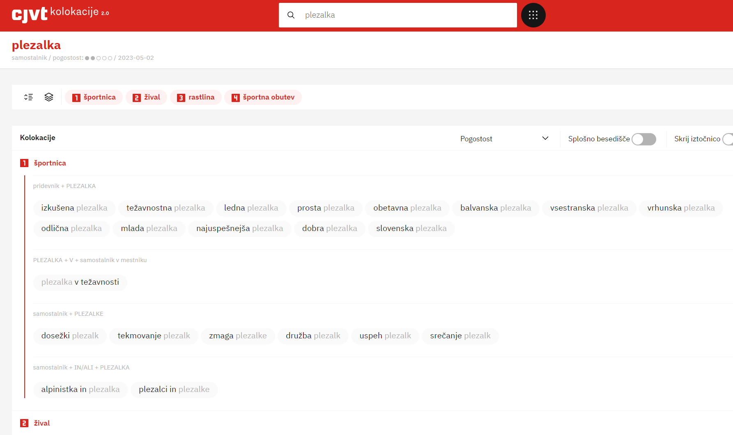
Three types of entries
Notes:
Akrobat – neuporabljeni pomeni

Slide 15
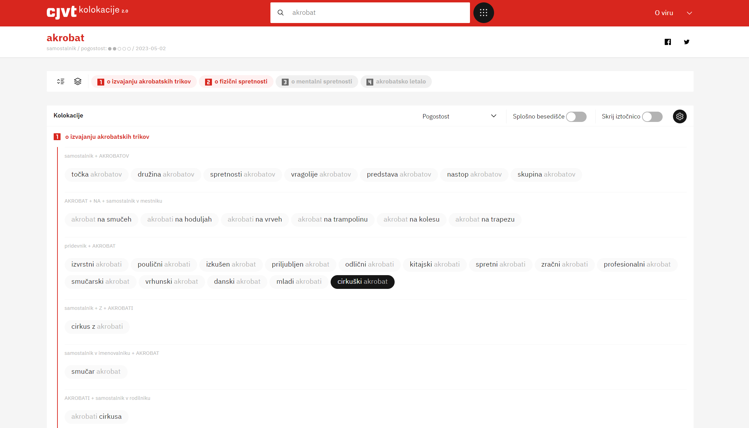
Three types of entries
Notes:
Akrobat – neuporabljeni pomeni

Slide 16
Three types of entries (2)
Type 2: Semi-completed entry
Senses
Examined collocations (*if available)
Automatically extracted collocations
Automatically extracted examples
Notes:
Akrobat – neuporabljeni pomeni

Slide 17
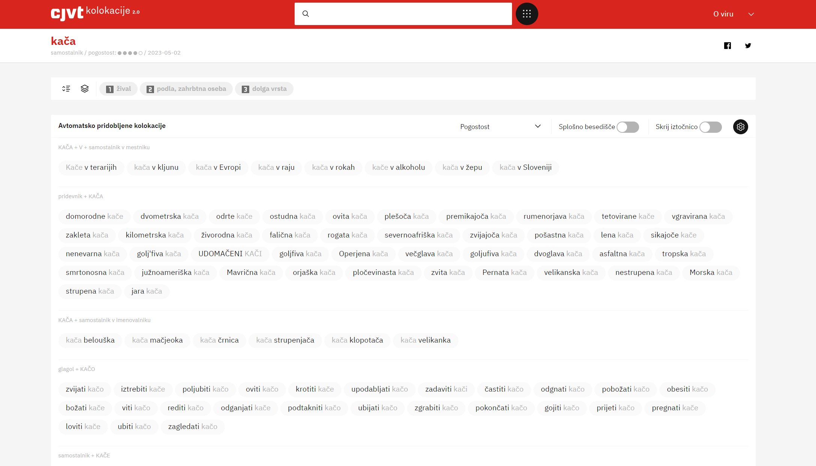
from Thesaurus of Modern Slovene
Three types of entries
Notes:
Akrobat – neuporabljeni pomeni

Slide 18
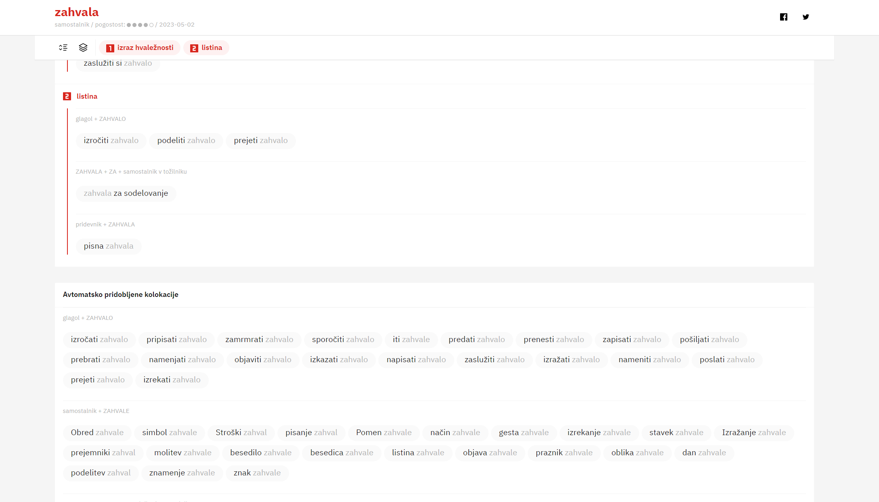
from Comprehensive Slovenian-Hungarian dictionary
Three types of entries
Notes:
Akrobat – neuporabljeni pomeni

Slide 19
Three types of entries (3)
Type 3: Automatic entry
Automatically extracted collocations
Automatically extracted examples
Notes:
Akrobat – neuporabljeni pomeni

Slide 20
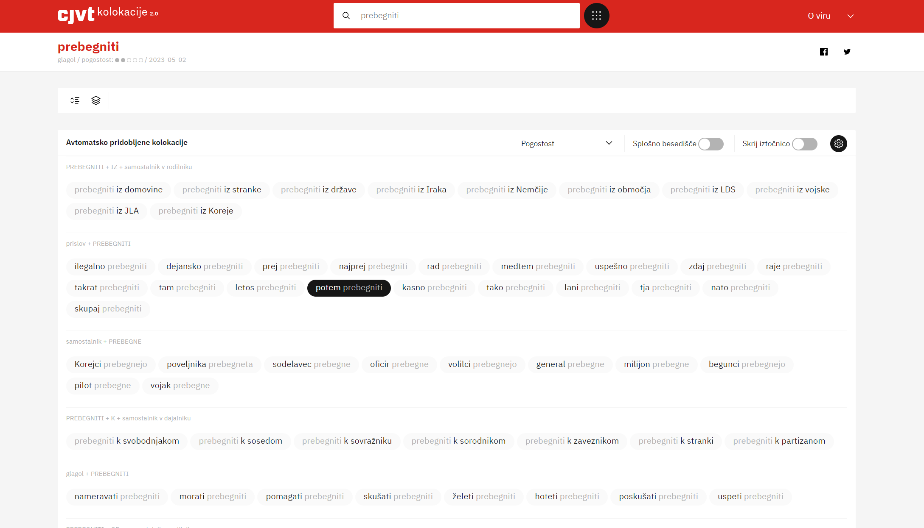
Three types of entries
Notes:
Akrobat – neuporabljeni pomeni

Slide 21
Crowdsourcing feature
Various crowdsourcing studies have shown that:
Users have difficulties in determining whether a word combination is or is not a collocation
Much higher reliability when asked to assign examples of collocations to relevant senses
Shift of crowdsourcing option in version 2.0
Determining the suitability (and sense) of examples
Indirectly confirming collocation but the final decision is left to lexicographers
Notes:
Akrobat – neuporabljeni pomeni

Slide 22
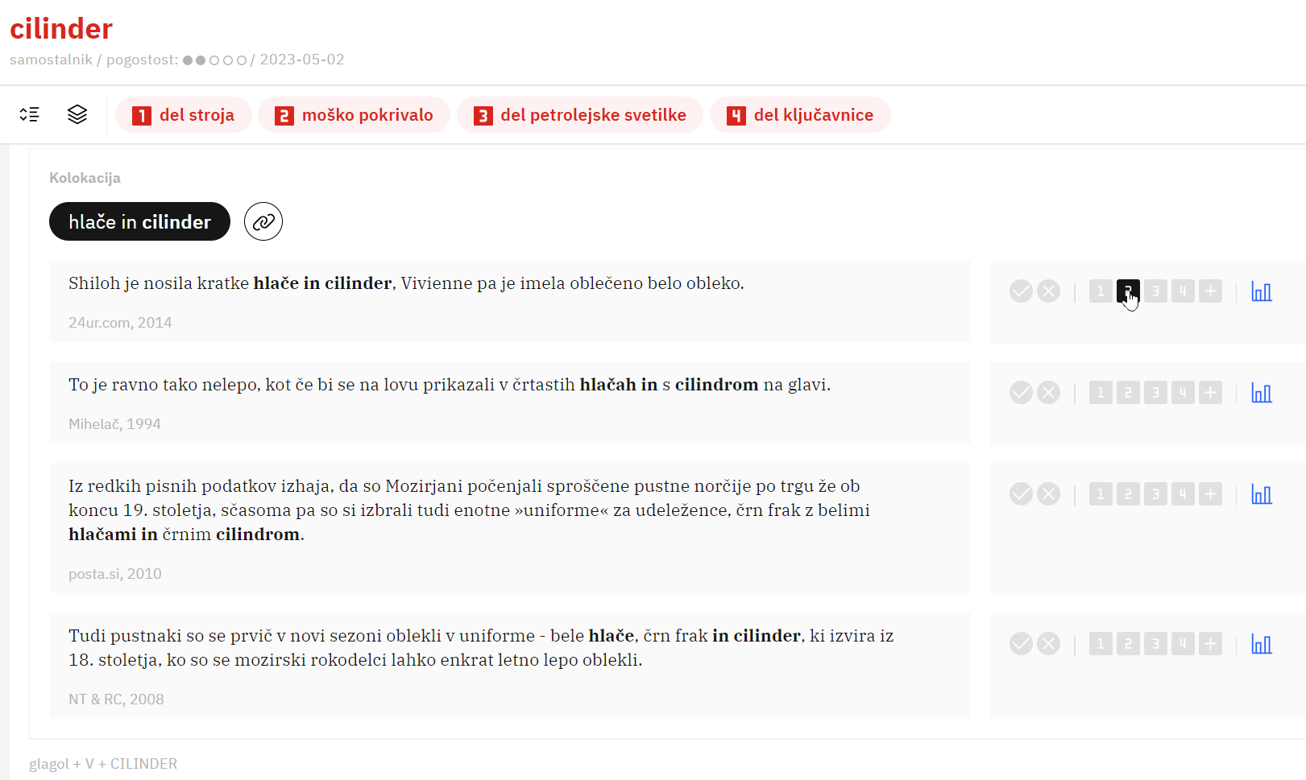
Three types of entries
Notes:
Akrobat – neuporabljeni pomeni

Slide 23
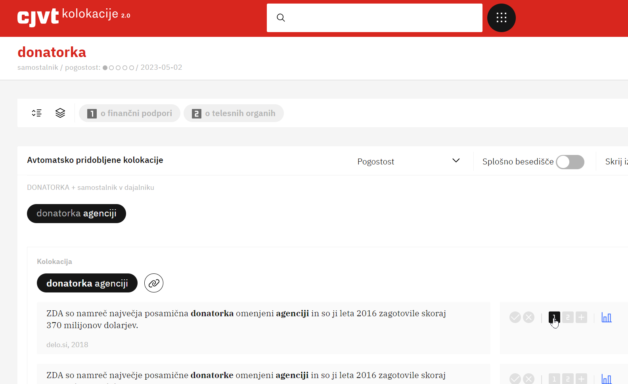
Three types of entries
Notes:
Akrobat – neuporabljeni pomeni

Slide 24
Plans for the future
More regular updates to the dictionary
New editor for the Digital Dictionary Database!
over half a million of collocation candidates in the most relevant structures to be checked by end of 2023 (CLARIN.SI project)
Further improvements of extraction methodology
Extended collocations
Grouping of collocations by characteristics and/or semantic properties
Immediate availability of user votes in the interface

Slide 25
Thank you.
Iztok Kosem
iztok.kosem@ff.uni-lj.si
This research was carried out with the support of ARRS (Slovenian Research Agency) through
the research programme P6-0411 "Language Resources and Technologies for Slovene“,
The research programme P6-0215 “Slovene Language – Basic, Contrastive, and Applied Studies”
the infrastructure programme I0-0022 "Network of Research Infrastructure Centres (MRIC)“ at the University of Ljubljana.

