Slide 1
Representing Ideology in Terminological Knowledge Bases
Pilar León-Araúz, Arianne Reimerink, Melania Cabezas-García, and Pamela Faber

Slide 2
Aims
Analysis of ideological framing and term variation of climate change in political discourse
Sketch Engine
Parlamint 2.1: Spanish and English parliamentary debates
Representation of ideology in TKBs: concept, term and graphic modules

Slide 3
Cognitive term variation
Cognitive term variants often respond to the cognitive intention of the speaker and may influence the way a concept is perceived by the recipient (Cabré, 2008)
Cognitive term variants illustrate the relation between term and concept variation, which are the consequence of the convergent influence of multidimensionality, context and dynamism in specialised domains (León-Araúz, 2017)
climate change
climate crisis
climate emergency
climate breakdown

Slide 4
Framing
Goffmann, 1974
Climate change communication
“the process by which people develop a particular conceptualisation of an issue and reorient their thinking about an issue” (Chong & Druckman, 2007)
Selection and salience

Slide 5
Framing
Bolsen & Shapiro (2018): climate change in the media
Scientific consensus (+/-)
Economic consequences (+/-)
Environmental consequences (+/-)
Morality/ethics
Disaster
Political conflict
National security
Public health
Self-efficacy (+/-)
External efficacy (+/-)
Response efficacy (+/-)

Slide 6
Ideological knowledge extraction
Method
Parlamint 2.1: Spanish and English parliamentary debates (lower houses, main political parties)
Around 1,000 excerpts with
climate + noun in English (e.g. climate change, climate emergency)
noun + climático in Spanish (e.g. cambio climático [climate change], crisis climática [climate crisis])
Annotation according to Bolsen & Shapiro (2018)

Slide 7
Ideological knowledge extraction
Frame annotation: examples
Economic consequences (+):
“One of the frustrations that many of us feel is that tackling fuel poverty by investing in energy efficiency can really be a win-win situation in getting people's fuel bills down, tackling climate change and creating jobs.”
Morality/ethics:
“Climate change is the biggest challenge that any of us or any future generations will face.”

Slide 8
Ideological knowledge extraction
Frame annotation: examples
Political conflict: preference for other frames present
“Does my right hon. Friend agree that a vital part of the debate about how to address climate change is our energy consumption? In that context, people in Twickenham are very aware of the three Rs –reduce, reuse, recycle–but we do not have smart meters everywhere. I do not see a smart meter here; I do not have one in my office. How is the roll-out of smart meters going?”
→ Self-efficacy

Slide 9
Ideological knowledge extraction
Frame annotation: examples
Several frames in one intervention: division
“(a) There will, of course, be disagreements. There is, however, a basic set of assumptions: the science on climate change is real; we know that, as human beings, we are responsible for it; (b) and we are conscious–this is crucial–that we have in our hands the ingenuity to tackle the problem and deal with it. (c) Whatever party we are from, we care about our responsibilities to hold the planet in trust for future generations. Whatever party we are from, we know we will be held to account for the actions we take or do not take now. ”
Scientific consensus (+)
Response efficacy (+)
Morality/ethics

Slide 10
Ideological knowledge extraction
Frame annotation: examples
New frames:
Political consensus
“In recent years, Members of Parliament have worked hard on this issue in an attempt to safeguard our wildlife and oceans for future generations. I pay tribute to their efforts, and I am grateful to colleagues from all parties for their support for the Bill. ”
Call for action
“Let us make sure that we have the social protections needed now to face the next revolution, not just the current crisis. Let us not let the global pandemic distract us from the urgency of the climate emergency. Let us make sure that our recovery is a green recovery.”
Neutral
“I speak as a former chair of Flood Risk Management Wales, responsible for adapting Wales to climate change in terms of flood defences and investing the Welsh Assembly 's money through the Environment Agency and partners.”

Slide 11
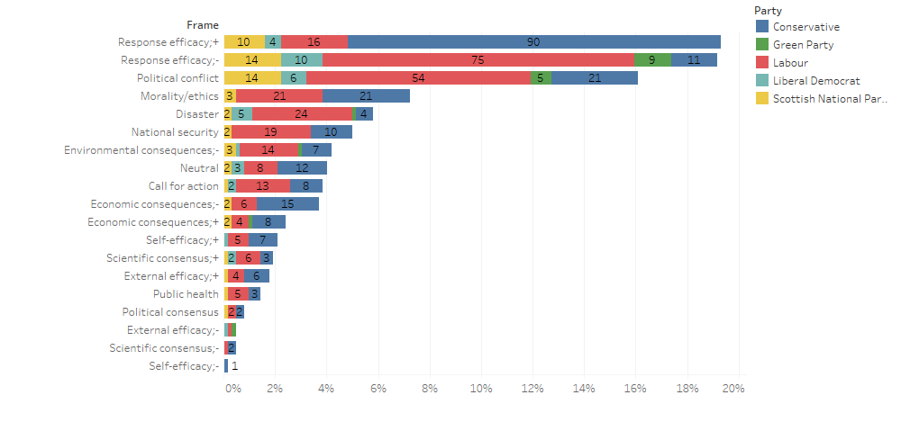
Ideological knowledge extraction
Frames in UK political discourse

Slide 12
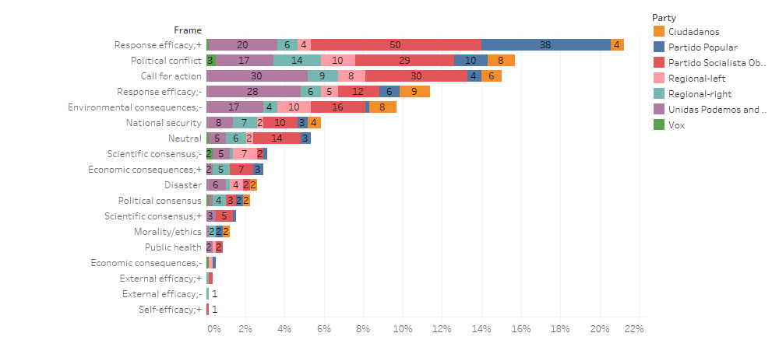
Ideological knowledge extraction
Frames in ES political discourse

Slide 13
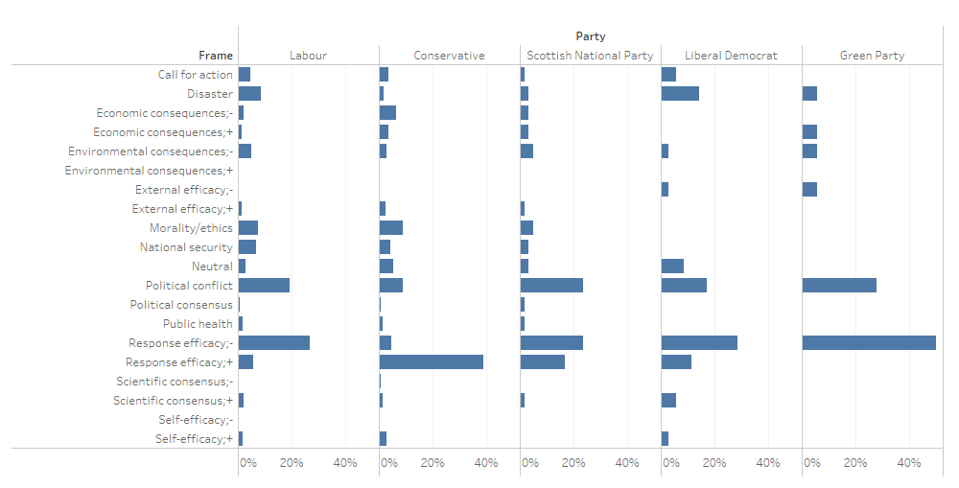
Ideological knowledge extraction
Frames and parties (UK)

Slide 14
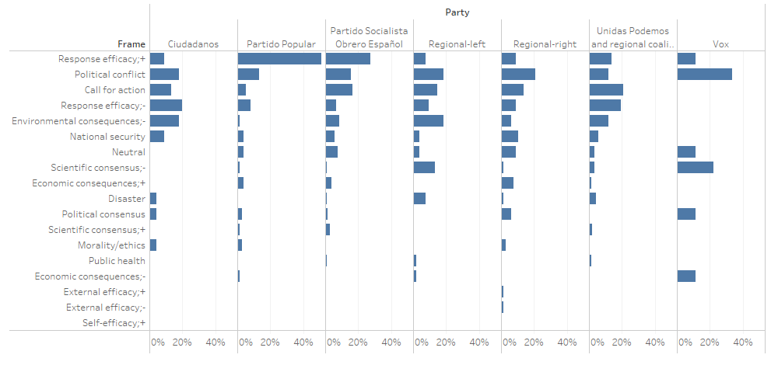
Ideological knowledge extraction
Frames and parties (ES)

Slide 15
Ideological knowledge extraction
Term variants and frames (UK)

Slide 16
Ideological knowledge extraction
Term variants and frames (ES)

Slide 17
Ideological knowledge extraction
Term variants, political spectrum and date (UK)

Slide 18
Ideological knowledge extraction
Term variants, political spectrum and date (ES)

Slide 19
Representation of ideology
Should lexicographers be invisible?
We take a stand: reflect scientific reality AND frame for climate change mitigation
Our proposal:
Scientific consensus
Adaptation to the intended audience
Use of frames beyond ideological divisions
Use of solutions, self-efficacy, hope, and value frames

Slide 20
Representation of ideology

Slide 21
Representation of ideology
Should lexicographers be invisible?
We take a stand: reflect scientific reality AND frame for climate change mitigation
Our proposal:
Scientific consensus
Adaptation to the intended audience
Use of frames beyond ideological divisions
Use of solutions, self-efficacy, hope, and value frames

Slide 22
Representation of ideology
Concept module: previous definition of climate change
Previous definition | Facets (frames)
long-term changes in temperature, precipitation, wind, and all other aspects of the Earth's climate in response to physical feedbacks, chemical feedbacks, and changes in terrestrial and aquatic systems caused by humans and nature. | Process: change
 | Time: long-term
 | Cause: human, nature
 | Effect: changes

Slide 23
Representation of ideology
Concept module: new definition of climate change
New definition | Facets (frames)
Long-term changes in the Earth’s climate in response to physical feedbacks, chemical feedbacks, and changes in terrestrial and aquatic systems. Although it can be the result of natural causes such as changes in the Sun’s activity or large volcanic eruptions, the acceleration of the past two centuries is due to human activities, mostly the burning of fossil fuels that increase greenhouse gas emissions. Its effects include intense droughts, water scarcity, severe fires, rising sea levels, flooding, melting polar ice, catastrophic storms and declining biodiversity, which will lead to problems for human health and migration. Policies and individual measures, such as transport, food and energy use choices, can reduce greenhouse gas emissions and mitigate the process. | Process: change
 | Time: long-term, acceleration
 | Cause: human, nature
 | Effect: droughts, water scarcity, etc. (disaster); health problems, migration (human health, natural security)
 | Policies (response efficacy; solutions) Individual measures (self-efficacy; solutions)

Slide 24
Representation of ideology
Concept module
Concept note for climate change
In political discourse (ES+UK), climate change is mostly portrayed as part of the Response efficacy+ frame, which means that politicians, regardless of their ideology, believe that policy action can make a positive difference to address it. In Spain, Political conflict and Call for action are the next frames most frequently activated, whereas in UK these are Political conflict and Response efficacy- frame. This means that UK politicians are more divided across the political spectrum. Left-wing parties evoke the Response efficacy+ frame more frequently and right-wing parties evoke the Response efficacy- frame more frequently. Morality seems to drive UK political discourse much more often than in Spanish political discourse (…)

Slide 25
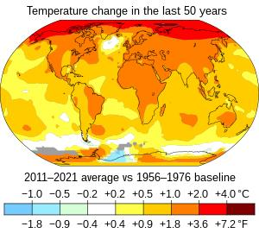
Representation of ideology
Graphics module
Scientific consensus vs. Scientific uncertainty

Slide 26
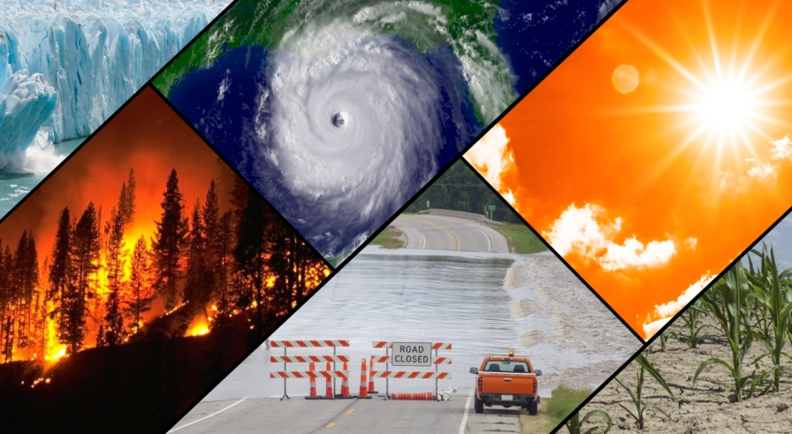
Representation of ideology
Graphics module
Environmental consequences → but inaction

Slide 27
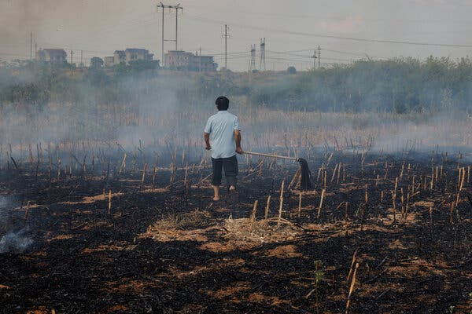
Representation of ideology
Graphics module
Xinyao, China → distance vs closeness

Slide 28
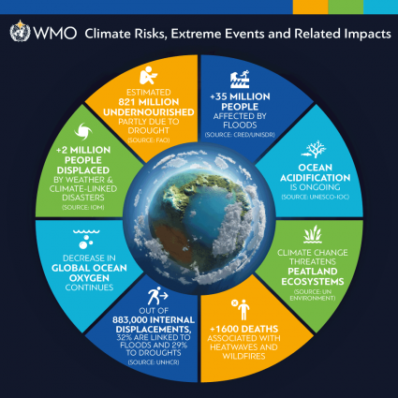
Representation of ideology
Graphics module
Consequences: national security and public health

Slide 29
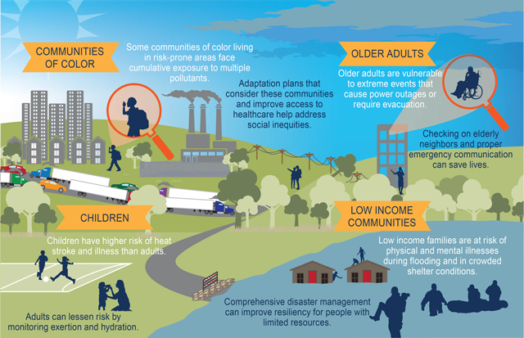
Representation of ideology
Graphics module
Vulnerable populations, efficacy

Slide 30
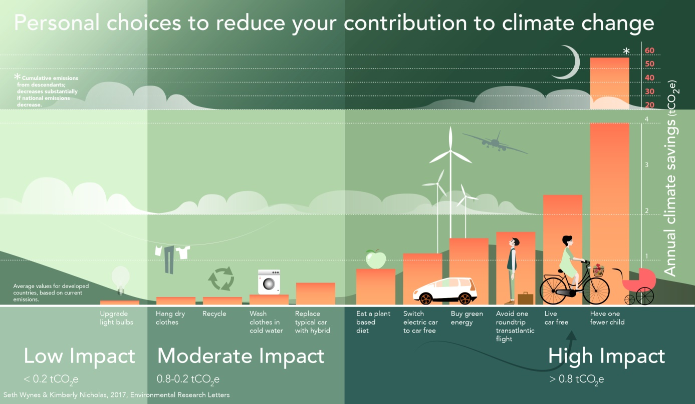
Representation of ideology
Graphics module
Self-efficacy

Slide 31
Representation of ideology
Term module
Term note for climate catastrophe
In political discourse (UK), the term is mostly used to convey the Disaster, Morality, Political conflict, and Response efficacy- frames. Although it is not frequently used, the Green Party applies the term when framing for Response efficacy-, whereas the Liberal Democrats use it to frame for Disaster, and the Labour Party for Morality and Political conflict.

Slide 32
Representation of ideology
Term module
Term note for climate emergency
In political discourse (UK), the term is used across the whole political spectrum since 2019 when the UK Parliament declared a climate emergency, therefore prioritizing climate action in government policy.

Slide 33
Thank you!
Any questions?
Pilar León-Araúz: pleon@ugr.es
Arianne Reimerink: arianne@ugr.es
Melania Cabezas-García: melaniacabezas@ugr.es
Pamela Faber: pfaber@ugr.es

Slide 34
References
Bolsen, T. and Shapiro, M.A. (2018). The US News Media, Polarization on Climate Change, and Pathways to Effective Communication. Environmental Communication, 12(2), pp. 149-163.
Cabré, M.T. (2008). El principio de poliedricidad: La articulación de lo discursivo, lo cognitivo y lo lingüístico en Terminología (I). Ibérica, 16, pp. 9-36.
Chong, D. and Druckman, J.N. (2007). Framing Theory. Annual Review of Political Science, 10, pp. 103–126.
Erjavec, T., Ogrodniczuk, M., Osenova, P. et al. (2023). The ParlaMint corpora of parliamentary proceedings. Language Resources and Evaluation, 57, pp. 415–448.
Kilgarriff, A., Baisa, V., Bušta, J., Jakubíček, M., Kovář, V., Michelfeit, J., Rychlý, P. and Suchomel, V. (2014). The Sketch Engine: ten years on. Lexicography, 1(1), pp. 7–36.
León-Araúz, P. (2017). Term and concept variation in specialized knowledge dynamics. In Multiple Perspectives on Terminological Variation, edited by Drouin, P., Francœur, A., Humbley, J. & Picton, A. Terminology and Lexicography Research and Practice, 18:213-258. Amsterdam/Philadelphia: John Benjamins. doi:10.1075/tlrp.18.09leo.

