Slide 1

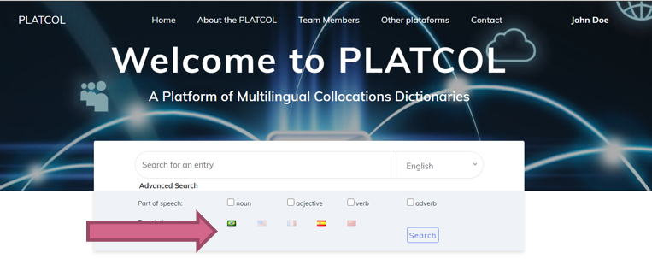




Research results and outcomes of the project
“A Phraseographical Methodology and Model for an Online Corpus-Based Multilingual Collocations Dictionary Platform”
Adriane ORENHA-OTTAIANO
Maria Eugênia OLÍMPIO
Carlos Roberto VALÊNCIO
João Pedro QUADRADO
José Manuel PAZOS-BRETAÑA
Zonghmei XIONG

Slide 2


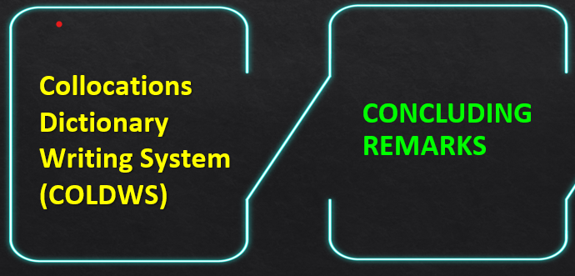
SOME RESULTS
AND OUTCOMES
DESCRIBE THE PROJECT
MULTPLATCOL’S
METHODOLOGY
Outline

Slide 3
Project Objectives
Develop a phraseographical methodology and model for an Online Corpus-Based Multilingual Collocations Dictionary Platform (MULTPLATCOL)

Slide 4
Presentation Objectives
Describe the project and our view of collocations
Show some results and outcomes achieved within the scope of a project funded by The São Paulo Research Foundation (Process 2020/01783-2)

Slide 5
A Phraseographical Methodology and Model for an Online Corpus-Based Multilingual Collocations Dictionary Platform (Process FAPESP 2020/01783-2)

Slide 6
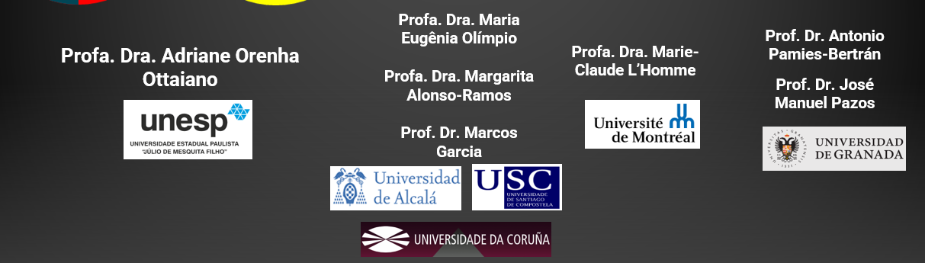








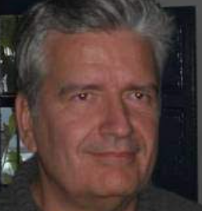

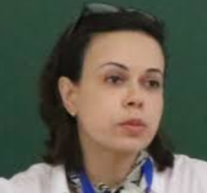
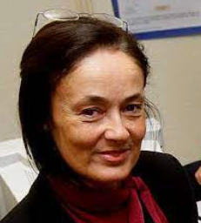
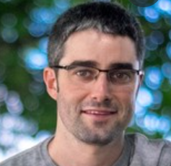
Carlos Roberto Valêncio
João Pedro Quadrado

Slide 7
More languages will be included
in the second phase of the Project:
German and European Portuguese
EUROPEAN PORTUGUESE
ITALIAN
GERMAN

Slide 8
HOW DO WE VIEW COLLOCATIONS IN THE PROJECT?
Pazos-Bretaña, Orenha-Ottaiano and Xiong (in press):
Under a statistically oriented approach, we view collocations as frequent word combinations whose co-occurrence within a certain distance of each other is statistically higher than expected in comparison to any other words randomly combined in a specific language (Barfield; Gyllstad, 2009; Nesselhauf, 2005; Sinclair 1966, 1991; etc.).

Slide 9
HOW DO WE VIEW COLLOCATIONS IN THE PROJECT?
However, as Teubert (2004: 188) mentioned, being statistically significant is not enough to identify a combination of words as a collocation:
  ‘They also have to be semantically relevant. They have to have a meaning of their own, a meaning that isn’t obvious from the meaning of the parts they are composed of’.

Slide 10
For this reason, it is important to describe collocations under a phraseological approach:
    pervasive, recurrent, and conventionalized combinations consisting of a base and a collocate (Haussmann 1979, 1989), which are lexically and/or syntactically fixed to a certain degree.
    They can be said to be partially compositional because its base maintains its meaning, however, the collocate may take on a special meaning only when only combined with the base (Alonso-Ramos, 1994; Corpas 1996; Haussmann, 1989; Heylen; Maxwell, 1994; Orenha-Ottaiano, 2020; Pamies, 2019; Penadés Martínez, 2017; Torner & Bernal, 2017)

Slide 11
A more or less restricted Collocational Range
The more specific a word is
The more generic a word is
The more senses (attracts more collocations for each sense)
The fewer senses (attracts fewer collocations)
The lower its collocational range
The higher its collocational range

Slide 12
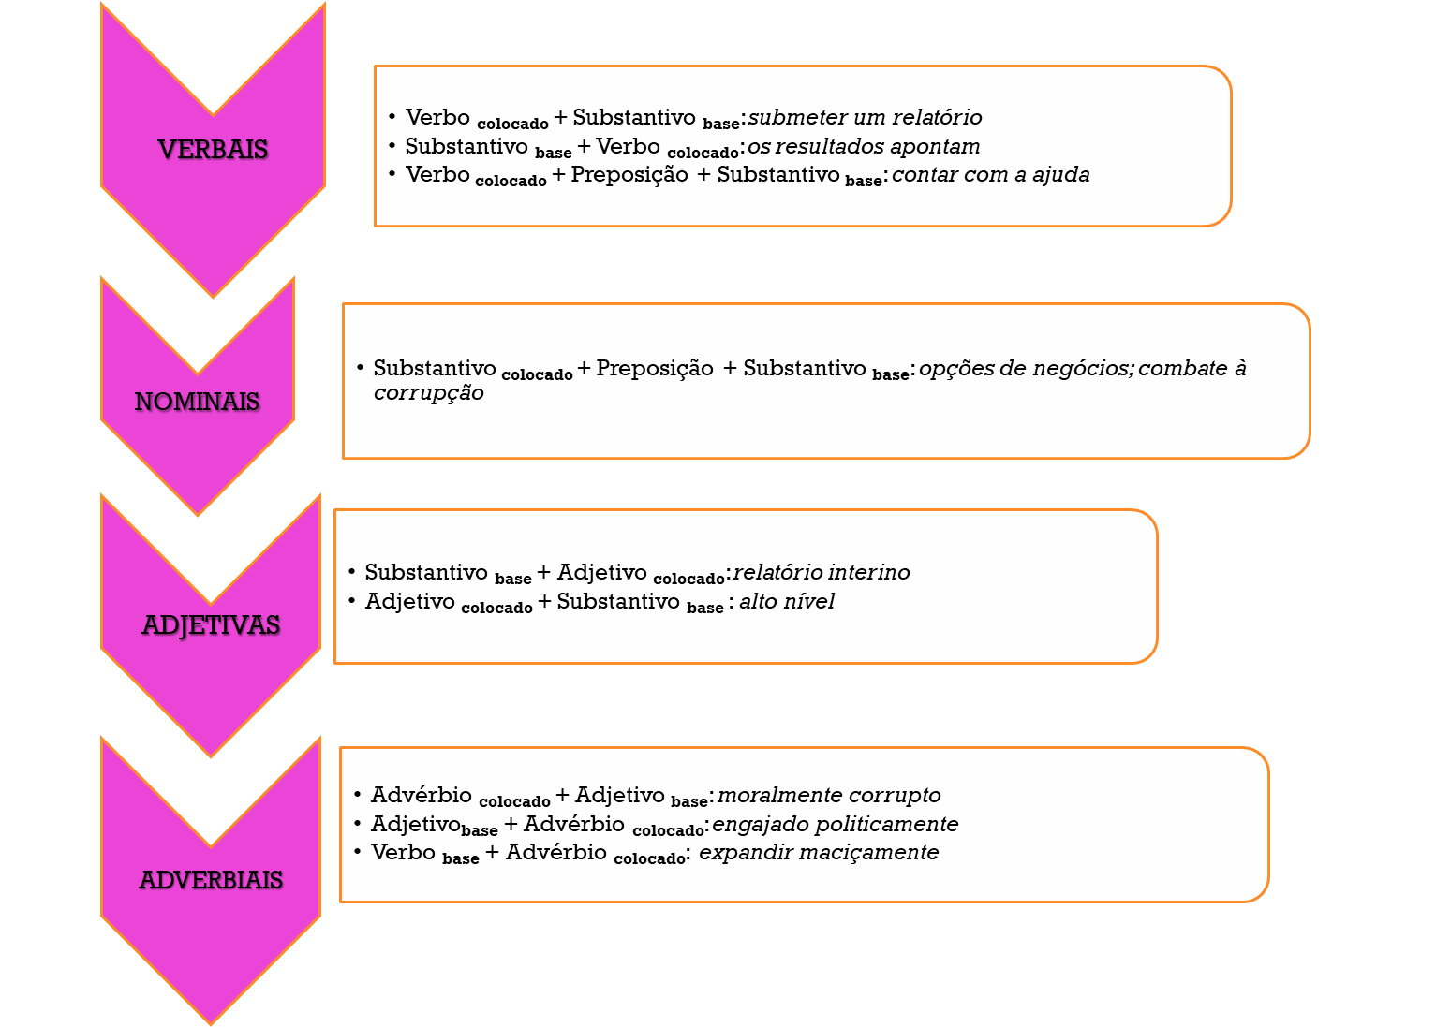
Taxonomy
of Collocations

Slide 13
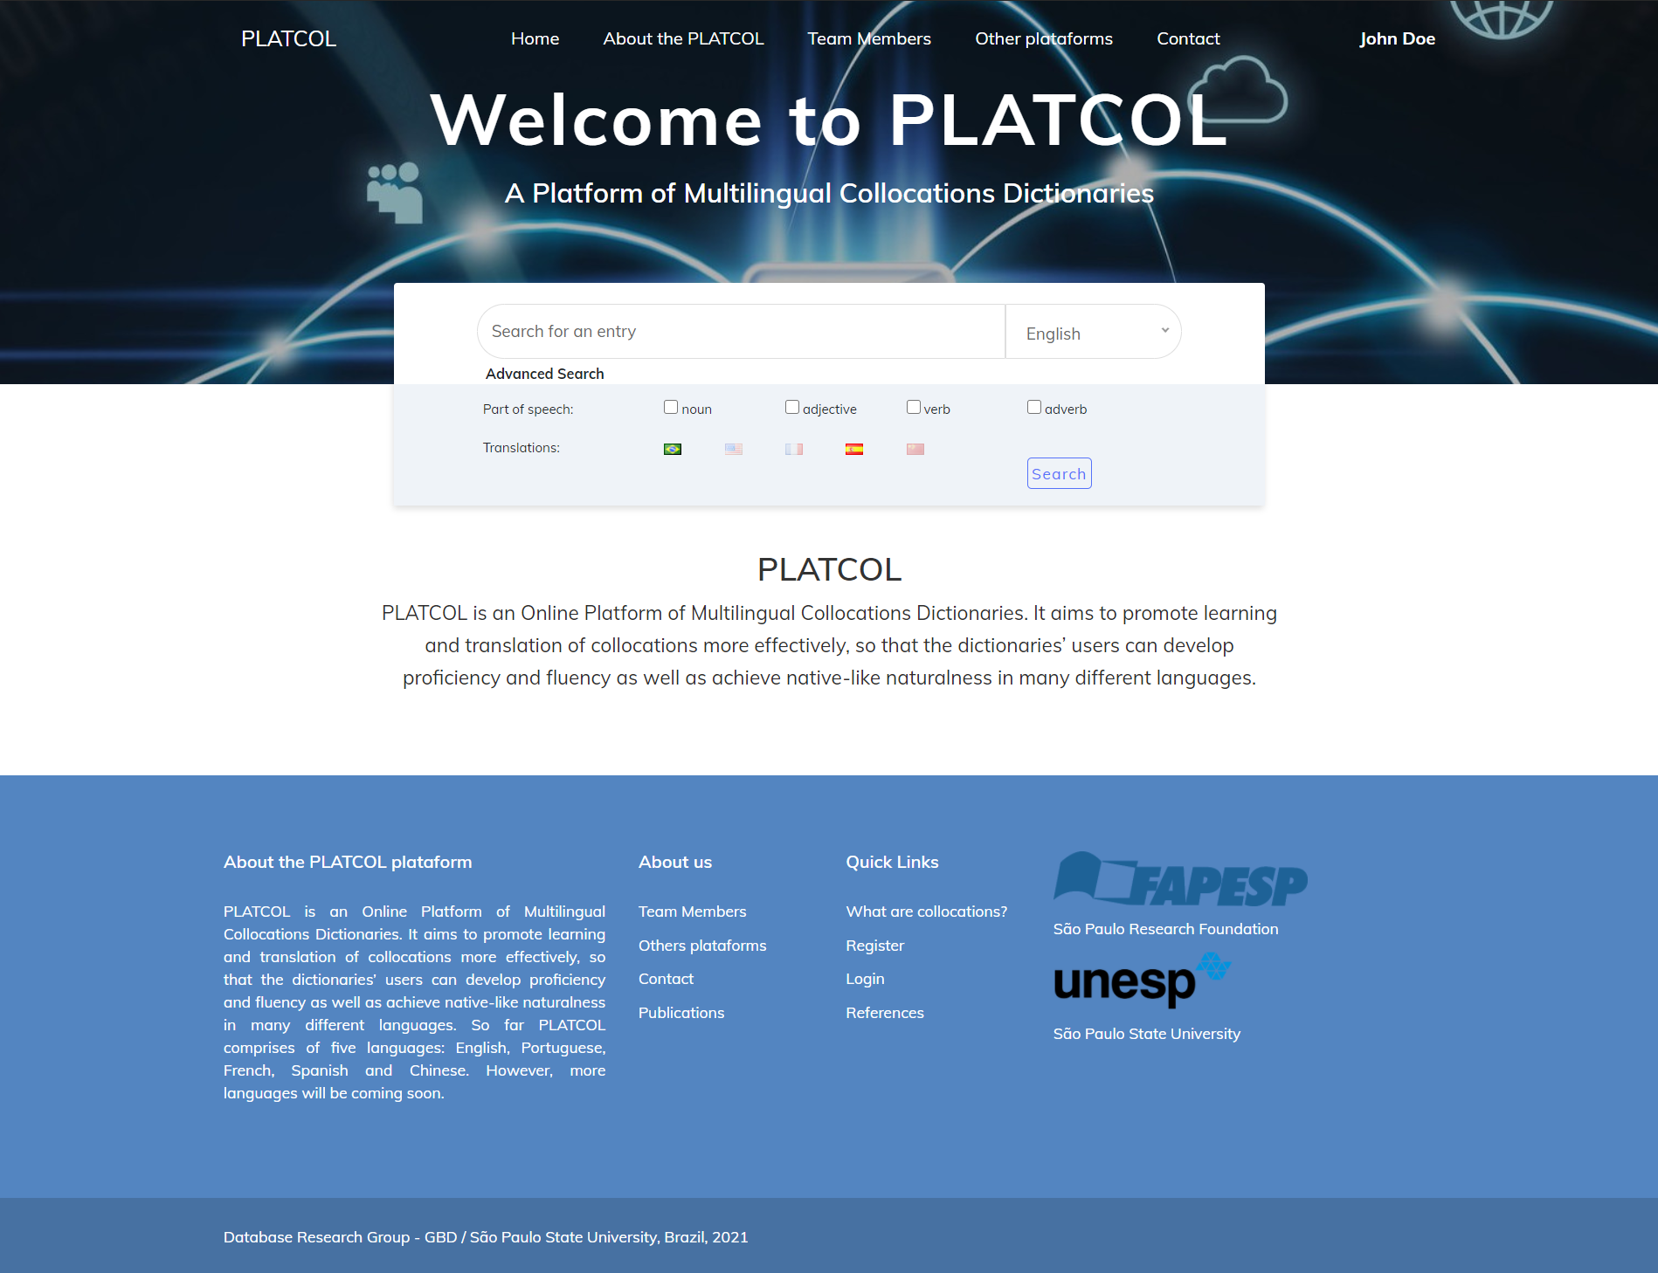

http://www.institucional.grupogbd.com/dicionario/sobre?locale=en

Slide 14
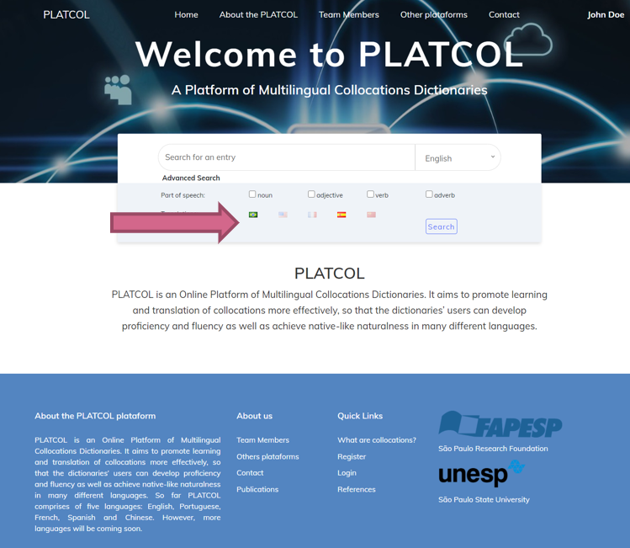
What is PLATCOL?
A Platform that aims to offer a new way to search collocations, with a new dictionary format
A Platform that seeks to meet its users’ needs - higher customization of the structure of the dictionaries
Production dictionaries that can provide help to users and contribute to the development of their collocational knowledge and competence

Slide 15
Our proposal is based on the Functional Theory of Lexicography (Bergenholtz & Tarp 2003, Bothma & Tarp 2012, Fuertes-Olivera & Tarp 2014, Tarp 2013, 2014 and 2015).
Thus, both the procedures chosen for the selection, organization and presentation of lexicographical data, as well as the determination of the content, form and access routes are adapted and subordinated to the preferences of the users.

Slide 16
USERS
Learner and Professional Translators
Pre-service Teachers
In-service Teachers
Material Developers
Researchers and Lexicographers
Language Learners

Slide 17
Survey on users’ needs

Slide 18
METHODOLOGY
The methodology is based on the automatic approach described in Garcia et al. (2019a) and a manual review and validation of the extracted data made by lexicographers.

Slide 19
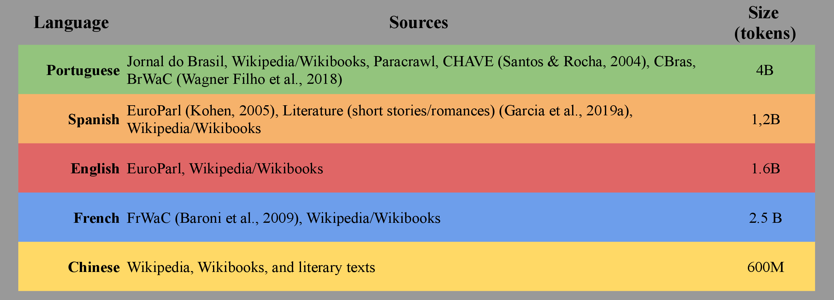
THE CORPUS
A large corpus for each of the five languages was automatically compiled, using different source data – and parsed with UDPipe (Straka & Straková, 2017):

Slide 20
METHODOLOGY
Automatic retrieval of bases
Focus on collocation types with three morphosyntactic classes of bases:
  nouns
  verbs
  adjectives

Slide 21
VALIDATED BASES
AUTOMATICALLY EXTRACTED BASES
 | French | Portuguese | English | Spanish | Chinese
Nouns | 9,754 | 10,307 | 10,545 | 8,853 | 1,858
Verbs | 4,895 | 5,573 | 5,502 | 3,549 | 2,206
VALIDATED CANDIDATES
 | French | Portuguese | English | Spanish | Chinese
Nouns | 8,361 | 8,690 | 8,713 | 6,576 | 103
Verbs | 2,902 | 3,817 | 3,982 | 2,459 | 100

Slide 22
Registered Collocaciones in the COLDWS
Chinese | 5,786
Spanish | 71,131
French | 60,447
English | 52,826
Portuguese | 62,968
Total | 253,158

Slide 23
Identification of example sentences
We use GDEX-inspired heuristics (Kilgariff et al., 2008) to automatically assign a score to each sentence in the corpus (containing candidate collocations).
Following Kosem et al (2019), we discard sentences with less than 6 tokens and incrementally penalize those with more than 30 tokens.

Slide 24
METHODOLOGY
Automatic Translation of Collocations
(Garcia et al. 2019c)

Slide 25
MULTPLATCOL’S OUTCOMES AND RESULTS

Slide 26
Team of Reviewers
Who are They?

Slide 27
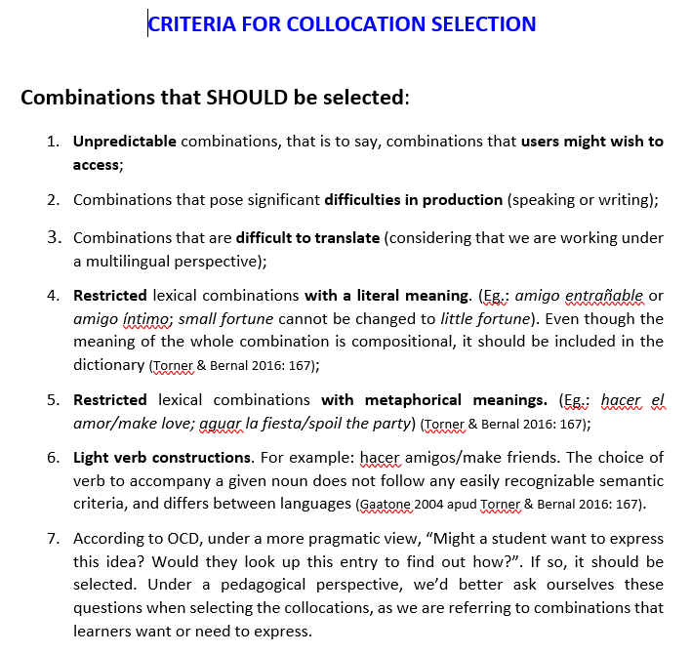
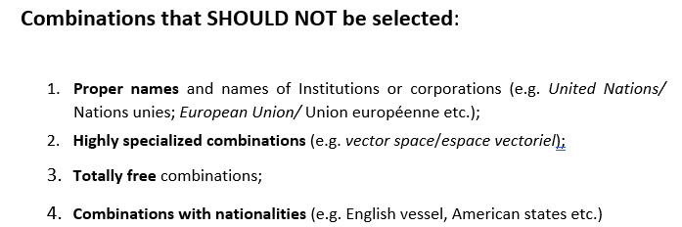
Lexico-semantic criteria for collocation identification

Slide 28
Deleted candidates
10,678 in Spanish
1,898 in Portuguese
1,656 in English
Candidates that were not collocations
PORT – primeiro ano; muito importante
ING – same thing; some country; first song
ESP – más hermoso; muy importante;
FR – aussi permettre; déjà avoir; mieux valoir

Slide 29
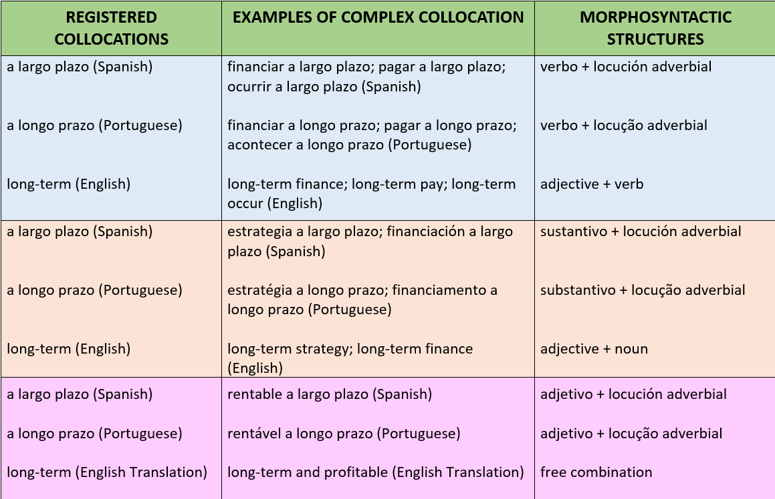
A new
category
COMPLEX
COLLOCATIONS
Koike, 2005)

Slide 30
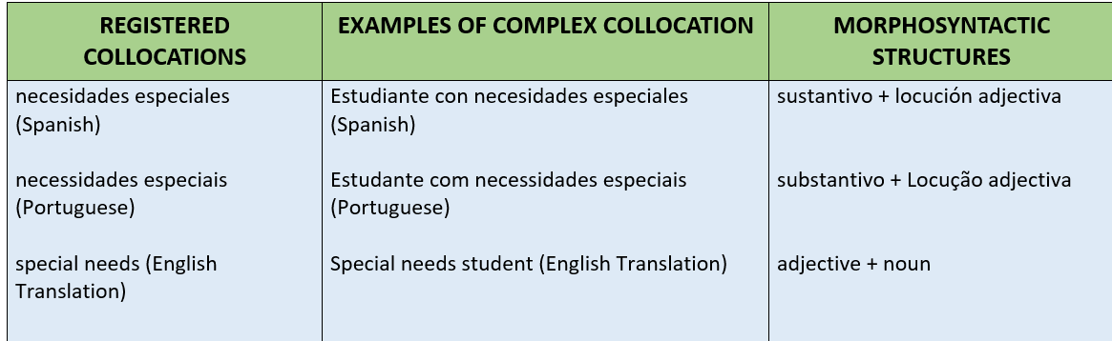
A new
category
COMPLEX
COLLOCATIONS

Slide 31
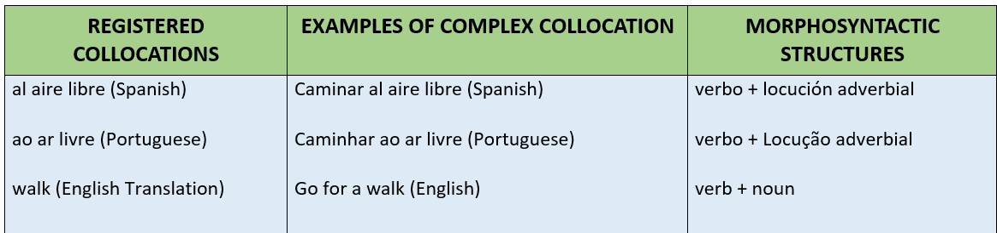
A new
category
COMPLEX
COLLOCATIONS

Slide 32
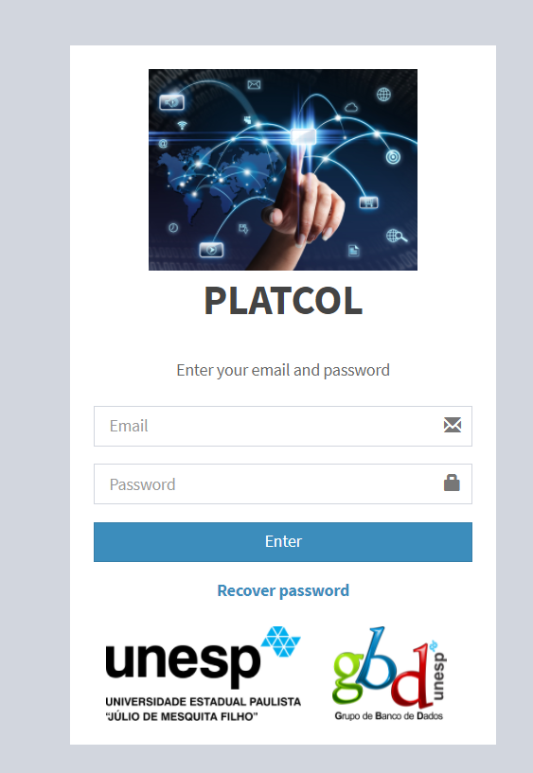

Collocations Dictionary Writing System (COLDWS) - Purposes
Better enable or enhance the post-editing of all the automatically retrieved data
Developed to specifically compile and produce collocation dictionaries, so that all automatically extracted data are automatically inserted into this COLDWS, post-edited by the lexicographers, as well as be exported to an end-user platform.
duly created to fulfill the specific needs of the collocations dictionaries.

Slide 33
Collocations Dictionary Writing System (COLDWS)
The software has a lot of functionalities – register, edit, and post-edit all dictionary information, such as:
senses
collocations
morphosyntactic structures
taxonomy of the collocations
Translations
statistical measures etc.

Slide 34
Collocations Dictionary Writing System (COLDWS)
In what concerns computational development, the COLDWS was built using languages from current and widespread programming such as Java (with Model View Controller [MVC] architecture), HTML and Javascript (jQuery library)
For the storage, consultation and deletion of entries, the relational data model with PostgreeSQL software was used in conjunction with SQL language
In addition, concepts of User Experience - UX were applied to provide a good experience for the lexicographers.

Slide 35
Collocations Dictionary Writing System (COLDWS)
http://www.institucional.grupogbd.com/dicionario2/index

Slide 39
Collocations

Slide 40
LEGAL PERSON

Slide 42
With respect to the validation process, the software will allow lexicographers to choose from three phases (traffic lights phases), indicating to users the status of the entries or collocations.
Phase 1 – data automatically inserted into the COLDWS (not revised yet): a red icon will be displayed, even to users, when exported to the end-user platform
Phase 2 – represents data revised by one member of the team (reviewer 1), but which may still need a second evaluation and/or some adjustments: an orange icon will be shown.
Phase 3 – data is checked by a second reviewer (reviewer 2) and now considered to be suitable

Slide 51
COLDWS will also be of valuable help when it comes to optimizing translation of entries or collocations
COLDWS –
Translations
For example, the collocations “develop a plan”, in English, and “desenvolver um plano”, in Portuguese, are equivalents. Similarly, the collocations “desenvolver um plano”, in Portuguese, and “desarrollar un plan”, in Spanish, also have a translation relationship.
This way, even if it has not been previously identified in the automatic extraction process, the relationship between the collocations “develop a plan” and “desarrollar un plan” will be automatically inferred.

Slide 52
COLDWS – Translations into other languages
Once translation pairs between collocations are identified and registered in the system, making up a multilingual database, it becomes possible to identify and automatically suggest new translations among other languages (Mausam et al., 2010).

Slide 53
COLDWS – Translations into other languages
This process occurs through an inference-based algorithm (e.g. Mausam et al., 2010), built from an inference hypothesis related to the composition of multiple translation dictionaries:
  If word A translates into word B which in turn translates into word C, what is the probability of C being a translation of A?

Slide 54
It shows lexicographers the possibilities of translations
They analyze the reliability and quality of the translation found (from 0 -1).

Slide 55
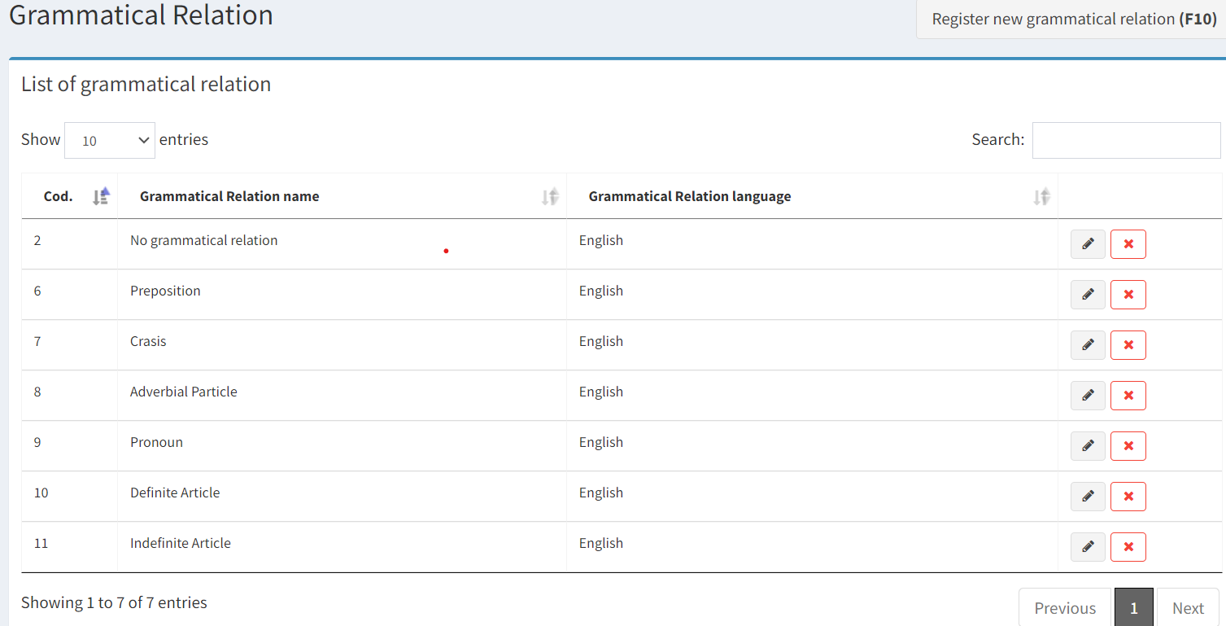
The creation of a new functionality

Slide 57
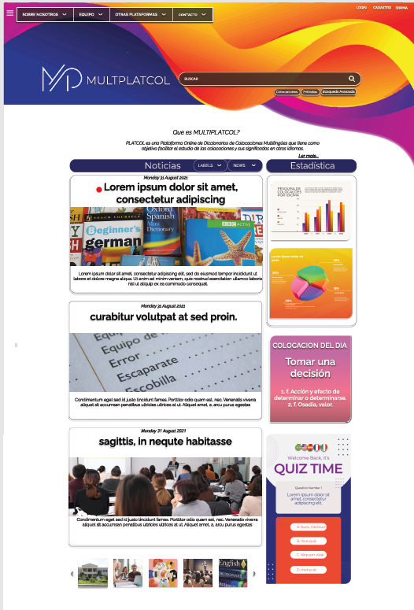

Slide 58
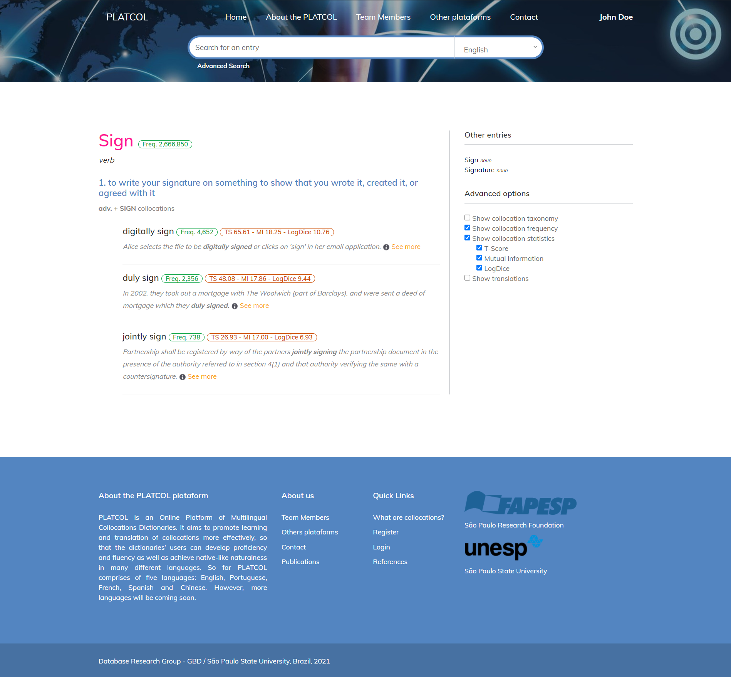
Advanced options will be available if a user opts to sign in, according to a users’ profile.
A new dictionary structure will be available as users can choose from items in a Menu

Slide 59
FUTURE WORK
Need for carrying out some minor improvements in the COLDWS.
Some macro and microstructure decisions may still be reshaped, with a view to best adjust the dictionaries to the new languages as well as to users’ different lexicographical needs – will be further discussed in future work.
Finish developing the end-user platform in order to launch PLATCOL until the October 2023!

Slide 60
Thank you!
adriane.ottaiano@unesp.br

