Slide 1
The role of the invisible lexicographer in the compilation of the Slovene dictionary of abbreviations
Associate pROFESSOR Mojca Kompara Lukančič, pHd
University of Maribor, Faculty of cRIMINAL justice and Security, Faculty of Tourism, Faculty of arts

Slide 2
Slovenski slovar krajšav - Slovene Dictionary of Abbreviations
great importance for the Slovene language
a work that comprehensively gathers Slovene abbreviations and expansions
the Slovene dictionary of abbreviations is comparable to English, German, Spanish, Italian and French dictionaries of abbreviations.
waiting for 75 years
contribution to the development and preservation of the Slovene language
Krajšave - Mala izdaja (Župančič, 1948)

Slide 3
Slovene Dictionary of Abbreviations
on a diachronic and synchronic level, it examines the position of abbreviations in Slovene language
classification of abbreviations
the position of abbreviations in Slovenian orthographic dictionaries and
general and specialized dictionaries and
examples and characteristics of dictionary entries
introduction – description of the design of the dictionary, examples of dictionary entries
a list of abbreviations and expansions
general Slovene abbreviation and terminological abbreviations

Slide 4
https://press.um.si/index.php/ump/catalog/book/759

Slide 5
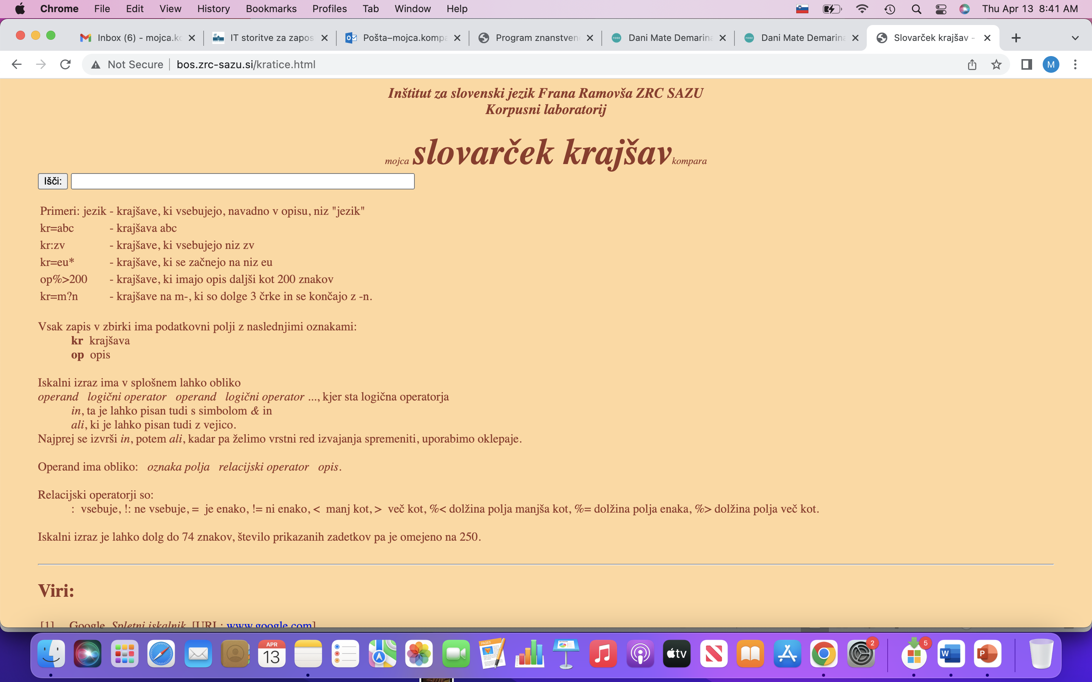
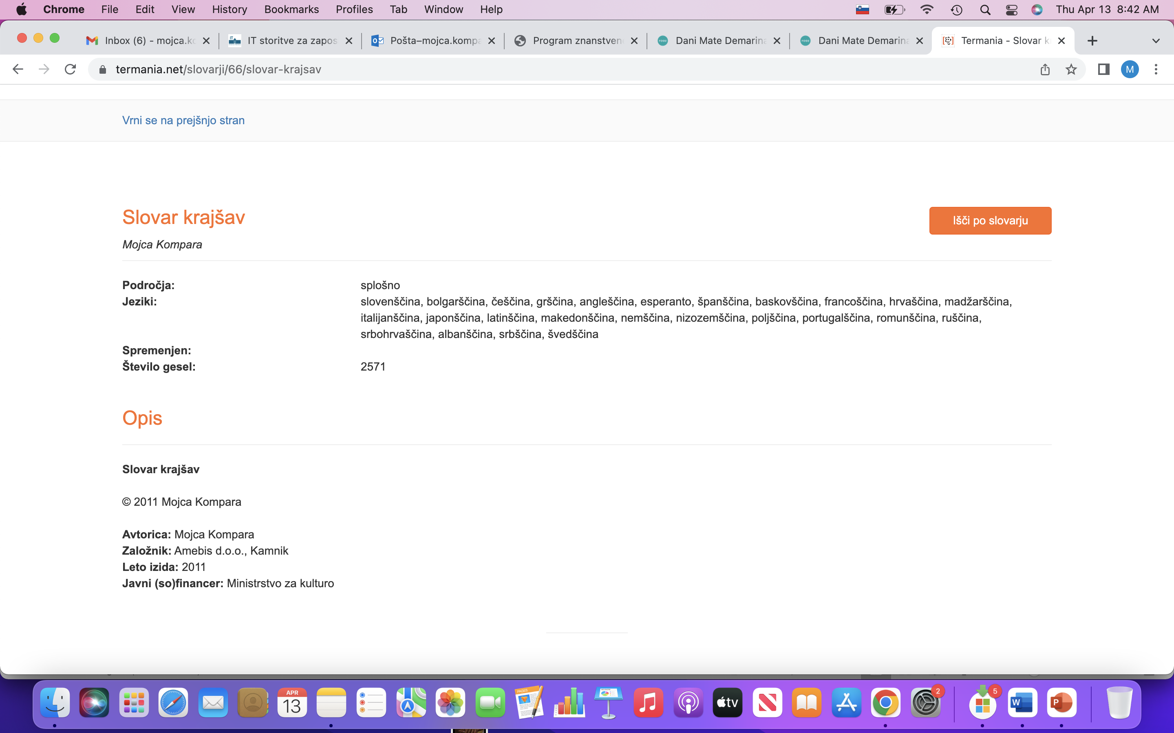
Historic overview
undergraduate student at the Faculty of Arts, University of Ljubljana
diploma, master, doctorate dissertation
scientific papers, monographs, guest lectures, conference
algorithm for automatic recognition of abbreviations and expansions in electronic texts
two experimental online dictionaries:
Manual:
http://bos.zrc-sazu.si/kratice.html
Automatic:
https://www.termania.net/slovarji/66/slovar-krajsav

Slide 6
Slovene Dictionary of Abbreviations
financed by ARRS
Faculty of Tourism (UM)
Faculty of Arts (UM)
University of Maribor Press

Slide 7
Dictionary overview

Slide 8
About abbreviations
"There are issues and problems with abbreviations" (Gabrovšek 1994: 164)
Abbreviations, these generally short, but sometimes longer, compositions of only a few letters, signs, symbols, hide a longer and more complex meaning from the eyes
almost no language is immune to abbreviations
formed on daily base; some remain in use while other disappear after some time
due to their rapid emergence and unpredictable survival in the language, it is difficult to include them in dictionaries
compilation of the dictionary - a lot of work, knowledge, experience, time etc.
when published a dictionary is already outdated

Slide 9
In English (De Sola 1986, Paxton 1983),
French (Murith and Bocabeille 1992),
German (Steinhauer 2005),
Italian (Righini 2001) and
Spanish (Galende 1997, 2000) language there are several dictionaries of abbreviations available
In Slovene language the first comparable dictionary of abbreviation was published in 2023.

Slide 10
The history
Slovarček krajšav (2006)
Prior abbreviations in - the Slovene orthographic dictionaries and the monolingual dictionaries of Slovene language.
Kratice, Mala izdaja (Župančič, 1948) - can be accessed only at the National and University Library in Ljubljana.
It covers abbreviations from the time of publication, no computer era, limited sources and no Internet - still a good work, including not only abbreviations but also an extensive supplement with symbols, currencies, measurements and also currency exchange rates.
Slovar krajšav (Kompara 2011)
Termania (http://www.termania.net/)
The dictionary is compiled automatically using an algorithm for automatic recognition of abbreviations in electronic texts,
an algorithm for automatic lemmatization of Slovene expansions and
an algorithm for language recognition.
Slovar krajšav (Kompara 2011) includes 2,570 Slovene and foreign abbreviations and is the first Slovene automatically compiled dictionary.

Slide 11
The compilation of the Slovene Dictionary of Abbreviations
material for the preparation of a multilingual dictionary of abbreviations
we focused on Slovene abbreviations
alphabetically ordered
3,400 abbreviations, more than 4,000 expansions
was created with the help of an algorithm for automatic recognition of abbreviations and abbreviations in texts
the lemmatization algorithm, language detection
manually collected abbreviations
general and terminological Slovene abbreviations
corrections
review
publication

Slide 12
Dictionary entry
A adenin alt; pevski glas → a amper as; igralna karta masno število
a alt; pevski glas → A
arranged alphabetically
two possible abbreviations – cross-reference (meaning alt in the abbreviation a)
The Slovene dictionary of abbreviations is not an explanatory dictionary – next to the expansion ther is an explanation added, e.g. singing voice, currency of Albania
adj. in the meaning of adjektiv, we also add the Slovenian equivalent, namely adjective and the Slovene abbreviation, namely prid.
adj. adjektiv; pridevnik → prid.
ALL lek; denarna enota Albanije

Slide 13
Conclusion
In the dictionary, we can find a variety of abbreviations, from general ones, e.g. abbreviations for months, days of the week, measurement units, currencies, countries, etc. to terminological ones, namely from the fields of medicine, military, economics, linguistics, etc.
It is a dictionary that was created over several years, first manually, followed by the use of software tools and the acquisition of material with the help of algorithms, namely with the long-term understanding and study of abbreviations in the Slovene language.

Slide 14
Thank you for your attention

