Slide 1
The Dark Side of the Dictionary
Robert Lew & Sascha Wolfer
eLex 2023, Brno
27th June 2023

Slide 3
Background

Slide 4
Background
the Wiktionary project (NCN Poland)
what lexical features make it more/less likely for people to consult entries?
based on Wikimedia logs of user visits to the English Wiktionary over several years
factors considered:
corpus frequency (well established)
age of acquisition
word prevalence
polysemy

Slide 5
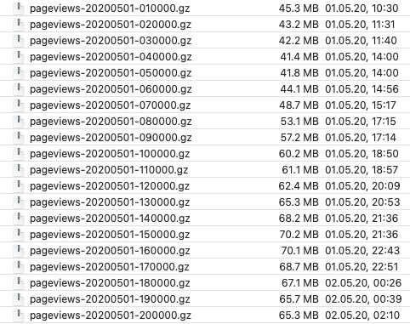
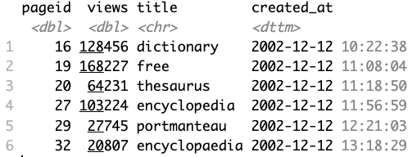
A peek at raw log view data
Wikimedia API
Selection of Wiktionary data
Aggregations for days, months, years
Notes:
On the left, each .gz file is logs for one hour of ALL Wikimedia projects.
On the right: We accessed the Wikimedia API via custom R scripts using the httr package to extract the first revision (= technical name of creation) of each entry.

Slide 6
Frequency
Frequency: strongest effect on predicted entry views
More frequent words looked up more often
In line with other recent findings
Supports reliance on corpus frequency in lexicography

Slide 7
Polysemy
Words with more senses looked up more often
Greater challenge when encountered since there are competing meaning candidates (?)

Slide 8
Age of acquisition
Words acquired later in life more likely to be looked up
Solid grasp of early words before onset of literacy, a condition for using a dictionary (?)

Slide 9
Prevalence
Words known to more people looked up less often
Small effect compared to the other predictors

Slide 10
Relative importance
corpus frequency
polysemy
AoA
prevalence
Notes:
The size of the font reflects the relative role of each factor

Slide 12
The Dark Side: Entries Unseen
Notes:
That was some Background information
Now we look at the dark side

Slide 13
The Dark Side … Entries Unseen
are lexicographers wasting time and effort making entries no-one looks at?
new dataset: logs from 2019-2021 for all entries
… cross-checked with a complete list of entries in the English lemmas Wiktionary category
overall, 1.1 billion views on 545,014 entries
101 entries never seen
3000 entries hardly seen (less than 12 times over three years)
Notes:
"Subset" might be a bit misleading because it's a A LOT MORE Wiktionary entries (over half a million vs. ~30k) but in a smaller timeframe. This is simply due to the amount of data that needs to be processed for the raw look-up data.
Further explanation: The views for the 30k entries can be extracted via the R package {pageviews} where you can specify the timeframe. This would take too long for over half a million articles. That is why we had to process the vast amount of raw look-up data for the 500k entries which is directly downloadable. We checked whether the look-up data matches up between the two sources ({pageviews} vs. downloads). It does.

Slide 14
Overall distribution of views in 2019-2021
101 entries never seen
3000 entries hardly seen ( <12 times over 3 years)
Notes:
3,020 includes the 101, and so on. Less means LESS OFTEN, because it could be a bit ambiguous, maybe some can interpret this is less time = shorter interval between views

Slide 15
Log Rank vs. Log Views
A handful of top-view entries, then inverse decay in views:
for ranks 10...10K, views↘️~3x per 10x↗️rank
for ranks 10K...300K, views↘️~10x per 10x↗️rank
sharper drop > 300K
Notes:
log-log plots are often used in visualizations of word frequencies, we can use them here accordingly. Power functions appear as straight lines in log-log plots.
BF = best friend, boyfriend, but also black female, bisexual female and a few others (so it could be confusing if sb only knows one but it doesn’t fit context)
studder = a worker who does STUDS, but Wiktionary has “Misspelling of stutter.”
1 BF
2 XXXX
3 sexy
4 XXX
5 xxx
6 sapiosexual
7 simp
8 Wikipedia
9 cookie
10 cat
11 y
12 a
13 Cookie
14 demisexual
15 what
> dat[dat$view_rank %in% as.vector(c(1,5) %o% 10^(1:5)), c('view_rank','views')] %>%
+ mutate(shift.1 = lag(views)/(views), shift.2 = lag(views, 2)/(views))
# A tibble: 10 × 4
view_rank views shift.1 shift.2
<int> <dbl> <dbl> <dbl>
1 10 751761 NA NA
2 50 287749 2.61 NA
3 100 221123 1.30 3.40
4 500 104781 2.11 2.75
5 1000 76694 1.37 2.88
6 5000 32356 2.37 3.24
7 10000 20589 1.57 3.72
8 50000 3938 5.23 8.22
9 100000 1511 2.61 13.6
10 500000 32 47.2 123.

Slide 16
Mean views per month
median entry seen 10 times a month
Notes:
This means that 10% of entries are seen more than 100 times a month each.

Slide 17
Single-word entries consulted more than multi-word entries

Slide 18
Number of words in entry title (headword)
Multi-word (> 5) viewed more?
Notes:
It would appear however, that super-multi-word entries (over five words) are viewed more, (why) is that so …. (that’s a question to audience)

Slide 19
Same limited to 50K most viewed multi-word advantage disappears
long tail of rare one-word entries
care required to avoid premature generalizations
Notes:
However, this apparent advantage of super-multi-word entries goes away when we only consider 50K most viewed items.
That’s because of the long tail of RARE ONE-WORD entries, which is bringing down the stats for single-word entries.
Careful with analysis and conclusion!

Slide 20
Top “English Proverbs”
The blind spot of lexicography: experts won’t always predict correctly what users will choose to look up, so we need actual data and studies like this
Notes:
Not only do we have THE DARK SIDE, but also THE BLIND SPOT: who would have guessed without empirical data that these are the proverbs that people look up so much???
For some of these, we tried to find specific points in time when views peaked (for example because a song containing the 'proverb' was very popular in a certain time frame). However, we did not find any clear indication of this. Invite suggestions from the audience?

Slide 21
Bonus slide: Entries are like wine (?)
probable interpretation:
more relevant words are added earlier
Notes:
It might seem that as entries age, they are appreciated more. But no, the effect is simply that more relevant words are added first, so here it’s the correct intuition of what needs to be prioritized that’s producing this effect.
NB: This is not a longitudinal analysis. One could think of this as an "apparent time" analysis: Entities from different points in time are compared at one certain point in time. Also: Do not forget that even older entries might get revised a lot in the time period shown here.

