Slide 1
How Lexicographers Evaluate User Contributions in The Thesaurus of Modern Slovene in Comparison to Dictionary Users
Magdalena Gapsa¹, Špela Arhar Holdt^{1,2}
¹ University of Ljubljana, Faculty of Arts
² University of Ljubljana, Faculty of Computer and Information Science
Magdalena.Gapsa@ff.uni-lj.si, Spela.ArharHoldt@fri.uni-lj.si
Brno, 27 June 2023

Slide 2
Thesaurus 1.0 Key Information and Functions
Digitally-born dictionary created from pre-existing language resources
Initial version generated automatically
Noise
Absence of some essential lexical information
Responsive dictionary model
Users can suggest new synonym candidates
User suggestions displayed immediately in the interface
Lexicographic review and approval process for inclusion in the database
Users can evaluate existing synonyms

Slide 3
Background
No large-scale study on the content and relevance of user-suggested data
Evaluation of the quality of user contributions.
User survey – enhancing user participation by identifying potential problems user have.
Evaluation of almost 1,000 user-suggested synonyms by a total of 42 evaluators from 7 user groups
Observing the differences between the views of lexicographers and wider language community.
Developing editorial protocols based on the needs of dictionary users.
Focus on how lexicographers evaluate user-suggested synonyms in comparison to other user groups
Testing four hypotheses about lexicographers as evaluators.
Lexicographers expected to reflect main problems and needs of the users.

Slide 4
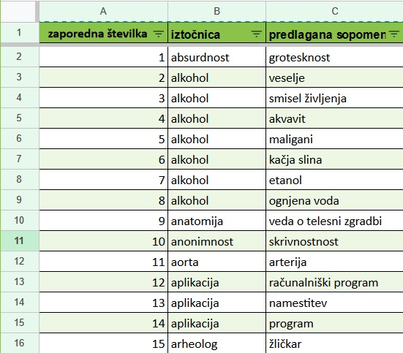
Evaluation Set
972 synonym pairs for 307 nouns (headwords)
List of nouns → openly available language resources
a) Thesaurus of Modern Slovene 1.0 database
b) sloWNet 3.1 database
c) Lexical Database for Slovene
d) Comprehensive Slovenian-Hungarian Dictionary
e) Database of nouns labelled with semantic types
User-suggested synonyms extracted from the Thesaurus of Modern Slovene 1.0 interface
Whole list of synonym pairs available to evaluators
Spreadsheet
Alphabetical order (acc. to headword)

Slide 5
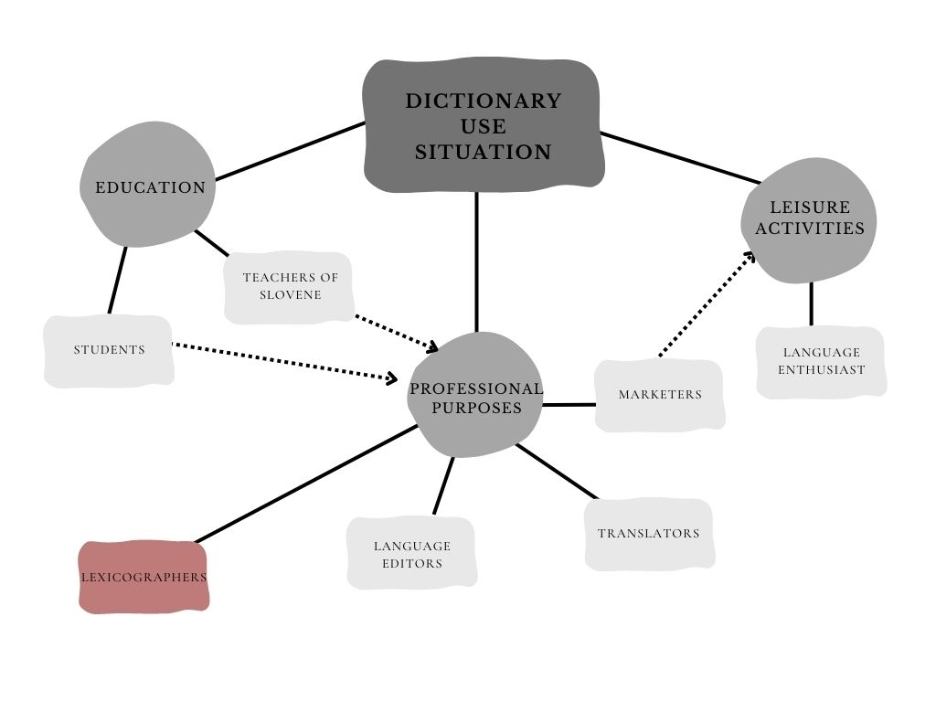
Evaluators
User groups based on typology of potential dictionary users and study on users' attitudes towards lexicographic novelties
7 groups, with 6 evaluators each = 42 evaluators
Lexicographers included due to critical role in evaluating synonyms in editorial process

Slide 6
Task and Guidelines
Main question: Are the words in the pair synonyms?
Four possible answers: Yes, No, Conditional Yes, Not Sure/Don't Know
Guidelines intentionally general, without defining synonymy or providing examples
Discouraging from consulting other language resources
Context-free word pairs to simulate Thesaurus 1.0 browsing experience
Unlimited time to answer
Evaluators could add comments for each pair
Mandatory explanation for Conditional Yes, optional for other answers

Slide 7
Lexicographers as Evaluators - Hypotheses
H1: Lexicographers’ evaluation would be more consistent, and their Inter-Annotator Agreement would be higher than in other groups.
H2: Lexicographers would argue their decisions in more detail than other groups.
H3: Lexicographers would make statistically different decisions about (un)acceptability of user-suggested synonyms and identify more potential problems with user-suggested synonyms than other groups.
H4: Lexicographers would be more reserved to include user-suggested synonyms than other groups.

Slide 8
Data Analysis
Total of 40,801 answers received
Total of 8,582 comments recorded and categorized
Evaluators‘ answers
Inter-Annotator Agreement (IAA) calculated using Krippendorff's alpha
Entropy used to determine the distribution of answers
Evaluators' comments
Manually categorized into 11 bottom-up comment categories
Additional subcategories created for specific comment types
Statistical tests conducted to identify group dependencies and significant differences

Slide 9
User group | Full IAA | Very high IAA | High IAA | TOTAL at least high IAA | Moderate IAA | Tied answers
Lexicographers | 28 (3 %) | 136 (14 %) | 341 (35 %) | 505 (52 %) | 395 (41 %) | 130 (13 %)
Language Editors | 139 (14 %) | 222 (23 %) | 286 (29 %) | 647 (67 %) | 271 (28 %) | 58 (6 %)
Language Enthusiasts | 52 (5 %) | 149 (15 %) | 336 (35 %) | 537 (55 %) | 359 (37 %) | 109 (11 %)
Marketers | 188 (19 %) | 256 (26 %) | 272 (28 %) | 716 (74 %) | 219 (23 %) | 59 (6 %)
Translators | 46 (5 %) | 195 (20 %) | 300 (31 %) | 541 (56 %) | 349 (36 %) | 32 (3 %)
Students | 34 (3 %) | 140 (14 %) | 263 (27 %) | 437 (45 %) | 396 (41 %) | 72 (7 %)
Teachers of Slovene | 165 (17 %) | 209 (22 %) | 285 (29 %) | 658 (68 %) | 255 (26 %) | 55 (6 %)
AVERAGE | 93 (10 %) | 187 (19 %) | 298 (31 %) | 577 (59 %) | 321 (33 %) | 74 (8 %)
H1: Consistency and Inter-Annotator Agreement
Hypothesis rejected: Lexicographers' answers were less consistent and more tied compared to other groups.
Second lowest total IAA (52%) among all groups.
The lowest Full IAA (3%) and Very high IAA (14%) among all groups.
The highest High IAA (35%) and the second-highest Moderate IAA (41%).
The highest number of tied answers.

Slide 10
User group | Comments made | Comments categorised
Lexicographers | 2,717 | 1,802
Language Editors | 363 | 388
Language Enthusiasts | 783 | 708
Marketers | 640 | 609
Translators | 1,234 | 1,249
Students | 2,593 | 1,845
Teachers of Slovene | 252 | 246
TOTAL | 8,582 | 6,846
AVERAGE | 1,226 | 978
H2: Detailed argumentation of the decisions
Hypothesis confirmed: Lexicographers provided more detailed and informed argumentation compared to other evaluator groups.
The most comments in total and second-highest in the number of categorized comments.
The most comments to the "Other" category.
Most subcategories within "Other" category:
💰: menstruacija ‘a menstruation’ – rdeča armada ‘red army’
📚: mandarina ‘a mandarine’ – klementina ‘a clementine’
🤝: babica 'a granny' – starejša gospa 'an elderly lady'
🖊️: parfum – parfem ‘a perfume’
🤔: alkohol ‘alcohol’ – veselje ‘a joy’
📉: avtoriteta ‘an authority’ – veščak ‘an expert’

Slide 11
H3: Focus on different problems
Hypothesis confirmed: Lexicographers identified different potential problems and their decisions differ from other groups
Comment categories – compared to other groups
More frequent:
comments on (lack of) sense disambiguation
reporting "definition" or "description" issues.
comments categorized as Other
Less frequent:
suggestions lacking essential sense component, semantic discrepancies and alternative semantic relations.
reporting unknown words or meanings.
opinion-based comments
comments on foreign word origin.
Similar:
reporting incomplete word units.
commenting on marked vocabulary.

Slide 12
H4: Rigour and reserve in incorporating user suggestions
Hypothesis partially confirmed: Lexicographers show caution and reserve in incorporating user suggestions but are rejecting suggestions less often than other groups.
Lexicographers and Students gave CONDITIONAL YES more frequently.
Lexicographers gave NO answer significantly less often than other groups and were the least strict and rigorous group.

Slide 13
Lexicographers' characteristics - summary
2 out of 4 hypotheses supported
Least consistent group with low Inter-Annotator Agreement (IAA) score and highest number of tied answers.
Non-binary response options (with CONDITIONAL YES selected most frequently)
Desire to provide users with various types (e. g. semantic and contextual) information.
Identified more potential shortcomings of the suggested synonyms
Identifying more language phenomena and operating with more precise terminology
Understanding their possible implications
Addressed issues less frequently mentioned by other evaluators.
Awareness of current limitations of the Thesaurus
Previous attempts to identify users' needs
Least rigorous group, deeming only a small portion of data unsuitable.
Desire to provide users with multiple synonym options.

Slide 14
Next Steps
Practical implications:
Guide for drafting editorial protocols and defining suitable data and additional information.
Adding new types of information to the Thesaurus, e. g. semantic disambiguation, labels, metadata.
Prioritizing issues identified in the study in further development of the Thesaurus.
Ongoing need to monitor community priorities and needs:
Ensure responsiveness of lexical resources.

Slide 15
Wednesday, 28 June 2023, 14.00: Thesaurus of Modern Slovene 2.0
Want
to
know more?
Stay connected!
Magdalena.Gapsa@ff.uni-lj.si
Spela.ArharHoldt@fri.uni-lj.si
Centre for Language Resources and Technologies (CJVT UL):
Website: www.cjvt.si
Facebook: Center za jezikovne vire in tehnologije
Questions? Comments?
Thoughts?

