Slide 1
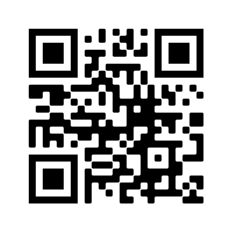
Towards a comprehensive dictionary of Middle Persian
Francisco MONDACA, Kianoosh REZANIA, Claes NEUEFEIND, Slavomír ČÉPLÖ

Slide 2
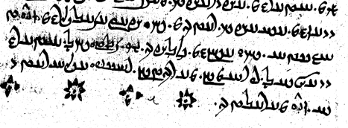
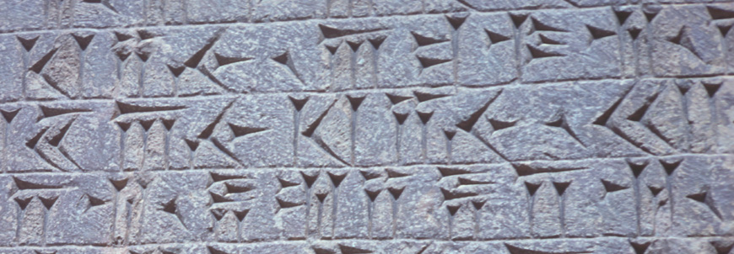
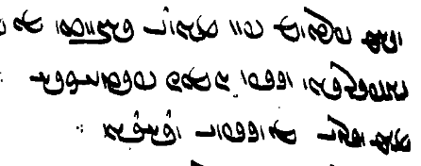
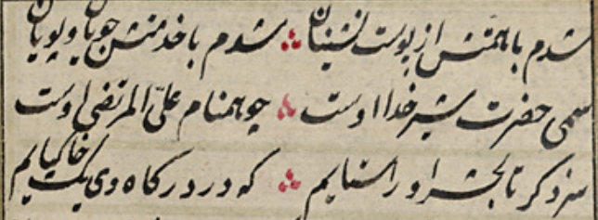
Avestan
(Image Pr1 f. 89b © TITUS project)
~1000 BCE
Middle Persian
MPCD
Lexicography
Modelling a dictionary
- with RelaxNG
Modelling lexical data
- with Django
~600 BCE
~300 BCE
Old Persian
(Image © Wikimedia Commons)
~0 CE
~500 CE
Middle Persian ( = Pahlavi)
(Image Dk Ms. B, Dresden 1966: 552)
New/Modern Persian
(Image TG 14 f. 595 © ULIB.sk)
~800 CE
2023

Slide 3
Best attested Middle Iranian language
Lingua franca of the multilingual Sassanian empire (224 CE – 651 CE)
Along with Avestan, main language of Zoroastrianism
Also used by adherents of Manicheism and Christianity
Cultural mediator, large influence on Jewish Aramaic and Syriac cultures
Written in various scripts (Pahlavi, Manicheic, Perso-Arabic) on various materials
Middle Persian
MPCD
Lexicography
Modelling a dictionary
- with RelaxNG
Modelling lexical data
- with Django

Slide 4
Zoroastrian Middle Persian
~85% of all Middle Persian texts (~700k tokens)
Manichean Middle Persian 5%
Oldest extant codices date to 14th century CE
Not all strictly religious:
Middle Persian
MPCD
Lexicography
Modelling a dictionary
- with RelaxNG
Modelling lexical data
- with Django
ZAND | NON-ZAND
Zand proper | Theological
Zand-based | Juridical
 | Moral-didactic
 | Narrative
 | Ritual

Slide 5
Zoroastrian Middle Persian
Not all texts are well edited
Various editions of minor works, large works still unedited
Mostly dead tree editions
Electronic corpora: TITUS*, Pārsīg**
Edited texts only, no annotation
No connection to manuscripts
Middle Persian
MPCD
Lexicography
Modelling a dictionary
- with RelaxNG
Modelling lexical data
- with Django
* https://titus.uni-frankfurt.de/indexe.htm?/index.htm#Dtabelle
** https://www.parsigdatabase.com/

Slide 6
Middle Persian Corpus and Dictionary
DFG Langfristvorhaben 2021-2030
CERES Ruhr-Universität Bochum + Freie Universität Berlin + Universität zu Köln
Aims to create a proper corpus of Zoroastrian Middle Persian
Based on actual language (i.e. manuscripts)
Richly annotated
Orthographically & phonographically
Morpho-syntactically (UD treebank)
Semantically
Intertextually (linking Zand to Avestan originals)
Connected with a dictionary
Middle Persian
MPCD
Lexicography
Modelling a dictionary
- with RelaxNG
Modelling lexical data
- with Django

Slide 7
Manichean Middle Persian
Better resourced (Durkin-Meisternernst 2004)
Sasanian Middle Persian
Back 1978; Humbach & Skjærvø 1980, 1983; all in need of updating
Zoroastrian Middle Persian
Standard dictionaries: Nyberg 1928, MacKenzie 1971, Nyberg 1974
Cca, 3000 lemmata, do not include Zand
Zand: Dhabhar 1949; Kapadia 1953
Largest part of the ZMP corpus > glossaries to text editions
Middle Persian
MPCD
Lexicography
Modelling a dictionary
- with RelaxNG
Modelling lexical data
- with Django

Slide 8
Middle Persian
MPCD
Lexicography
Modelling a dictionary
- with RelaxNG
Modelling lexical data
- with Django
MacKenzie 1971: 66

Slide 9
GOOD printed dictionaries as paragons?
Lemmas, morphosyntactic information
Including derivational morphology
Etymology
Meaning hierarchy,
Special use (termini technici)
Linking with corpus, other resources
> HOW TO?
Middle Persian
MPCD
Lexicography
Modelling a dictionary
- with RelaxNG
Modelling lexical data
- with Django

Slide 10
Step 1: integrate annotation + lexicography
CoNLL-U > M(iddle)P(ersian)T(able)F(ormat)
Added fields for meaning and term._tech._(cat.)
representation of MWEs
Middle Persian
MPCD
Lexicography
Modelling a dictionary
- with RelaxNG
Modelling lexical data
- with RelaxNG
- with Django

Slide 11
lemma
meaning
term._tech._(cat.)

Slide 12
Step 2: Model dictionary entries in RelaxNG
entry = element entry {
attribute entryId {xsd:ID}, # unique ID for the entry
element lemma {xsd:string}, # the normalized form
headword?, # e.g. verbs with different infinitive forms and present stems
language,
attribute crossRef {xsd:IDREF},
morphology, # different components shown in different locations, see infra
timeline, # shows the frequency of the occurrences of the lemma in different cent.
element relativeFrequency {xsd:string}, # from corpus, per 100,000; string types, # all unique attested types in the corpus linked to the lemma
orthographicVariants, # union of transliterations
occurrences, # union of all unique occurrences/attestations
hierarchizedSenses,
internalReferences?,
equivalents?,
etymology?,
biblioEntry?,
comment?, attribute stage {"inprogress" | "finished" | "published"},
attribute DOI {xsd:anyURI}
}
Middle Persian
MPCD
Lexicography
Modelling a dictionary
- with RelaxNG
Modelling lexical data
- with Django

Slide 13
Step 2: Model dictionary entries in RelaxNG
Middle Persian
MPCD
Lexicography
Modelling a dictionary
- with RelaxNG
Modelling lexical data
- with Django
hierarchizedSenses = element hierarchizedSenses { # one per entry
semantic+
}
semantic = element semantic {
attribute serialId {xsd:int}, # internal numbering
node?,
semanticCore,
pos?,
element morphologicalForms {morphologicalForm+},
element mwes {mwe*} # alphabetic sorted
}

Slide 14
Step 2: Model dictionary entries in RelaxNG
semanticCore = element semanticCore {
element sense {xsd:string},
# in the case of term. tech. = its definition
element explanation {xsd:string}?,
# explanation may include detailed description of the use
element grammar {xsd:string}?,
# reference to the taxonomy
element semanticDomain {concept+}?,
termTech?,
occurrences
}
Middle Persian
MPCD
Lexicography
Modelling a dictionary
- with RelaxNG
Modelling lexical data
- with Django

Slide 15
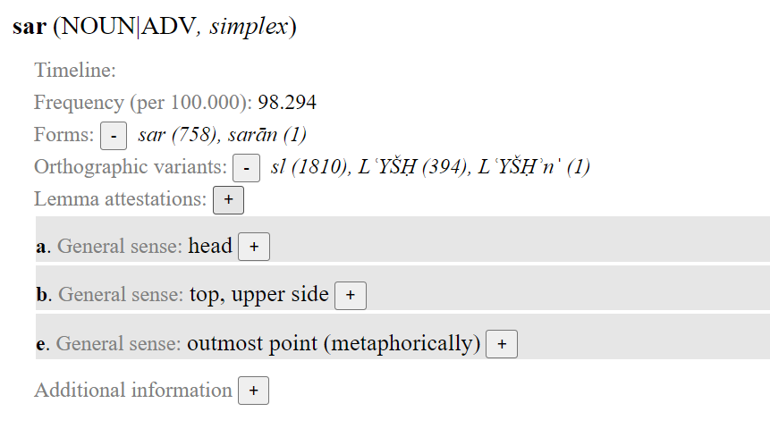
Step 2: Model dictionary entries in RelaxNG
Middle Persian
MPCD
Lexicography
Modelling a dictionary
- with RelaxNG
Modelling lexical data
- with Django

Slide 16
Prototypical categories
Middle Persian
MPCD
Lexicography
Modelling a dictionary
- with RelaxNG
Modelling lexical data
- with Django
POS
transcription
translit.
[MPTF fields]
LEMMA
MEANING
TOKEN

Slide 17
MWEs
Less prototypical categories
Middle Persian
MPCD
Lexicography
Modelling a dictionary
- with RelaxNG
Modelling lexical data
- with Django
POS
transcription
TAXONOMY
translit.
[MPTF fields]
LEMMA
MEANING
TOKEN

Slide 18
Technical implementation
BACKEND:
Django
GraphQL
Lexical Markup Framework for the handling of MWEs
FRONTEND
ReactJS
REST APIs
Middle Persian
MPCD
Lexicography
Modelling a dictionary
- with RelaxNG
Modelling lexical data
- with Django

Slide 19
class Lemma(models.Model):
id = models.UUIDField(primary_key=True, default=uuid_lib.uuid4, editable=False)
word = models.CharField(max_length=100)
language = models.CharField(max_length=3, null=True, blank=True)
categories = ArrayField(
models.CharField(max_length=50, blank=True, null=True), null=True, blank=True
)
multiword_expression = models.BooleanField(default=False)
related_lemmas = models.ManyToManyField(
"self", blank=True, related_name="lemma_related_lemmas", through="LemmaRelation"
)
related_meanings = models.ManyToManyField(
"Meaning",
blank=True,
related_name="lemma_related_meanings",
through="LemmaMeaning",
)
…
Middle Persian
MPCD
Lexicography
Modelling a dictionary
- with RelaxNG
Modelling lexical data
- with Django

Slide 20
class Meaning(models.Model):
id = models.UUIDField(primary_key=True, default=uuid_lib.uuid4, editable=False)
meaning = models.TextField(null=True, blank=True, db_index=True)
lemma_related = models.BooleanField(default=True)
language = models.CharField(max_length=10, blank=True, null=True, db_index=True)
related_meanings = models.ManyToManyField('self', blank=True, related_name='meaning_related_meanings')
created_at = models.DateTimeField(auto_now_add=True)
def related_lemmas(self):
return self.lemma_related_meanings.all()
Middle Persian
MPCD
Lexicography
Modelling a dictionary
- with RelaxNG
Modelling lexical data
- with Django

Slide 21
CURRENT STATUS
No actual model for entry
At the moment, it is not required
… but can be easily added any time due to the flexibility of the entire model
FUTURE WORK
full-fledged lexicographic tool adaptable to any language
ElasticSearch-based semantic search
First based on English meanings and taxonomies
Word-embedding model for Middle Persian
Middle Persian
MPCD
Lexicography
Modelling a dictionary
- with RelaxNG
Modelling lexical data
- with Django

Slide 22
Middle Persian
MPCD
Lexicography
Modelling a dictionary
- with RelaxNG
Modelling lexical data
- with Django
http://mpcorpus.org
https://bulbul.sk/MPCD/
(sample dictionary entries)

