Slide 1
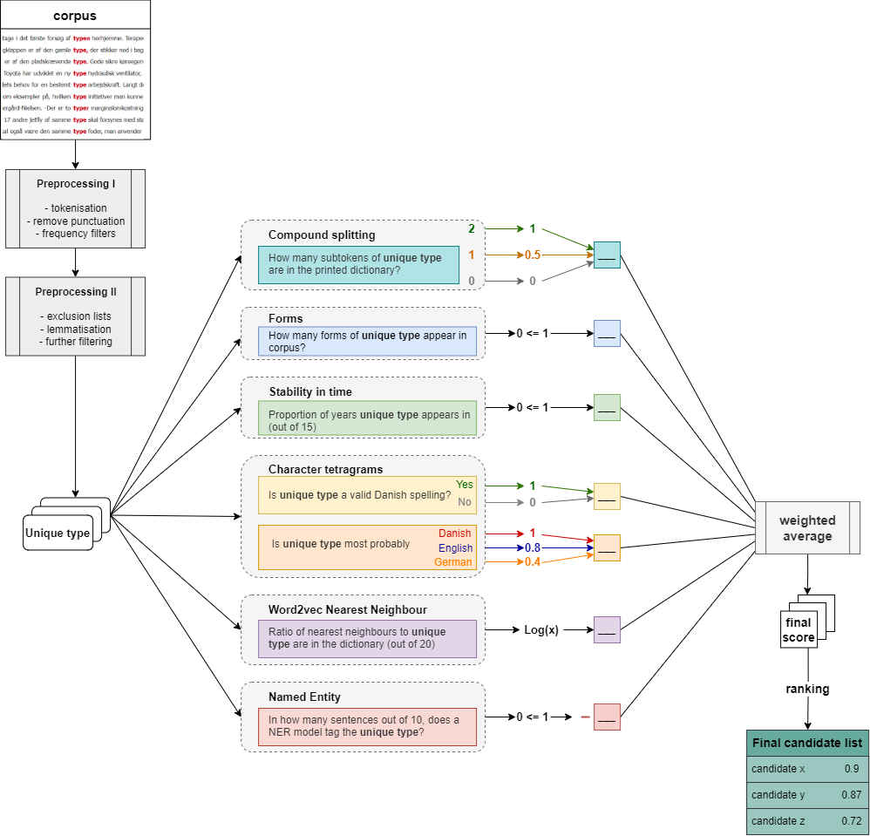
Trawling the Corpus for the Overlooked Lemmas
The Danish Dictionary (DDO)
A corpus-based online monolingual dictionary
Continuously updated with new words and senses
How do we find the mundane lemmas that our previous lemma selection methods have overlooked?

