Slide 1


Thesaurus of Modern Slovene 2.0
[Brno, 28. 6. 2023]
Špela Arhar Holdt^{1,2}, Polona Gantar¹, Iztok Kosem^{1,3}, Eva Pori¹, Marko Robnik-Šikonja², Simon Krek^{1,3}
¹Faculty of Arts, University of Ljubljana, Slovenia
²Faculty of Computer and Information Science, University of Ljubljana, Slovenia
³Jožef Stefan Institute, Slovenia

Slide 2
Outline
Responsive Dictionary Model
Novelties in 2.0
Sense divided entries and labels for negative vocabulary
Future work
Thesaurus 2.0 demo
Thesaurus of Modern Slovene 2.0

Slide 3
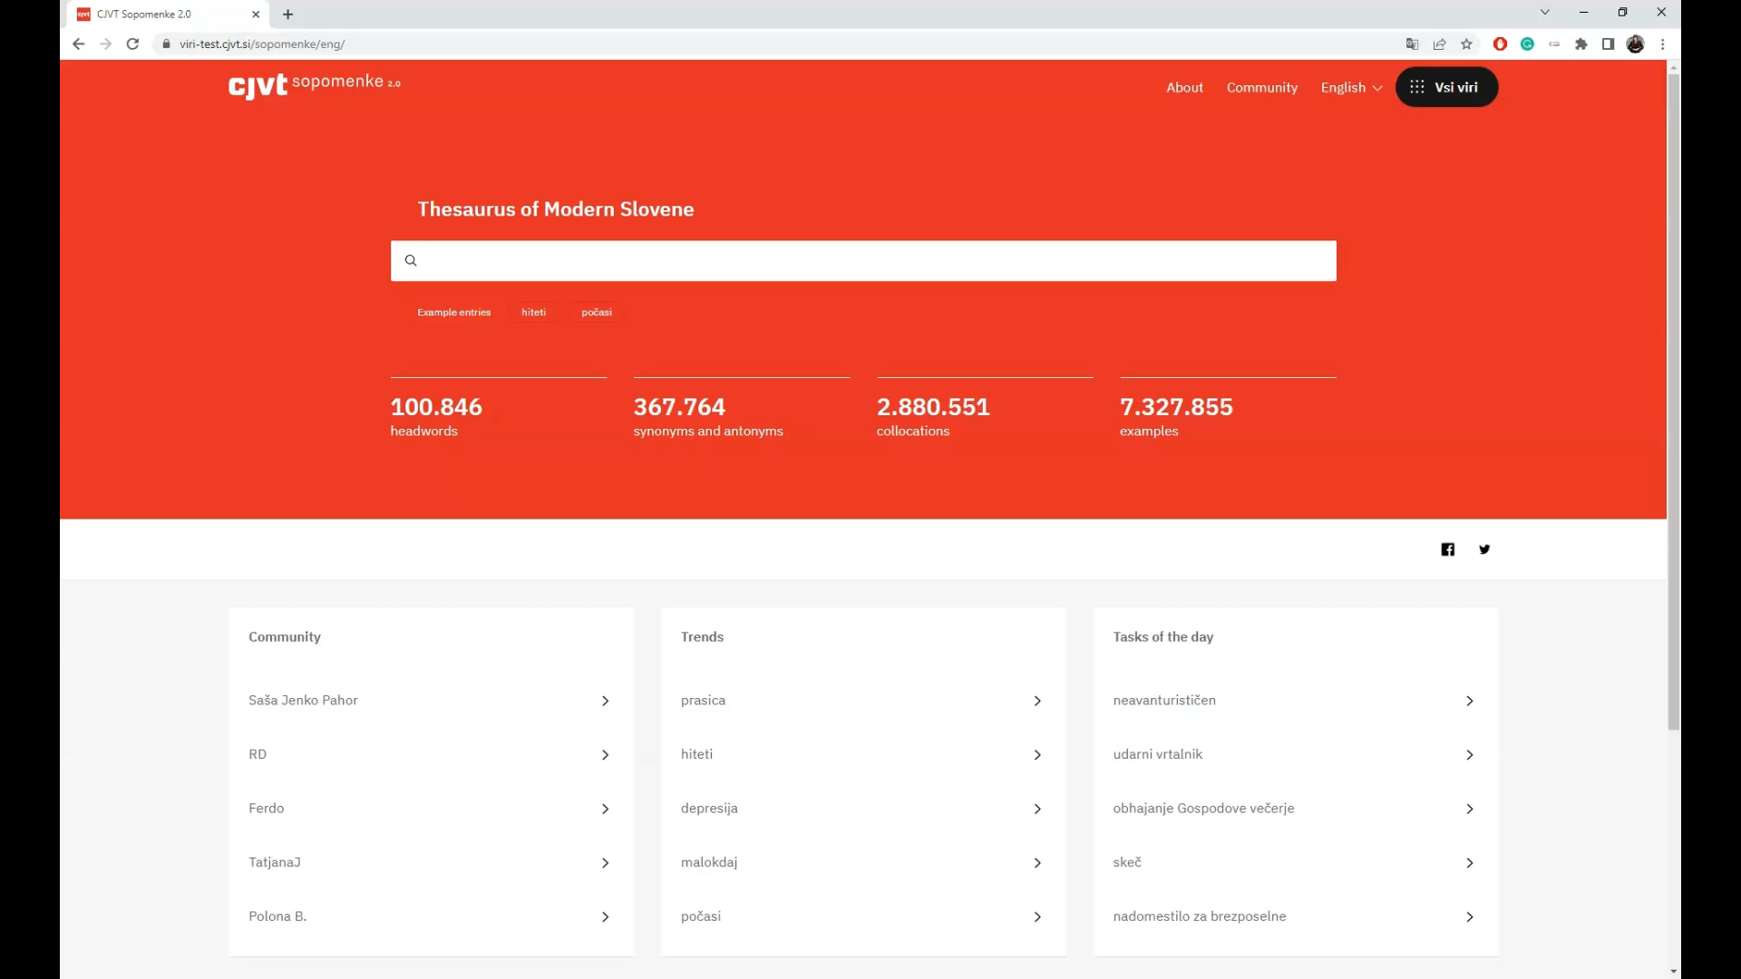
Thesaurus of Modern Slovene 2.0
Thesaurus of Modern Slovene 2.0

Slide 4
Responsive Dictionary Model
It responds to language change and the feedback from the language community.
Developed specifically for the digital medium.
The database is constructed entirely automatically from pre-existing resources, and released to the community as soon as it is linguistically evaluated as relevant.
  Thesaurus 1.0 was created from the Oxford®-DZS Comprehensive English-Slovenian Dictionary and the Gigafida reference corpus of written Slovene (Krek et al., 2017).
The dictionary is gradually improved through editing which involves both lexicographic work and user participation.
  In the Thesaurus, users can contribute by voting and by adding their own suggestions of missing synonyms / antonyms.
As the data evolves, the changes are transparently tracked and archived.
The database is openly accessible for further use – fast access to open language data!
Read more in Arhar Holdt et al. 2018.
Thesaurus of Modern Slovene 2.0

Slide 5
Thesaurus of Modern Slovene 1.0 | Thesaurus of Modern Slovene 2.0
Entirely automatically created. | Partially manually revised and edited.
Headwords in form of lemmata (no metadata to help disambiguate between forms). | Included information on part-of-speech, corpus frequency, and disambiguated entries.
Automatically obtained semantic clusters. | Lexicographic sense division for 2.000 entries.
Only domain dictionary labels. | Also labels for negative vocabulary.
Users can‘t add labels in a systematic way. | Users can add labels in a systematic way.
Only synonyms. | Also 2,544 antonym pairs.
Stand-alone database. | Stand-alone database and integration into the Digital Dictionary Database for Slovene.
No analyses of the selected grammatical relations for the comparative collocate view. | Analysed and improved set of grammatical relations and improved collocation extraction.
No large-scale analyses of user-suggested synonyms. | Analyses and pilot evaluation of user-suggested synonyms: editorial guideliness for 3.0.
Thesaurus 1.0
Thesaurus of Modern Slovene 2.0

Slide 6
Sense Divided Entries
Selecting 2,000 headwords considering POS, number of senses, dictionary labels, and potentially offensive vocabulary.
Equipping the headwords with semantic indicators – from the Comprehensive Slovenian-Hungarian Dictionary (Kosem et al., 2021b) and newly prepared.
  for the verb hiteti ‘to hurry’: [1: with an activity] / [2: of movement] / [3: of passing time].
Attributing the synonyms for these headwords to the corresponding senses.
Checking the usage of words in various corpora and other resources: the reference corpus of written Slovene Gigafida 2.0, the Monitor corpus of Slovene Trendi, the JANES corpus of Slovene user-generated content 1.0, and KAS corpus of academic Slovene 2.0.
Removing candidates when usage could not be confirmed. With borderline candidates, we chose to prioritize inclusion over exclusion (in line with the responsive model).
Exporting data from the dictionary database to a tabular form (Google Sheets), editing and validating the data, and importing it back into the database.
Thesaurus of Modern Slovene 2.0

Slide 7
Negative Vocabulary
Automatically extracted data appeared without usage warnings even in highly problematic cases (peder, črnuh). Users were also adding marked vocabulary to marked headwords.
We decided to label all negative vocabulary (social sensitivity, pedagogic use).
The database was checked to identify potentially problematic vocabulary: first step with the help of students, 1.810 synonym sets reviewed by lexicographers (Arhar Holdt et al. 2023).
Checking the usage of words in various corpora and other resources and labeling.
Two types of cases: problematic in all senses (zajebati) and problematic in (a) cetrain sense(s) (nategniti) – the latter were included among the headwords for sense division.
Labeling system is based on the dictionary style guide used for developing lexicographic resources (including the Digital Dictionary Database) at CJVT.
Three distinct labels: hateful, coarse, and expresses negative attitude.
Thesaurus of Modern Slovene 2.0

Slide 8
Negative Vocabulary
In the interface: labels, clickable icons with explanation of the potential impact the use of the labeled word can have. Users can also chose to add these labels to their suggestions.
peder (‘a faggot’), črnuh (‘a nigger’), čifut (‘a kike’)
jeba (‘fuck it’), drek (‘shit’),
nascati (‘to piss someone’ = ‘to double-cross’)
trapa (‘a bimbo’), blefer (‘a phony’), beznica (‘a dive’)
work in progress
Thesaurus of Modern Slovene 2.0

Slide 9
Future Work: Thesaurus 3.0
Continue the work on labeling negative vocabulary and sense divided entries.
Evaluate (60,976) user suggestions and include the relevant ones into the database.
Further work on the automatically extracted antonyms (promising results that require further evaluation and more extensive implementation).
Further work on the selection and visualization of collocates for comparing the use of synonyms and antonyms.
Linking the data with the new version of Slovene Wordnet (project „Slokit“, leader S. Krek).
(Hopefully) another large-scale user study on the new features (last one Arhar Holdt 2020).
…
Thesaurus of Modern Slovene 2.0

Slide 10


Thank you for your attention!
https://viri-test.cjvt.si/sopomenke/eng/
The authors acknowledge that the project Empirical foundations for digitally-supported development of writing skills (J7-3159) and the programmes Language Resources and Technologies for Slovene (P6-0411) and Slovene Language – Basic, Contrastive, and Applied Studies (P6-0215) were financially supported by the Slovenian Research Agency. The project Upgrading fundamental dictionary resources and databases of CJVT UL was funded by the Ministry of Culture of the Republic of Slovenia in the period 2021–2022.
Spela.ArharHoldt@ff.uni-lj.si
Thesaurus of Modern Slovene 2.0

Slide 11
References
Arhar Holdt. Š. (2023, in press). Negativno zaznamovano besedišče v Slovarju sopomenk sodobne slovenščine 2.0. Slovenščina 2.0.
Arhar Holdt, Š. (2021). Kolokacije v Slovarju sopomenk sodobne slovenščine: evalvacija podatkov in predlog za izboljšavo. In I. Kosem (ed.) Kolokacije v slovenščini. Ljubljana: Znanstvena založba Filozofske fakultete, pp. 269–296. Available at: https://ebooks.uni-lj.si/zalozbaul//catalog/view/318/465/6967-1
Arhar Holdt, Š. (2020). How users responded to a responsive dictionary: the case of the Thesaurus of Modern Slovene. Rasprave Instituta za hrvatski jezik i jezikoslovlje, 46(2), pp. 465–482. doi: 10.31724/rihjj.46.2.1
Arhar Holdt, Š., Čibej, J., Dobrovoljc, K., Gantar, P., Gorjanc, V., Klemenc, B., Kosem, I., Krek, S., Laskowski, C. & Robnik-Šikonja, M. (2018b). Thesaurus of Modern Slovene: By the Community for the Community. In J. Čibej, V. Gorjanc, I. Kosem & S. Krek (eds.) Proceedings of the XVIII EURALEX International Congress: Lexicography in global contexts. Ljubljana: Znanstvena založba Filozofske fakultete, pp. 401–410. Available at: https://e-knjige.ff.uni-lj.si/znanstvena-zalozba/catalog/view/118/211/3000-1
Devlin, J., Chang, M.W., Lee, K., & Toutanova, K. (2019). BERT: Pre-training of Deep Bidirectional Transformers for Language Understanding. In J. Burstein, C. Doran & T. Solorio (eds.) Proceedings of the 2019 Conference of the North American Chapter of the Association for Computational Linguistics: Human Language Technologies. Minneapolis, Minnesota. Association for Computational Linguistics, pp. 4171–4186. Available at: https://aclanthology.org/N19-1.pdf
Čibej, J. & Arhar Holdt, Š. (2019). Repel the syntruders! A crowdsourcing cleanup of the thesaurus of modern Slovene. A crowdsourcing cleanup of the thesaurus of modern Slovene. In I. Kosem et al. (eds.) Proceedings of the eLex 2019 conference, Electronic lexicography in the 21st century: Smart lexicography. Sintra, Portugal. Brno: Lexical Computing, pp. 338–356. Available at: https://elex.link/elex2019/wp-content/uploads/2019/09/eLex_2019_19.pdf
Fišer, D., Ljubešić, N. & Erjavec, T. (2020). The Janes project: language resources and tools for Slovene user generated content. Language resources and evaluation, 54(1), pp. 223–246. doi: 10.1007/s10579-018-9425-z
Gapsa, M. (2023, preprint). “But why??” Evaluation of user-suggested synonyms in the Thesaurus of Modern Slovene. Research Square. doi: 10.21203/rs.3.rs-2775161/v1
Gapsa, M. & Arhar Holdt, Š. (2023, in reviews). How Lexicographers Evaluate User Contributions in The Thesaurus of Modern Slovene in Comparison to Dictionary Users. In Electronic lexicography in the 21st century. Invisible Lexicography. Proceedings of the eLex 2023 conference. Brno, Czech Republic.
Kilgarriff, A., Baisa, V., Bušta, J., Jakubíček, M., Kovář, V., Michelfeit, J., Rychlý, P. & Suchomel, V. (2014). The Sketch Engine: ten years on. Lexicography, 1(1), pp. 7–36. doi: 10.1007/s40607-014-0009-9
Kosem, I., Čibej, J., Dobrovoljc, K., Erjavec, T., Ljubešić, N., Ponikvar, P., Šinkec, M. & Krek, S. (2022). Monitor corpus of Slovene Trendi 2022-10, Slovenian language resource repository CLARIN.SI, http://hdl.handle.net/11356/1681.
Kosem, I., Krek, S. & Gantar, P. (2021a). Semantic data should no longer exist in isolation: the Digital Dictionary Database of Slovenian. In Z. Gavriilidou, L. Mitits, S. Kiosses (eds.), EURALEX XIX, Congress of the European Association for Lexicography, Lexicography for inclusion. Komotini: Democritus University of Thrace, pp. 81–83. Available at: https://euralex2020.gr/wp-content/uploads/2021/09/EURALEX2020_BookOfAbstracts-Preview-1.pdf
Kosem, I., Bálint Čeh, J., Ponikvar, P., Zaranšek, P., Kamenšek, U., Koša, P., Gróf, A., Böröcz, N., Harmat Császár, J., Szíjártó, I., Šantak, B., Gantar, P., Krek, S., Roblek, R., Zgaga, K., Logar, U., Pori, E., Arhar Holdt, Š. & Gorjanc, V. (2021b). Comprehensive Slovenian-Hungarian Dictionary 1.0, Slovenian language resource repository, CLARIN.SI, http://hdl.handle.net/11356/1453.
Kosem, I., Gantar, P., Krek, S., Arhar Holdt, Š., Čibej, J., Laskowski, C., Pori, E., Klemenc, B., Dobrovoljc, K., Gorjanc, V. & Ljubešić, N. (2019). Collocations Dictionary of Modern Slovene KSSS 1.0, Slovenian language resource repository CLARIN.SI, http://hdl.handle.net/11356/1250.
Kosem, I., Krek, S., Gantar, P., Arhar Holdt, Š., Čibej, J., Laskowski, C. A. et al. (2018). Collocations dictionary of modern Slovene. In J. Čibej et al. (eds.) Proceedings of the 18th EURALEX International Congress: lexicography in global contexts. Ljubljana: Ljubljana University Press, Faculty of Arts, pp. 989–997. Available at: https://e-knjige.ff.uni-lj.si/znanstvena-zalozba/catalog/view/118/211/3000-1
Krek, S., Gantar, P., Kosem, I. & Dobrovoljc, K. (2021). Opis modela za pridobivanje in strukturiranje kolokacijskih podatkov iz korpusa. In Š. Arhar Holdt (ed.) Nova slovnica sodobne standardne slovenščine. Ljubljana: Znanstvena založba Filozofske fakultete, pp. 160–194. Available at: https://ebooks.uni-lj.si/zalozbaul//catalog/download/325/477/7320-1?inline=1
Krek, S., Arhar Holdt, Š., Erjavec, T., Čibej, J., Repar, A., Gantar, P., Ljubešić, N., Kosem, I., Dobrovoljc, K. (2020). Gigafida 2.0: the reference corpus of written standard Slovene. In N. Calzolari (ed.) LREC 2020: Twelfth International Conference on Language Resources and Evaluation: May 11-16, 2020, Palais du Pharo, Marseille, France. Paris, ELRA - European Language Resources Association, pp. 3340-3345. Available at: http://www.lrec-conf.org/proceedings/lrec2020/LREC-2020.pdf
Krek, S., Laskowski, C., Robnik Šikonja, M., Kosem, I., Arhar Holdt, Š., Gantar, P., Čibej, J., Gorjanc, V., Klemenc, B. & Dobrovoljc, K. (2018). Thesaurus of Modern Slovene 1.0., Slovenian language resource repository CLARIN.SI, http://hdl.handle.net/11356/1166.
Krek, S., Laskowski, C. & Robnik Šikonja, M. (2017). From translation equivalents to synonyms: creation of a Slovene thesaurus using word co-occurrence network analysis. In I. Kosem et al. (eds.) Proceedings of eLex 2017: Lexicography from Scratch. Leiden, Netherlands, pp. 93–109. Available at: https://elex.link/elex2017/wp-content/uploads/2017/09/paper05.pdf
Logar Berginc, N., Grčar, M., Brakus, M., Erjavec, T., Arhar Holdt, Š. & Krek, S. (2012). Korpusi slovenskega jezika Gigafida, KRES, ccGigafida in ccKRES: gradnja, vsebina, uporaba. Ljubljana: Trojina, zavod za uporabno slovenistiko; Fakulteta za družbene vede. doi: 10.4312/9789610603542
Pegan, J., Robnik-Šikonja, M., Kosem, I., Gantar, P., Ponikvar, P. & Laskowski, C. (2022). Slovenian datasets for contextual synonym and antonym detection, Slovenian language resource repository CLARIN.SI, http://hdl.handle.net/11356/1694.
Ulčar, M. & Robnik-Šikonja, M. (2020). FinEst BERT and CroSloEngual BERT: less is more in multilingual models. In P. Sojka (ed.) Proceedings of Text, Speech, and Dialogue: 23rd International Conference. Brno, Czech Republic. Cham: Springer, pp. 104–111. doi: 10.1007/978-3-030-58323-1_11
Žagar, A., Kavaš, M., Robnik Šikonja, M. (2021). Corpus KAS 2.0: Cleaner and with New Datasets. In Proceedings of the 24th International Multiconference – IS2021 (Slovenian Conference on Artificial Intelligence). Available at: https://doi.org/10.5281/zenodo.5562228
Thesaurus of Modern Slovene 2.0

