Slide 1
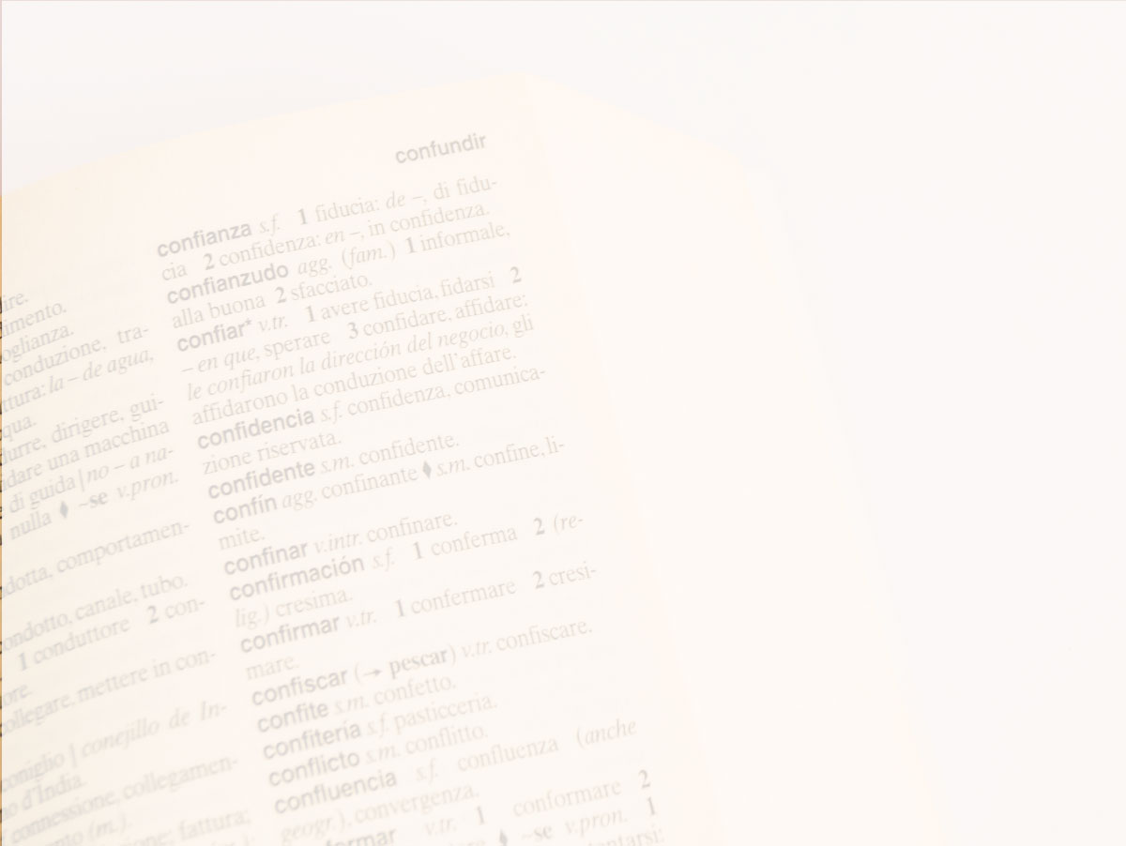
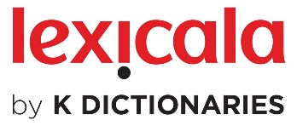
eLex 2023 Brno
Invisible lexicography enhances machine translation
Ilan Kernerman

Slide 2
STATEMENT
The use of lexicographic resources can enhance the quality of machine translation !

Slide 3
HIGHLIGHTS
Machine Translation shortcomings
Multilingual parallel corpora projects
Chat-GPT MT preliminary conclusions
Lexicography qualities
Use case

Slide 4
MACHINE TRANSLATION
Neural MT
big data
machine learning
training models
Generative AI
massive data
large language models
cross-lingual extrapolation
quality evaluation

Slide 5
MT FLAWS (1)
Web-crawled data
noise
MT origin
copyright issues
terms of use

Slide 6
MT FLAWS (2)
Grammar/Syntax
gender/number errors
wrong verb tense
coreference problems
wrong inflections
misinterpreted grammatical inflections

Slide 7
MT FLAWS (3)
Failed language identification
Incorrect alignment
Wrong tokenization (no separator between words)
Trademarks translated (e.g. Nike Air)
Inconsistent reference to same object/person
Lexical errors
omitted/added words
wrong lexical item
Awkward/unidiomatic language usage
Failure to use commonly recognized titles and terms
Free translation (content reformulated or re-styled)

Slide 8
MT FLAWS (4)
Lack of data for under-resourced languages
Insufficient multilingual corpora
Post-editing overburden

Slide 9
MASSIVE (1)
Multilingual Amazon Slu resource package (SLURP) for Slot filling, Intent classification, and Virtual assistant Evaluation
1M-example multilingual dataset
realistic, human-created virtual assistant utterances
51 (typologically diverse) languages
18 domains
60 intents
55 slots
English seed
data, codes and models released publicly

Slide 10
MASSIVE (2)
Focus on SLU (Spoken Language Understanding)
raw audio data converted to text, pre-NLU
serve as foundation of voice-based virtual assistants (VAs) like Alexa, Siri, and Google Assistant
VAs still support only few of world’s 7,000+ languages
challenges of multilinguality span the software stacks and a variety of operational considerations
major concern in creating massively multilingual NLU models is the lack of training and evaluation data
particularly data that is realistic for the task and that is natural for each given language
also requires costly human vetting

Slide 11
MASSIVE (3)
Cross-lingual transfer learning
19,521 utterances in English
Translated into 50 languages
Languages determined according to
cost and worker availability
languages available in existing VAs, for benchmarking
language categorization according to their genera
14 language families
21 diverse scripts
internet influence and resource availability

Slide 12
MASSIVE (4)
Utterances directed at a device, rather than a person
consequences for type of linguistic patterns, primarily
interrogatives (i.e. questions)
imperatives (commands or requests)
relatively few declarative utterances
Word order depends on word-type and sentence-type
Imperative marking of mood of the utterance
Different levels of politeness
Randomly selected samples subset of English
paraphrased by professional annotators
* (Fitzgerald et al. 2022 @ Amazon)

Slide 13
NTREX-128 (1)
News Text References of English into X (128) languages
dataset for MT evaluation
English into 128 languages
123 documents
1.997 sentences
42,000 words
translation created by professional human translators
native speakers of target language, bilingual in English
reference translation could not be created based on post-editing MT output
test data released publicly

Slide 14
NTREX-128 (2)
Quality filtering method based on human evaluation
Directionality plays important role
recommended use for English-sourced translation models
not in reverse direction
Serve as benchmark to evaluate massively multilingual MT research

Slide 15
NETREX-128 (3)
Limited amount of available test data
creating such resources is expensive
this hinders progress
serve as another benchmark to evaluate massively multilingual MT research
(TICO-19, FLORES-101, FLORES-200)
Test data must be of high-enough quality to be useful
* (Federmann et al. 2022 @ Microsoft)

Slide 16
GPT4MT
Chat-GPT translation tests
garbage in – garbage out
fluency is sometimes deceptive
massive post-editing required
LLM uneconomical
need quality monolingual data
integrate
ontologies
terminologies
knowledge graphs

Slide 17
LEXI GOODIES
Deep lexical investigation
Monolingual linguistic mapping
Word sense disambiguation
Multiword expressions and phraseology
Definitions and sense indicators
Semantic labels
Examples of usage
Grammatical details
Domain classification
Frequency and morphology
Neologisms and etymology

Slide 18
LEX4MT
Typical monolingual patterns
Multi-layer translation networks
Expert human linguists and translators
Bilingual and multilingual parallel corpora
Domain attribution
Data interoperability
Pronunciation (for Text-to-Speech)

Slide 19
MAPPING
AlternativeScripting
AlternativeSpelling
Antonym
CompositionalPhrase
CrossReference
Definition
Example
GeographicalUsage
GrammaticalGender
GrammaticalNumber
HomographNumber
Lemma
PartOfSpeech
Pronunciation
RangeOfApplication
Register
SenseIndicator
SenseQualifier
SubCategorization
SubjectField
Synonym
[Translation]

Slide 20
MULTI-LAYER
cross-lingual
mono-lingual
bi- lingual
multi- lingual

Slide 21
MULTI-LAYER
cross-
lingual
mono-lingual
bi- lingual
multi- lingual

Slide 22
CROSS-LINGUAL

Slide 23
MULTILINGUAL PARALLEL CORPORA
AR يجب عليك أولا أن تفكر قبل أن تتصرف.
BR Você deve primeiro refletir antes de agir.
DA Du skal tænke før du handler.
DE Du musst zuerst nachdenken, bevor du handelst.
EL Πρέπει πρώτα να σκεφτείς πριν κάνεις κτ.
EN You must think first, then act.
ES Primero debes reflexionar antes de actuar
FR Tu dois d'abord réfléchir avant d'agir.
HE סוף מעשה במחשבה תחילה.
IT Devi riflettere prima di agire.
JA 君（きみ）はまず行動（こうどう）する前（まえ）によく考（かんが）えなくてはならない。
NL (Je moet) eerst denken, dan doen.
NO Du må først tenke deg om og så handle.
PL Powinieneś najpierw pomyśleć, zanim zaczniesz działać.
PT Deves primeiro reflectir antes de agir.
RU Поду́май, пре́жде чем де́йствовать.
SV Du måste först tänka efter innan du gör något.
TR Yapmadan önce düşünmen gerekir.
ZH 你应该三思而后行。

Slide 24
MULTILINGUAL DOMAIN (FINANCE)
AR .‎سيتم خصم المبلغ من حسابكم خلال الأيام القادمة‎.
BR O montante será sacado de sua conta nos próximos dias.
DA Beløbet trækkes på din konto i løbet af et par dage.
DE Der Betrag wird in den nächsten Tagen von Ihrem Konto abgebucht.
EN The sum will be deducted from your account in the next few days.
JA 表記額（ひょうきがく）を数日中（すうじつちゅう）に口座（こうざ）より 引（ひ）き落（お）とさせていただきます。
NL Het bedrag wordt één dezer dagen van uw rekening afgeschreven.
NO Beløpet vil bli belastet Deres konto i løpet av de nærmeste dagene.
SV Beloppet debiteras ditt konto inom de närmaste dagarna.
TR Meblağ önümüzdeki günlerde hesabınızdan çekilecek.

Slide 25
USE CASE (1)
Parallel corpora for 4 Korean language pairs
Korean English
Korean French
Korean German
Korean Spanish
Total 260,000+ segments
consisting of examples of usage and their translations
Type 1 – L1 to KO
Type 2 – KO to L1
Type 3 – L1-KO created via L3 pivot

Slide 26
USE CASE (2)
Only EN-KO dataset had Type 1 segments (93%)
all other segments were Type 3
Preliminary test on random sample indicated 6-19% imperfect equivalence in Type 3 segments
All Type 3 segments were reviewed by native speaker Korean bilingual translators, and revised as appropriate
Excellent score in final test on random 1% data samples
2 typos in Korean French data
1 typo in Korean German data
2 typos in Korean Spanish data

Slide 27
REFERENCES
Federmann, C., Kocmi, T., and Xin, Y. 2022. NTREX-128 – News Test References for MT Evaluation of 128 languages. Proceedings of the First Workshop on Scaling Up Multilingual Evaluation (SUMEval 2022). ACL: pp 21-24. https://aclanthology.org/2022.sumeval-1.4/
Fitzgerald, J. 2022. Amazon releases 51-language dataset for language understanding. Amazon Science. https://amazon.science/blog/amazon-releases-51-language-dataset-for-language-understanding
Kocmi, T., and Federmann, C. 2023. Large Language Models are State-of-the-Art Evaluators of Translation Quality. arXiv:2302.14520v1 [cs.CL] 28 Feb 2023

Slide 28
THANK YOU
[θӕŋk juː] interjection
a common elliptical expression used to express gratitude or appreciation
Thank you for your attention ☺ Thank you for your cooperation!
Afrikaans dankie
Albanian faleminderit Arabic شُكْرا، أشْكُرَك Azerbaijani təşəkkür edirəm Bulgarian благодаря Catalan gràcies Chinese 謝謝(你) Croatian hvala Czech děkuji Danish tak Dutch dank je Estonian aitäh, tänan teid Farsi ممنون Finnish kiitos
French merci
Frisian tanke, tankjewol
German danke Greek (σε, σας) ευχαριστώ Hebrew תוֹדָה Hindi धन्यवाद Hungarian köszönöm! Icelandic þakka þér Indonesian terima kasih Italian grazie Japanese ありがとう Korean 감사합니다 Latvian paldies; pateicos Lithuanian ačiū Malay terima kasih Norwegian tusen takk (for) Polish dziękuję Portuguese obrigado/-da Romanian mulţumesc Russian благодарю Serbian hvala Slovak ďakujem Slovenian hvala Spanish gracias Swedish tack, tackar! Thai การแสดงความขอบคุณ Turkish teşekkür ederim Ukrainian дякую; спасибі Urdu آپ کا شکريہ Vietnamese cảm ơn

