Slide 1
Repository for the argument/adjunct distinction SARGADA: syntactic resource with a lexicographical background *
Matea Birtić, Ivana Brač, Siniša Runjaić
Institute of Croatian Language and Linguistics
ELEX 2023: ELECTRONIC LEXICOGRAPHY IN THE 21ST CENTURY
Brno, June 27 2023
* This work has been fully supported by Croatian Science Foundation under the projects
Syntactic and Semantic Analysis of Arguments and Adjuncts in Croatian – SARGADA (2019–04–7896).

Slide 2
Short introduction…
creating an monolingual or multilingual dictionaries (along with lexicographic methodology) requires an authors' knowledge of certain grammatical phenomena of one or more languages
while planning and organizing the creation of valency lexicon or dictionary, knowledge of certain grammatical phenomena is often more valuable than lexicographic theory and practices
an indicatory case of a closer connection between methodologies of lexicography and grammaticography because valency dictionaries are a type of resource that use both lexicographic and grammaticographic methods at the same time (provide grammatical properties of verb lemmas (such as their tense, aspect, and mood), but more importantly information on the syntactic structure of sentences that include the verbs, and information on the semantic roles of the arguments that a verb assigns.

Slide 3
E-Glava: online valency dictionary
Croatian online verb valency dictionary http://valencije.ihjj.hr/
Part of the Institute of Croatian Language and Linguistics internal project: Valency base of Croatian verbs
List of 900 most frequent Croatian verbs (B1 CEFR) classified into 34 semantic groups according to Levin (1993)
first semantic group (finished): psych-verbs
syntactic alternations in the same semantic class
[Njihov dolazak_{NOM}]_{CAU} raduje [grad_{ACC}]_{EXP}.
‘His arrival rejoices the city.’
[Grad_{NOM}]_{EXP} se raduje [njihovu dolasku_{DAT}]_{CAU}
‘The city rejoices in his arrival.’
In details:
2017. Birtić, Matea, Ivana Brač, Siniša Runjaić. The Main Features of the e-Glava Online Valency Dictionary. // Electronic lexicography in the 21st century. Proceedings of eLex 2017 conference. Leiden, the Netherlands, 19–21 September 2017. / ed. Iztok Kosem et al. Leiden: Lexical Computing CZ s.r.o., Brno, Czech Republic, 2017. Pp. 43–62.

Slide 4
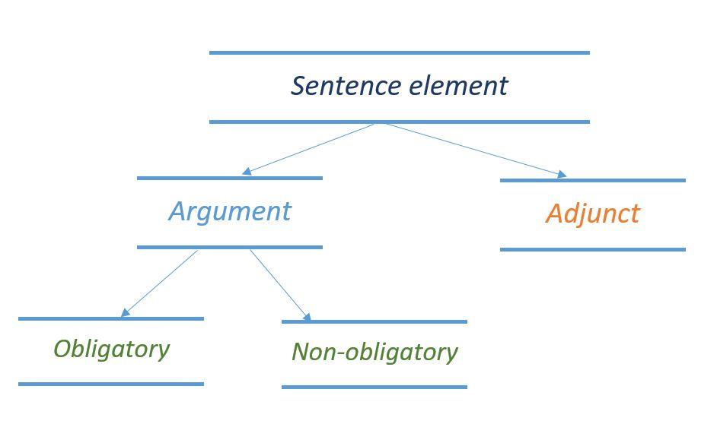
E-Glava: approach to valency
based on the German approach to valency:
VALBU (Schumacher et al. 2004) and E-VALBU
verb – the center of the sentence, dependency grammar
verb valency – number and types of arguments a verb requires; a verb’s capacity to combine with other elements

Slide 5
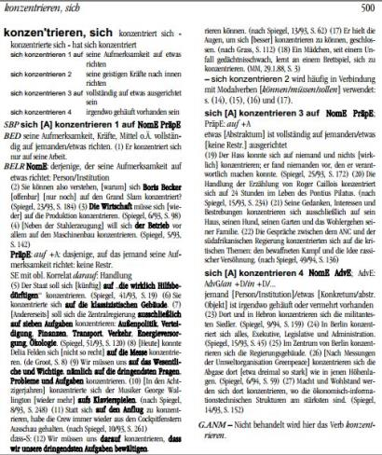
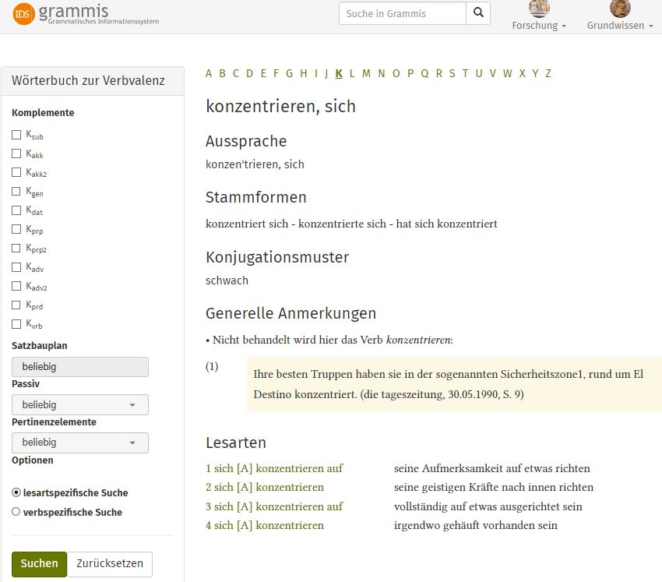
Role mode: German dictionary (printed VALBU & e-VALBU)

Slide 6
DTD shema for Tscwanelex application

Slide 7
From Tscwanelex to e-Glava output
(57 verb lemmas, 187 meanings and 375 valency patterns)
Tschwanelex DTD (editing)
PostgreSQL database
Native XML (complete lemmas)
PHP admin + HTML 5 coding
E-Glava output
Notes:
lexicon using DTD editing module in TshwaneLex, and all of the data is automatically transcribed into a SQL database environment.
When we finish with description of verbs from one semantic class, we export the native XML file from Tschwanelexs' SQL database. Using the custom-made PHP admin interface and HTML 5 coding system, which our IT department has developed following that XML structure, all the data is presented online in e-Glava output in the form, which we are going to show you our dictionary today.

Slide 8
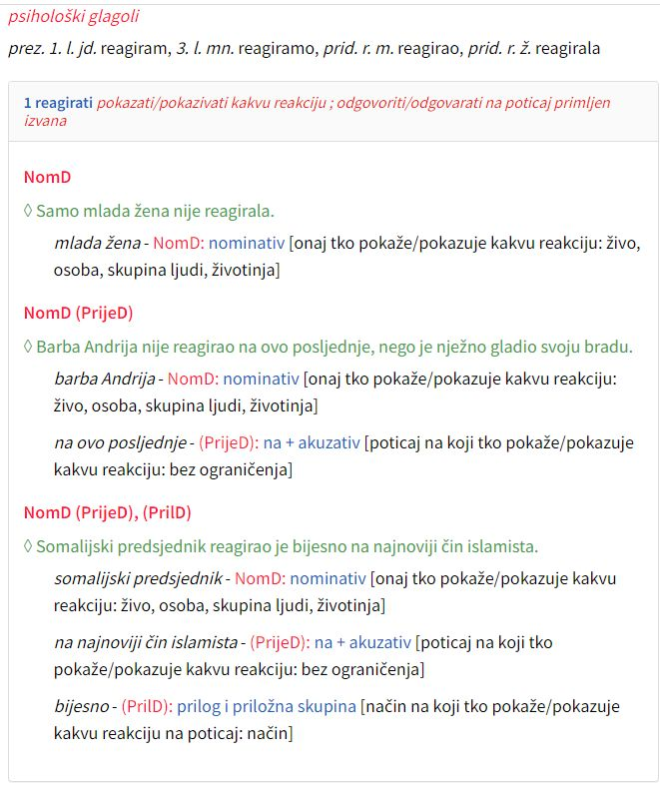
Example: are some dependents non-obligatory arguments or adjuncts??

Slide 9
Project SARGADA
Syntactic and Semantic Analysis of Arguments and Adjuncts in Croatian - SARGADA
aims:
theoretical research of the distinction between arguments and adjuncts within three theoretical frameworks
valency theory and dependency grammar
cognitive grammar
generative grammar
syntactic repository – containing sentences with ambiguous syntactic parts regarding argument/adjunct distinction
Notes:
As you may know, the project SARGADA has two main aims. The first is theoretical research of distinction between arguments and adjuncts within three theoretical frameworks: valency theory and dependency grammar, cognitive grammar, and generative grammar. The second aim is more practical – it is a syntactic repository that contains sentences with ambiguous syntactic parts regarding argument/adjunct distinction. In this talk, we are going to present to you selected test and our repository in detail.

Slide 10
SARGADA Repository: goal and project planning
Goal:
building the repository of sentences in Croatian with ambiguous phrases regarding the argument/adjunct status
Plan:
The repository is grounded on the computational database whose building encompasses several methodological steps (4 years span):
the design of the specific relational database in SQL environment on server infrastructure – year 1
personalized input interface for project members – year 2
setting of a stable working version with sentence descriptions (with the relevant central content management system - CMS) – year 3
revision and organization of data for the opening for the public and adding additional user functions – year 4
Notes:
Thank you Ivana, and now we will show how these basic ideas were transformed into the SARGADA repository as an applied part of the project. I won't bother you with too many technical details and notions, so we can more time for a preliminary analysis of the examples in the database. It is important to emphasize that this resource directly arises as a by-product of the research of ambiguous phrases in Croatian and isn't similar to other syntactic resources like dependency treebanks, valency lexicons, or some application of Framenet or Verbnet, and therefore, does not have a specific role model. The plan for building the repository is presented here. At the beginning of this year 2023, the planned phases (in green) for the first three years of the project were completed (so called backend), so now we can use the system, and by the end of the project public access to these data should be enabled via the Internet (so called frontend, in red).

Slide 11
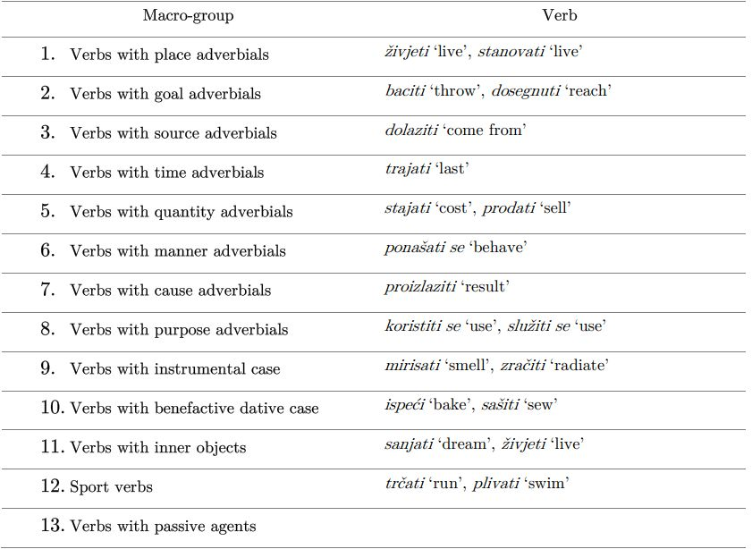
Project SARGADA: lemmas and macrogroups
Lemmas: list of 130 verbs/lemmas with ambiguous syntactic parts regarding argument/adjunct distinction.
Classification:
Notes:
For the repository, we compiled a list of 130 verbs or lemmas with ambiguous syntactic parts regarding argument/adjunct distinction. Further, we divided them into so-called macrogroups based on the syntactic part that we are testing. For example, we have a group of verbs with place, goal, source, time, quantity, manner, cause, purpose adverbials and so on. In this presentation, we will focus on the macrogroups with adverbials. For classification of adverbials, we took classification provided in Palić’s paper on obligatory adverbial complements in Bosnian.
Polysemous verbs, of course, can belong to different macrogroups, for example, stajati belong to place adverbials meaning ‘stand’, quantity meaning ‘cost’ and manner meaning ‘fit’.

Slide 12
SARGADA Repository: tagging model for examples
We have chosen 12 tags (basic syntactic model) for tagging sentence structure: definite tags for unquestionable elements, i.e. the tag 'test' for a sentence elements that can be either arguments or adjuncts.
1. (Argument) Subject: tag Argument_S
2. (Argument) Direct object: tag Argument_DO
3. (Argument) Indirect object : tag Argument_IO
4. (Argument) Prepositional phrase: tag Argument_PP
5. Adjunct: tag Adjunct
Verb: tag Verb
Adverb: tag Adverb
8. Reflexivity: tag Refl
9. Auxilary verb: tag Aux
10. Conjuction: tag Conj
11. Negation: tag Neg
12. Tested sentence part: tag TEST
Notes:
Ivana has already introduced you to the list of verbs, their classification in so-called macrogroups, and, of course, with chosen diagnostic tests in detail. Before entering the example sentences, in the end, we still had to choose a simple model for tagging sentence elements (“manual parsing in advance”) to analyse the sentences according to the intended idea. We have chosen 12 tags for this basic syntactic model: 11 definite tags for other elements, i.e. the twelfth tag 'test' for an ambiguous phrase that we should test.

Slide 13
Diagnostics for argument/adjunct distinction
Omission test
Implication test
Do so test
This happened test
Replacement test
Substitution test
Dialogue test
the tests from dependency grammar and generative grammar are employed in repository
Notes:
To those verbs, we applied 7 tests that have been chosen. These are: the omission test, implication test, do so test, this happened test, replacement test, substitution test and the dialogue test, mainly for dependency grammar and generative grammar.

Slide 14
1. Omission test
optionality test (Toivonen 2011), Eliminierungs test (Helbig & Schenkel 1978), Reduktionstest (Engel 2009)
separation of obligatory elements from non-obligatory elements
if a syntactic phrase can be omitted, and the sentence remains grammatical, the omitted part is not an obligatory argument, but an optional argument or an adjunct
(1)
(2)
problem: arguments can be omitted (eat, read, sing) and some adjuncts are obligatory (by-phrases)
Dječak | baca | kamenje | (u | vodu).
boy | throws | stones | into | water.ACC.SG
‘A boy throws stones (into the water).’
Moj | rođak | boravi | (*u | Chicagu).
my | cousin | is-staying | in | Chicago. LOC.SG
‘My cousin is staying (*in Chicago.)’
Notes:
The omission test, also called optionality test and so on, is a standard test for the separation of obligatory elements in a sentence from non-obligatory elements. If a syntactic phrase can be omitted, and the sentence remains grammatical, the omitted part is not an obligatory argument, but either an optional argument or an adjunct. For example, A boy throws stones into the water., we can omit into the water and the sentence remains grammatical, so the prepositional phrase is not an obligatory argument. While in the sentence My cousin is staying in Chicago, we cannot omit in Chicago, so it is an obligatory argument. The problem is that some arguments can be omitted (e.g. with verbs eat, read, sing) and some “adjuncts are obligatory” (for example by-phrases in English).

Slide 15
2. Implication test
Folgerungstest, Core Participant Test
if a verb presupposes the appearance of an entity, then we are dealing with an argument
is there always a presupposed place where the stone has been thrown
replace the imagined part by a pronoun/adverb (3) and the pronoun/adverb cannot be negated (4)
(3)
(4)
used for the optional arguments
used for non-stative verbs
Dječak | baca | kamen | nekamo.
boy | throws | stone | somewhere
‘A boy throws a stone somewhere.’ – anaphorisation (DP)
#Dječak | baca | kamen | nekamo, | ali | nekamo | ne | postoji.
boy | throws | stone | somewhere | but | somewhere | NEG | exists
‘#A boy throws a stone somewhere, but somewhere does not exist.’ – dialogue test
Notes:
According to the implication test, if a verb presupposes the appearance of an entity, then we are dealing with an argument. For example, if we imagine an act of throwing a stone into the water, we have to ask ourselves is there always a presupposed place where the stone has been thrown. After that, we try to replace the imagined part with a pronoun/adverb as in A boy throws a stone somewhere. and negate it, as in A boy throws a stone somewhere, but somewhere does not exist.
Negation of examined phrases links this test with the dialogue test, which we are going to present very soon.
The application of this test makes sense for the optional arguments, and it does not need to be done for obligatory arguments because they are already pointed out by the omission test.

Slide 16
3. Do so test
Lakoff and Ross 1966
nonstative verb + its argument(s) = do so
(5) Harry forged a check, but Bill could never bring himself to do so.
elements after do so – outside the verb phrase – adjuncts
(6) John took a trip last Tuesday, and I’m going to do so tomorrow.
(7) The army destroys villages with shells, but the airforce does so with napalm.
direct objects, indirect objects, directional adverbs, affected locatives – arguments
time, place, manner, duration, frequency, instruments, comitative – adjuncts

Slide 17
4. This happened test
Brown and Miller 1991
if a sentence can be paraphrased by two sentences, one contains the nuclear predications and the other adverbial
(8) John stood on the table. This happened in the bathroom.
(9) *John stood. This happened on the table.
used for non-stative verbs
Notes:
According to the this happened test, if a sentence can be paraphrased by two sentences, one contains the “nuclear predication” and the other the adverbial.
The sentence John stood on the table in the bathroom. We can paraphrase: John stood on the table. This happened in the bathroom., but we cannot say John stood. This happened on the table., so on the table is an argument.
This test, as well as do so test, is used for non-stative verbs.

Slide 18
5. Replacement test
Ersatzprobe, Kommutations test (Ágel 2000)
arguments are selected by a verb, while adjuncts are not
If the replacement of a phrase with the different morphological form is possible → the phrase is an adjunct
if the replacement is not possible → the phrase is an argument
10)
11)
Brat | je | bacio | kamen | u | vodu / | na | krov / | preko | kuće.
brother | AUX | threw | stone | into | water.ACC.SG | onto | roof.ACC.SG | over | house.GEN.SG
‘The brother threw a stone into the water/onto the roof/ over the house.’
Jezik | je | proistekao | iz | naroda | *na | narod / | *preko | naroda.
language | AUX | arose | from | people.GEN.SG | onto | people.ACC.SG | over | people.GEN.SG
‘The language arose from the people / *onto the people / *over the people.’
Notes:
This test relies on the fact that the arguments are selected by a verb and adjuncts are not. If the replacement of a phrase with the different morphological form is possible, then the phrase is an adjunct, which we can see in example xx, We can say the brother threw a stone into the water, onto the roof, or over the house.
But it the replacement is not possible, then the phrase is an argument, which we can see in example xx.
We cannot say The language arose onto the people or over the people., this prepositional phrase is an argument.

Slide 19
6. Substitution test
Substitutionstest (Ágel 2000), Supklassentest (Engel 2009)
substitution test examines the verb specificity (Subklassenspezifik, subcategorization)
→ if the verb next to a syntactic phrase can be replaced by another verb, then the phrase is an adjunct (Ágel 2000, Šojat 2008)
12) Brat je bacio/ gurnuo / izbacio/ zavitlao / *razveselio se /*pojeo /*sjećao se kamen u vodu.
13) The brother threw / pushed / ejected / swirled / *cheered /*ate/ *remembered a stone into the water.
Notes:
By the substitution test, the verb next to the questioned phrase is substituted by another verb. If a sentence remains grammatical after the verb is replaced by another verb, then the questioned phrase is an adjunct. However, not every adjunct can be attached to every verb and arguments are specific to a class of verbs, not to each verb.

Slide 20
7. Dialogue test
Functional Generative Description framework (Panenova 1974, Sgall 1978)
for the arguments that are not realized at the surface, information about them has to be present in the speaker’s mind
A: Dinara leži na granici između Hrvatske i BiH.
‘Dinara lies on the border between Croatia and BiH.’
B: Gdje Dinara leži?
‘Where does Dinara lie?’
A: #Ne znam.
‘I don’t know.’
Notes:
According to the test, if we are dealing with an argument, it needs not to be present in a surface structure, but information about it is always present in the speakerʼs mind.
If we have a sentence under A and we ask an utterer to answer the question under B, his answer cannot be C (I don't know) since the place where someone has arrived is a semantic argument of the verb arrive.
The test accounts for the fact that very often some complements are not expressed, but are nevertheless semantic arguments of the verb.
→ even if I don’t pronounce the phrase on the border between Croatia and Bosnia and Herzegovina, the answer still cannot be I don’t know.
However, it is more acceptable with the three-place verb baciti ‘throw’.

Slide 21
Technical details and preliminary results
a subdomain http://ihjj.hr/sargada/ has been created
the Ubuntu 18 server operating system with LAMP architecture (Linux, Apache, MySQL and PHP) has been successfully installed and configured for the server
infrastructure. structure (according to our initial design) - HTML; markup language used for structuring and presenting content
development (logical structure) - Javascript, i.e. Vue.js framework for building user interfaces
visual presentation - Cascading Style Sheets (CSS); style sheet language for describing the presentation of a document written in a HTML.

Slide 22
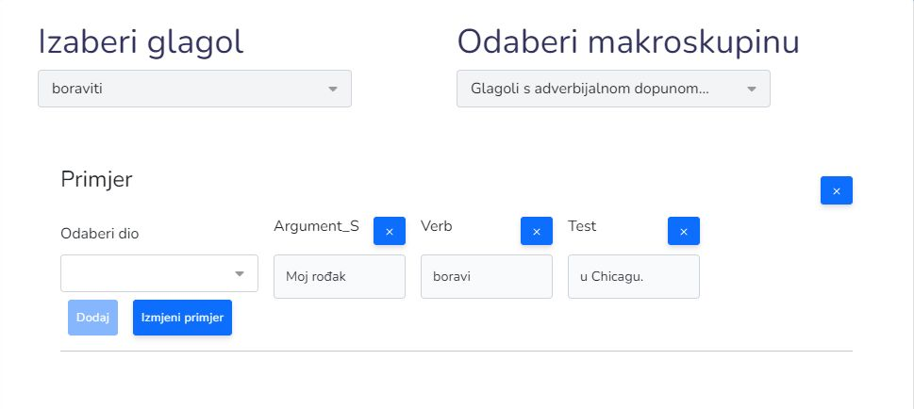
Interface – 1 (example: boraviti ‘stay’)
Notes:
Firstly, we pick up the verb from a predefined list, and then we assign the example to the macro group. We type the chunks of sentence elements in separate fields according to the simple syntactic model. After processing all sentence parts for the example, the database field with tests opens up,

Slide 23
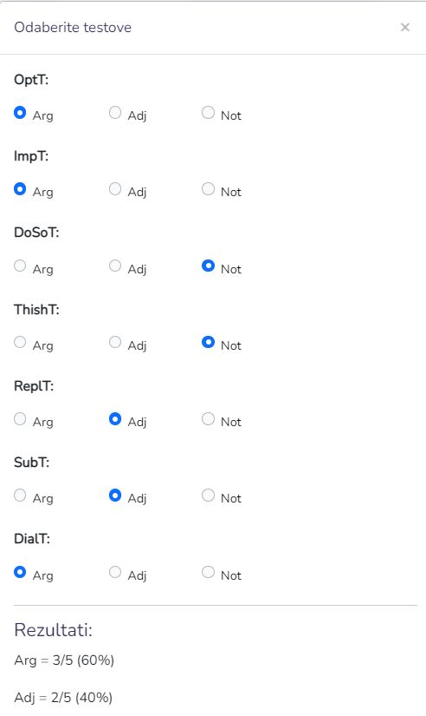
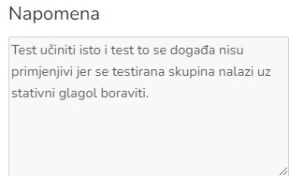
Interface – 2 (example: boraviti ‘stay’)
Note:
The Do so test and This happened test are not applicable because the tested sentence part is following the stative verb boraviti 'to stay'.
the morphological form of an argument is dictated by a verb, and the morphological form of an adjunct is not (traces back to Tesnière)
if the verb next to a syntactic phrase can be replaced by another verb, then the phrase is an adjunct
Notes:
and we can enter the results for our seven tests (you can see the menu with choices Argument, Adjunct or test not taken for every one of them. Here are results for the phrase in Chicago from My cousin is staying in Chicago., with percentages also). We can also add a simple text note like that one about applying the tests (or some other notion about the examples if necessary).

Slide 24
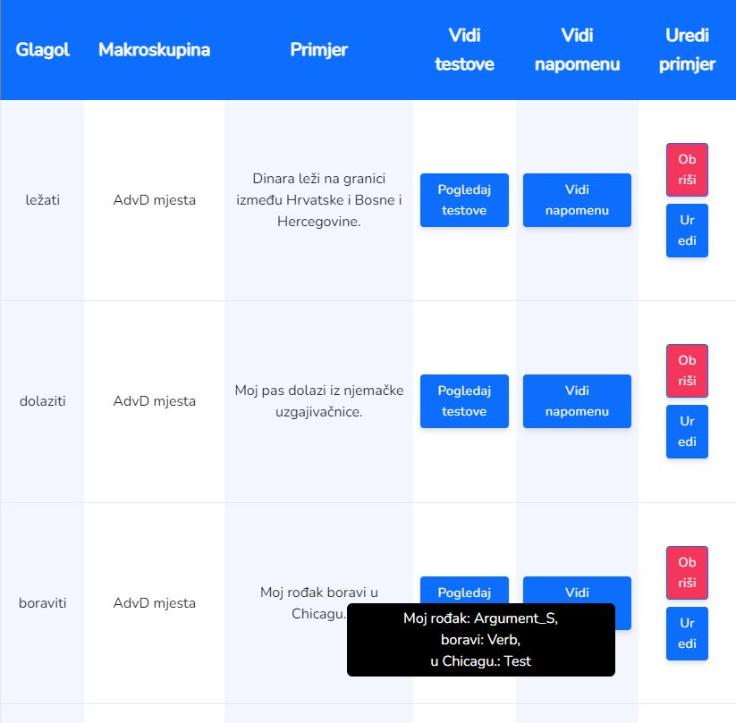
Interface – 3 (example: boraviti ‘stay’)
Notes:
The results are stored in the database and editable again (blue button far right) if we learn something new about the example, or remove them if something was wrong (red button far right). Then we can carry on with the next verbs and examples.

Slide 25
SARGADA repository: place adverbials analysis
Notes:
As I said, we just recently started filling the database and only three examples with place adverbials are there. But, we can already see that the analysis for prototypical place adverbials in Chicago for the verb boraviti ‘stay’, and phrase on the border between Croatia and Bih for ležati ‘lie, be’ in Dinara lays, or Dinara is on the border between Croatia and Bih gave us expected similar test results. But phrase from German dog breeding kennel for dolaziti ‘come’ in My dog comes from German dog breeding kennel is already different. The reason is relatively obvious. Although the verb dolaziti 'come' is justifiably assigned to the macrogroup of verbs followed by place adverbials, if we use a finer granulation, that verb is not completely comparable to pure stative verbs like stay or lie, therefore this happened test is used, and substitution test shows us that dolaziti cannot be replaced by another verb (verb specificity, Engel: Direktivergänzung, maybe we could open the macrogrup with directive adverbials?).

Slide 26
služiti ‘serve’
Vozilo služi za prijevoz stvari.
Vehicle_{Nom.sg} serve_{3.sg} to transport_{Acc.Sg} things_{Acc.Pl}
"The vehicle is used to transport things."
Vozilo služi prijevozu stvari.
Vehicle_{Nom.sg} serve_{3.sg} transport_{Dat.Sg} things_{Gen.Pl}
"The vehicle is used to transport things.„
(Vozilo služi da se prevezu stvari.)
Vozilo služi čovjeku za prijevoz stvari.
Vehicle_{Nom.sg} serve_{3.sg} man_{Dat.Sg} to transport_{Acc.Sg} things_{Gen.Pl}
„The vehicle serves a person to transport things.“
* Vozilo služi čovjeku prijevozu stvari.
* Vehicle_{Nom.sg} serve_{3.sg} man_{Dat.Sg} transport_{Dat.Sg} things_{Gen.Pl}
Notes:
If we strip this example to bare elements, we could assign the following semantic roles. In Croatian, in this example prepositional phrase for + Acc.Sg is morphologically interchangeable with the dative case and still has the same semantic roles (hence the result adjunct in the Replacement test). But, as we know, meaning of the head (verb) is crucial when we discuss arguments and adjuncts, and it is inherently predictable that this construction semantically has to have a beneficiary role in expectedd argument structure besides theme and goal/purpose. If we add this non-obligatory argument (person, dative case) into the structure, the prepositional phrase for + Acc.Sg isn’t morphologically interchangeable anymore with dative case because it is not expected to be grammatical to have two different successive arguments in the dative case.

Slide 27
Thank you for your attention!
mbirtic@ihjj.hr
ibrac@ihjj.hr
srunjaic@ihjj.hr

