Slide 1
The lexicographic process revisited
Annette Klosa-Kückelhaus (Leibniz-Institute for the German Language)
Carole Tiberius
(Dutch Language Institute)

Slide 2
Introduction
Why do we need to know about the lexicographic process?
facilitates the planning of new lexicographic resources
helps to understand in which parts of the process new technologies can be of use
supports the evaluation of form and content of existing dictionaries
supports users’ understanding of the lexicographic process

Slide 3
Outline
Definition of lexicographic process
Phases of lexicographic processes
Reasons for new lexicographic processes
Discussion

Slide 4
Definition of lexicographic process
Wiegand (1999: 134): A completed lexicographic process [...] is the set of process activities carried out to create a particular dictionary.
He distinguishes between a computer-assisted lexicographic process and a computer lexicographic process.
(Müller-Spitzer 2003:157)

Slide 5
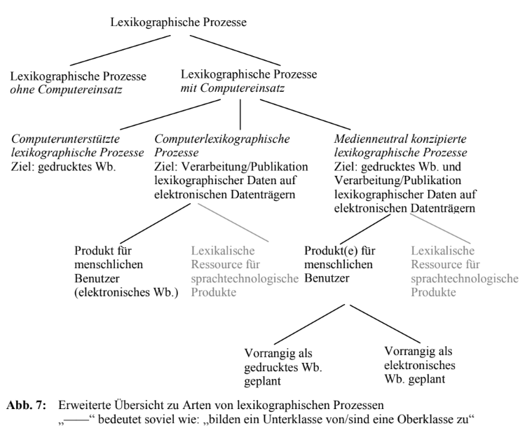
Definition of lexicographic process
with or without computer
goal:
print dictionary,
electronic dictionary
lexical resource
user:
human
computer
(Müller-Spitzer 2003:161)

Slide 6
Lexicographic Process including Dictionary Portals
Klosa/Tiberius (2015): A computer-lexicographic process is the sum of activities that have to be undertaken so that a particular dictionary or a group of dictionaries (in a portal) comes into being on or in an electronic carrier medium. This process can be divided into different phases in which computers are used consistently.

Slide 7
Definition of lexicographic processes
Re-definition (2023):
A (completed) lexicographic process is the set of process activities performed to create a lexicographic database. Lexicographic databases can be used in language technology or for creating dictionaries for human users or be integrated in a dictionary portal

Slide 8
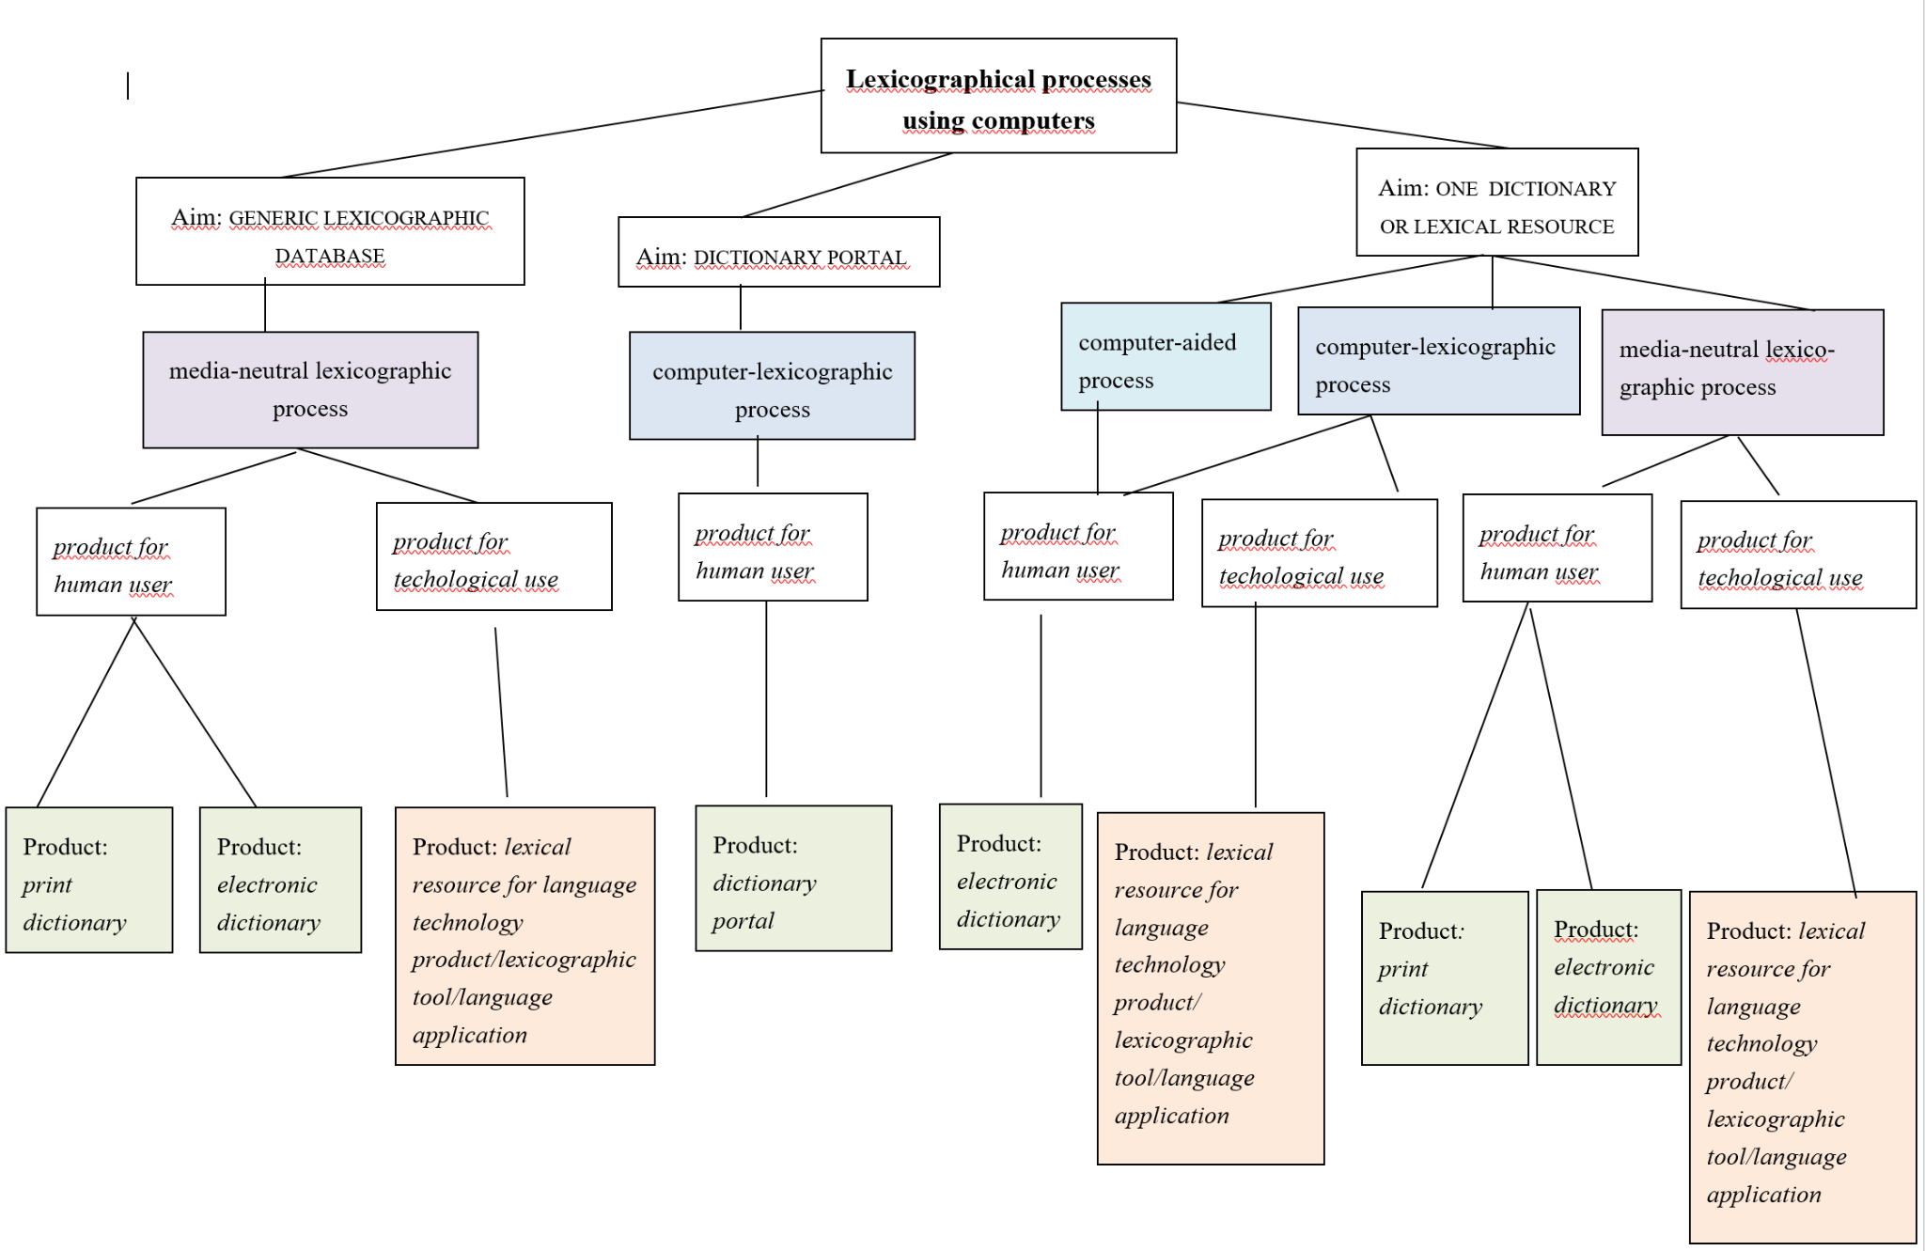

Slide 9
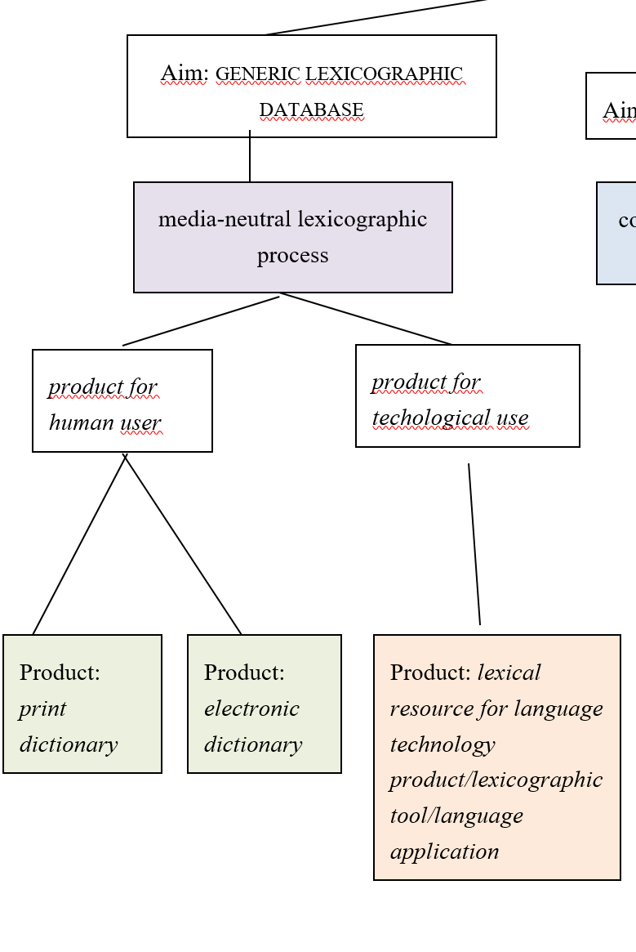
Process for generic lexicographic database

Slide 10
Process for generic lexicographic database

Slide 11
Process for generic lexicographic database
Invisible Lexicography

Slide 12
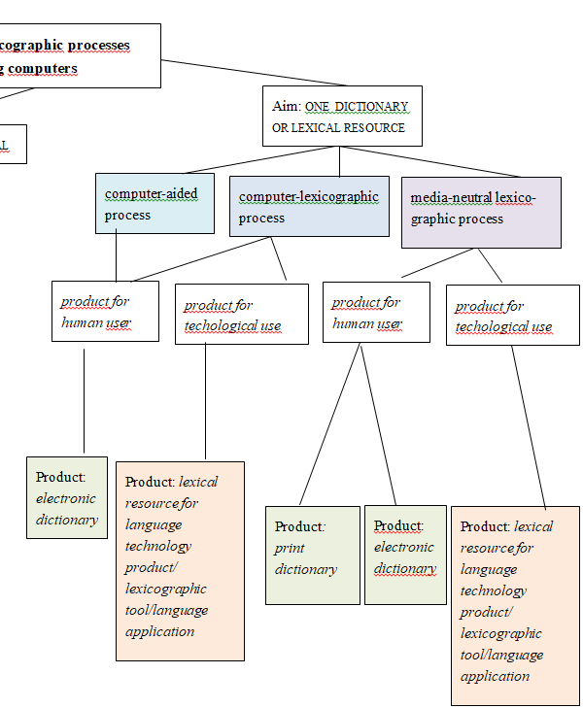
Process for one dictionary or lexical
resource

Slide 13
Phases of the lexicographic process
phase of preparation
phase of data acquisition
phase of computerization
phase of data processing
phase of data analysis
phase of preparation for publication
(Klosa 2013)

Slide 14
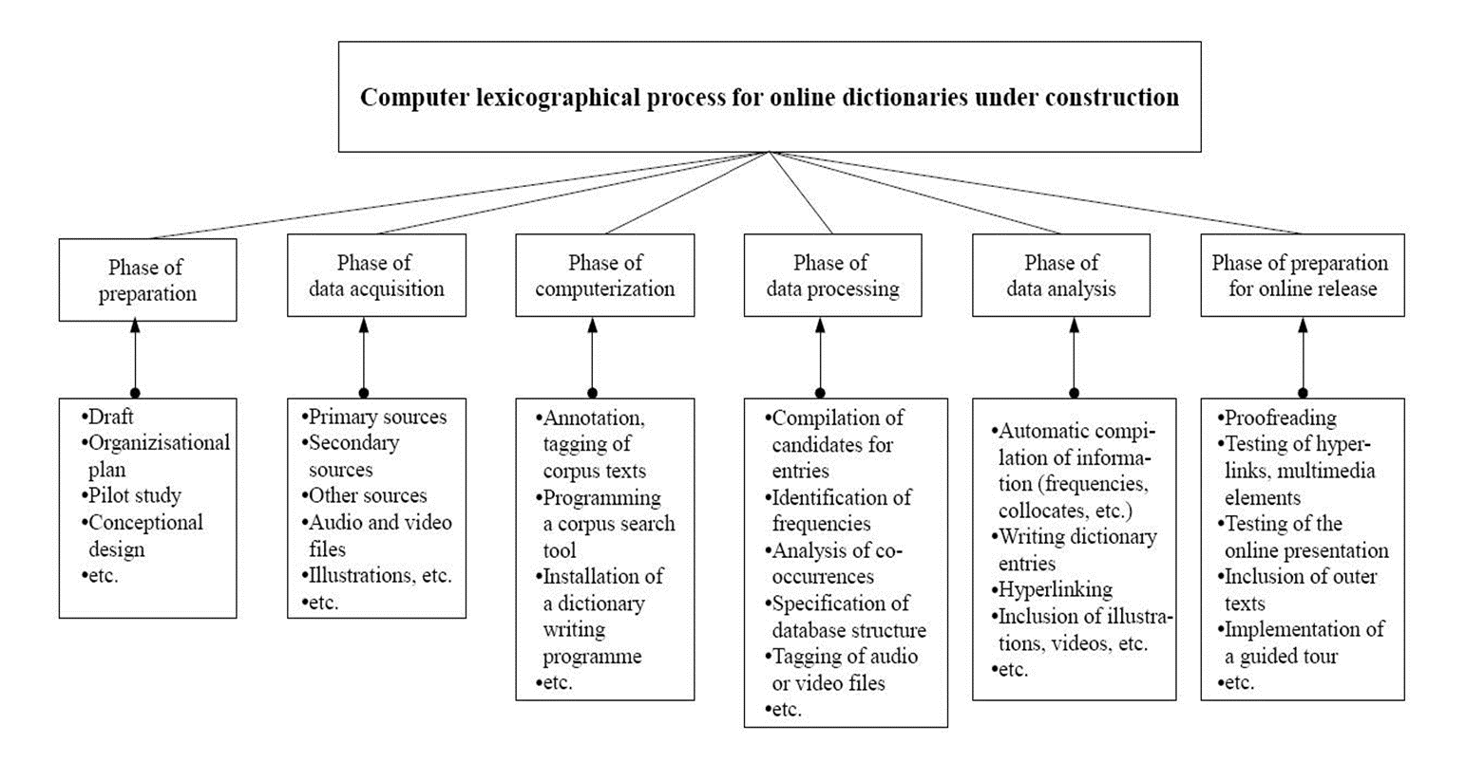

Slide 15
Phases of the lexicographic process
phase of preparation
phase of data acquisition
phase of computerization
phase of data processing
phase of data analysis
phase of preparation for publication
phase of maintenance and preservation (COST ENeL)

Slide 16
Phases of lexicographic process
COST ENeL (2014): most dictionary projects could fit in their process into these phases.
BUT: can we still distinguish the same phases when we move to a generic database?
Before we try to answer this, let’s first look at the reasons for this change.

Slide 17
Major changes in lexicography
The shift from print to online
The shift from unstructured to structured data
The emergence of Linguistic Linked Open Data
Changing role of lexicography: more content provider
Crowdsourcing and gamification
Technological innovations
Sources:
ELEXIS surveys (Kallas et al. 2019; Tiberius et al. 2022),(Steurs et al. 2020)

Slide 18
A generic lexicographic database
Definition: An integrated lexicographic database that contains at least a common core of lexicographic data that feeds into individual lexicographic projects and possibly other tools and applications.
A few adopters of this approach:
Duden Dictionaries (Alexa et al. 2002, 2016)
KDictionaries (e.g. Kernerman 2011)
OUP (e.g. Parvizi et al. 2016)
Institute of the Estonian Language (EKI) (e.g. Tavast et al. 2018)
Jožef Stefan Institute
Dutch Language Institute (e.g. Depuydt et al. 2019)
…
Please get in touch with us if your institute/department/project is adopting a similar approach!

Slide 19
Pros
Having a single pool of data has several practical advantages.
It supports reusability of the lexicographic data for different end products, dictionaries as well as language technology applications.
It also supports efficient maintenance of the lexicographic data in a homogenous manner.

Slide 20
Challenges
Linking heterogenous content from existing projects in one integrated database
The need for more stable and established formats for encoding lexicographic data
How to organise language data in a complex data model efficiently

Slide 21
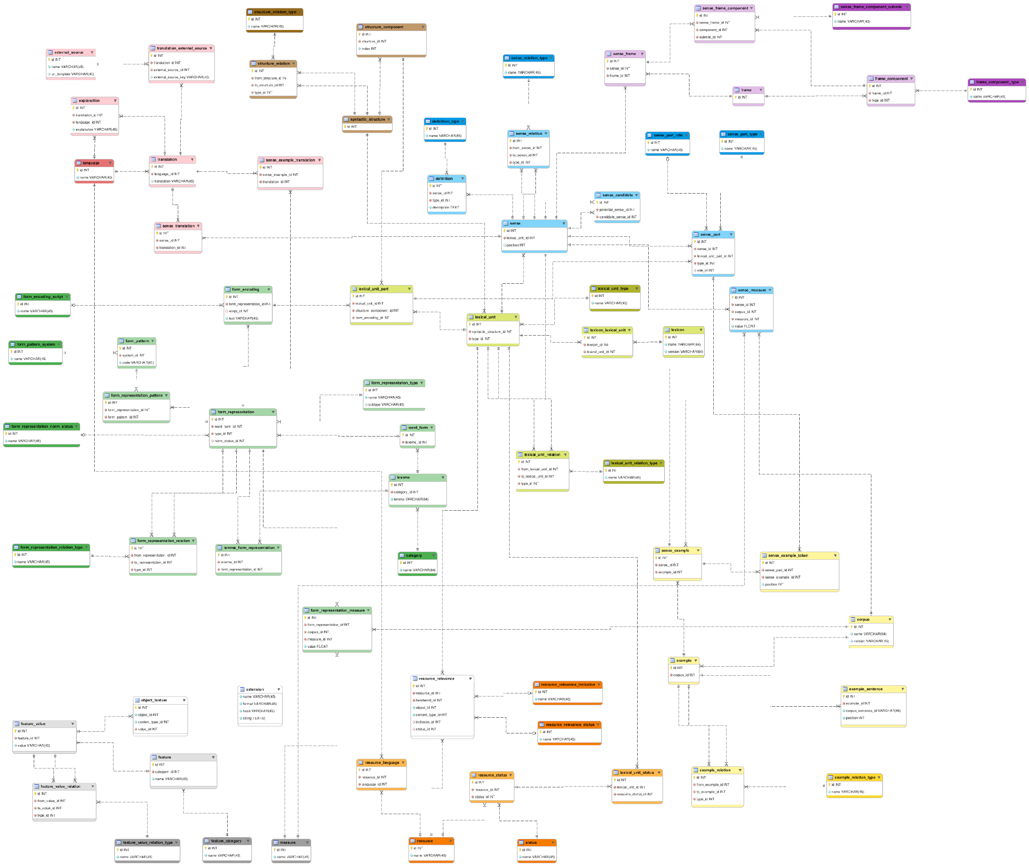
Slovene data model
https://wiki.cjvt.si/books/digital-dictionary-database/page/data-model

Slide 22
Challenges
Development of a specialised editing tool for the generic database
Different views on the data are required: per headword, per ‘feature’ = move to relational organisation (cf. DMLex presentation)
Generic content creation (not something lexicographers are used to)
Customisation of the generic content for specific end-products
How to extract the most accurate data from corpora; to have an explicit link between corpus data and lexicographic description

Slide 23
This requires rethinking the lexicographic process as a modular approach.
(cf. Heylen & Vandeghinste (2021))

Slide 24
Phases in the lexicographic process for a generic database
phase of preparation
phase of data acquisition
phase of computerization
phase of data processing
phase of data analysis
phase of maintenance and preservation
Plus for the creation of individual end-products
phase of preparation
phase of preparation for publication
phase of maintenance and preservation
More task-based

Slide 25
Integration of new technologies
AI
Crowdsourcing and gamification
Where do we find these in the process?

Slide 26
Will AI take over?
Check out the Round Table on Large language models and AI in lexicography on Wednesday
What does chatGPT think about this?
https://pixabay.com/illustrations/ai-generated-robot-7847688/

Slide 27
Is ChatGPT suitable for lexicography?
As a language model, ChatGPT can certainly be used for lexicography, which is the practice of compiling dictionaries or word lists. ChatGPT has been trained on a large corpus of text and can understand and generate language with a high degree of fluency and accuracy. This means that it can provide definitions, synonyms, antonyms, and other types of linguistic information for a wide range of words.
However, it's important to note that ChatGPT is a machine learning model and not a human expert in language. While it can provide a lot of useful information, it may not always be able to capture the nuances and complexities of language that a human lexicographer could. Additionally, ChatGPT is only as good as the data it was trained on, so there may be gaps or biases in its knowledge.
Overall, ChatGPT can be a useful tool for lexicography, but it should be used in conjunction with human expertise and careful editing and review to ensure the accuracy and completeness of any resulting dictionaries or word lists.
ChatGPT’s answer given in May 2023

Slide 28
Integration of AI
We foresee potentially three roles for LLMs and AI in lexicography:
data acquisition
evaluation (cf. crowdsourcing and gamification)
as another secondary source that lexicographers consult whilst editing (dictionary entries), preferably integrated in the DWS (cf. OpenAI GPT integration in TLex (using their API).

Slide 29
User involvement:
crowdsourcing and gamification
phase of preparation: pilot study
phase of data acquisition: crowdsourcing and gamification (e.g. finding synonyms)
phase of data analysis: crowdsourcing and gamification
(e.g. evaluating automatically extracted data)
phase of preparation for publication: testing
phase of maintenance and preservation: feedback forms

Slide 30
Thank you!

