Slide 1
Introduction
Methods
Results
Error analysis
Conclusion
Definition Extraction for Slovene: Patterns, Transformer Classifiers and ChatGPT
Hanh Thi Hong Tran, Vid Podpečan, Mateja Jemec Tomazin, Senja Pollak
Definition Extraction for Slovene: Patterns, Transformer Classifiers and ChatGPT

Slide 2
Introduction
Methods
Results
Error analysis
Conclusion
Introduction
Definition Extraction for Slovene: Patterns, Transformer Classifiers and ChatGPT

Slide 3
Contributions
Introduction
Methods
Results
Error analysis
Conclusion
Definition extraction: extracting textual definitions from naturally occurring texts.
Context: Slovene terminological portal
1
The creation of a novel Slovene corpus for Definition Extraction evaluation.
Filling the research gap in the Definition Extraction for Slovene by different neural approaches.
2
3
An empirical evaluation of rule-based, transformer binary classifier, and ChatGPT prompting.
Definition Extraction for Slovene: Patterns, Transformer Classifiers and ChatGPT

Slide 4
Introduction
Methods
Results
Error analysis
Conclusion
Methods
Definition Extraction for Slovene: Patterns, Transformer Classifiers and ChatGPT

Slide 5
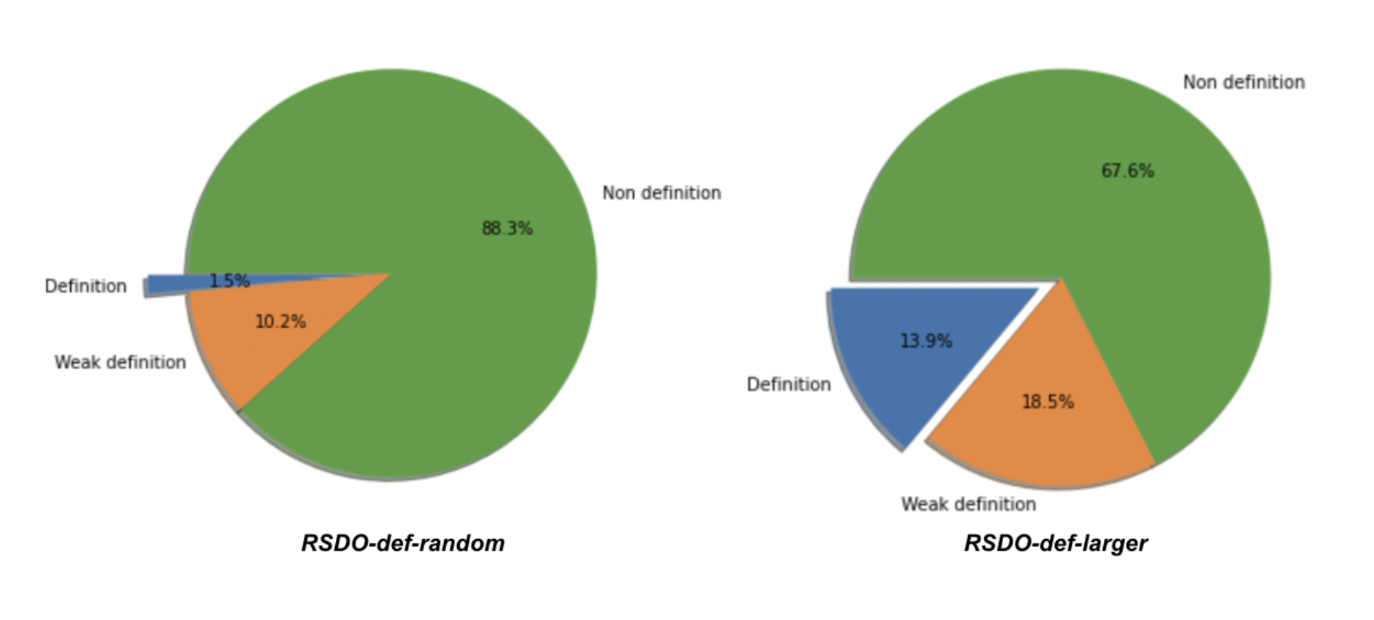
New corpora: RSDO-def
Introduction
Methods
Results
Error analysis
Conclusion
961 examples
1255 examples
Random
Sampling
Random
Sampling
+
Pattern-based
Sampling
Figure 1: The distribution of Definition, Weak definition, and Non-definition category in each corpus.
Definition Extraction for Slovene: Patterns, Transformer Classifiers and ChatGPT

Slide 6
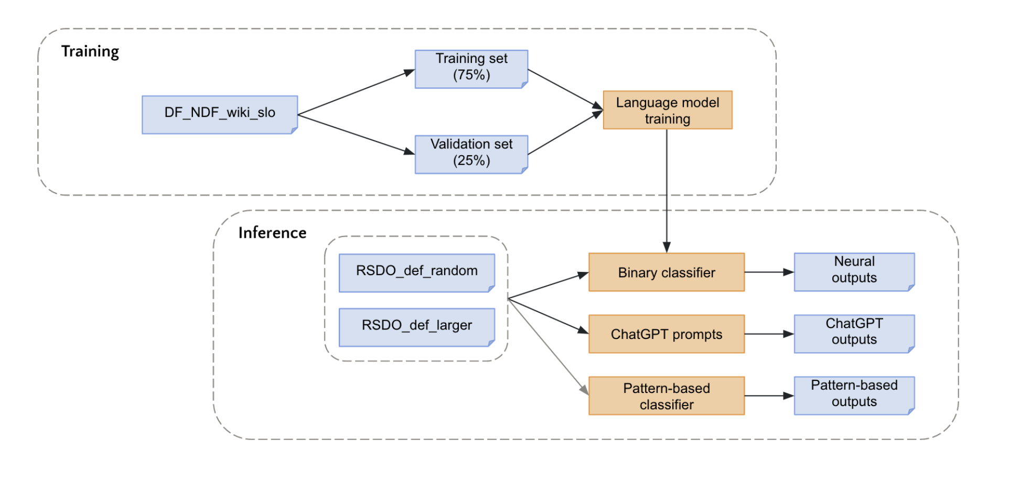
New Benchmarks
Introduction
Methods
Results
Error analysis
Conclusion
Figure 2: The experimental workflow.
Definition Extraction for Slovene: Patterns, Transformer Classifiers and ChatGPT

Slide 7
Rule-based approach (Pollak et al., 2014)
Introduction
Methods
Results
Error analysis
Conclusion
1
Patterns-all
JeStaSoPatterns
The list of all 12 patterns.
Based on a set of the soft lexico-syntactic patterns
A subset of the entire pattern set.
Containing only the patterns of “X is a Y” type and its variations.
NP-nom je [Eng. is] NP-nom
NP-nom se nanaša na [Eng. refers to] NP-nom
NP-nom pomeni [Eng. denotes] NP-nom
…
Naloga NP-nom je [Eng. The task of NP is]
NP-nom je [Eng. is] NP-nom
...
Definition Extraction for Slovene: Patterns, Transformer Classifiers and ChatGPT

Slide 8
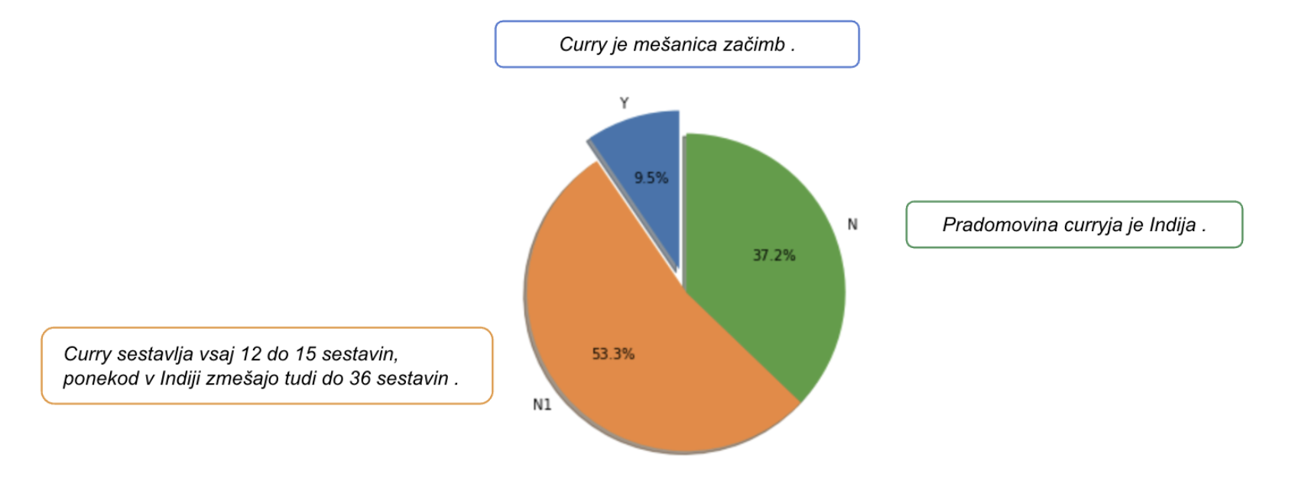
Transformer classifiers
Introduction
Methods
Results
Error analysis
Conclusion
2
3,251 sent.
Training set: DF_NDF_wiki_slo
Fišer et al. (2010)
Wikipedia “silver standard”
14,678 sent.
non-def.
20,684 sent.
Definition Extraction for Slovene: Patterns, Transformer Classifiers and ChatGPT

Slide 9
Transformer classifiers
Introduction
Methods
Results
Error analysis
Conclusion
2
Training set: DF_NDF_wiki_slo
Train-valid 75-25
Models:
Multilingual: mBERT, mDistilBERT & XLMR
Monolingual: SloBERTa
Class weighting
Configuration: Learning rate: 1e-05, Epoches: 5, Batch size: 8.
Definition Extraction for Slovene: Patterns, Transformer Classifiers and ChatGPT

Slide 10
ChatGPT prompting
Introduction
Methods
Results
Error analysis
Conclusion
3
Zero-shot prompting
ChatGPT Mar 23 Version between 5th and 10th April 2023.
Figure 5: Slovene dataset prompt scenario.
Definition Extraction for Slovene: Patterns, Transformer Classifiers and ChatGPT

Slide 11
Introduction
Methods
Results
Error analysis
Conclusion
Results
Definition Extraction for Slovene: Patterns, Transformer Classifiers and ChatGPT

Slide 12
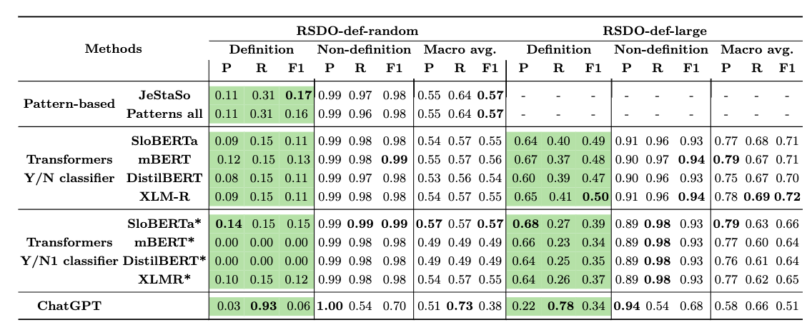
Results: strict evaluation scenario
Introduction
Methods
Results
Error analysis
Conclusion
Definition Extraction for Slovene: Patterns, Transformer Classifiers and ChatGPT

Slide 13
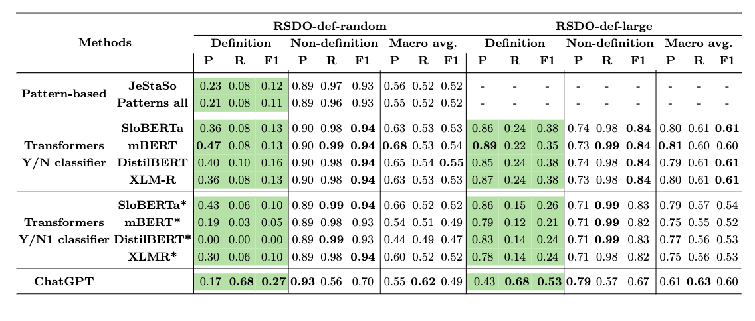
Results: relaxed evaluation scenario
Introduction
Methods
Results
Error analysis
Conclusion
Definition Extraction for Slovene: Patterns, Transformer Classifiers and ChatGPT

Slide 14
Introduction
Methods
Results
Error analysis
Conclusion
Error analysis
Definition Extraction for Slovene: Patterns, Transformer Classifiers and ChatGPT

Slide 15
Error analysis
Introduction
Methods
Results
Error analysis
Conclusion
1
Rule-based approach
Error #1: When sequence are too long, contain lists of items, or have wrong sentence segmentation, the segments rarely contain definitions.
Error #2: There are several examples formulated as questions, but still matching the patterns
Error #3: Insufficient context for the extracted term, too general phrases, and errors in automated morpho-syntactic annotations.
Definition Extraction for Slovene: Patterns, Transformer Classifiers and ChatGPT

Slide 16
Error analysis
Introduction
Methods
Results
Error analysis
Conclusion
Rule-based approach
1
Transformer classifiers
Misclassified long sequences -> Sentence segmentation errors (long, concatenated sentences)
Many cases, which are informative, have e.g. genus, but not definitional (differentia not well expressed)
“Steklina je zoonoza , prisotna na vseh celinah in ugotovljena že v najmanj 150 državah sveta .”
EN: Rabies is a zoonosis, present onall continents and found in at least 150 countries of the world.)
2
Definition Extraction for Slovene: Patterns, Transformer Classifiers and ChatGPT

Slide 17
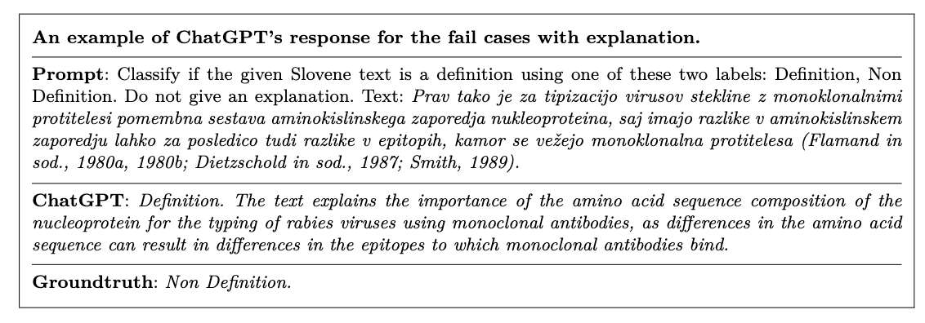
Error analysis
Introduction
Methods
Results
Error analysis
Conclusion
3
ChatGPT prompting
Figure 6: Prompt errors.
Definition Extraction for Slovene: Patterns, Transformer Classifiers and ChatGPT

Slide 18
Introduction
Methods
Results
Error analysis
Conclusion
Conclusion
Definition Extraction for Slovene: Patterns, Transformer Classifiers and ChatGPT

Slide 19
Conclusions
Introduction
Methods
Results
Error analysis
Conclusion
We presented a novel evaluation dataset for Slovene Definition Extraction using (1) random sampling; (2) pattern-based methods.
1
If there are only a few well-structured instances of definitions that have clear linguistic characteristics (strict eval. scenario), a rule-based technique performed best in F1-score on the Definition class
2
For less structured examples (relaxed eval. Scenario), ChatGPT prompting and language models classifiers were more effective than classical rule-based approaches. Transformer classifiers have higher precision, while ChatGPT higher recall.
3
Definition Extraction for Slovene: Patterns, Transformer Classifiers and ChatGPT

Slide 20
Future work
Introduction
Methods
Results
Error analysis
Conclusion
Increasing the evaluation data’s size and diversity.
1
Using ensemble methods to improve overall performance.
2
3
Leveraging LLM for the definition generation
Definition Extraction for Slovene: Patterns, Transformer Classifiers and ChatGPT

Slide 21
Introduction
Methods
Results
Error analysis
Conclusion
Thank you
Definition Extraction for Slovene: Patterns, Transformer Classifiers and ChatGPT

