Slide 1
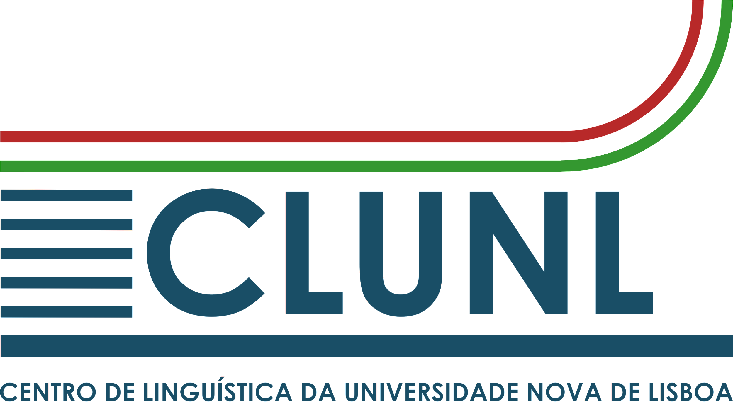
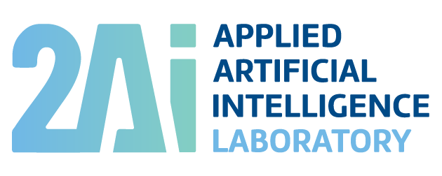
Dicionário da Língua Portuguesa:
a new lexicographic resource of
Academia das Ciências de Lisboa
Ana Salgado, Alberto Simões, Álvaro Iriarte Sanromán,
Rita Vieira, Manuela Ferreira, Rita Carmo, Conceição Pinheiro
ELEX 2023: ELECTRONIC LEXICOGRAPHY IN THE 21ST CENTURY
Brno, Czech Republic, 27 June 2023

Slide 2
Outline
Academia das Ciências de Lisboa [Lisbon Academy of Sciences]
Dicionário da Língua Portuguesa (2023)
presentation of the workflow of the Dicionário da Língua Portuguesa (DLP) project
presentation of the DLP model and general characteristics
main conversion errors (from PDF to database)
the main changes introduced compared to the previous edition
measures implemented to ensure the quality and long-term preservation
Future work
Salgado et al. (2023). Dicionário da Língua Portuguesa…

Slide 3
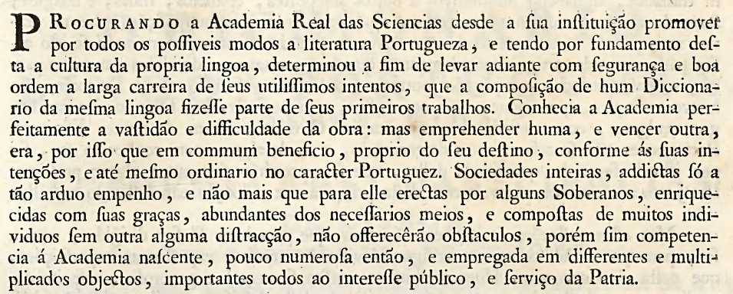
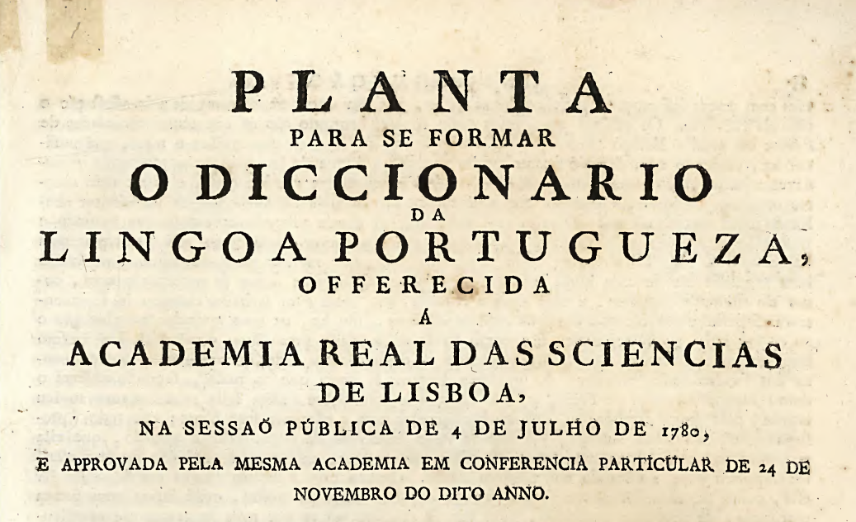
Academia das Ciências de Lisboa
«utilíssimos intentos, que a composição de hum Diccionario da mesma lingoa fizesse parte de seus primeiros trabalhos» [very useful intentions, that the composition of a dictionary of the same language should be part of its first works] (ACL, 1793, s. p.)
The plan for the dictionary was presented during an academic session on July 4, 1780.
Salgado et al. (2023). Dicionário da Língua Portuguesa…

Slide 4
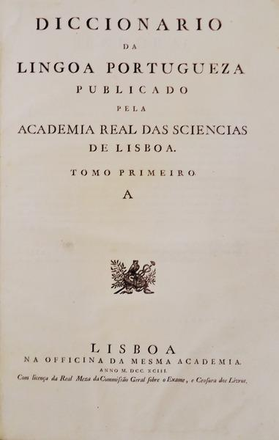
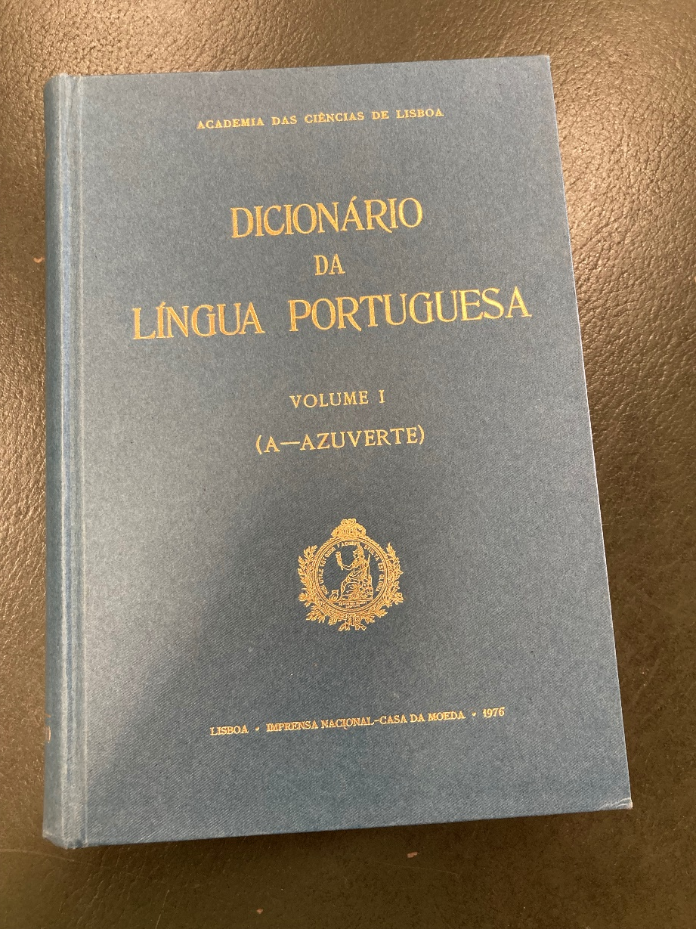
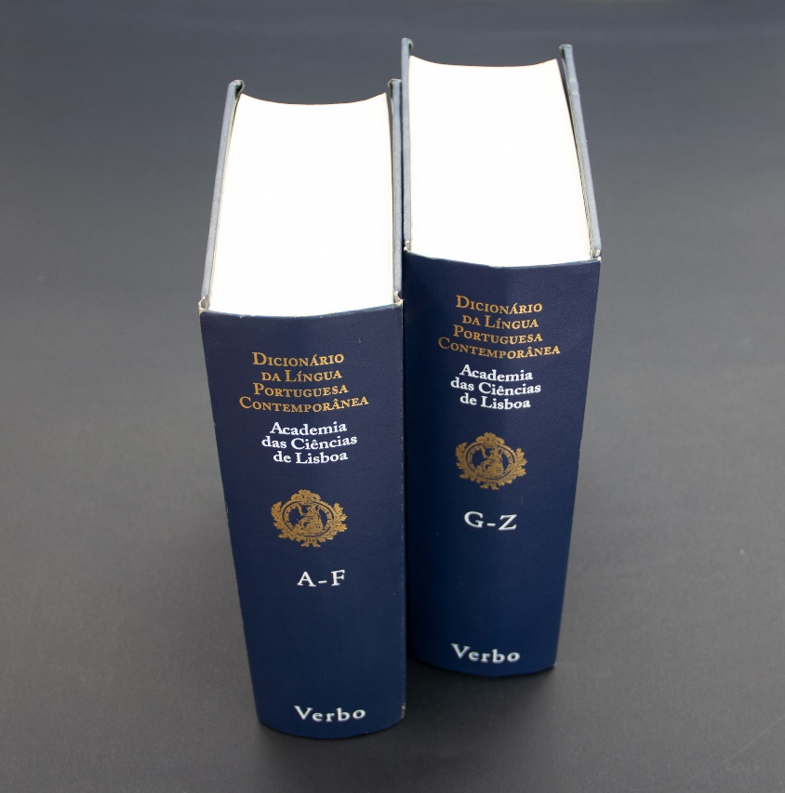
Academia das Ciências de Lisboa (dictionaries)
Diccionario da Lingoa Portuguesa (1793)
Academia Real das Sciencias de Lisboa
From a to azurrar
Dicionário da Língua Portuguesa (1976)
Academia das Ciências de Lisboa, coord. Jacinto Prado Coelho (1920–1984)
From a to azuverte (678pp.)
Dicionário da Língua Portuguesa Contemporânea (2001)
Academia das Ciências de Lisboa, coord. João Malaca Casteleiro (1920–1984), Editorial Verbo
From a to z, 2 vols. (A-F e G-Z; pp. 3809pp.) 69,426 entries
167,556 senses
Salgado et al. (2023). Dicionário da Língua Portuguesa…

Slide 5
Academia das Ciências de Lisboa (a new dictionary)
In 2015, ACL decided to proceed with preparatory work for the creation of a new language dictionary:
to continue the work from the previous edition
to conduct a comprehensive review of the previous edition (domains)
to address any potential gaps or inconsistencies found in the previous edition
to expand and update the range of lexical units
to adhere to the new spelling agreement
to bet on a digital edition, using a standardised and interoperable
Salgado et al. (2023). Dicionário da Língua Portuguesa…
5

Slide 6
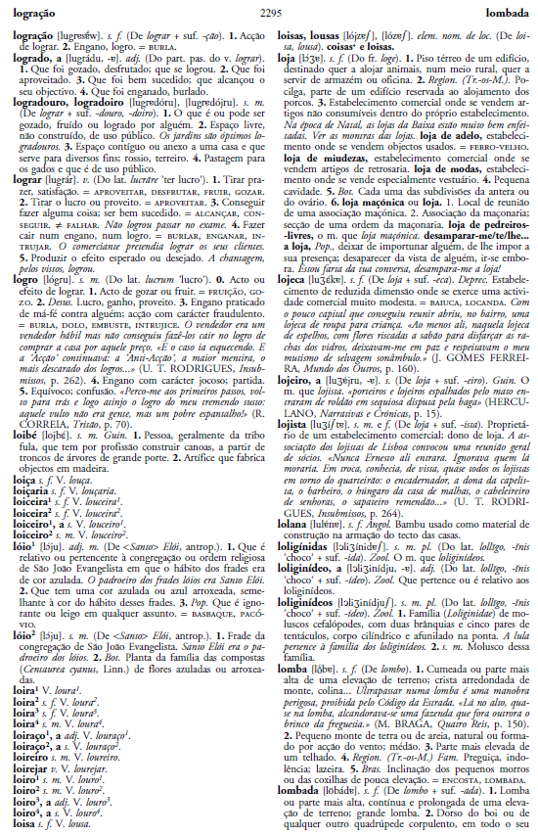
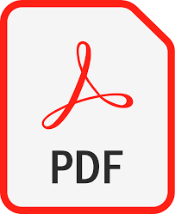
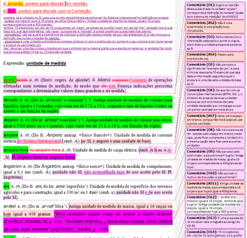
Academia das Ciências de Lisboa (a new dictionary)
Salgado et al. (2023). Dicionário da Língua Portuguesa…
6

Slide 7
Academia das Ciências de Lisboa (a new dictionary)
Protocol with the University of Minho (2016)
ACL signed a protocol with the University of Minho for the development of a database that would support a digital version of the ACL dictionary.
The agreement included the provision of programming expertise and a commitment from both parties to share resources.
The first task was to convert the aforementioned PDF into an XML document, following the guidelines of the Text Encoding Initiative (TEI).
The necessity of ensuring a daily backup system capable of registering changes and allowing reverting to previous versions if necessary.
The initial editing support was the Oxygen editor, which has never ceased to be used. However, it has gradually been replaced by LeXmart (http://lexmart.eu/).
Salgado et al. (2023). Dicionário da Língua Portuguesa…
7

Slide 8
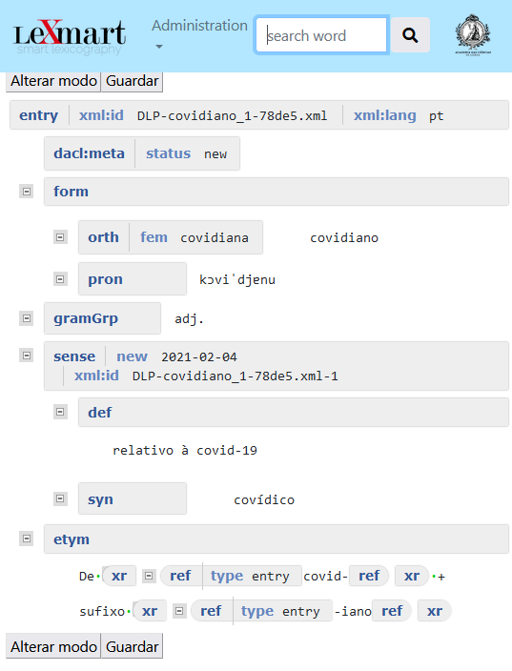
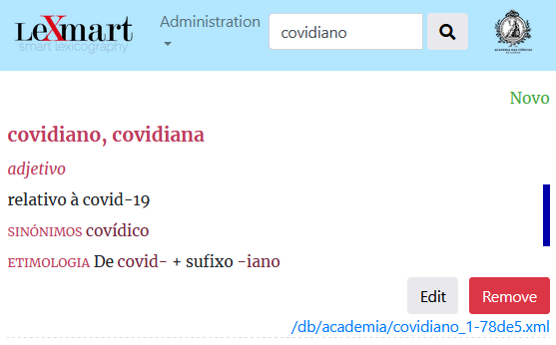
Academia das Ciências de Lisboa (a new dictionary)
<?xml-model href="http://dacl.zbr.pt/exist/rest/db/schemas/academia.rng" type="application/xml" schematypens="http://relaxng.org/ns/structure/1.0"?><?xml-model href="https://exist.dacl.zbr.pt/exist/rest/db/schemas/academia.rng" type="application/xml" schematypens="http://relaxng.org/ns/structure/1.0"?> <entry xmlns="http://www.tei-c.org/ns/1.0" xml:id="DLP-covidiano_1-78de5.xml" xml:lang="pt"> <dacl:meta xmlns:dacl="http://dacl.zbr.pt/annotations" status="new"/> <form> <orth fem="covidiana">covidiano</orth> <pron>kɔviˈdjɐnu</pron> </form> <gramGrp>adj.</gramGrp> <sense new="2021-02-04" xml:id="DLP-covidiano_1-78de5.xml-1"> <def>relativo à covid-19</def> <xr type="synonymy"> <ref type="entry">covídico</ref> </xr> </sense> <etym>De <xr><ref type="entry">covid-</ref></xr> + sufixo <xr><ref type="entry" >-iano</ref></xr></etym> </entry>
LeXmart (Simões & Salgado) is an open-source web platform created to support the lexicographic word of ACL.
LeXmart includes an editor, but it also allows you to edit an entry directly in Oxygen.
Salgado et al. (2023). Dicionário da Língua Portuguesa…
8

Slide 9
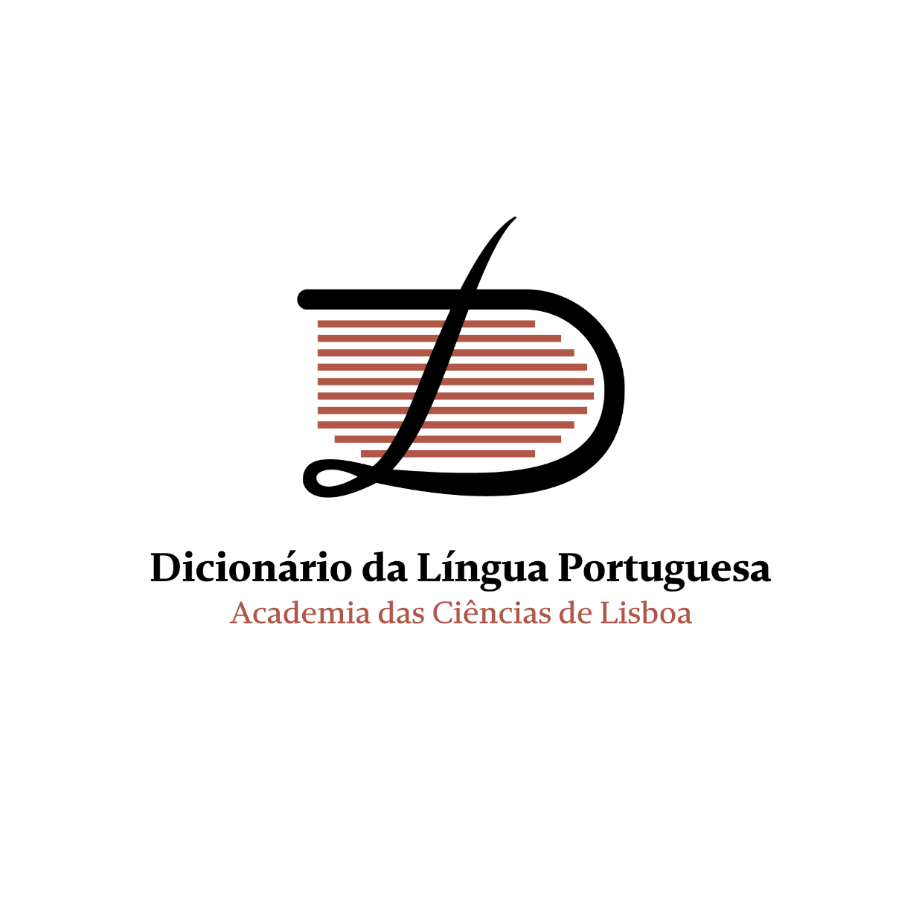
Dicionário da Língua Portuguesa (2023)
Dicionário da Língua Portuguesa (2023)
Academia das Ciências de Lisboa, coord. Ana Salgado
From a to z, digital edition More than 100 000 entries
194,683 senses
The digital version of the academy dictionary, based on the lexicographic work published in 2001, is the result of the commitment and collaboration of several academics and national researchers.
More than 30,000 entries have been added compared to the previous edition, and the previous content has been partially revised.
The project was supported by the Community Support Fund (FAC) through the Foundation for Science and Technology (FCT).
https://dicionario.acad-ciencias.pt/
Salgado et al. (2023). Dicionário da Língua Portuguesa…
9

Slide 10
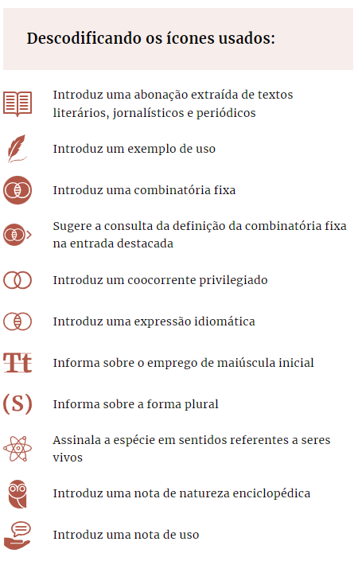
Dicionário da Língua Portuguesa (2023)
https://dicionario.acad-ciencias.pt/guia-de-uso/
Salgado et al. (2023). Dicionário da Língua Portuguesa…
10

Slide 11
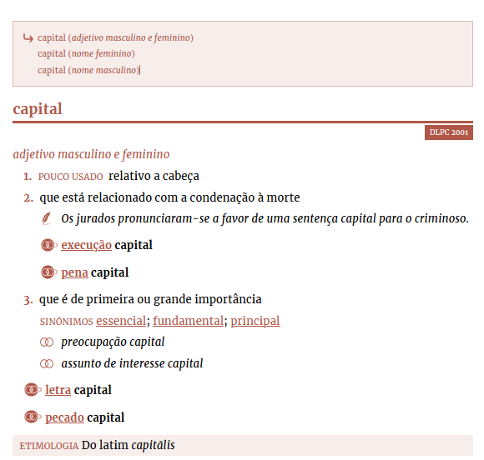
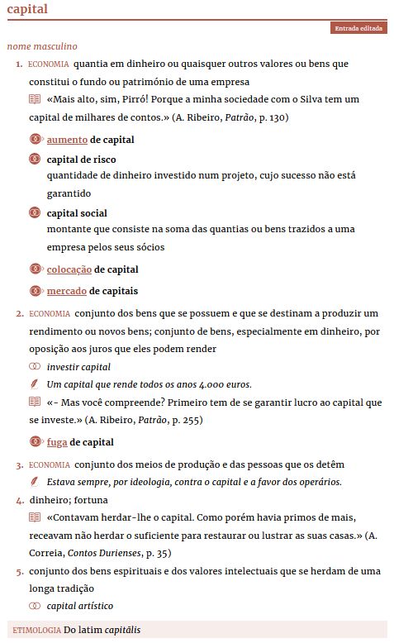
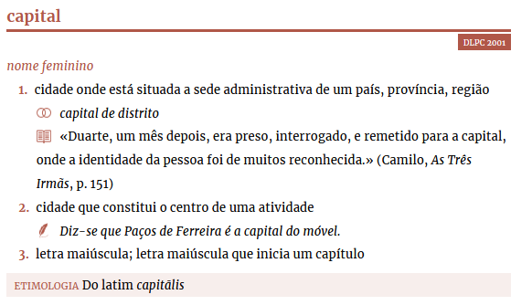
Dicionário da Língua Portuguesa (2023)
Salgado et al. (2023). Dicionário da Língua Portuguesa…

Slide 12
Dicionário da Língua Portuguesa (2023)
the list of gaps identified in the previous edition
the comparison of entries between Jspell and DLP
the list of entries from the Vocabulário Ortográfico da Língua Portuguesa (ACL, 2018)
lexical units extracted from the corpus of current Portuguese periodics (Sketch Engine)
manual collection of lexical units
suggestions from end-users
Salgado et al. (2023). Dicionário da Língua Portuguesa…
12

Slide 13
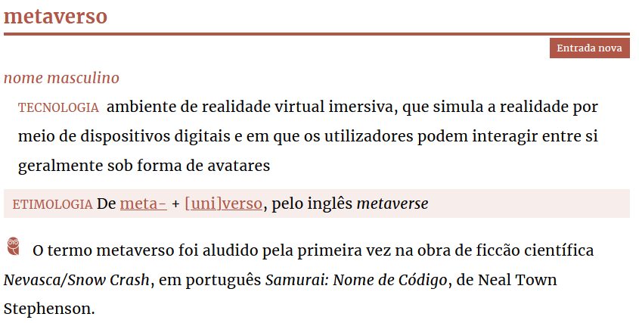
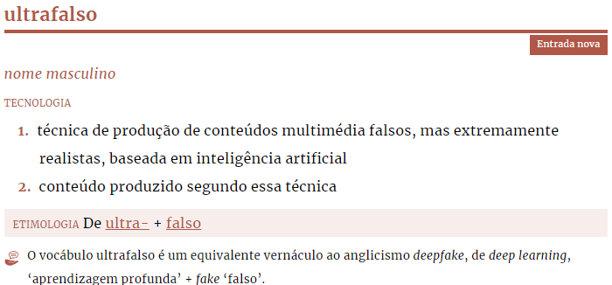
Dicionário da Língua Portuguesa (2023)
Salgado et al. (2023). Dicionário da Língua Portuguesa…
13

Slide 14
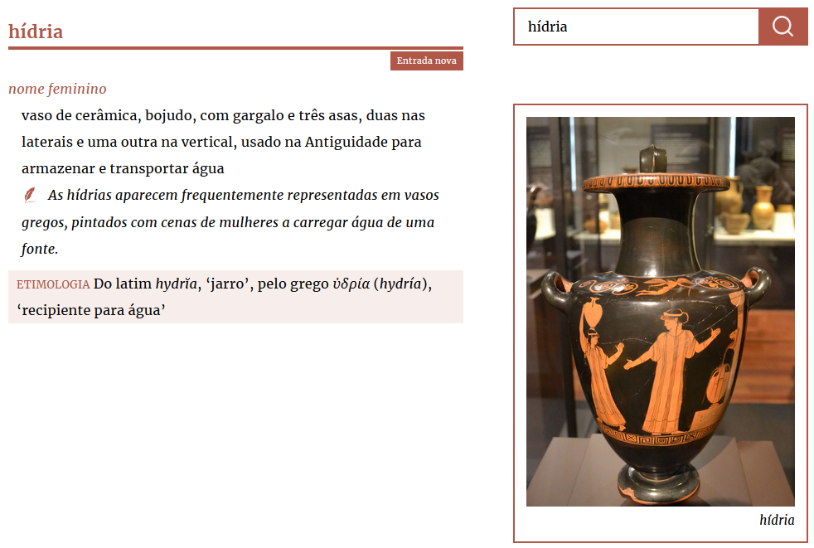
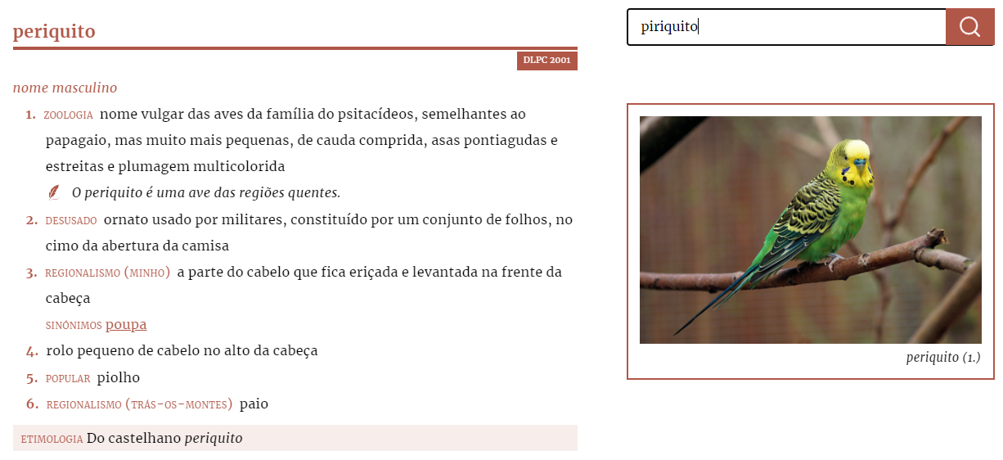
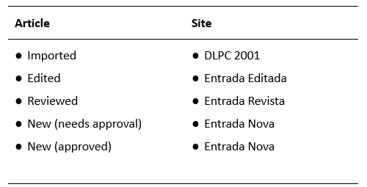
Dicionário da Língua Portuguesa (2023)
Salgado et al. (2023). Dicionário da Língua Portuguesa…
14

Slide 15
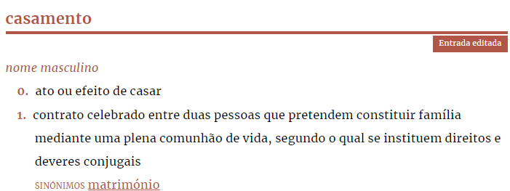
Dicionário da Língua Portuguesa (2023)
Salgado et al. (2023). Dicionário da Língua Portuguesa…
15

Slide 16
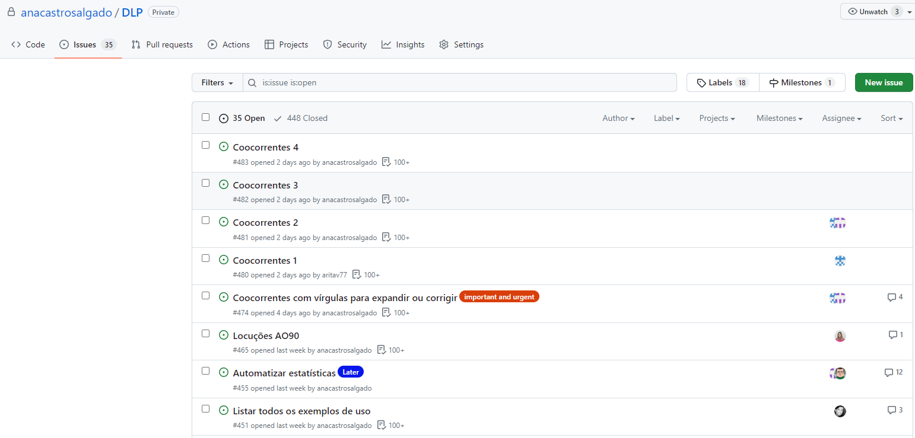
Dicionário da Língua Portuguesa (2023)
Salgado et al. (2023). Dicionário da Língua Portuguesa…
16

Slide 17
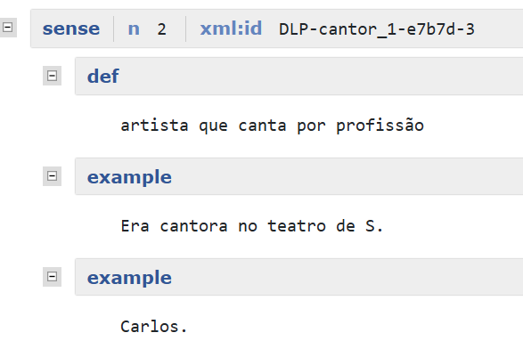
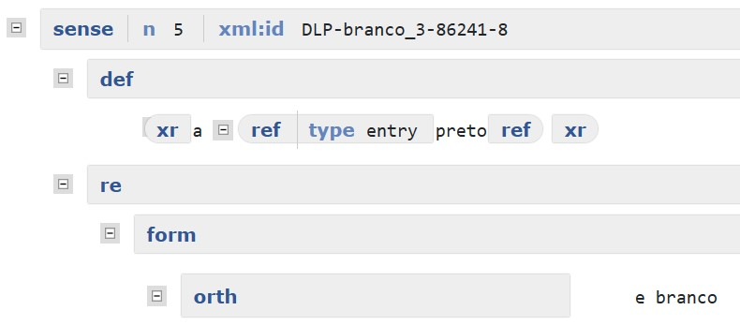
Dicionário da Língua Portuguesa (2023)
Salgado et al. (2023). Dicionário da Língua Portuguesa…
17

Slide 18
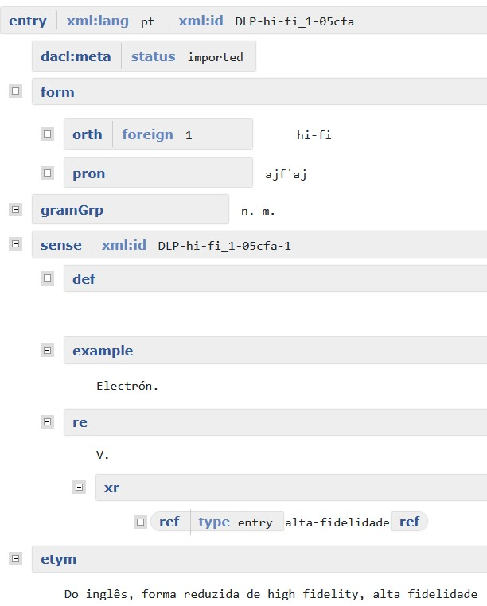
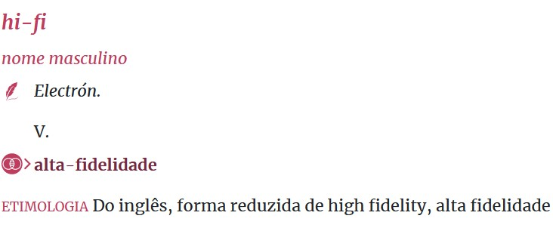
Dicionário da Língua Portuguesa (2023)
“hi-fi”, in Dicionário da Língua Portuguesa Contemporânea. Academia das Ciências de Lisboa
“hi-fi”, in Dicionário da Língua Portuguesa. Academia das Ciências de Lisboa
Salgado et al. (2023). Dicionário da Língua Portuguesa…
18

Slide 19
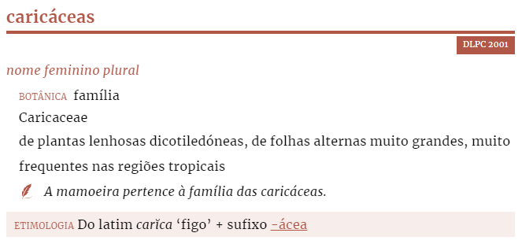
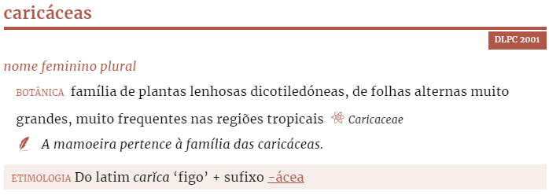
Dicionário da Língua Portuguesa (2023)
Salgado et al. (2023). Dicionário da Língua Portuguesa…
19

Slide 20
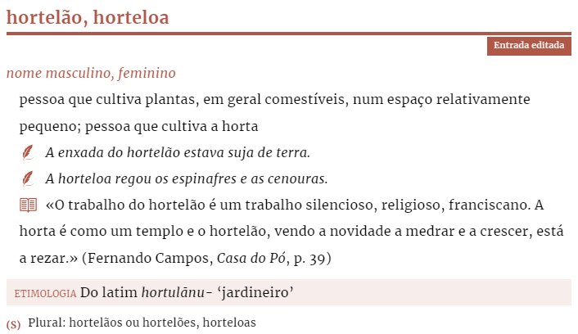
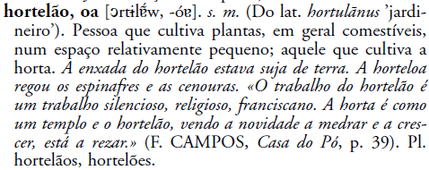
Dicionário da Língua Portuguesa (2023)
Salgado et al. (2023). Dicionário da Língua Portuguesa…
20

Slide 21
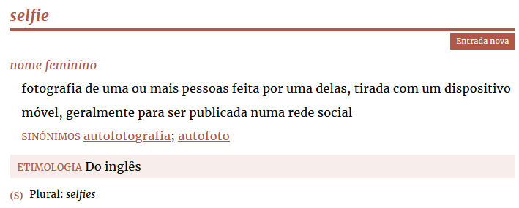
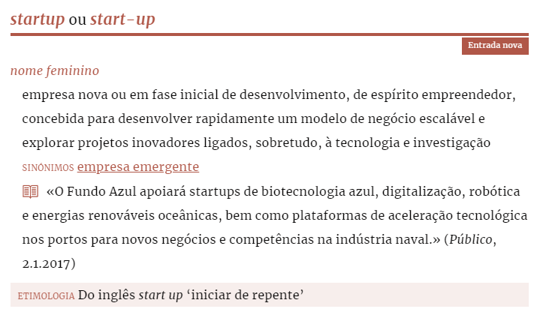
Dicionário da Língua Portuguesa (2023)
“free/ice-cream/nonsense/volley”,
in Dicionário da Língua Portuguesa Contemporânea (2001)
Salgado et al. (2023). Dicionário da Língua Portuguesa…

Slide 22
Dicionário da Língua Portuguesa (2023)
Long-Term Preservation
Use open formats following public standards
Document decisions and standard adaptation/interpretation
Ensure Quality
Development of tools to check consistency:
references/cross-references to existing entries
conventions for specific contexts (language constructs, sense 0, etc.)
order of components (collocations, examples, quotes)
Salgado et al. (2023). Dicionário da Língua Portuguesa…
22

Slide 23
Future work
Continuously update the DLP by adding new lexical units.
Improve the overall encoding of lexicographic components and develop a clear metalanguage.
Enhance the search engine algorithm for accurate results.
Link the DLP’s lexicographic data with other reference resources for comprehensive information.
Review and organise terms in the DLP based on terminological principles and create definitions that align with these principles.
Stay informed and involved in other lexicographic projects for ongoing learning and collaboration.
Explore collaborations with research centres and cultural organisations.
Salgado et al. (2023). Dicionário da Língua Portuguesa…

Slide 24
Ana Salgado ana.salgado@fcsh.unl.pt Alberto Simões asimoes@ipca.pt Álvaro Iriarte Sanromán alvaro@elach.uminho.pt Rita Vieira illlp@acad-ciencias.pt Manuela Ferreira illlp@acad-ciencias.pt Rita Carmo illlp@acad-ciencias.pt Conceição Pinheiro illlp@acad-ciencias.pt
Thank you for your attention!

