Slide 1
From Structured Textual Data to Semantic Linked-data for Georgian Verbal Knowledge
Archil Elizbarashvili¹, Mireille Ducassé², Manana Khachidze¹, Magda Tsintsadze¹
¹TSU, Georgia ²IRISA-INSA, France
eLex 2023: electronic lexicography in the 21st century June 26-29, 2023. Brno, Czech Republic

Slide 2
Plan
2
Introduction
Transformation Process
Decision Tree to Improve Occasional Missing Fields
Perspectives & Conclusion

Slide 3
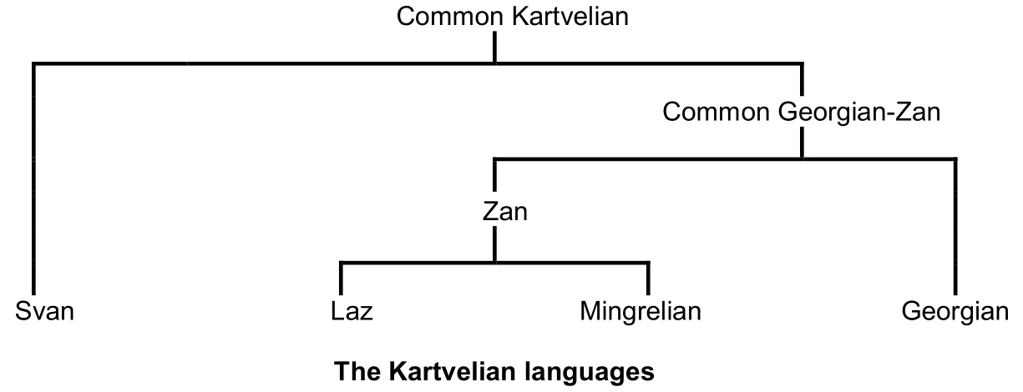
Introduction: Kartvelian languages
3
The Caucasian Languages & The Kartvelian
Languages [Hillery 2013]
Svan | ონწონ | on-ts'on
Mingrelian | დოვწონი | do-v-ts'on
Laz | ფწონი | p-ts'on-i
Georgian | ავწონე | a-v-ts'on-e
I weighted it

Slide 4
Introduction: Georgian Grammar
4
Georgian Language is Agglutinative and inflectional
Verbs can contain many markers changing meaning of a word
Conjugation can modify both the beginning and the ending of verbs
Example: Verb “to work” (mushaoba - მუშაობა)
Present 1pl - “v-mushaob-t” (ვ-მუშაობ-თ)
The preradical “v” at the beginning of the verb to mark the first person, and the ending “t” to mark the plural
Future 1sg - “vimushaveb” (ვიმუშავებ)
An “i” has been inserted after the “v” marker of first person and stem formant “ob” has changed into “eb”

Slide 5
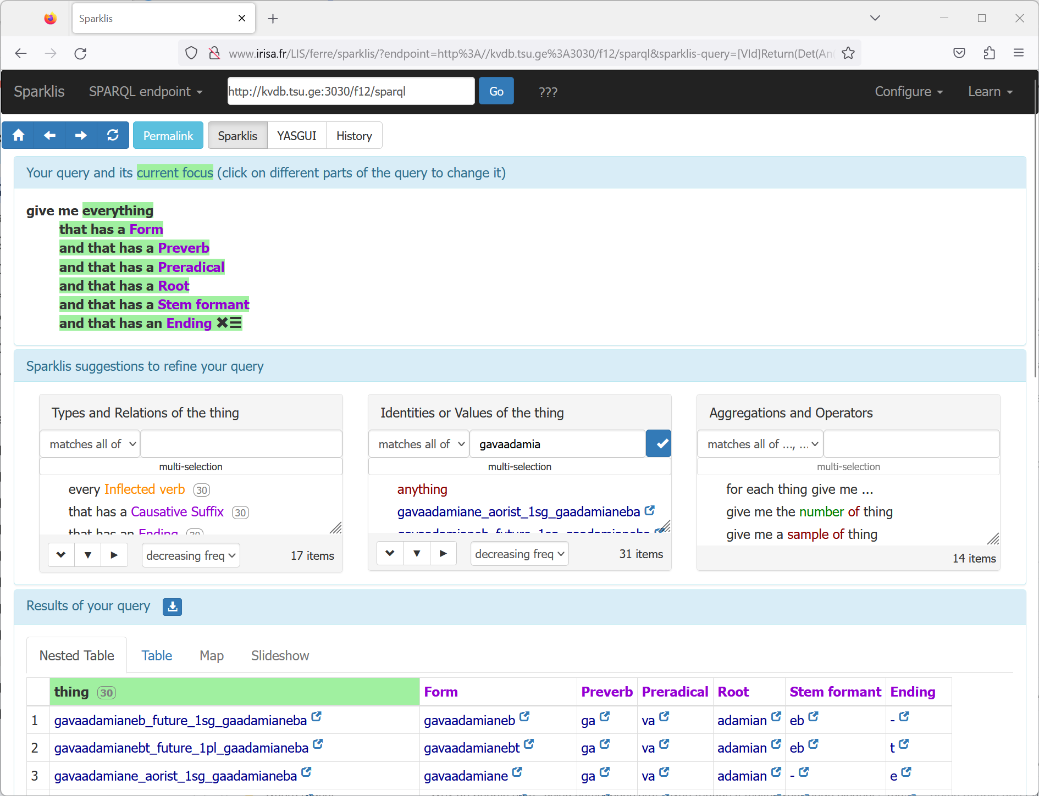
Introduction KartuVerbs
5
[Ducasse, Euralex 2020]
Knowledge base of inflected forms of Georgian verbs
Semantic web knowledge base
Powerful navigation thanks to Sparklis [Ferré, S. (2017)]
280 verbs
[Ducasse & Elizbarashvili, Euralex 2022]
16 000 verbs, 80 million connections
From Clarino [Meurer, P. (2007)]
https://clarino.uib.no/iness
Acceptable navigation response times
Still needs to be validated
This paper: construction, validation and improvement of an enlarged base

Slide 6
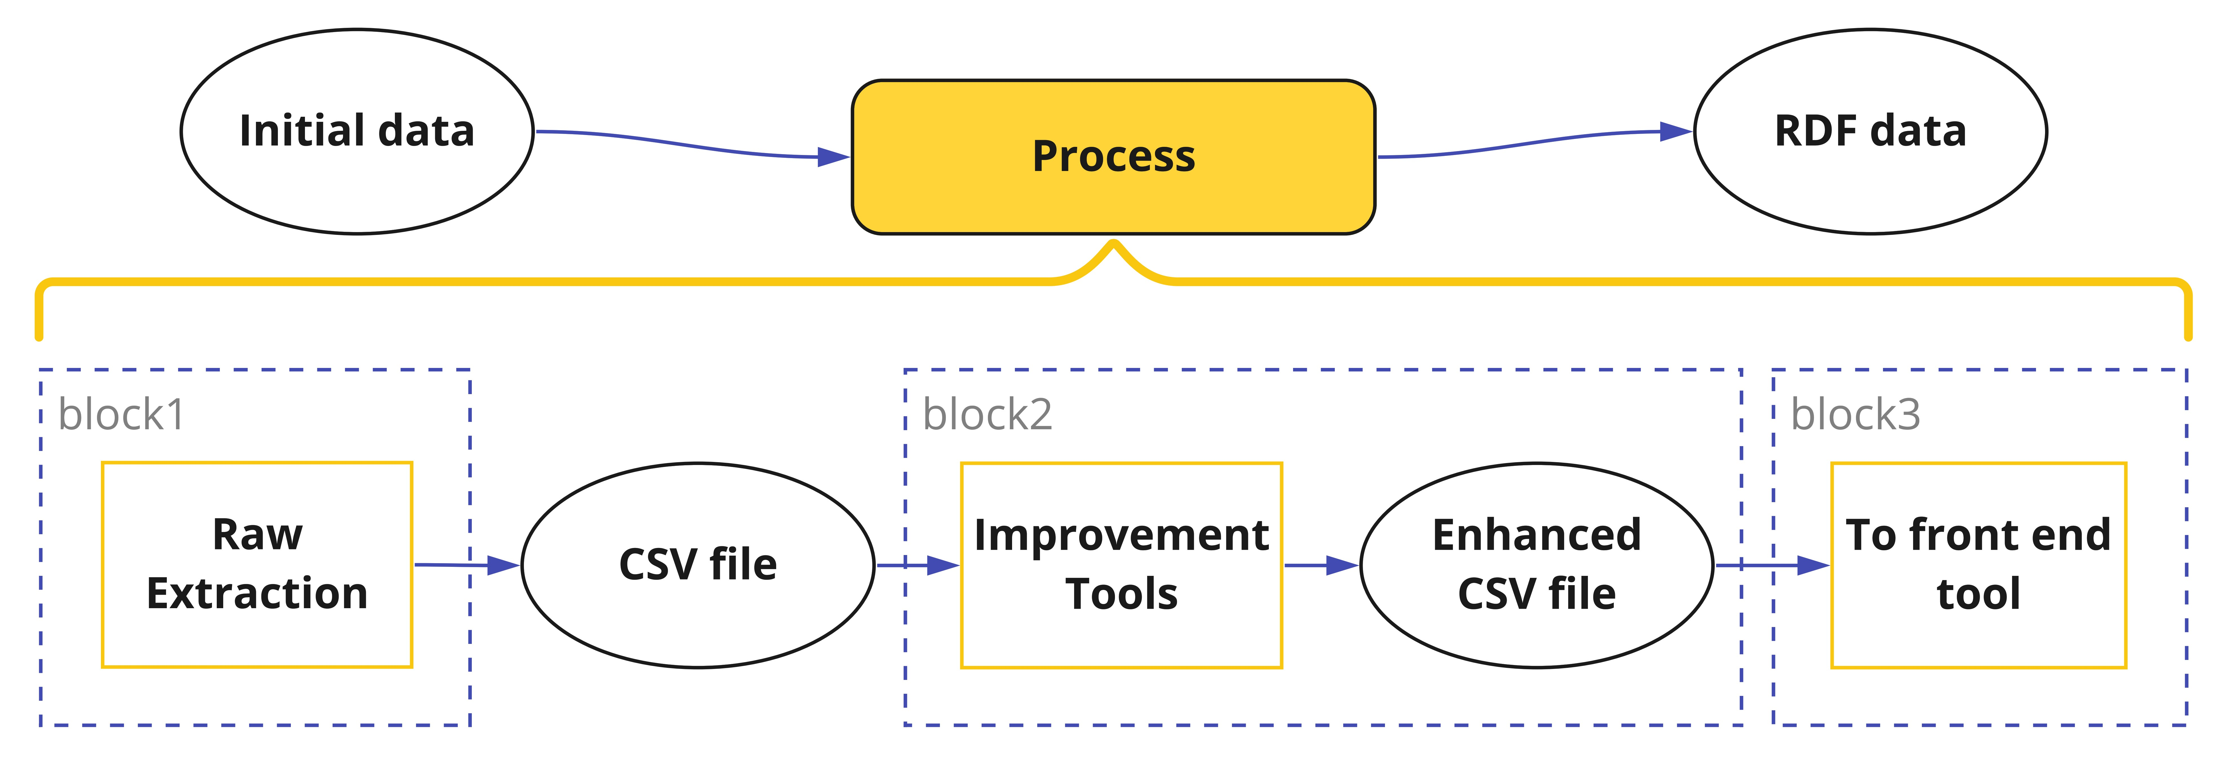
Construction, Validation and Improvement Process
6
Block1 – Scrap Clarino and generate CSV file
Block2 – Improve raw data (several processes)
Block3 – Transform CSV to RDF data

Slide 7
Clarino vs Kartuverbs: different aims
7
verb “to humanize somebody”
Clarino page, aiming at linguists, text
KartuVerbs, aiming at foreigners learning the Georgian language, data
Clarino |  | “aorist” | “verbal noun”
 | … | “1sg ვაადამიანე, გავაადამიანე” | “*ადამიანება” | …
 | … | … | … | …
KartuVebs | form | tense | person | number | masdar | …
 | ვაადამიანე | aorist | 1 | sg | გაადამიანება | …
 | გავაადამიანე | aorist | 1 | sg | გაადამიანება | …
 | … | … | … | … | … | …

Slide 8
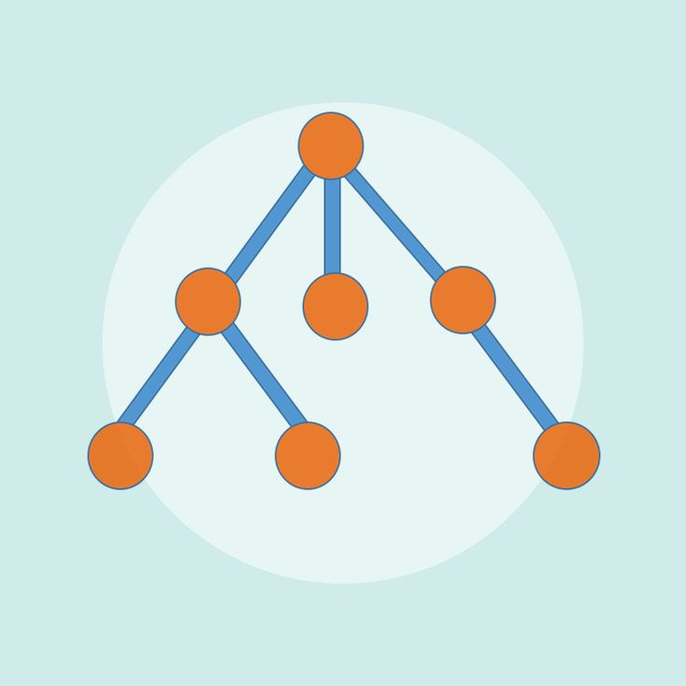
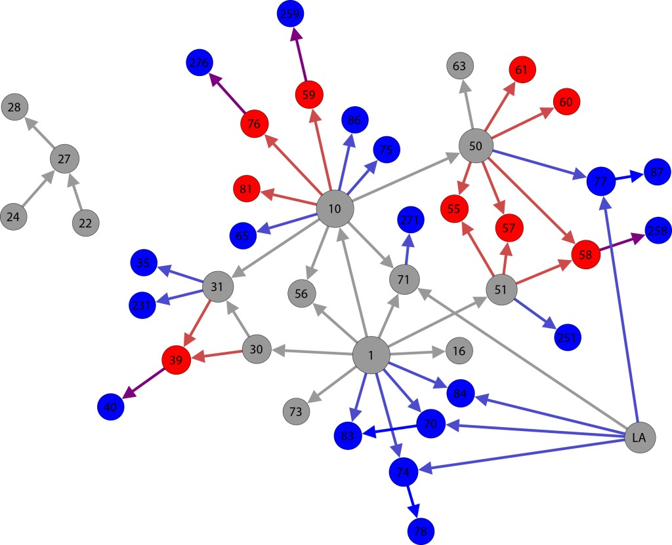
Clarino vs Kartuverbs: hierarchical vs relational
8
Clarino:
Information is hierarchical
Access key is root
Structure starts with root, then verb
KartuVerbs:
Information is relational, linked data
Access key any characteristic
Linked to all other characteristics

Slide 9
Plan
9
Introduction
Transformation Process
From Clarino To An Intermediate CSV File
Improvement of Intermediate Data
From CSV To RDF linked-data for SparkLis
Decision Tree to Improve Occasional Missing Fields
Perspectives & Conclusion

Slide 10
Construction: Clarino to CSV
10
The Clarino web pages are scraped
Initial scrapping: C++ program
Output:
Json pretty format
22 M lines
625 MB
From Json to Csv: Python script
Output:
3.3 GB
5.7 M Lines
64 properties

Slide 11
Construction: Improvement of Intermediate Data
Example of Fields that are systematically present but with specific encoding
Root:
Verb root can contain Latin characters among the Georgian characters
They are used to signal alternatives
Multiplication of lines containing Latin characters with alternative values
Root
I | ი (i) OR ე (e) | ვIდ = ვიდ OR ვედ (vid OR ved)
A | ა (a) OR Null | სხAლ = სხლ OR სხალ (skhl, skhal)
u | ვ (v) | ხილu = ხილვ (khilv)
… | … | …
...*სვლა;ვIდ... (...*svla;vId...)
ავიდეთ;optative;1;pl;*სვლა;ვიდ...
ავედით;aorist;1;pl;*სვლა;ვედ...
avidet;optative;1;pl;*svla;vid...
Let’’s go up
avedit;aorist;1;pl;*svla;ved...
We went up

Slide 12
Construction: Improvement of Intermediate Data
Example of Missing fields with enough information to deduce information
Preverb: some forms start with a preverb that gives an indication similar to English postpositions. There are more than 40 possible preverbs
Verbal noun: verb lemma root (without preverb)
Masdar: verb lemma
When verbal noun is available, the script merges it with the preverb
Preverb
ა (a), ამო (amo), გა (ga), გადა (gada), და (da), მი (mi), მო (mo), შე (she), ჩა (cha), წა (ts’a) … | “-”, “გა” (ga), “-”
Verbal noun
Form: “გადა-ვა-კეთ-ეთ” (gada-va-ket-et) Preverb: “გადა” (gada) Verbal noun: “*კეთება” (*keteba)
Deduced “masdar”: “გადაკეთება” (gadaketeba, to alter) “გაკეთება” (gaketeba, to do) “შეკეთება” (sheketeba, to repair) “მოკეთება” (moketeba, to recover) …

Slide 13
Construction: From CSV to Sparklis
13
One line of the CSV file with $n$ columns is transformed into $n−1$ triplets
Kartuverbs (CSV)
form |  | tense | person | number | …
ვაადამიანებ |  | present | 1 | sg | …
… |  | … | … | … | …
RDF triplets
<ვაადამიანებ> <tense> <present> . <ვაადამიანებ> <person> <1> . <ვაადამიანებ> <number> <sg> . ...
To humanize somebody

Slide 14
Plan
14
Introduction
Transformation Process
Decision Tree to Improve Occasional Missing Fields
Experimental setting
Results and Discussion
Implementation issues
Perspectives & Conclusion

Slide 15
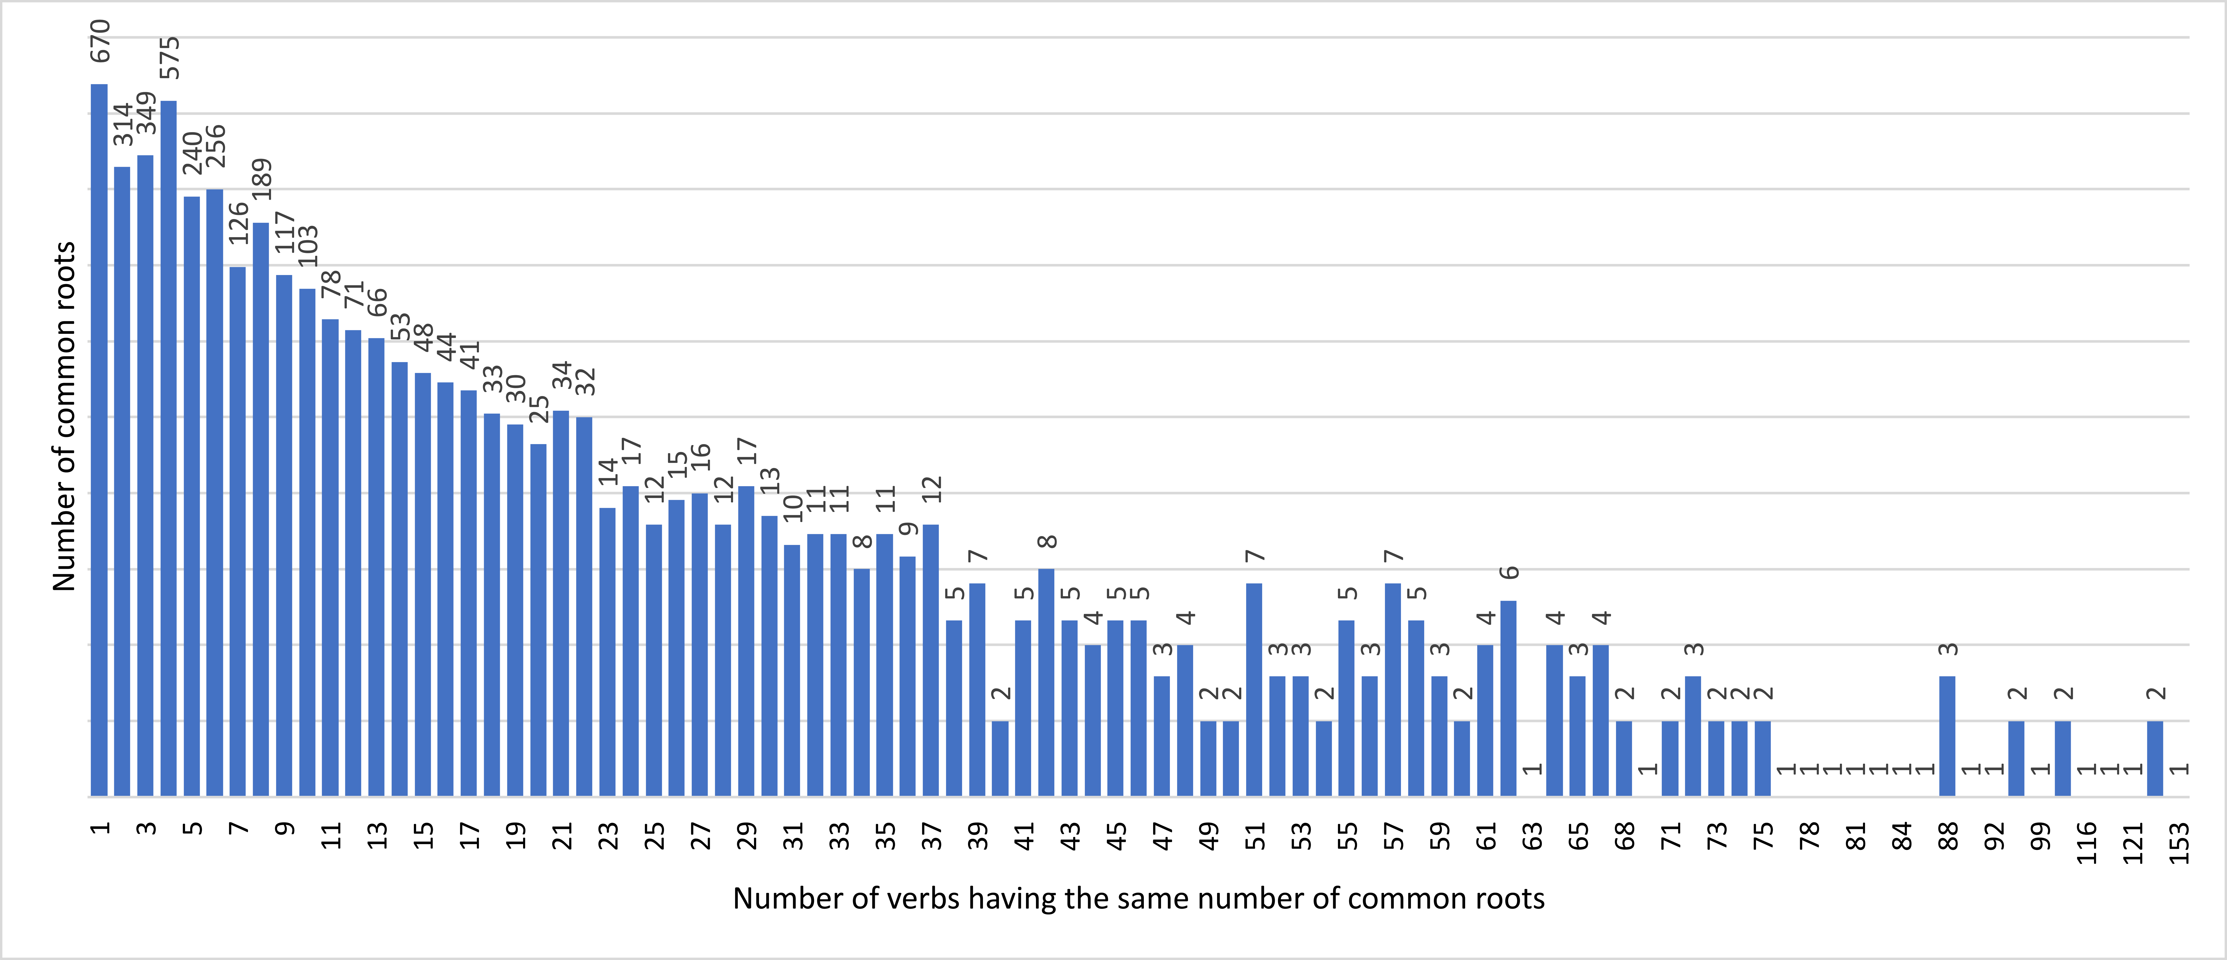
Construction: Improvement of Intermediate Data
Example of Fields that should be present, but that are occasionally absent
Verbal noun: verb lemma root (without preverb). Over 600 000 forms (corresponding to 4640 verbs) do not have a verbal noun
Machine learning experiment to fill missing values for verbal nouns
Common-root can lead to multiple verbs
670 common roots lead to a single verb
1 common root leads to 153 different verbs
In average, 1 common root leads to 9 different verbs
Conjecture:
Missing values should be present in the base somewhere else

Slide 16
Decision Tree: Experimental setting
16
Improvement process is incremental
Filtration: duplicated lines, empty forms lines, lines with morphologically incorrect forms, all lines without verbal noun before training
The input file for ML - 3.8 million lines, each one containing a Georgian inflected verb form and 14 of its features

Slide 17
Why Decision Tree?
17
Supervised learning algorithm: 80% of data is present
Multiclass classification tasks [Bansal et al. (2022)]: 1 verbal noun should be selected from 6539 verbal nouns
DT model is non-parametric: complex patterns in the input data. Impossible to be modeled using a parametric algorithm
DT possesses very low complexity: Crucial considering the size of input data
DT is not influenced by missing values:

Slide 18
Decision Tree: Experimental setting
18
Transform Georgian texts to numbers with specific encoding $f\left(string\right)=\sum_{i=1}^{string length}{Byte value(Last byte(UTF−8({character}_{i}))))}$
Transform Categorical variables to numbers
Training/Testing data subsets with 80% / 20% ratio
Systematic and seed number (>10) randomization
Same evaluation scores with both approaches across different run

Slide 19
Decision Tree: classification report
Verbs with VN
~66 inflected forms per verb
15 features per form
if VN is present, it is present in all forms
Form in training data (80%)
Form in test data (20%)
v₁ v₂ ….. v_{i} v_{j} ….
VN
 | Precision | Recall | F1-score | Support
Accuracy |  |  | 1.00 | 759663
Macro avg | 1.00 | 1.00 | 1.00 | 759663
Weighted avg | 1.00 | 1.00 | 1.00 | 759663
VN
VN
VN
Score value 1 => 100% of prediction rate
Some Individual scores < 1
Zero shot: No candidate to compare
Multiple possibility in the train data
VN
VN
Zero shot

Slide 20
Decision Tree: Results and Discussion
20
Trained model applied to the 600 000 forms with missing verbal noun
Manual sampling showed some mistakes
Conjecture has to be refined (If a verb does not have a verbal noun and there exist other verbs with the same common root, verbal noun can be deduced?)
Non-bijective encoding problem? Zero-shot classification problem?
Development of tools to facilitate the validation of results
Heuristics to reduce the number of results to be manually checked
Example: A predicted verbal noun is questionable when it does not match the root of the form.
Configuration of crowd-sourcing platform HEADWORK https://druid-garden.irisa.fr/spipollhw/

Slide 21
Plan
21
Introduction
Transformation Process
Decision Tree to Improve Occasional Missing Fields
Perspectives & Conclusion

Slide 22
Perspectives
22
Refine the process and add more improvement tools
Apply decision tree to occasional incorrect value fields
Investigate if [Stefanovitch et al., (2022)] process for Georgian texts could be adapted to help improve or validate our morphemes
Investigate BERT [Devlin et al. 2019] for further improvement tools
Add zero-shot classification possibility

Slide 23
Conclusion
23
Process to transform textual structured knowledge into semantic linked data, applied to Georgian verbal knowledge
Target users and objectives of the two bases differ
Initial data has to be reconstructed and interpreted to fit KartuVerbs objectives
DT algorithm gives approximately 100% of prediction on the test data while have some mistakes on the missing values
The produced scripts are freely available
Can be adapted to other applications into other data suited for different objectives.
https://github.com/aelizbarashvili/KartuVerbs

Slide 24
References 1/2
24
Bansal, M. et al. (2022). A comparative analysis of K-Nearest Neighbor, Genetic, Support Vector Machine, Decision Tree, and Long Short Term Memory algorithms in machine learning. Decision Analytics Journal
Conneau, A. et al. (2020). Unsupervised Cross-lingual Representation Learning at Scale. Proceedings of the 58th Annual Meeting of the Association for Computational Linguistics
Devlin, J. et al. (2019). BERT: Pre-training of Deep Bidirectional Transformers for Language Understanding. Proceedings of the 2019 Conference of the North American Chapter of the Association for Computational Linguistics: Human Language Technologies
Ducassé, M. (2020). Kartu-Verbs: A Semantic Web Base of Inflected Georgian Verb Forms to Bypass Georgian Verb Lemmatization Issues. In Z. Gavriilidou, M. Mitsiaki, & A. Fliatouras (Ed.), Proceedings of XIX EURALEX International Congress
Ducassé, M., & Elizbarashvili, A. (2022). Finding Lemmas in Agglutinative and Inflectional Language Dictionaries with Logical Information Systems: The Case of Georgian verbs. Proceedings of XX EURALEX International Congress
Ferré, S. (2017). Sparklis: An Expressive Query Builder for SPARQL Endpoints with Guidance in Natural Language. Semantic Web: Interoperability, Usability, Applicability
Kittask, C. et al. (2020). Evaluating multilingual BERT for Estonian. In A. Utka et al. (Ed.), Human Language Technologies – The Baltic Perspective.

Slide 25
References 2/2
25
Meurer, P. (2007). A computational grammar for Georgian. International Tbilisi Symposium on Logic, Language, and Computation
Pires, T., Schlinger, E., & Garrette, D. (2019). How multilingual is Multilingual BERT? Proceedings of the 57th Annual Meeting of the Association for Computational Linguistics
Stefanovitch, N. et al. (2022). Resources and Experiments on Sentiment Classification for Georgian. International Conference on Language Resources and Evaluation.
Tschenkéli, K. et al. (1965). Georgisch-deutsches Wörterbuch (Vol. 2). Amirani-Verlag Zürich.
Tuite, K. (1998). Kartvelian morphosyntax: Number agreement and morphosyntactic orientation in the South Caucasian languages. Lincom Europa Munich.
Wang, Z. et al. (2020). Extending Multilingual BERT to Low-Resource Languages. Findings of the Association for Computational Linguistics: EMNLP
Zhou, M. et al. (2020). Progress in Neural NLP: Modeling, Learning, and Reasoning.

Slide 26
Verb examples
26
Conjugation can modify both the beginning and the ending of verbs.
Verb “to work” (mushaoba - მუშაობა)
Present 1pl – “v-mushaob-t” (ვ-მუშაობ-თ)
The preradical “v” at the beginning of the verb to mark the first person, and the ending “t” to mark the plural.
Some tenses, such as future, often introduce a preverb.
Verb “to work”, the first person singular future is “vimushaveb” (ვიმუშავებ). An “i” has been inserted after the “v” marker of first person and stem formant “ob” has changed into “eb”.
თ.

Slide 27
Clarino fields Typology
27
Fields that are systematically present and that seem correct. Examples:
Tense
Person …
Fields that are systematically present but with specific encoding. Example:
Root
Missing fields but there is enough information to deduce the information. Examples:
Preverb
Masdar
Fields that we need that should always be present, but that are occasionally absent. Example:
Verbal noun

Slide 28
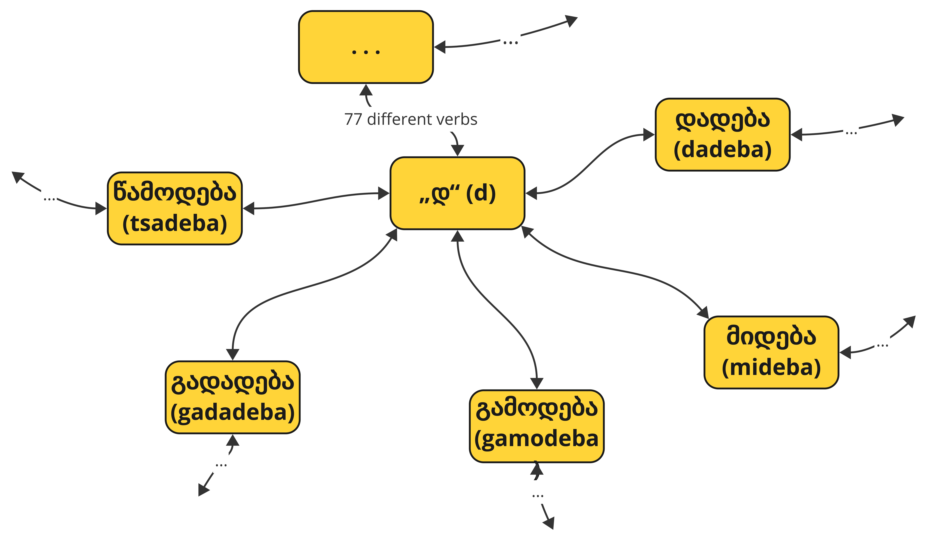
Clarino vs Kartuverbs: hierarchical vs relational
28
Common-root „დ“ (d) ▷
დადება (dadeba, to put)
მიდება (mideba, to touch)
გამოდება (gamodeba, to hook)
გადადება (gadadeba, to postphone)
წამოდება (tsamodeba, to catch (on))
…
77 different verbs
Clarino:
Information is hierarchical
Access key is root
Structure starts with root, then verb
Common-root “დ” (d) leads 77 different verbs: დადება (dadeba, to put), მიდება (mideba, to touch), გამოდება (gamodeba, to hook), გადადება (gadadeba, to postphone), წამოდება (tsamodeba, to catch (on))
KartuVerbs:
Information is relational, linked data
Access key any characteristic
Linked to all other characteristics
Key is inflected form. The process flattens the structure and generates tuples whose first field is an inflected form.
Notes:
Multiple values in Clarino fields are factorized in lines.
common-root „დ“ (d) => 77 verbs: დადება (dadeba, to put), მიდება (mideba, to touch), გამოდება (gamodeba, to hook), გადადება (gadadeba, to postphone), წამოდება (tsamodeba, to catch (on)), ...

Slide 29
Construction: Improvement of Intermediate Data
Verbs may have different roots in their forms.
For a given verb, Clarino gives all the possible roots attached to a common root. However, a given form only contains one of them. The script eliminates all the irrelevant roots from form descriptions.
Notes:
For example: common root “მბობ” (“mbob”) leads to verbs around the meaning of “to say” with 7 different roots: “ამბ” (“amb”), “თქ” (“tk”), “თქვ” (“tkv”), “თხრ” (“tkhr”), “მბობ” (“mbob”), “ტყ” (“t’q”), “უბნ” (“ubn”).

Slide 30
Decision Tree: classification report
30
Classification Model evaluation
Score value 1 => 100% of prediction rate
Some Individual scores < 1
No candidate to compare
Dual possibility in the train data
 | Precision | Recall | F1-score | Support
Accuracy |  |  | 1.00 | 759663
Macro avg | 1.00 | 1.00 | 1.00 | 759663
Weighted avg | 1.00 | 1.00 | 1.00 | 759663
Individual verbal noun prediction scores
… | … | … | … | …
361 | 0.80 | 0.87 | 0.83 | 113
6453 | 0.59 | 0.47 | 0.52 | 47
6448 | 0.00 | 0.00 | 0.00 | 1
Notes:
Precision is the percentage of correct positive predictions relative to total positive predictions. Calculation: Number of True Positives (TP) divided by the Total Number of True Positives (TP) and False Positives (FP). $Precision=\frac{TP}{TP+FP}$ Recall is the percentage of correct positive predictions relative to total actual positives. Calculation: Number of True Positives (TP) divided by the Total Number of True Positives (TP) and False Negatives (FN).$Recall=\frac{TP}{TP+FN}$ F1 score is a weighted harmonic mean of precision and recall. $F1=\frac{2∗Precision∗Recall}{Precision+Recall}$. $Accuracy F1=\frac{TP}{TP+(FP+FN)/2}$
For each metric, the closer to 1, the better the model. 1 corresponds to 100% of prediction rate.
The table gives the individual verbal noun prediction scores that are less than 100%, ranging as low as 83%, 52%, and even 0%. The 0% score is due to the fact that there is only one occurrence of verbal noun *ფშვენა (*pshvena, related to a family of verbs around heavily breathing) in the entire training and test datasets. Therefore, there are no other instances for comparison. The 52% corresponds to ბორძიკ (bordzik’, to stumble); a verb for which in the training dataset, half of the occurrences have verbal noun ბორძიკ (bordzik’) and the other half have verbal noun *ბორძიკება (*bordzik’eba).

Slide 31
Decision Tree: Implementation Issues
31
DT not suitable for variables continuous in nature [Bansal et al. (2022)]
Integers instead of floats => the F1-score 77% to 100%.
Debian 11 (bullseye) Ubuntu 22.04.2 LTS (jammy).
Python 3.9 Unix-tools (awk, sed ...).
SVM model calculation problem
> 100 times longer the DT with only 100,000 rows of input data (instead of 4 M), using maximum cores for parallel computations
 | Virtual Server | Laptop: ROG Zephyrus M16
Model | Intel(R) Xeon(R) Gold 5118CPU @ 2.30GHz | 12th Gen Intel(R) Core(TM) i9-12900H
CPU MHz | 2294.612, 32-64 cores | 2900.000, 20 cores
Cache size | 16896 KB | 24576 KB
Memory | 64-96 GB | 48 GB
Swap Memory | 4 GB | 400 GB
Notes:
In order to evaluate the performance, we conducted additional tests by training the model on datasets consisting of 10 fields (form, preverb, predarical, root, stem formant, causative stem formant, ending, verb paradigm sub-ID, clarino ID, verbal noun) instead of 15, and 5 fields (form, root, verb paradigm sub-ID, clarino ID, verbal noun). Both datasets yielded similar average results. However, when examining the individual verbal noun prediction rates, the model trained with the larger dataset model outperformed the others. In terms of machine resource consumption and time efficiency, our experiments revealed that there is not a significant disparity between processing 15 fields, 10 fields, and 5 fields. Regardless of the number of fields processed, the model utilized a substantial amount of memory during the prediction phase. Specifically, for our input file, the model required approximately 50 GB of memory, which exceeds the typical memory capacity of machines. To overcome this challenge, we resolved the issue by expanding the SSD-based swap memory. With this configuration in place, our model successfully completed training, testing, and prediction tasks within approximately 2 minutes and 30 seconds for 15 fields, 2 minutes for 10 fields, and 1 minute and 30 seconds for 5 fields input files. Hence, in this particular context, a regular machine or laptop equipped with ample SSD storage can be employed to train extensive datasets using a decision tree algorithm. Although this may lead to a longer processing time, it remains a viable option.

