Slide 1
Theo JD Bothma¹ Danie J Prinsloo² ¹ TheoBothma@up.ac.za ² Danie.Prinsloo@up.ac.za University of Pretoria South Africa
Invisible lexicography in Sepedi writing systems
eLex 2023 Brno, Czech Republic 27–29 June 2023

Slide 2
Danie Prinsloo

Slide 3
Overview
Introduction
Brief description of the Sepedi Helper and the Copulative Decision Tree
Functionalities
Screen shots
Invisible lexicography underlying the two systems
Possible extensions
Conclusion

Slide 4
Introduction
Much research and development is being done by numerous companies on writing assistants, e.g.
Grammarly (https://www.grammarly.com/)
Linguix (https://linguix.com/)
Ginger (https://www.gingersoftware.com/)
Most of these writings assistants work on text production in one language only
Some provide assistance in multiple languages, e.g.
LanguageTool, which provides assistance in more than twenty languages (https://languagetool.org/)
Most assistants work in resource-rich languages

Slide 5
Current paper
We describe some features of two pioneering writing assistants developed for Sepedi, a lesser-resourced language of South Africa, viz.
The Sepedi Helper
It provides access to constructing Sepedi sentences via Sepedi or English words, and makes use of a fairly basic translation dictionary
The Copulative Decision Tree
It enables the user to navigate the complex structures of copulative constructions in Sepedi
User studies revealed that both these systems are very useful tools for students learning Sepedi

Slide 6
Basic characteristics
In both cases, invisible lexicographic strategies played a major underlying role
Both systems –
Help users to write grammatically correct Sepedi
Provide different levels of drill-down options for limited or detailed grammatical explanations
Therefore also function as computer-aided language learning tools (CALL)
Are prototypes that can be developed further
Information is available on demand, i.e., no information overload
Current and future compilation of writing assistants for Sepedi should be inspired by these two successful efforts

Slide 7
Sepedi Helper functionalities in a nutshell
The Sepedi Helper is intended as a step-by-step building assistant, aimed at complementing the existing knowledge of the user
The core of the Sepedi Helper lies in the build-up facility where the user is prompted to provide a subject noun, a verb and optionally an object noun or nouns
The software adds all the required concords, negation morphemes, correct verbal endings, etc.
The main screen of the Sepedi Helper presents the layout and abilities of the program as a sentence builder in different moods, in all of the tenses as well as positive and negative forms
It is a work in progress, the ultimate aim being the design and implementation of a complete electronic grammar for Sepedi, integrated into an interactive e-dictionary.

Slide 8
Purpose of the Sepedi Helper as a user support tool
It combines user knowledge with production support, i.e., user-involved interactive text production of verbs in the different moods in Sepedi, as well as other constructions
The tool functions as a confirmation mechanism: should users utilize their own knowledge in a production situation, the tool must be able to confirm the correctness of their efforts
The tool must be able to assist users to identify mistakes and provide them with the necessary guidance to correct such errors

Slide 9
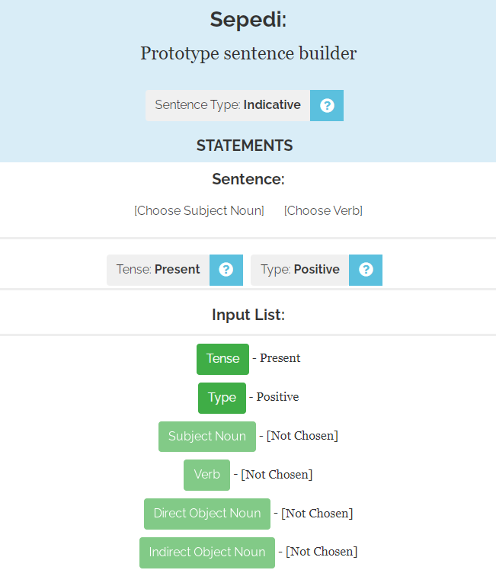
Sepedi Helper

Slide 12
Copulative Decision Tree functionalities in a nutshell
The copulative is the most complicated structure in Sepedi and a nightmare to conquer for students learning the language
It is intended as a step-by-step guidance for the user through the complicated system leading them to the correct answer through a sequence of binary choices
It navigates the user
through the two main types of copulatives,
via the three semantic relations, viz. identifying, descriptive and associative,
through the different verbal moods, and finally
through the nominal class system

Slide 13
Copulative Decision Tree

Slide 14
Decision tree for 3rd person Sepedi static copulatives

Slide 15
Invisible lexicography
In this paper, invisible lexicography is more broadly interpreted as including all lexicographically relevant aspects of a complex grammar typically catered for in a good dictionary for Sepedi
Paper-based – as front/back/middle matter
Online – also as pop-up information obtained through cursor hovering and clicking (drill-down)

Slide 16
Invisible lexicography
This includes lexicographic guidance for user and programmer
on
translation equivalents
the semantics of verbal moods
morphology of the verbal moods
nominal system
syntactic order, and
part of speech indication represented here as underlying/invisible part of speech markup
copulative system

Slide 17
Translation equivalents

Slide 18
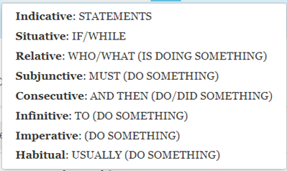
Semantics of verbal moods
Click on “Indicative” provides a summary of the meaning of the different moods

Slide 19
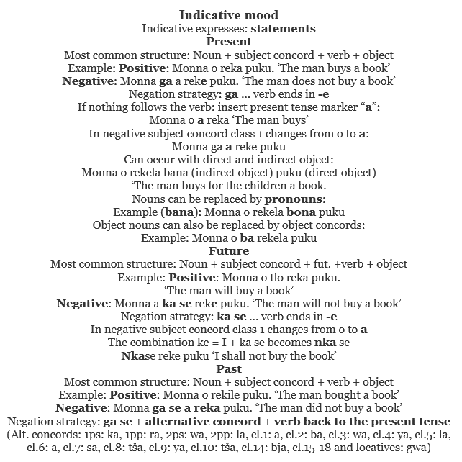
Morphology of verbal moods
Click on question mark provides a detailed description

Slide 20
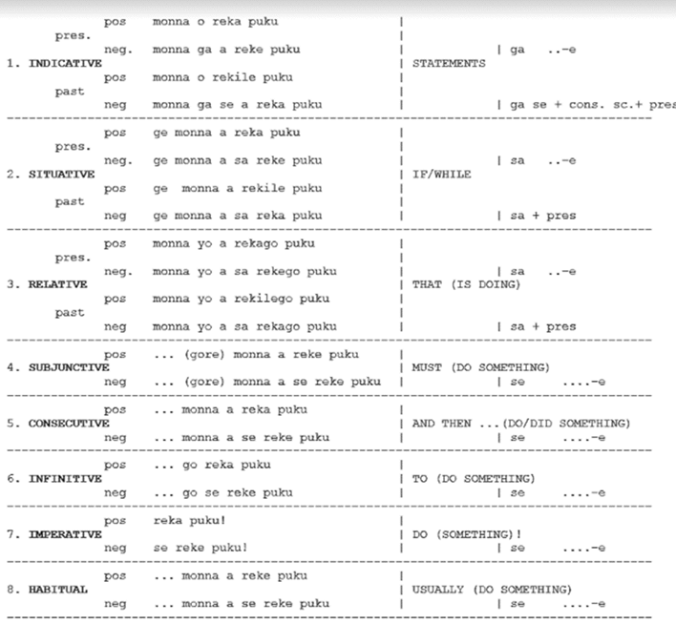
Semantics and morphology of verbal moods

Slide 21
Nominal system
Implementation result: Building possessive constructions
User is prompted for a possessor noun (typed in English or the African language), e.g. puku
User is prompted for a possession noun (typed in English or the African language) e.g. monna
Tool provides the correct possessive concord: ya
Result: puku ya monna, ‘the book of the man’

Slide 22
Nominal system

Slide 23
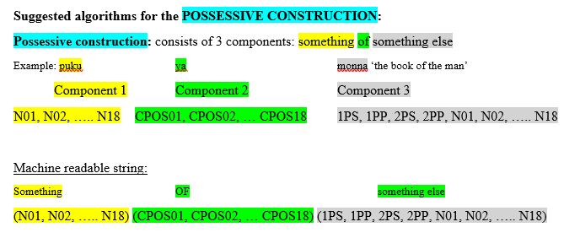
Syntactic order

Slide 24
Part of speech indication represented here as underlying/invisible part of speech markup

Slide 25
Copulative – hover over “More” – data for user and programmer

Slide 26
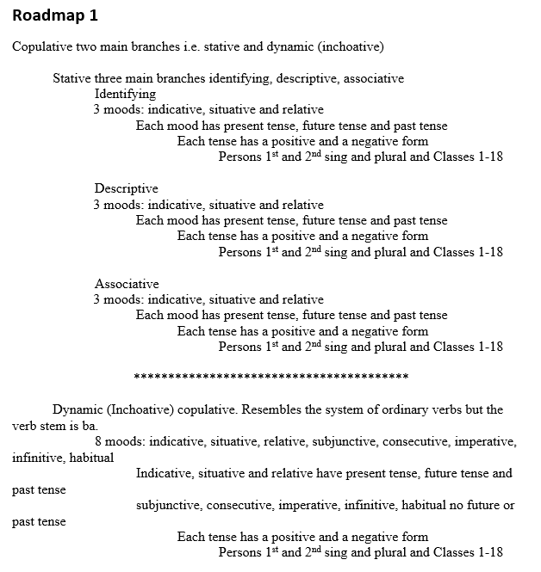
Copulative – summary and drill-down

Slide 27
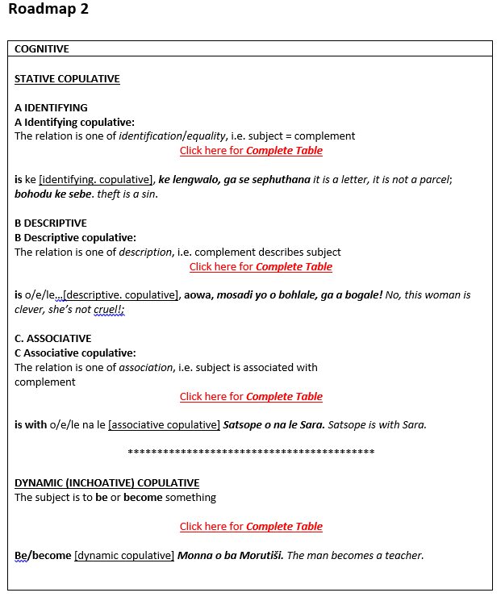
Copulative – explanatory summary plus further drill-down options

Slide 28
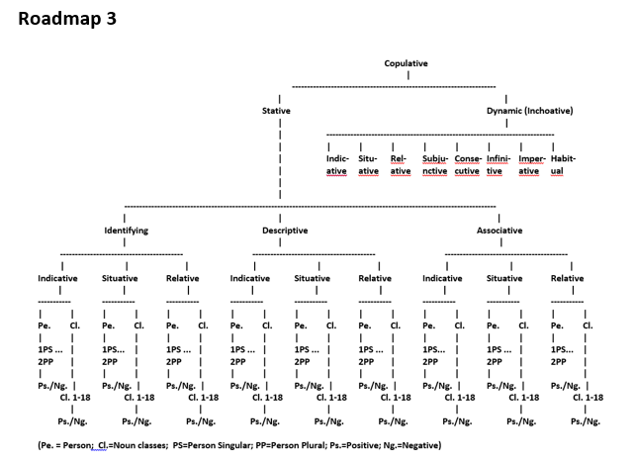
Copulative system (partial)

Slide 29
Extension - Verification
The basic objective is reassurance to the users that the text they produced is correct
The phrase produced is verified against a Sepedi corpus to ensure that concords and pronouns have been used and presented in the correct syntactic order, and that word division was done correctly
The verification is attempted on different levels:
The ideal is to find a perfect match, that is the identical phrase in the corpus preferably occurring several times
If an exact match is not found, the system offers a variety of near-matches which could also serve as confirmation of correct text production

Slide 30
Verification example, Copulative Decision Tree
Concordance lines:
O tlo kgopela Satsope yo a lego gona
Re tlo botšiša Madika yo a lego bohale kudu
Ke mang yo a lego ofising ya mopresidente
Typical collocates:
Motho yo a lego
Mang yo a lego
Yo a lego kgauswi

Slide 31
Further research
Both systems are prototypes, and should be further developed
The current dictionary of the Sepedi Helper is limited in terms of both the number of words and semantic details in the word list
It could not utilise any detailed grammatical and semantic descriptions
Research should be done how more semantic details will be enriching
Both systems should be integrated into a word processor for easy access
CALL aspects should be further developed
Further drill-down to more detailed descriptions or outer texts of dictionaries or grammars
Possible advantages of AI should be investigated

Slide 32
Conclusion
User studies revealed that students learning Sepedi find the Sepedi Helper a very useful tool
Both systems are de facto computer-aided language learning systems, as users can learn by doing, and check their results
Drill-down options for more detailed explanations
Links to detailed descriptions or outer texts of dictionaries or grammars
Information on demand and no information overload
The usability of next generation Sepedi writing assistants depend to a very large extent on an enriched lexicographic database and further technological innovation

Slide 33
References
Prinsloo, D.J., Heid, U., Bothma, T.J.D. & Faaß, G. 2012. Interactive, dynamic electronic dictionaries for text production. Lexikos 22: 290-320.
Prinsloo, D.J. 2002. The lemmatization of copulatives in Northern Sotho. Lexikos 12: 21-43.
Prinsloo, D.J. 2020. User studies on the Sepedi Copulative Decision Tree. Southern African Linguistics and Applied Language Studies 38(4): 323-335.
Prinsloo, D.J. & Bothma, T.J.D. 2020. A copulative decision tree as a writing tool for Sepedi. South African Journal of African languages 40:1: 85-97.
Prinsloo, D.J. & Prinsloo, Daniel. 2021. A writing assistant en route to a full computational grammar for Sepedi. South African Journal of African Languages 41(1): 12-21.
Prinsloo, D.J. & Taljard E. 2019. User studies on the Sepedi Helper writing assistant. Language Matters 50(2): 73-99.
Prinsloo, D.J & van Graan, N.D. 2021. Principles and Practice of cross-referencing in paper and electronic dictionaries with specific reference to African languages. Lexicography 8(1): 32-58. .
Sepedi Helper. nd. Available online at: http://www.sepedihelper.co.za/. Accessed June 11, 2023.

Slide 34
Thank you!
Theo Bothma
Theo.Bothma@up.ac.za
Danie Prinsloo
Danie.Prinsloo@up.ac.za

