Slide 1
Invisible meaning relations for representing near equivalents
Arvi Tavast, Kristina Koppel, Margit Langemets, Silver Vapper, Madis Jürviste
Eesti Keele Instituut | EKI

Slide 2
Background of Ekilex
Meanings are explicit entities in the database
Many-to-many relationship between word and meaning
If two words are equivalent, they have the same meaning
connected to the same meaning object in the database
NB: simplification is always present, whether explicit or not

Slide 3
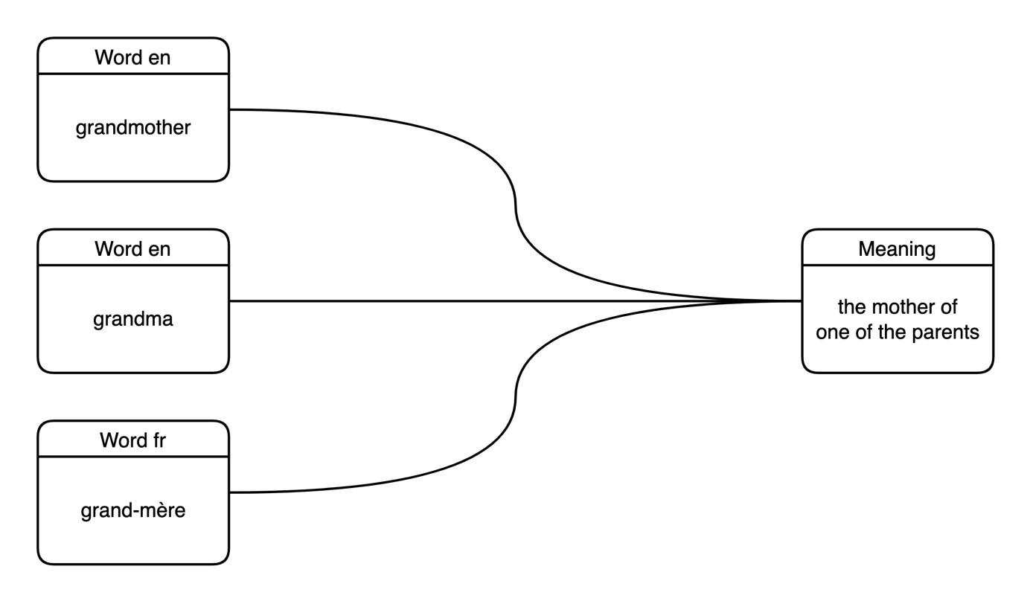
Full synonymy and equivalence

Slide 4
Reviewer 1
[D]etermining the meanings of general-purpose vocabulary would be quite challenging if the equivalents are chosen after fixing the abstract universal meaning units first.

Slide 5
Our current task
Wider and narrower equivalents
mormor – no direct equivalent, wider is grandmother
палец – no direct equivalent, narrower are finger and toe
Approximate equivalents
lilla – no direct equivalent, approximate are violeta, morado (and marginally also lila)

Slide 6
Partial synonymy and equivalence
mormor?

Slide 7
Partial synonymy and equivalence
What is the Spanish equivalent for Estonian lilla?
What is the colour that is called lilla in Estonian? What is that colour called in Spanish?

Slide 8
Caveat:
Relevant only
IF
the dictionary is an adequate medium for presenting lexical information
(come to the round table tomorrow)
eki.ee

Slide 9
Types of relations
Premise | Inference | Description
A ≈ B | B ≈ A | Approximate equivalence is symmetrical. If bread is almost equivalent to Brot, then Brot is almost equivalent to bread.
A > B | B < A | Wider and narrower are opposites. If mormor is a narrower equivalent for grandmother, then grandmother is a wider equivalent for mormor.
A > B and B = C | A > C | Adding more languages requires coordination between all languages. If mormor is a narrower equivalent for grandmother, and grandmother is a full equivalent for grand-mère, then mormor is a narrower equivalent for grand-mère.

Slide 10
Broader and narrower meanings

Slide 11
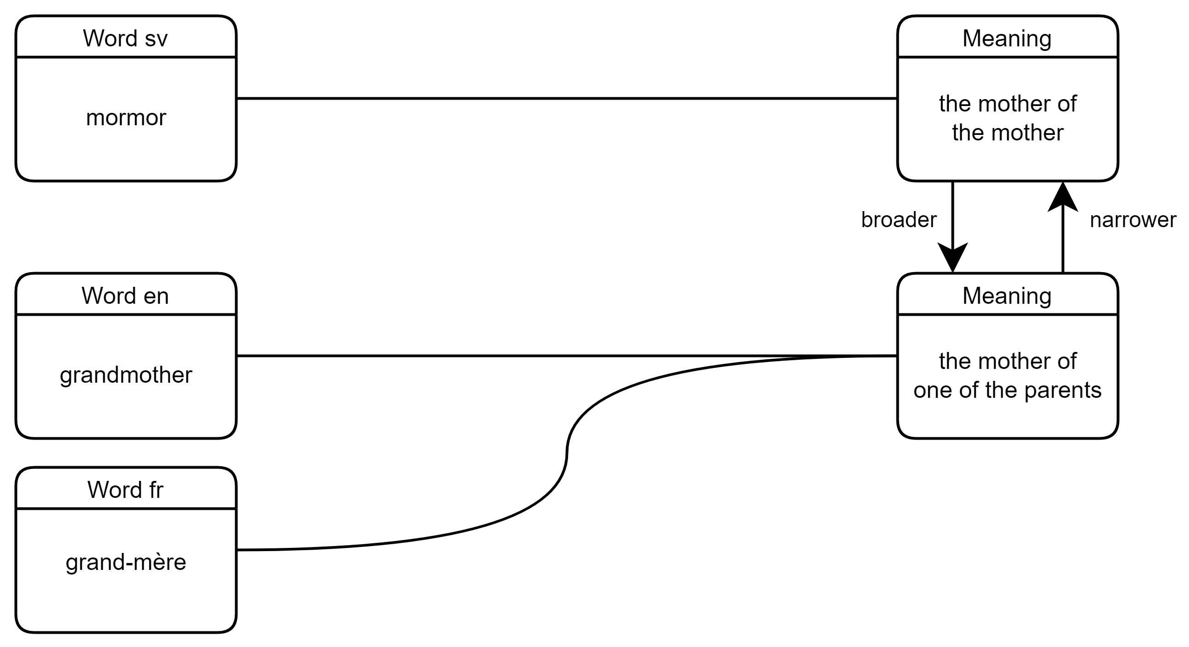
Broader and narrower meanings

Slide 12
Approximate meanings
Tavast, A., & Uusküla, M. (2015). How blue is azzurro? Representing probabilistic equivalency of colour terms in a dictionary. Cultura e Scienza del Colore-Color Culture and Science, 4, 43-48.

Slide 13
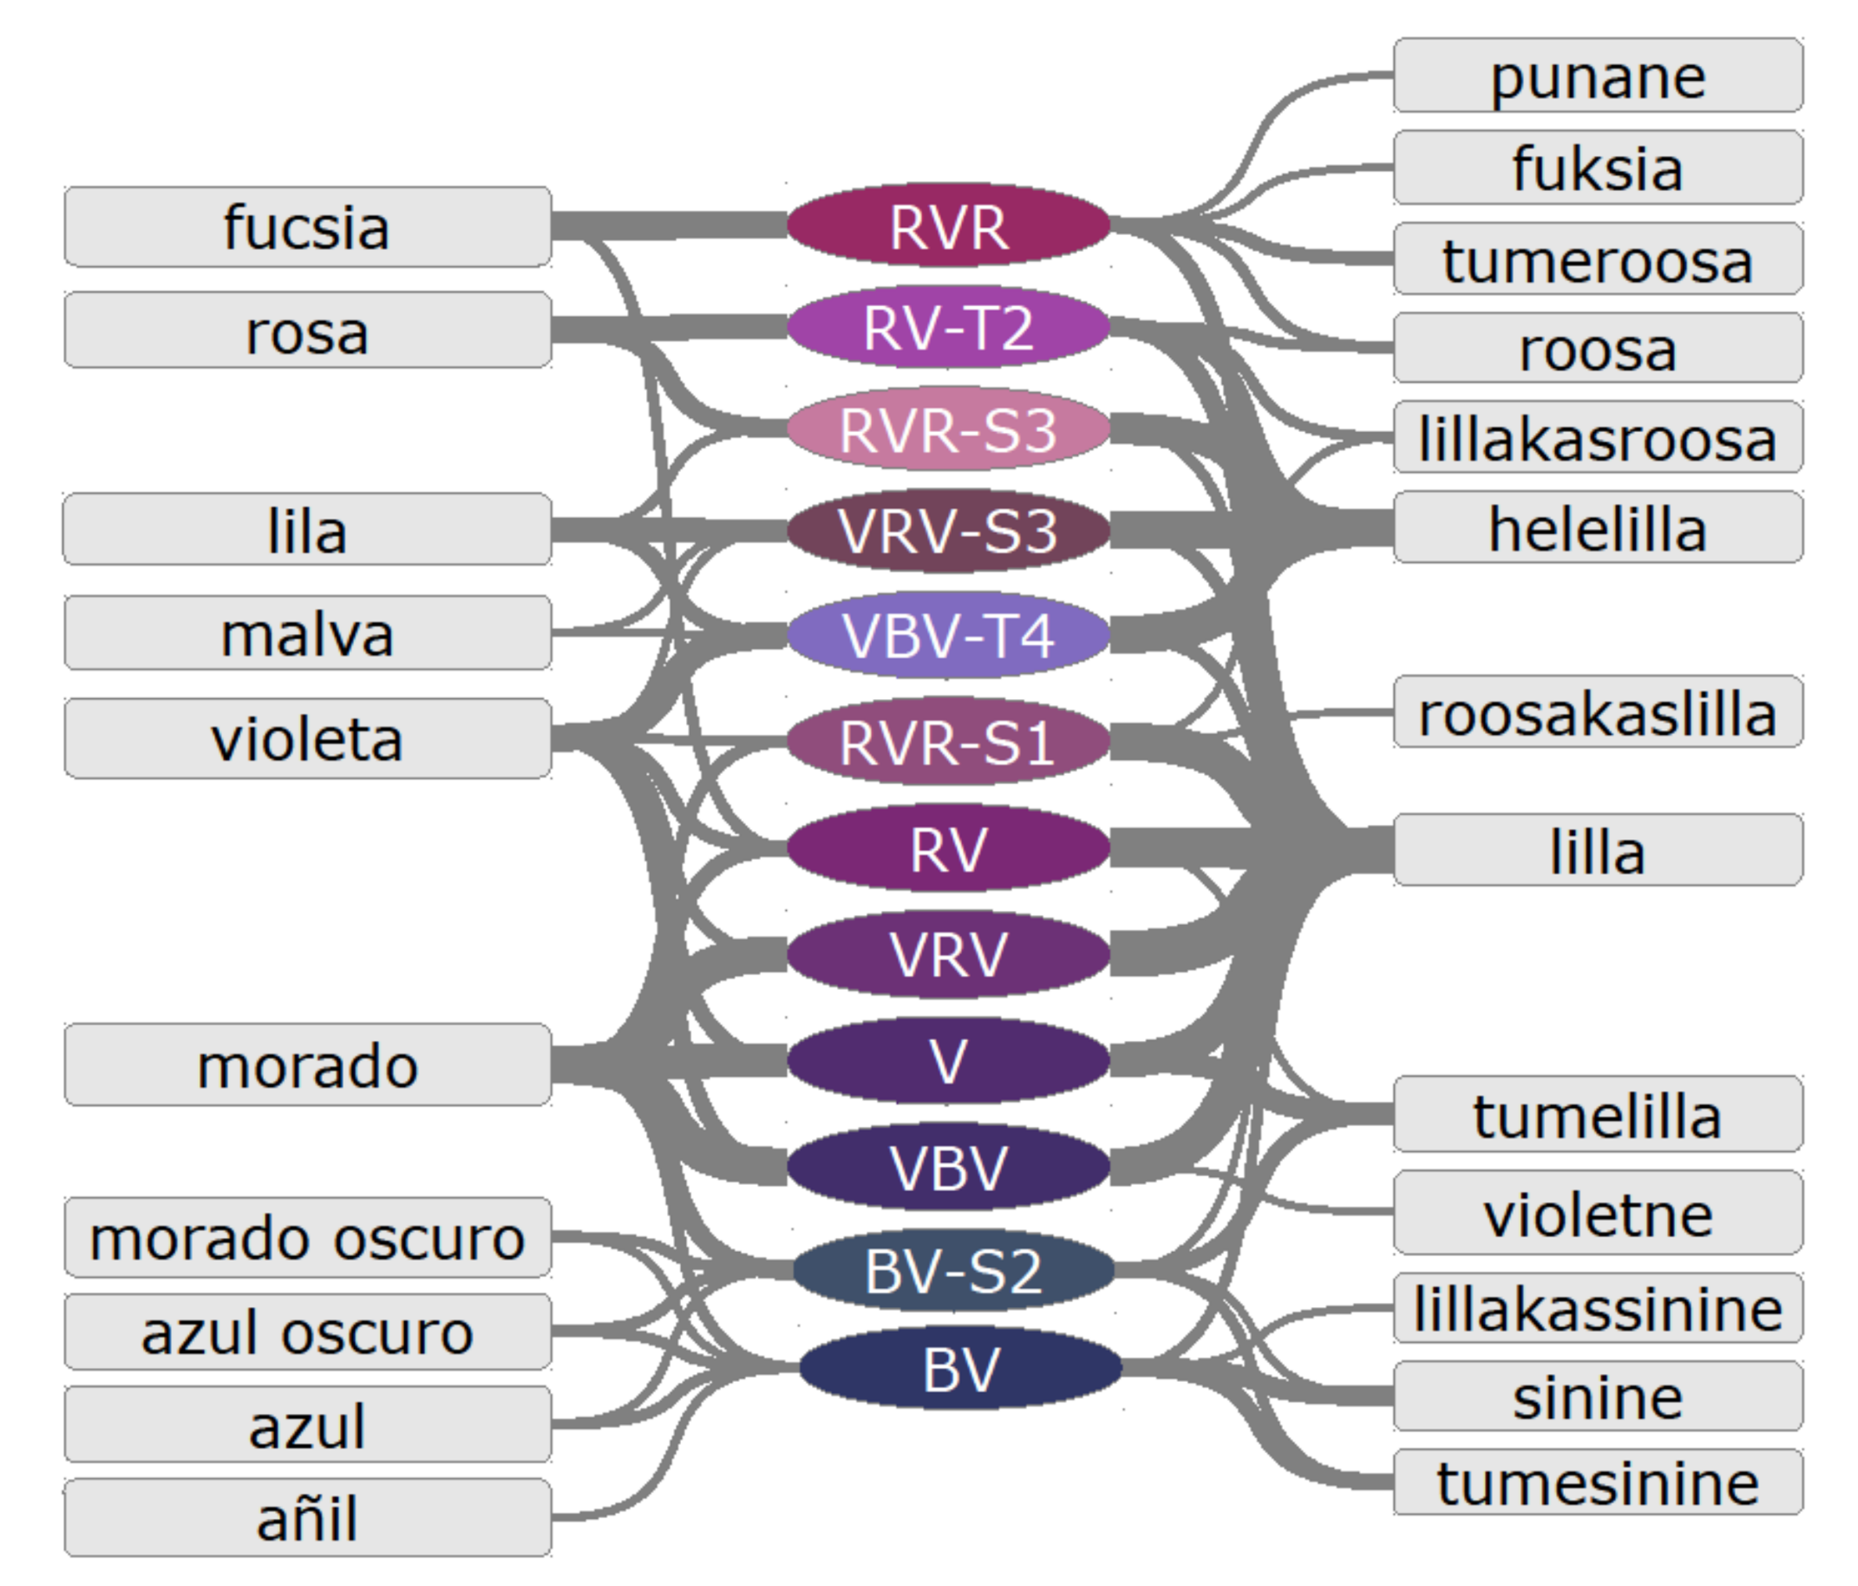
Approximate meanings
Tavast, A., & Uusküla, M. (2015). How blue is azzurro? Representing probabilistic equivalency of colour terms in a dictionary. Cultura e Scienza del Colore-Color Culture and Science, 4, 43-48.

Slide 14
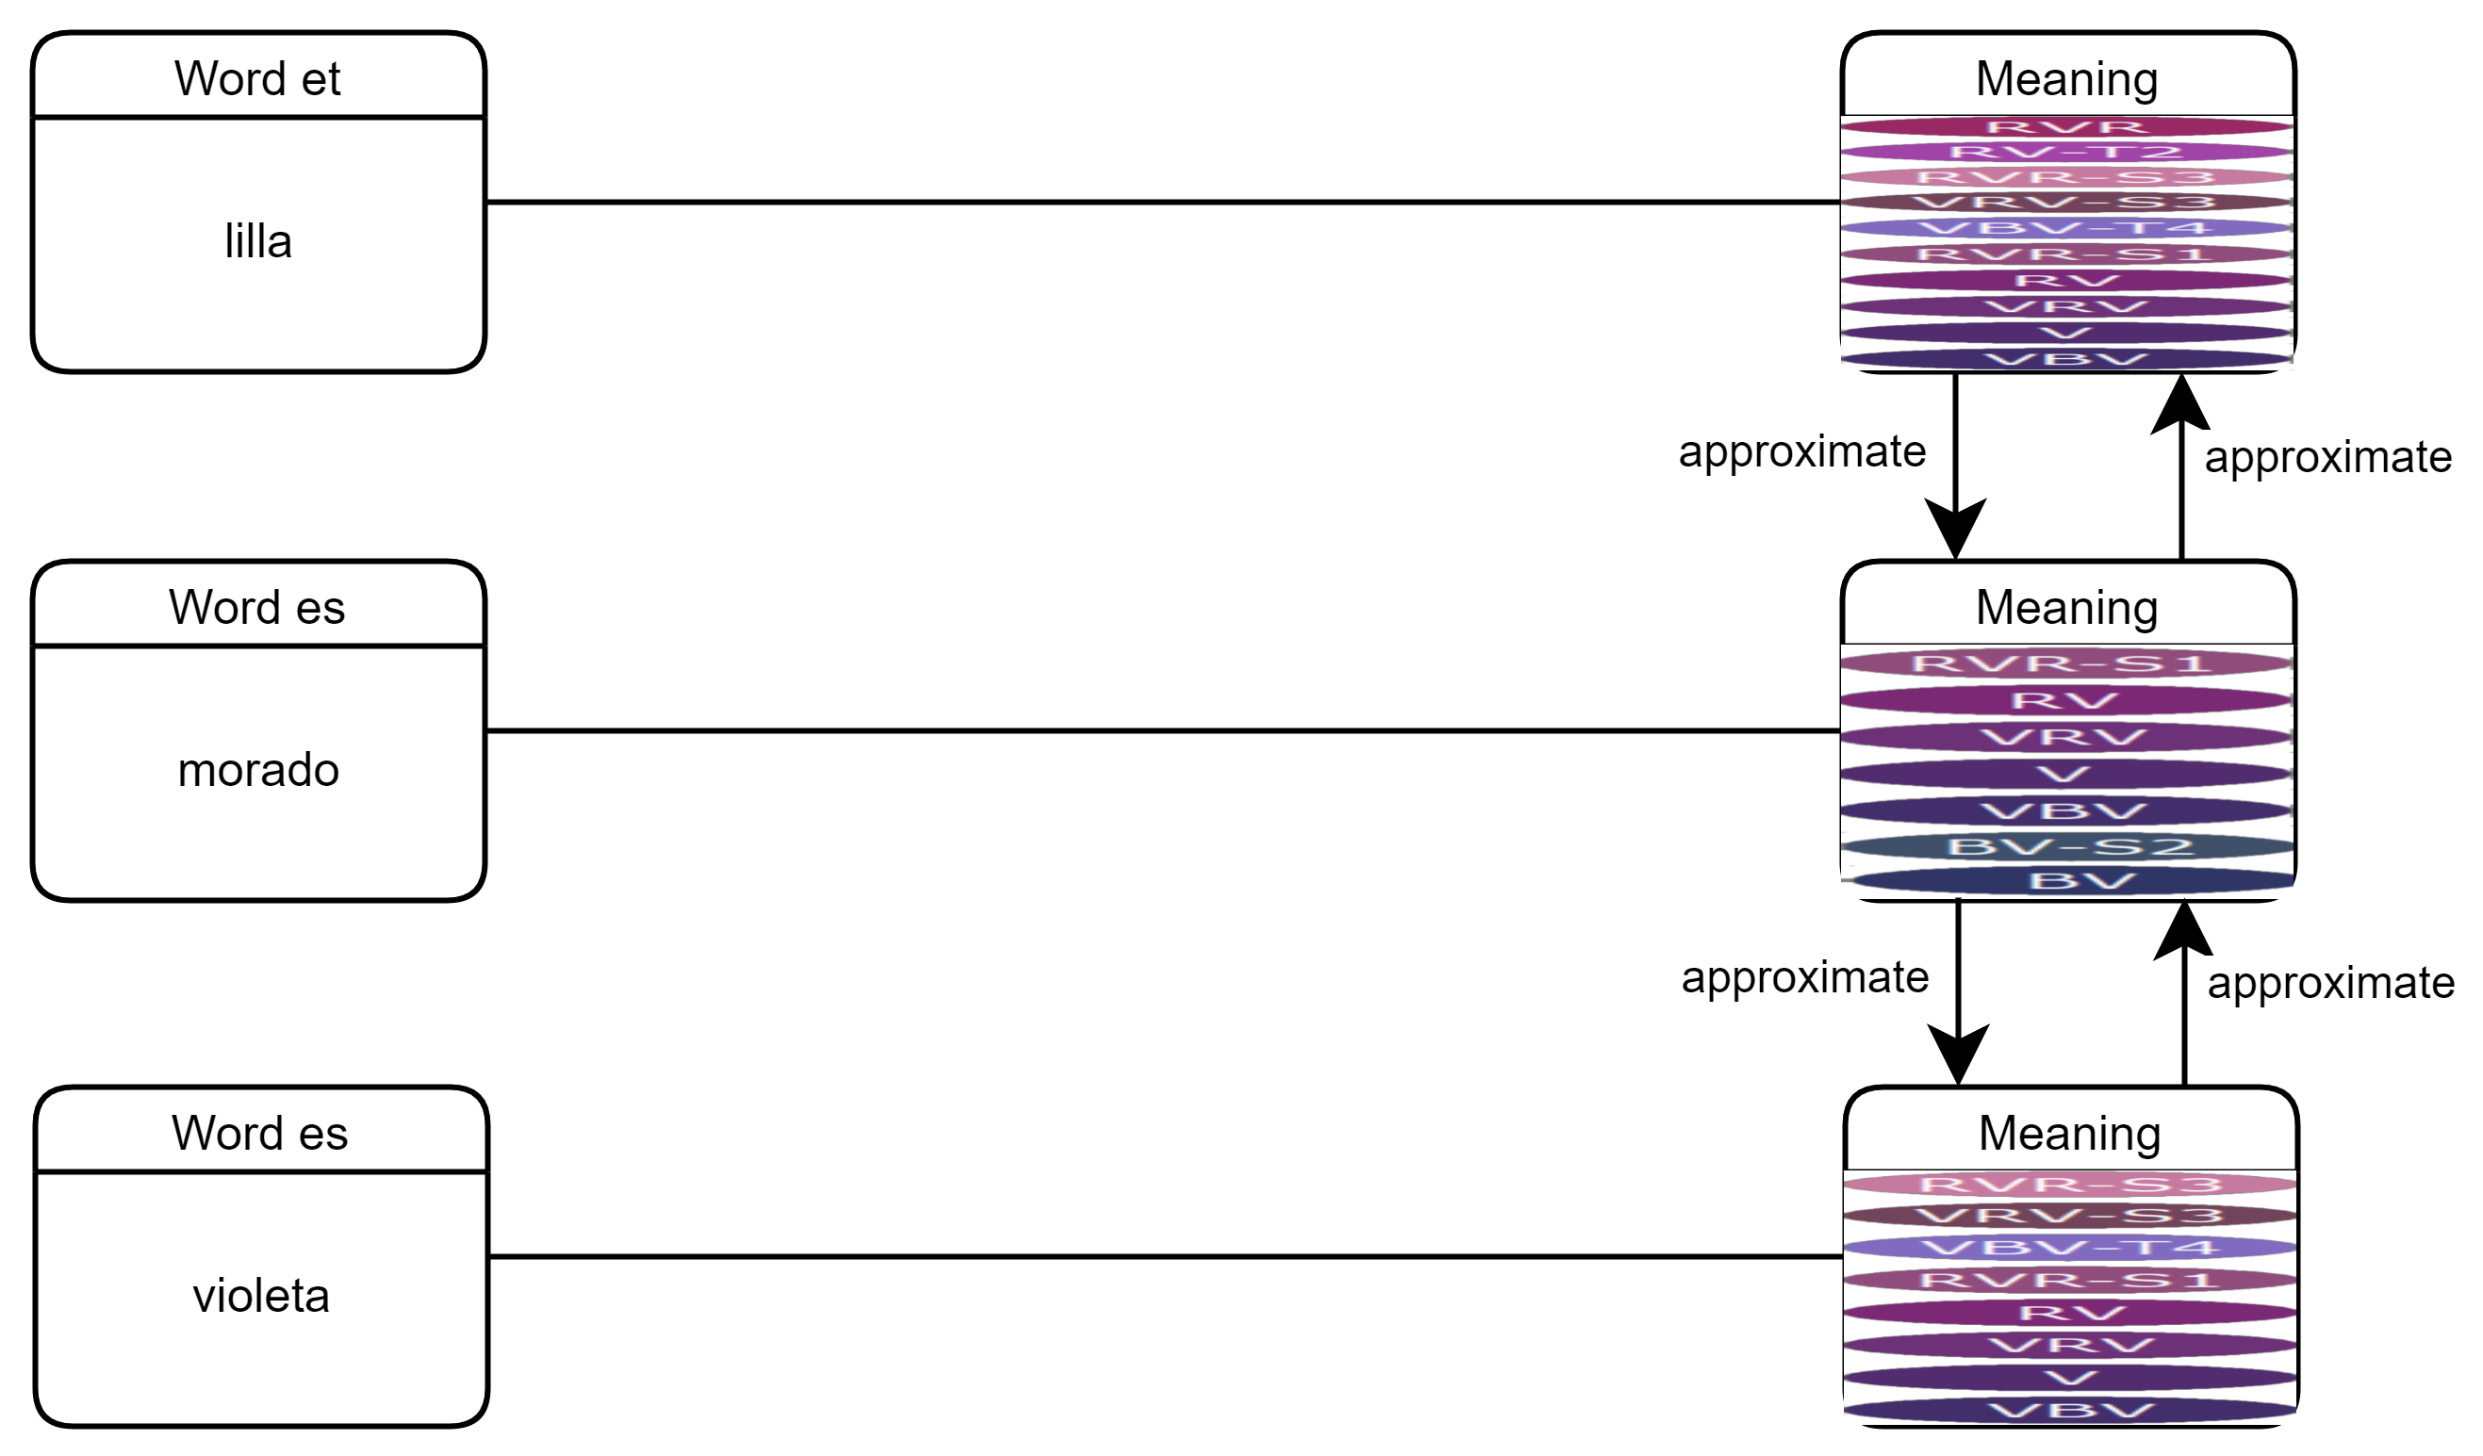
Approximate meanings

Slide 15
Uncertainty: more explicit
we know when we don’t know
Cooperation: more people
including some we don’t know
eki.ee

