Slide 1
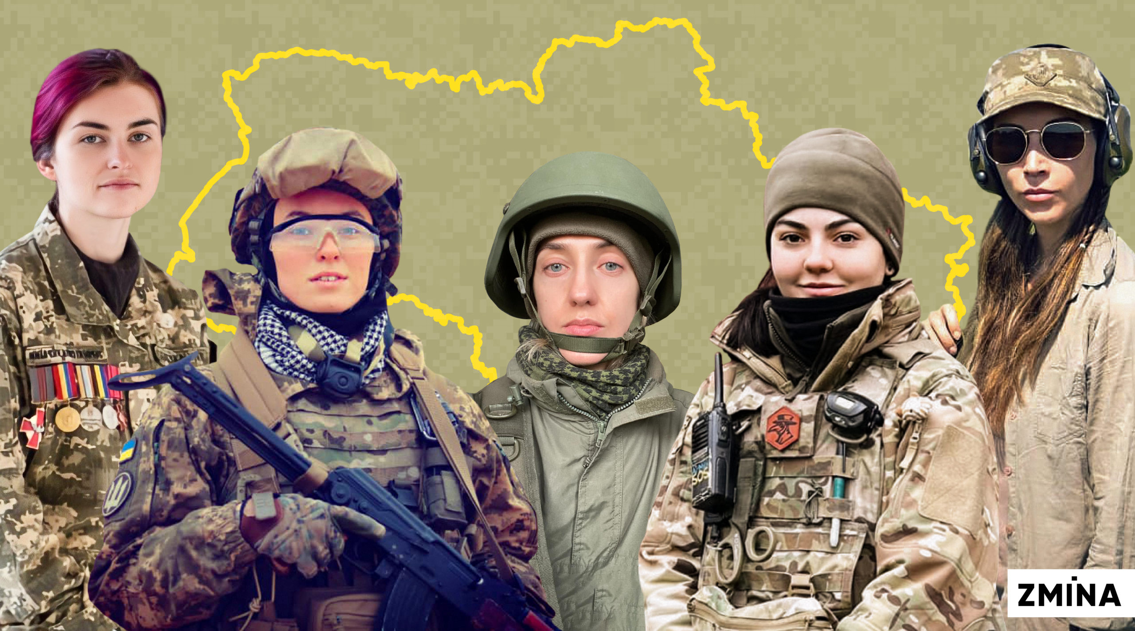
Military Feminine Personal Nouns:
Corpus-based Update to the
Web Dictionary of Ukrainian Feminine Personal Nouns
Olena Synchak,
Associate Professor at the Philology Department
Ukrainian Catholic University (Lviv, Ukraine)
o_synchak@ucu.edu.ua

Slide 2
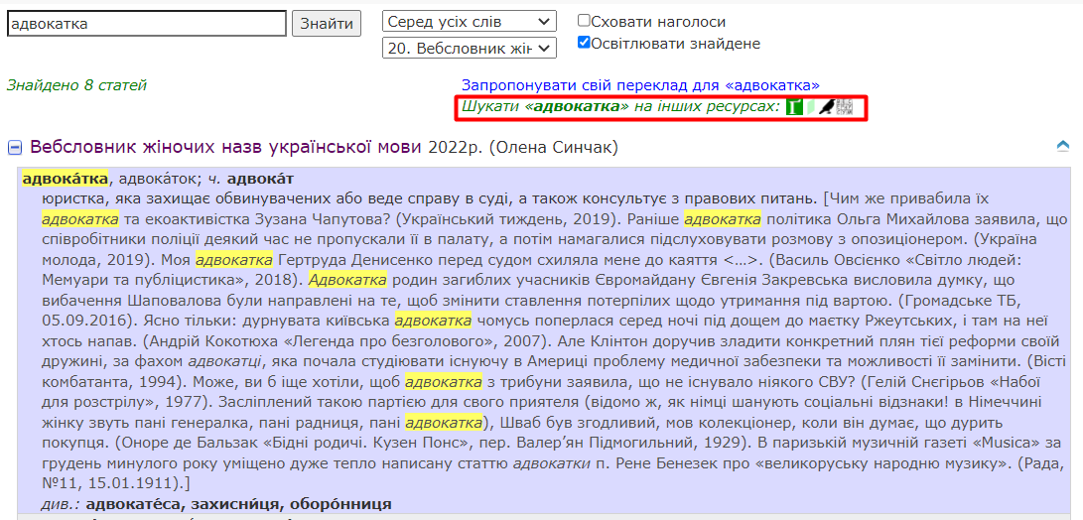
Web dictionary of Ukrainian feminine personal nouns (r2u.org.ua, 2022)
2 000 слів

Slide 3
WDUF
as a dictionary of a new generation
Online
dictionary
Comprehensive
description
Corpus data
Language panel
Compiler’s view
Notes:
Our dictionary is specifically designed for electronic/online publication. It has full-text search functionality;
the Web dictionary offers the most complete coverage of feminine personal nouns to date, including the most recent coinages, and provides various types of linguistic information to achieve a comprehensive description. • the Web dictionary suggests that Ukrainian feminine personal nouns are best described by combining/balancing corpus data with language panel results and compiler’s illustrative examples and recommendations.

Slide 4
Feminine Personal Nouns
Context
6000 – 9000 lexical items
1) masculine nouns + feminizing suffixes: -к(а), -иц(я), -ин(я)
офіцер – офіцерка “(female) officer’
військовослужбовець – військовослужбовиця ‘servicewoman’
стрілець – стрільчиня ‘(female) shooter’’
endings: свідок – свідка ‘(female) witness’
2) coderivation: спецназ – спецназ-ів-ець
– спецназ-ів-ка ‘servicewoman in the special forces unit’
derivational variants: військовослужбовиця – військовослужбовка

Slide 5
Media monitoring
Context
https://povaha.org.ua/
Notes:
Gender sensitivity, media coverage

Slide 6
Linguistic attitudes towards feminine terms
Context
Negative
artificially created
linguistic fashion
unusual or ad hoc coinages
non convenient
non-codified status
difficulties with deriving
aesthetically unappealing
offensive
violate the word-formative harmony of language
stylistically limited (colloquial)
supported by grants (“грантоїди”)
Positive
feminist and human right movements
gender-fair language to emphasize equal rights and possibilities
language changes, but people could have different reactions on novelty
the interaction of extralingual and intralingual factors
corresponds to the grammatical rules of Ukrainian (agreement by gender)
the efforts to move away from the Russian language rules and Soviet language policy
stylistic differentiation
a systemic-structural and typological feature of Ukrainian
“a revival of the identity and originality of Ukrainian” (Oleksandr Styshov)
Notes:
a temporary phenomenon that will pass as fashion passes

Slide 7
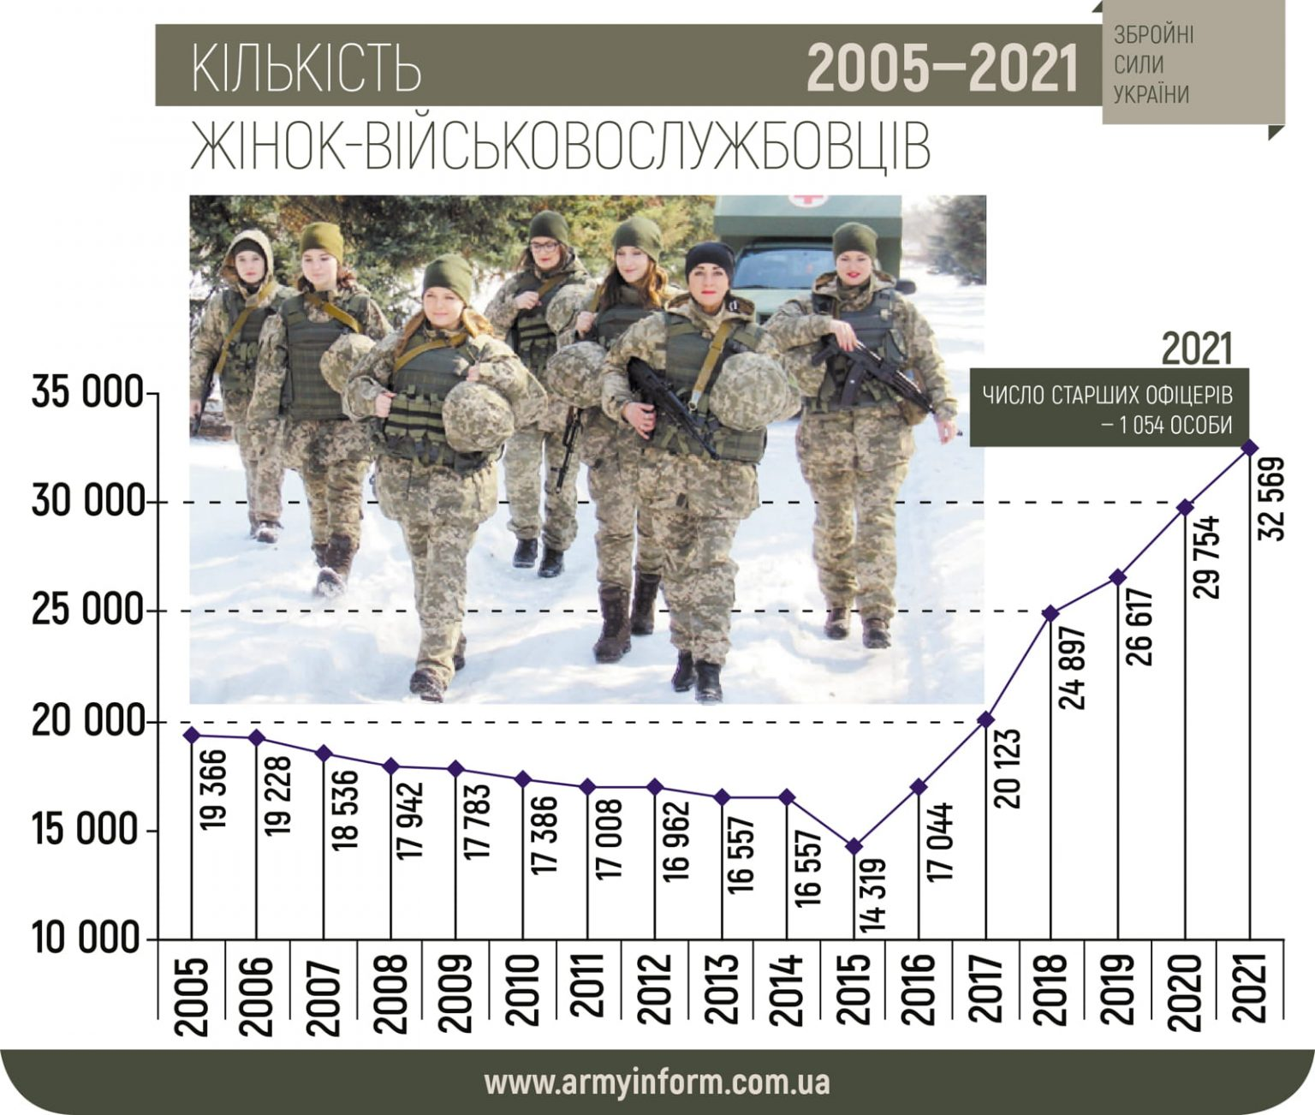
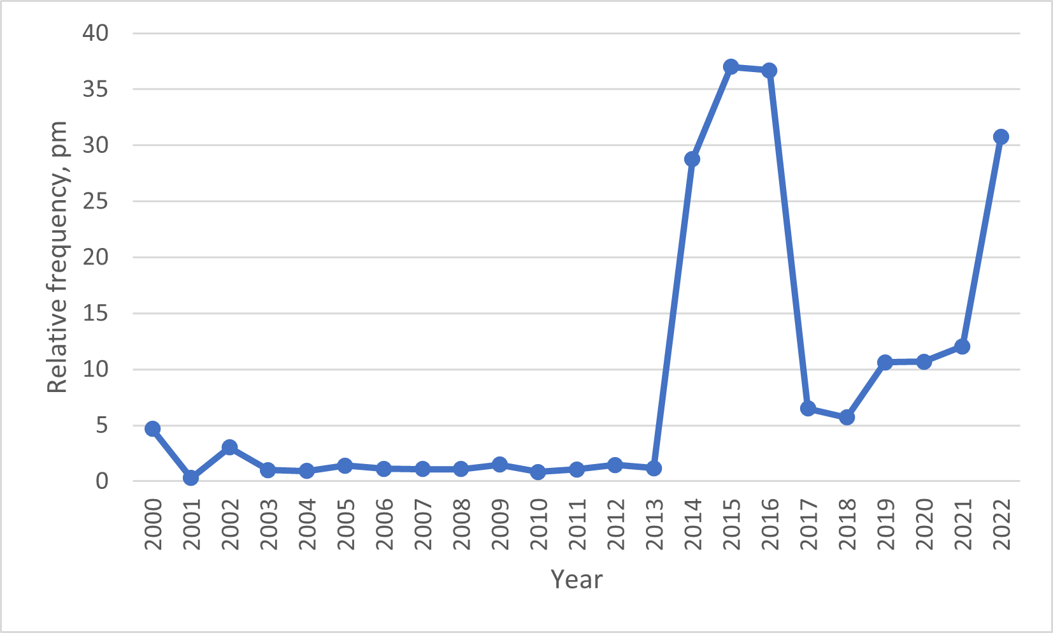
Women in the Ukrainian army forces
Dynamics of war-related feminine derivatives in GRAC
Context
Starko, V., Synchak, O. (2023). Feminine Personal Nouns in Ukrainian: Dynamics in a Corpus. COLINS-2023: 7th International Conference on Computational Linguistics and Intelligent Systems, National Technical University “Kharkiv Polytechnic Institute”, Kharkiv, Ukraine, pp. 407-425.
Notes:
As of 2022, the proportion of women serving in the Ukrainian military is 22%, which is one of the highest rates compared to other European nations. Women in Ukraine are standing guard for democratic changes as they defend the state's integrity at the cost of their own lives.
It is not a linguistic fashion, but a response to social demands after 2014 and 2022

Slide 8
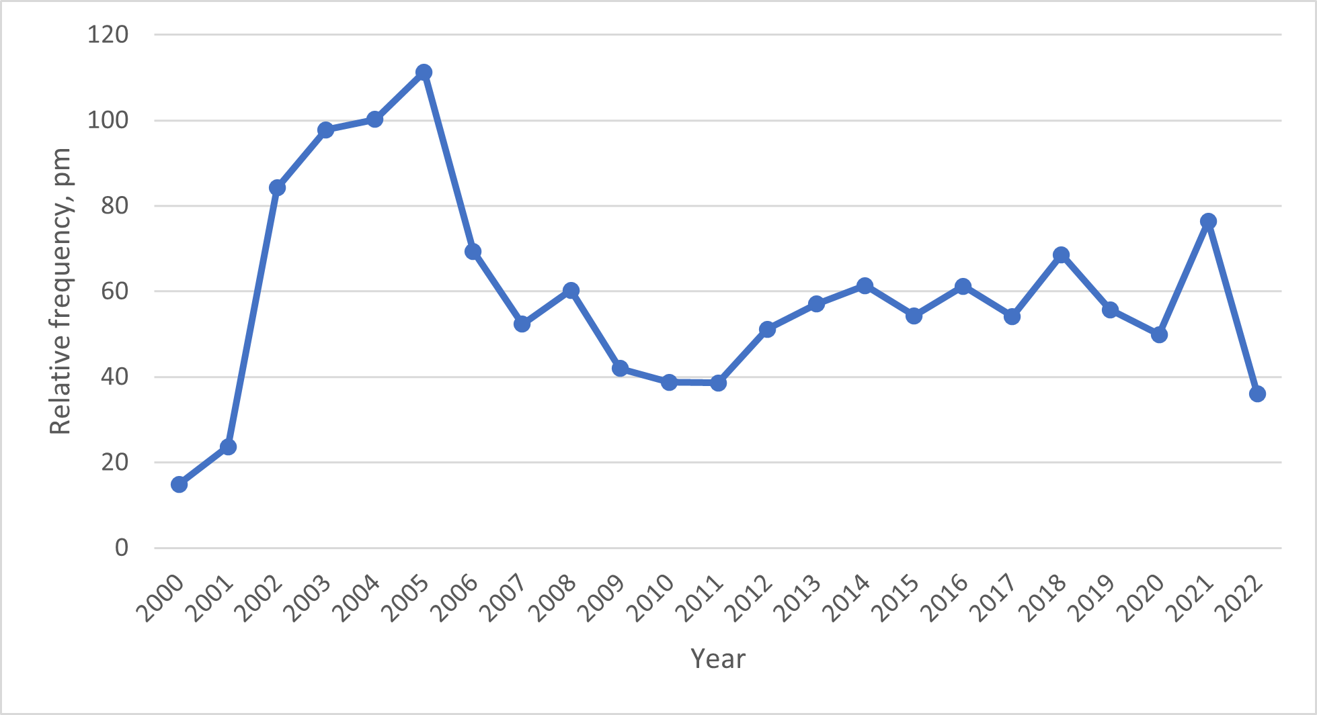
The dynamics of 86 feminine nouns in sports in 2000–2022 in newspaper texts.
The dynamics of using feminine terms in media texts corresponds to their thematic groups
Context
Dynamics of 124 war-related feminine derivatives in GRAC.
Starko, V., Synchak, O. (2023). Feminine Personal Nouns in Ukrainian: Dynamics in a Corpus. COLINS-2023: 7th International Conference on Computational Linguistics and Intelligent Systems, National Technical University “Kharkiv Polytechnic Institute”, Kharkiv, Ukraine, pp. 407-425.
Notes:
It is not a linguistic fashion, but a response to social demands after 2014 and 2022

Slide 9

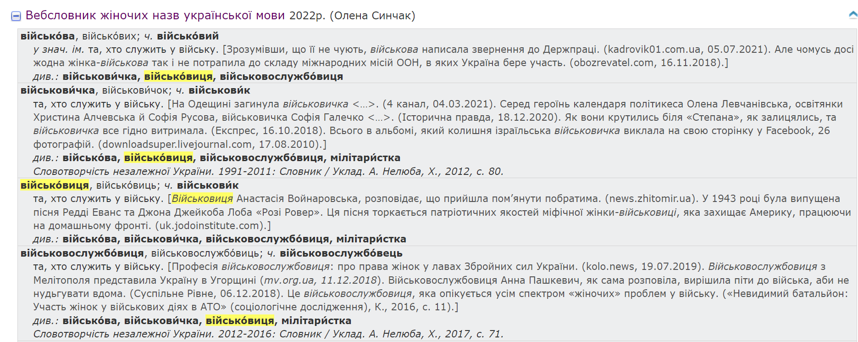
Web dictionary of Ukrainian feminine personal nouns (r2u.org.ua, 2022) –
76 items
Sources
Military feminine personal nouns make up 5% (76 items) of the total number of words in the WDUF (2000 items).

Slide 10

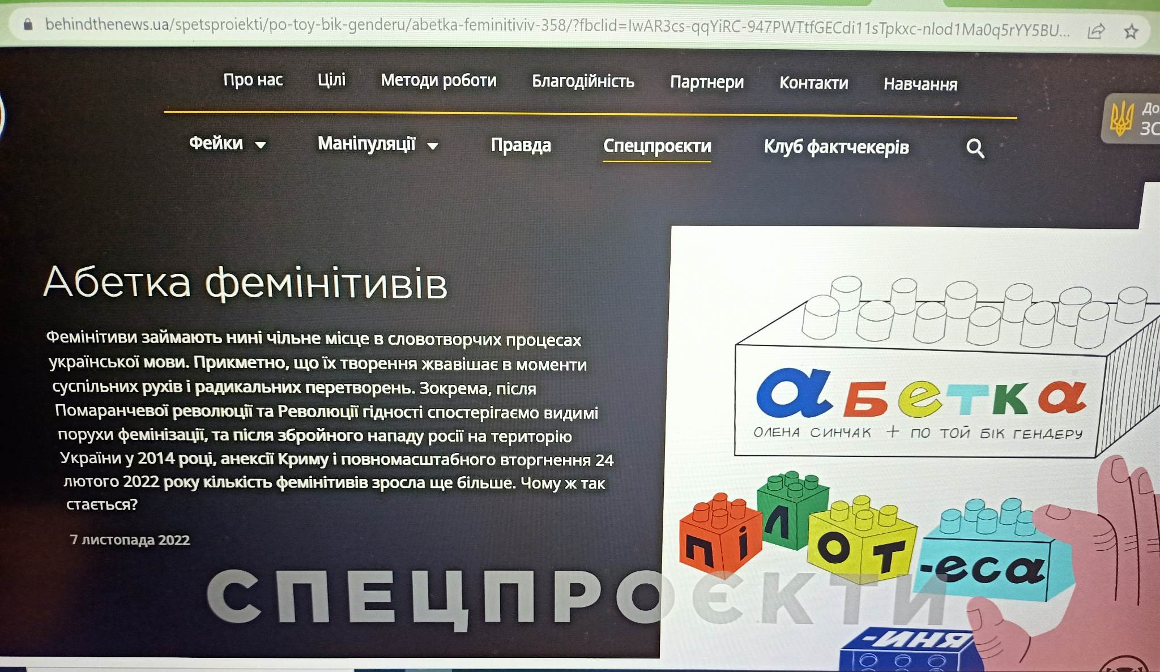
"Alphabet of Feminine Personal Nouns"
(behindthenews.ua) – 106 items
Sources

Slide 11
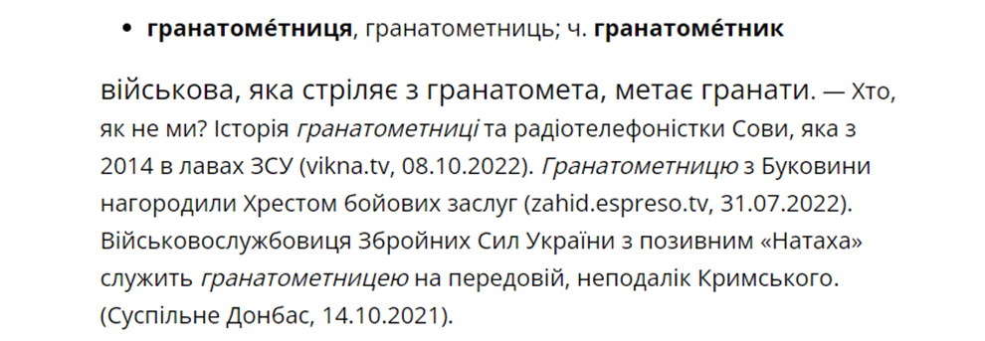
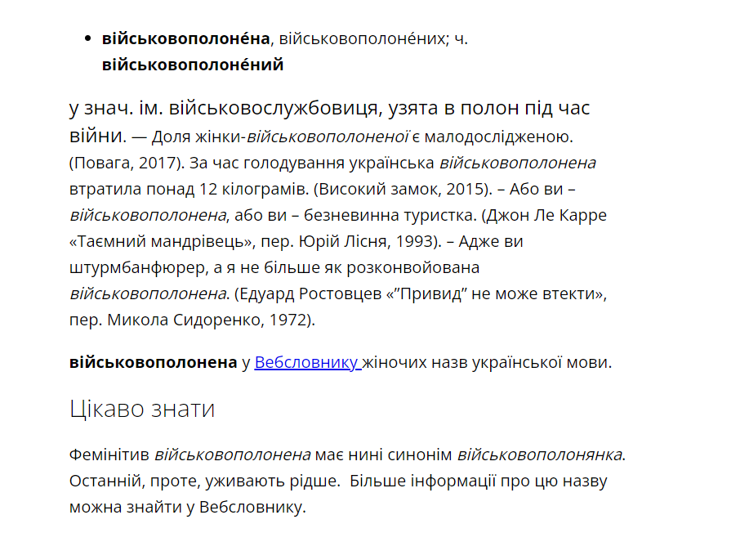
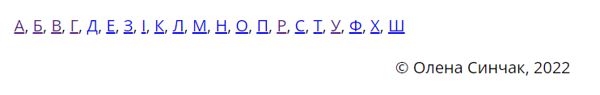
A dictionary entry in the "Alphabet of Feminine Personal Nouns“ (behindthenews.ua, 2022)
Sources

Slide 12



GRAC-16's unlemmatized military feminine personal nouns (28 titles)
CQL query according to the most productive suffixes
  [tag=″noun:anim.*″&lemma=″.*ка″]
  [tag=″noun:anim.*″&lemma=″.*иця″]
  [tag=″noun:anim.*″&lemma=″.*иня″]
CQL queries for regular expressions
  [word=".*демінер(ка|ку|кою|ки|ок|ками|кам)"]
  [word=".*мінометниц(я|ю|ею|і|ь|ями|ям)"]
Illustrations from corpus

Slide 13
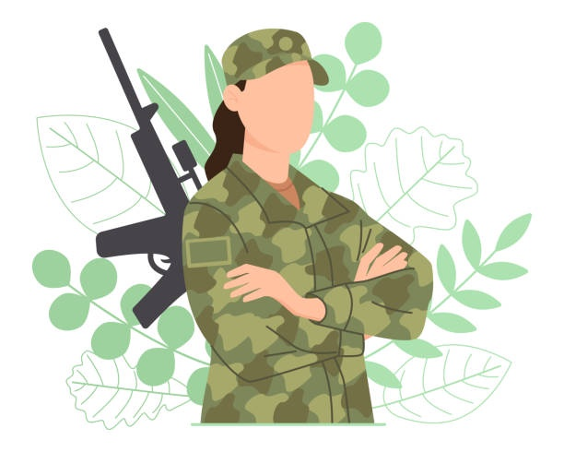
Military Feminine Personal Nouns – 134 items
Definition
a woman directly participating in military actions: сержантка ‘(female) sergeant’, танкістка ‘tankwoman’ etc.;
a woman who serves in the supply and assistance link of the army: волонтерка ‘(female) volunteer’, парамедиця ‘(female) paramedic’ etc.;
a woman involved in or affected by war: партизанка ‘(female) partisan’, заручниця ‘hostage’ etc.
Most of the terms (97%) refer to Ukrainian women and only 3% denote women engaged in the war from the Russian side: гауляйтерка ‘(female) gauleiter’, окупантка ‘(female) occupant’, ополченка ‘(female) member of a pro-Russian militia or paramilitary group’, бойовичка ‘(female) combatant fighting in the side of the Russian occupation’.

Slide 14
It is not a linguistic fashion, but a response to social demands after 2014 and 2022
Results
автоматниця
воячка
зенітниця
кулеметниця
фронтовичка
‘(female) sub-machine gunner’
‘virago’
‘(female) antiair crafter’
‘(female) machine-gunner’ ‘frontwoman’
Notes:
the majority of the military feminine terms analyzed (67.4%) were developed between 2014 and 2022 and are not registered in monolingual Ukrainian dictionaries: адміралка ‘female admiral,’ аеророзвідниця ‘(female) air-scout,’ армійка ‘army woman,’ військовослужбовиця ‘servicewoman,’ мінерка ‘(female) miner,’ миротворка ‘female peacemaker,’ снайперка ‘(female) sniper,’ танкістка ‘tankwoman,’ etc. This once again proves that feminine terms do not arise as a tribute to fashion, but as a language system’s response to social demands (Vplyv suspilnykh zmin, 2017, pp. 382). Since there was a need to name a woman as an active participant in the war, language actively provides such an opportunity.

Slide 15
Servicewoman (red) and (female) soldier (orange): the dynamics in news texts in GRAC
Results
Servicewoman and (female) soldier: the dynamics in news texts in GRAC
Notes:
It represents the usage dynamics of the nouns військовослужбовиця ‘servicewoman’ and солдатка ‘(female) soldier’. The chart indicates that the frequency of use of the noun солдатка, despite minor peaks in 2004 and 2017, is quite low. However, since 2015, the usage of the noun військовослужбовиця has rapidly increased, eventually surpassing the usage of the lexeme солдатка.

Slide 16
If women are active in a war-related domain, then language acknowledges their achievements by offering certain feminine term.
Lexico-semantic groups of military feminine personal nouns (134 items)
Results
офіцерка
‘(female) officer’
полковниця
‘(female) colonel’
лейтенантка
‘(female) lieutenant’
генералка
‘(female) general’

Slide 17
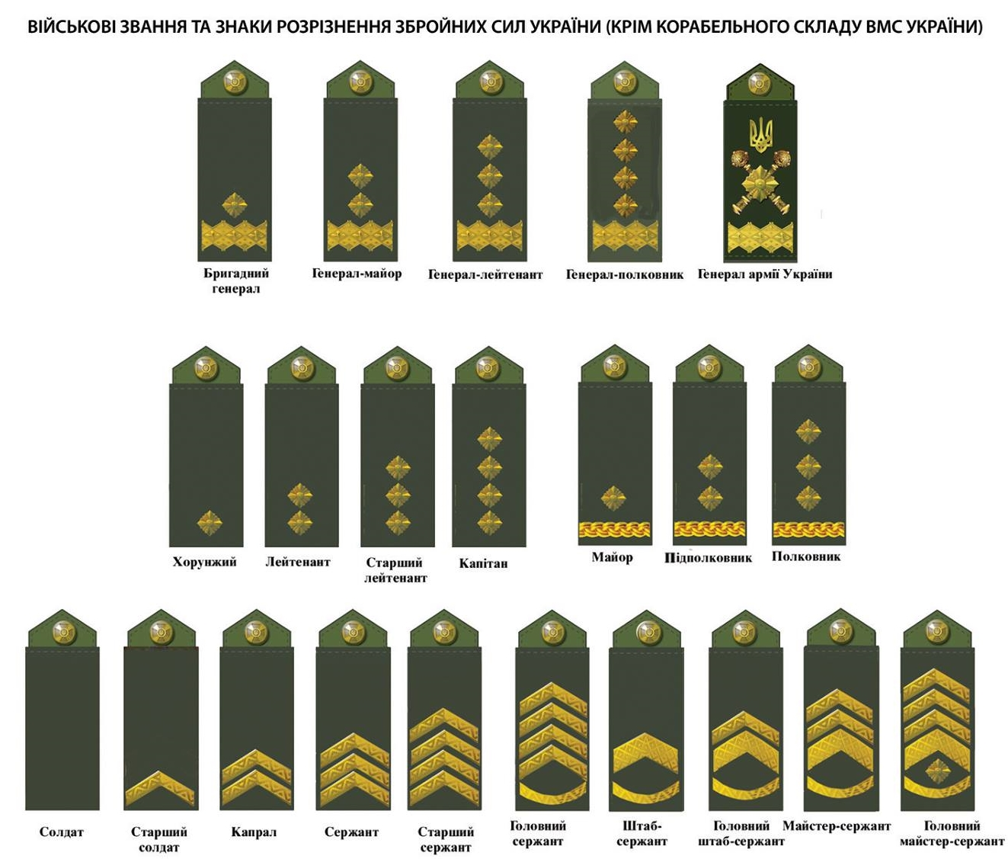

Feminization of Ukrainian military ranks
Results
солдатка ‘(female) soldier’
офіцерка ‘(female) officer’
полковниця ‘(female) colonel’
лейтенантка ‘(female) lieutenant’
генералка ‘(female) general’
сержантка ‘(female) sergeant’
капітанка ‘(female) captain’
адміралка ‘(female) admiral’
майорка ‘(female) major’
Andronymic titles Rank of women
солдатка ‘(female) soldier’
полковниця ‘(female) colonel’
підполковниця ‘(female) lieutenant-colonel’

Slide 18

Theory of symbolic power by Pierre Bourdieu
Discussion
“A whole social structure is present in every act of linguistic interaction"
The symbolic power of language is manifested in its ability to construct reality, to establish an epistemological order
Those who dominate the social space also dominate the space of symbolic production
Language legitimizes the current distribution of power in society by virtue of its authority to signify and express meaning.
Acknowledgments – symbolic capital – symbolic power

Slide 19
Attitudes towards feminization
Discussion
unusual or ad hoc coinages
non convenient
aesthetically unappealing
offensive
the attitude towards women that prevails in society
accepted in the community relations between women and men
the state of the women's movement
Hellinger Marlis. Revising the patriarchal paradigm. Language change and feminist language politics (1989)

Slide 20
Semantic changes
Results
ГЕРОЇНЯ [heroyinia] ‘heroine’
1. a woman outstanding in her abilities and activities, who shows courage, dedication and bravery in work and battle. – Heroyi ta heroyini ZSU ne vidpuskaiut vorohiv bez boiu. (24 kanal, 2022). Vin podiakuvav kozhnomu heroievi ta heroini, yaki trymaiut oboronu Ukrainy vid tsoho teroru. (24 kanal, 2022). Heroi ta heroini shchodnia vmyraiut za nashu svobodu y sered nykh – zovsim yuni voiny, taki yak Oleksandra Anikieva. (24 kanal, 2022). Spodivaiemos, shcho naiblyzhchym chasom “Ptashka” povernetsia razom iz inshymy ukrainskymy heroiniamy. (www.0352.ua, Ternopil, 2022).
// Slava heroyam i heroyiniam! – one of the versions of the response to the greeting "Glory to Ukraine!"; the slogan of the struggle for the independence of Ukraine.
2. woman who performed a heroic deed, distinguished herself in something. – Mariupolskyi fotohraf naholosyv, shcho matir khlopchyka – heroinia, adzhe vriatuvala svoikh ditei. (24 kanal, 2022). Ne heroinia ya, ale chyniu tak, yak vchynyla b usiaka normalna zhinka <...>. (O. Pylypenko «Normalni liudy abo Dekameron staroi divy», 2011).
ГЕРОЙКА [heroyka] ‘heroine’
1. a woman outstanding in her abilities and activities, who shows courage, dedication and bravery in work and battle. – My ne vtomymosia diakuvaty nashym vidvazhnym heroyam i heroykam, yaki shchodnia boroniat i zvilniaiut nashu Ukrainu vid okupanta. (Svoi.City, 2022). Pered vitanniamy khvylynoiu movchannia vshanuvaly pamiat vsikh heroiv ta heroyok, yaki zahynuly, zakhyshchaiuchy Ukrainu vid voroha. (Biliaivka.City, 2022). 84 riatuvalnyky, a zaraz spravzhni heroyi ta heroyky, buly zmusheni vyzhyvaty pid prytsilom putinskykh voiak bilshe misiatsia. (Apostrof, 2022).
// Heroyka Ukrayiny – the highest honorary title for exceptional services to the state and people of Ukraine. – Prochytaye yiyi tvir Heroyka Ukrayiny, narodna artystka Ada Rohovtseva. (24 kanal, 2022).
2. fearless woman who performed a heroic deed. – Heroyka vykhodyla do vorohiv ta rakhuvala vorozhu tekhniku. (24 kanal, 2022). Pid chas aktyvnykh boiovykh dii u Volnovasi Iryna Romanchenko pokazala sebe yak spravzhnia heroyka, khocha sama zhinka sebe takoiu ne vvazhaie. (Volnovakha.City, 2022).

Slide 21
Semantic changes
Results
ЗАХИСНИЦЯ [zakhysnytsia] ‘(female) defender’
1. woman who protects the citizens of her country, protects the territorial integrity of her state. – Boroniachy Ukrainu vid rosiiskoho vtorhnennia, zahynula zakhysnytsia Ukrainy Mariana «Kvitka». (Ukrainskyi prostir, 2022). Ta vona zalyshylas, prosyla ne zhality yii, bo vona zakhysnytsia ta ukrainka, yaka vykonuie svii oboviazok — riatuie pobratymiv ta tsyvilnykh. (Ukrainskyi prostir, 2022). Nekhai kozhen ukrainskyi zakhysnyk ta kozhna zakhysnytsia povernutsia dodomu, do svoikh ridnykh ta blyzkykh! (www.0352.ua, Ternopil, 2022). Zakhysnytsia Ukrainy z 26 okremoi artyleriiskoi bryhady ranishe pratsiuvala vchytelkoiu istorii ta vykladala do 2016 roku. (www.0352.ua, Ternopil, 2022).
// Den zakhysnykiv i zakhysnyts Ukrayiny – the national holiday of Ukraine, which is celebrated on October 14. – 4 lypnia 2021 roku Verkhovna Rada pereimenuvala sviato na "Den zakhysnykiv i zakhysnyts Ukrainy". (www.0352.ua, Ternopil, 2022).

Slide 22
Stylistic labels and collocations
Results
полонянка ‘bondswoman’
(also designated as folklore), not archaic
войовниця ‘warrior woman’
летунка ‘airwoman’
ветеранка ‘(female) veteran’ – not colloquial
командирка ‘(female) commander’
colloquial
медичка ‘(female) medic’ +
neutral
Слава героям та героїням! ‘Glory to heroes and heroines!’
Національна героїня ‘National heroine’
Геройка України ‘Heroine of Ukraine’
Захисниця України ‘(Female) Defender of Ukraine’
солдатка-контрактниця ‘(female) contract soldier’,
військова летунка ‘military airwoman’
морська піхотинка ‘(female) amphibious soldier’,
дешифрувальниця польотів ‘(female) flight decipherer’
бригадна генералка ‘(female) brigadier general’
заручниця обставин ‘hostage of circumstances’
Notes:
Similarly, the name ветеранка ‘(female) veteran’ has lost its colloquial meaning (although SUM-20 continues to label it that way).
The terms командирка ‘(female) commander’ and медичка ‘(female) medic’, in addition to colloquial usages, have developed neutral meanings.

Slide 23
Ambiguous and figurative meanings
Results
army
police
fleet
sport
кулеметниця ‘(female) machine-gunner’
fighter of a machine gun unit, machine gun shooter
woman who works very fast
бійчиня ‘(female) fighter’
female combatant during military operations
soldier, private
athlete who engages in combat sports
woman who fights to achieve something’
military + sport
снайперка ‘(female) sniper’
бійчиня ‘(female) fighter’
капітанка ‘(female) captain’
стрільчиня ‘(female) shooter’
резервістка ‘(female) reservist’
Idioms
одна в полі воїнка ‘alone in the field a warrior’
звитяжниця духу ‘(female) conqueror of the spirit’
Notes:
On the list of feminine military titles, 4.5% of the words have both military and sporting meanings, including снайперка ‘(female) sniper’, бійчиня ‘(female) fighter’, капітанка ‘(female) captain’, стрільчиня ‘(female) shooter’, резервістка ‘(female) reservist’.

Slide 24
Derivational variants of military feminine terms
Results
(With relative frequency indicators from GRAK-16)

Slide 25
Conclusions
Conclusion
The sharp rise in the number of military feminine nouns strongly proves that their use is not a tribute to fashion but rather the language system's response to a social demand: the majority of the feminine personal nouns in the military (67.3%) were produced between 2014 and 2022.
If Ukrainian explanatory dictionaries contain only a third (32.6%) of the military feminine personal nouns discussed in this study, then corpus-based dictionaries for describing such novel linguistic material have greater functionality at all stages of lexicographical work.
In the updated version of WDUF, the quantitative data obtained from the corpus will be used in the arrangement of the word-forming variant, as well as in the usage note to argue in favor of one of them.

Slide 26
Literature
Abetka feminityviv (2022). [Alphabet of Ukrainian Feminine Personal Nouns]. Comp. by O. Synchak, 2022. URL: https://behindthenews.ua/spetsproiekti/po-toy-bik-genderu/abetka-feminitiviv-358/ (07.11.2022).
Arkhanhelska, A. (2019). Femina cognita. Ukrainska zhinka u slovi y slovnyku [Femina cognita. The Ukrainian Woman in Words and Dictionaries]. Kyiv.
Brus, M. (2019). Feminityvy v ukrainskii movi: heneza, evoliutsiia, funktsionuvannia. [Feminine Personal Nouns in Ukraine: Genesis, Evolution, and Functioning], Ivano-Frankivsk.
Kostusiak, N., Navalna, M., Mezhov, O. (2020). The Functional-Cognitive Category of Femininity in Modern Ukrainian. Cognitive Studies [Études cognitives], 20, Article 2310. DOI: 10.11649/cs.2310
Machek, V. (2022). Feminatyvy v tekstakh slovatskoho narodnoho korpusu 20–30 r. 20 st. [Femininities in the Texts of the Slovak Peoples Corpus 20–30 th. of the 20th Century]. Naukovi zapysky Natsionalnoho universytetu “Ostrozka akademiia”: seriya “Filolohiya” [Scientific notes of the National University "Ostroh Academy": series "Philology"]. Vyd-vo NaUOA, Ostroh, 13 (81), pp. 81-86.
Shvedova, M., Waldenfels, R. von, Yarygin, S., Rysin, A., Starko, V., Nikolajenko, T. et al. (2017-2023). GRAC: General Regionally Annotated Corpus of Ukrainian. Electronic resource: Kyiv, Lviv, Jena. URL: http://uacorpus.org.
SUM-20: Slovnyk ukrayinskoyi movy (2015–2023). [A Dictionary of the Ukrainian Language]. In 20 vols. Naukova Dumka, Kyiv. Vols. 1–12. URL: https://services.ulif.org.ua/expl.
SUM-11: Slovnyk ukrayinskoyi movy (1970-1980). [A Dictionary of the Ukrainian Language]. In 11 vols. Naukova Dumka, Kyiv, 2018–2023. URL: http://sum.in.ua.
Starko, V., Synchak, O. (2023). Feminine Personal Nouns in Ukrainian: Dynamics in a Corpus. COLINS-2023: 7th International Conference on Computational Linguistics and Intelligent Systems, National Technical University “Kharkiv Polytechnic Institute”, Kharkiv, Ukraine, pp. 407-425.
Synchak, O., Starko, V. (2022). Ukrainian Feminine Personal Nouns in Online Dictionaries and Corpora. COLINS-2022: 6th International Conference on Computational Linguistics and Intelligent Systems. Gliwice, Poland. URL: http://ceur-ws.org/Vol-3171/paper58.pdf.
WDUF: Vebslovnyk zhinochykh nazv ukrainskoi movy. (2022). [A Web Dictionary of Ukrainian Feminine Personal Nouns]. Comp. by O. Synchak. URL: https://r2u.org.ua.

Slide 27
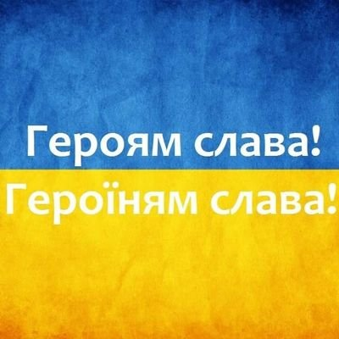
- Слава Україні!

