Slide 1
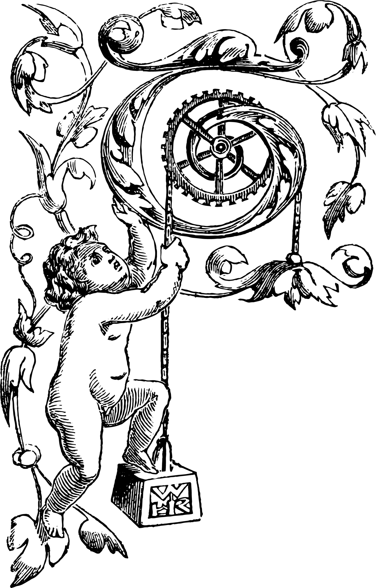
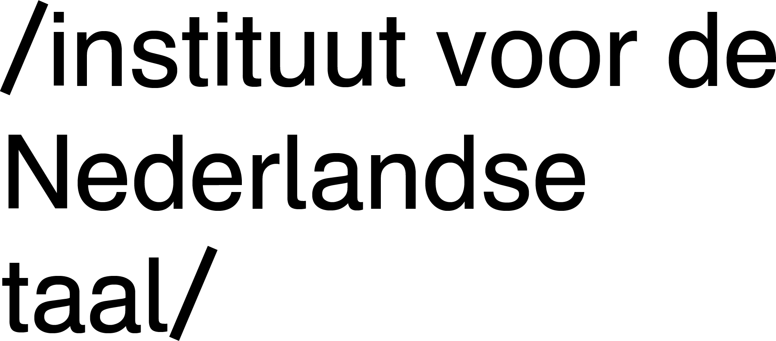
Dutch taboo language
Warning: Presentation contains language that may offend some people.
Towards a lexical database of
Gerhard B van Huyssteen Centre for Text Technology (CTexT) North-West University
Carole Tiberius Dutch Language Institute

Slide 2
Lexical databases of taboo language
TaboeLex
Dutch resources
Taboo language
Notes:
Four sections in our presentation:
What is the practical value of lexical databases of taboo language
Briefly: Which Dutch dictionaries and other resources of taboo language do we have available?
We will get to taboo languages and specifically which aspects of taboo language …
… relates to the design and implementation of a lexical database of taboo language, which we call TaboeLex.
JUST QUICKLY, so that we’re all on the same page, ≫≫

Slide 3
Lexical databases of taboo language
TaboeLex
Dutch resources
Taboo language
Notes:
a word on our definition of taboo language ≫≫

Slide 4
Taboo language
linguistic constructions that are potentially offensive to some users in some contexts
Notes:
General definition
Broadly speaking: we use taboo language as a hypernym to include other phenomena and/or synonyms like:
swearing or cursing/cussing (for example fucking brilliant),
profanity or blasphemy (for example oh my God!)
obscenity or vulgarity (for example words for various sex deeds)
euphemisms and dysphemisms (for example names for genitalia)
verbal abuse (like using (racial) slurs, terms of abuse, insults, and offensive language).
On this note: We mostly present English examples in this presentation to make it easier to follow. In the full version of the paper, we used Dutch examples.
The first question then is ≫≫
FULL DEFINITION: A maledictum is a construction with a culturally determined taboo or stigmatized (secondary) instantiation domain, which is used expletively, abusively, humoristically, euphemistically, dysphemistically or habitually in a variety of context-determined expressive/emotional language acts – whether intentional, semi-intentional or non-intentional.

Slide 5
Lexical databases of taboo language
TaboeLex
Dutch resources
Taboo language
Notes:
… what are lexical databases of taboo language, and specifically: What are the practical applications of such databases? In other words: Why do we need databases?
SOMETHING about hidden lexicography???

Slide 6
a.k.a.
greylists
swearword stop lists
profanity filters
Notes:
We define LDTLs as digital, structured, enriched collections of taboo constructions.
When implemented in NLP systems as simple look-up lists (gazetteers) for filtering of results, they might sometimes also be called blacklists, greylists, swearword stop lists, or profanity filters (e.g., Shutterstock, 2020).

Slide 7
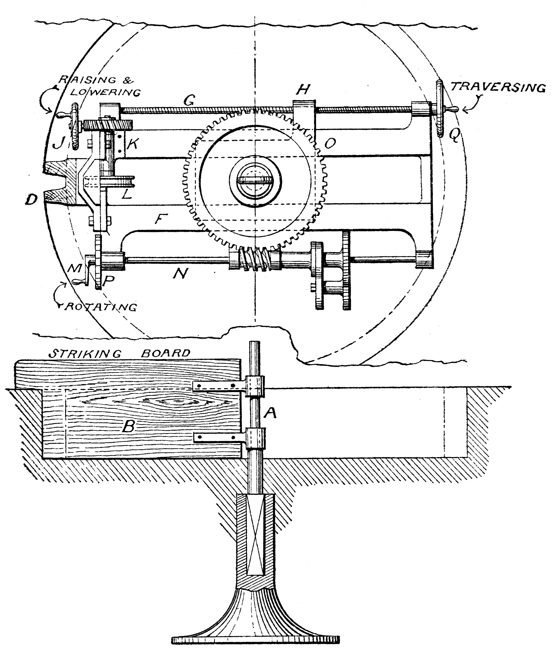
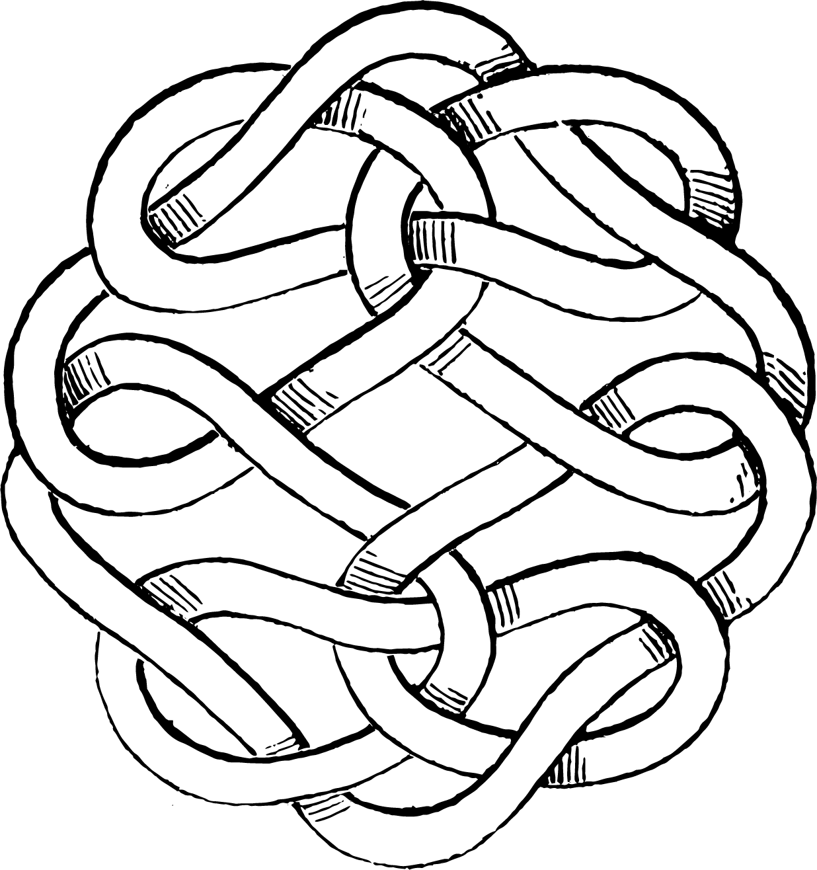
Bias evaluation
Conversational AI agents
Offensive Language ID
LLMs and AIs
e.g., for cyber-bullying detection; sentiment analysis
redacting, modifying, replacing or removing
Text filtering
censoring
e.g., predictive text filtering, suggestion filtering
Content filtering
Examples
Social media management
eLexicography
CALL
Hurtlex
Taboo Wordnet
Applications
Lewandowska-Tomaszczyk et al. (2021)

Slide 8
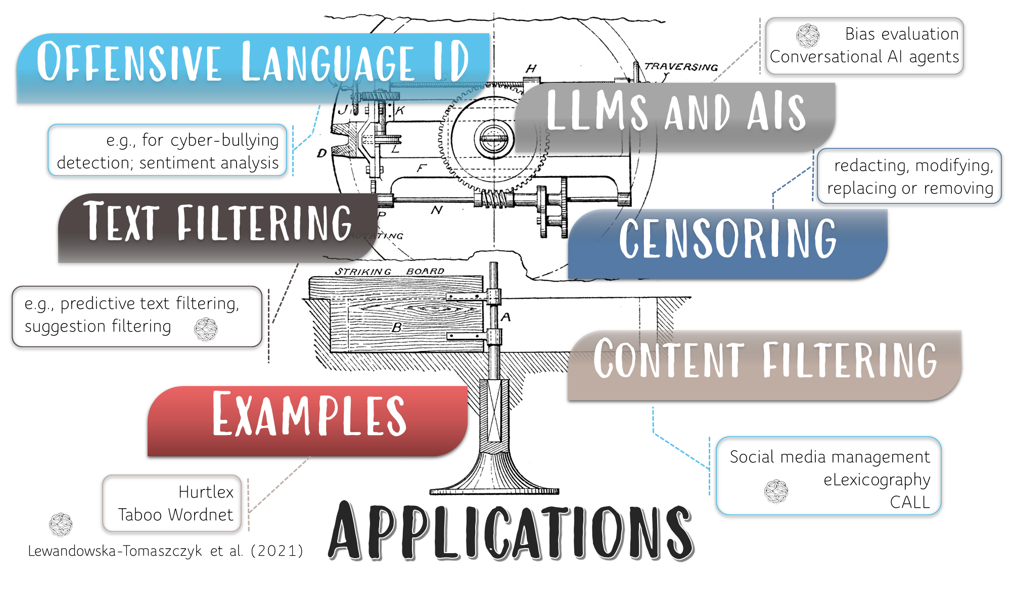

Slide 9
Notes:
By using subsets of data, or a selection of elements, attributes and/or values, from such lexical databases, the data could be used in a variety of practical NLP applications like some of the following:

Slide 10
Notes:
Offensive language identification has been a prevailing topic in NLP for a number of years, especially with a view on hate speech, cyber-bullying and abuse detection on social media platforms.
The identification of taboo language is also an important aspect of sentiment analysis, especially since the speech acts and language associated with sentiment analysis can oftentimes be more subtle or indirect, e.g., by using humour, or irony and sarcasm.

Slide 11
Notes:
More recently the evaluation of large language models for biased and toxic language have been pushed to the fore with the public availability of OpenAI’s GPT-4 and ChatGPT models.
However, from a linguistic and user interface design perspective, our understanding of the implementation of these models in conversational artificial intelligent agents (e.g., speech assistants and chatbots), and especially the relation with taboo language, is still in its infancy.

Slide 12
Notes:
LDTLs have been used for many years in applications of text filtering, like:
predictive text filtering, e.g., for search engines, keyboards on mobile phones, online text editors, etc.;
suggestion filtering, e.g., for spelling checkers and electronic dictionaries (especially dictionary apps for children) that should not suggest swearwords as corrections for ordinary typos;
FOR EXAMPLE: when you accidentally type *“gucking” on your phone, the phone should suggest “rucking”, “ducking” or “tucking”, but not “fucking”. However, if you type “fucking”, it should not be flagged as a spelling error.

Slide 13
Notes:
taboo language censoring, i.e., redacting, modifying, replacing or removing a word in a text that matches a word in the LDTL; implemented typically as part of parental control software for text, audio, and video – for example to bleep out swear word in films.

Slide 14
Notes:
content filtering, e.g., social media algorithms that (semi-)automatically delete posts or ban users, like Facebook’s profanity filter for Facebook Page, or spam filters used in email applications. Other examples of content filtering include e-lexicography tools for choosing good dictionary examples, or computer-assisted language learning systems that automatically selects suitable texts for learners.
CAROLE: Perhaps embellish a bit here with your own experiences?

Slide 15
Notes:
Two prominent examples of LDTLs are the following:
Hurtlex is a lexicon of 1,156 Italian “hate words” that were “linked to synset-based computational lexical resources such as MultiWordNet and BabelNet” (Bassignana et al., 2018).
Taboo Wordnet is an online, synset-based Japanese resource that could “help detection systems regulate and curb the use of offensive words online” (Choo & Bond, 2021). It consists of 2,095 words with 912 synsets, and it is linked to the Open Multilingual Wordnet.
Besides proprietary lists that are not accessible in the open-data domain, there are also numerous data sets for various taboo-related domains available
The different tagging schemas of more than 60 such data sets have been compared by Lewandowska-Tomaszczyk et al. (2021), with the aim to create an ontology basis for offensive language identification, while also getting insight in how the concept offensive is understood across different projects.
Their work holds the potential to play an important standardisation role with regards to the treatment of taboo language in the context of Linguistic Linked Open Data (LLOD).
In the next phase of our project, their ontology will therefore be the first point of reference to which we will compare our own ontology.

Slide 16
Lexical databases of taboo language
TaboeLex
Dutch resources
Taboo language
Notes:
OK, so now let’s VERY BRIEFLY look at some ≫≫

Slide 17
Lexical databases of taboo language
TaboeLex
Dutch resources
Taboo language
Notes:
Dutch resources that are available for our project.

Slide 18
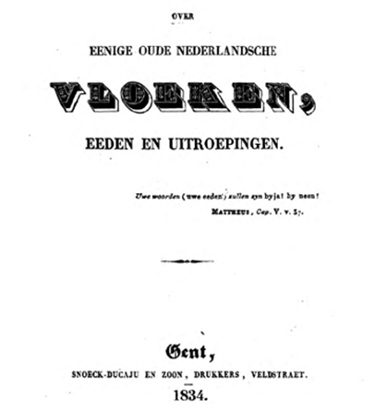
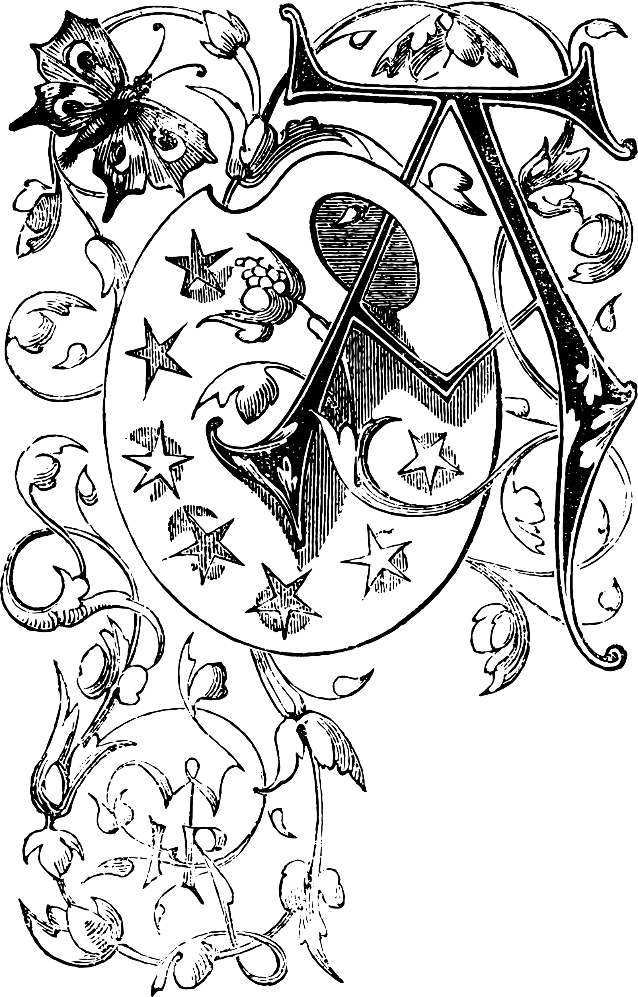
Notes:
Dutch has a rather long tradition in taboo language research, going back to at least 1834 with an history-focused article by J.F. Willems titled On some old Dutch curses, oaths and exclamations .

Slide 19
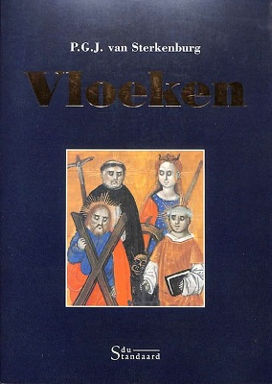
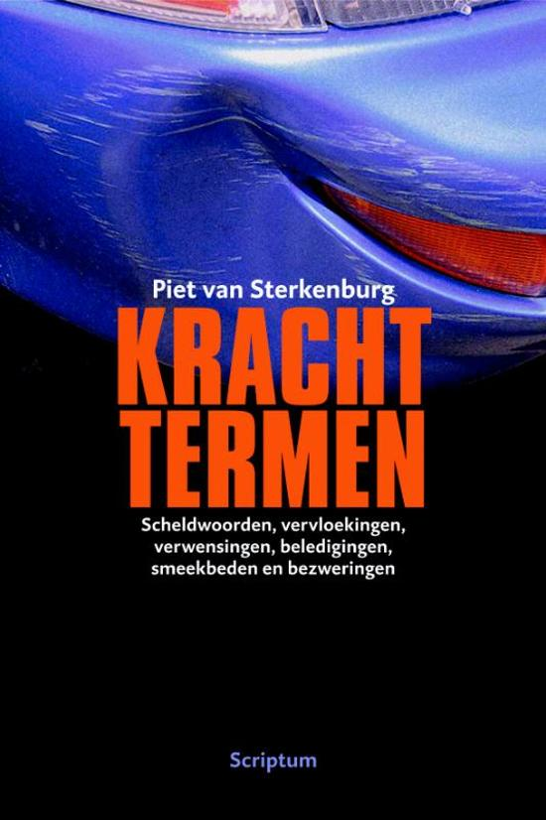
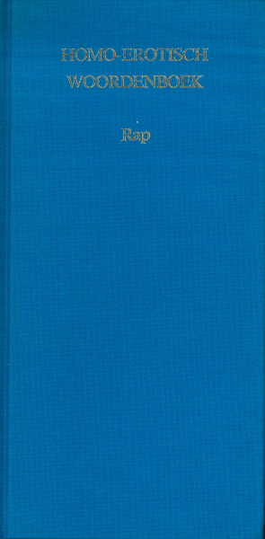
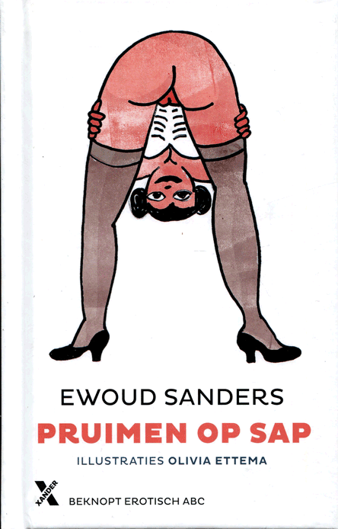
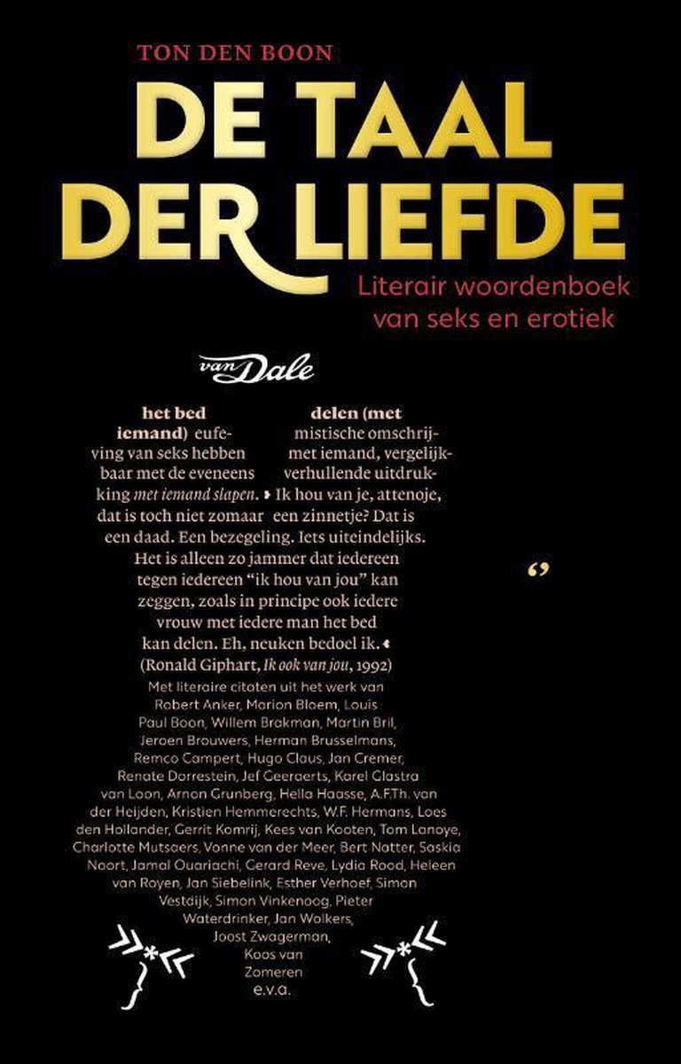
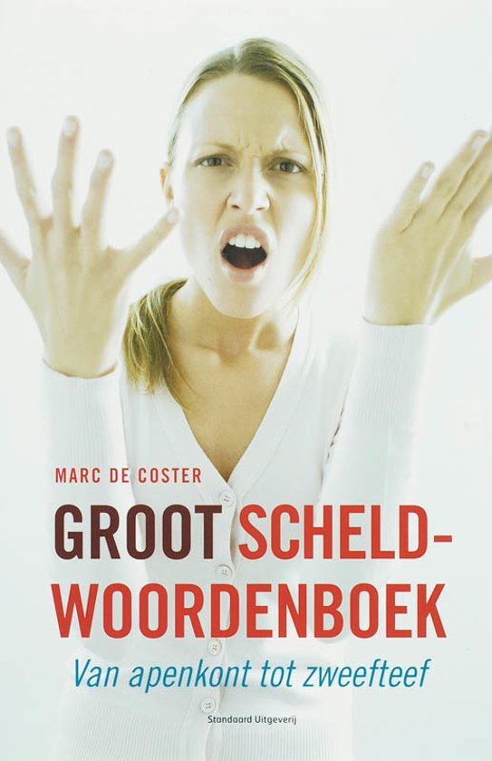
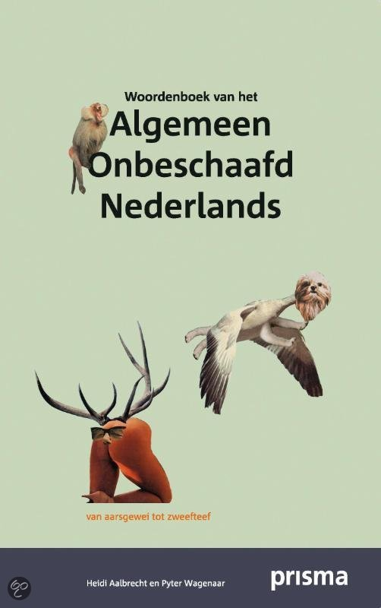
Notes:
However, the first specialised printed dictionary focusing on language from a taboo domain only appeared in 1977 (EW, 1977).
Since then, at least seventeen other printed dictionaries (or dictionary-like books) on various aspects of taboo language have been published
Of these, only two dictionaries are available and suitable for us … ≫≫

Slide 20
Notes:
… to identify candidate taboo constructions for TaboeLex, viz. :
“Cursing” from 2001 by the well-known Dutch lexicographer, Piet van Sterkenburg; and
The Big Swearing Dictionary from 2007 by another seasoned Dutch lexicographer, Marc de Coster.
Of course, our lexical database won’t be the first for Dutch: ≫≫

Slide 21
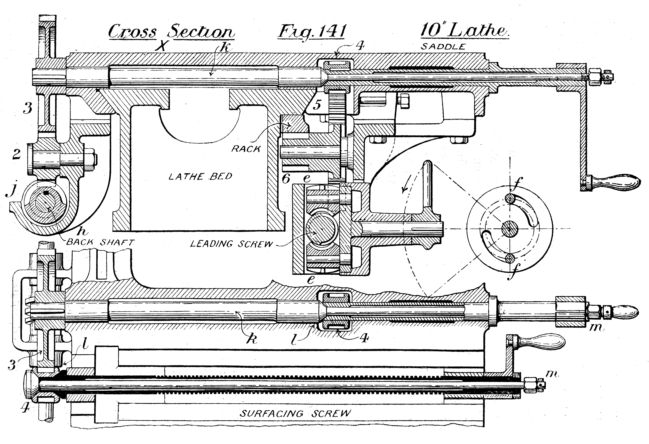
List-of-Dirty-Naughty-Obscene-and-Otherwise-Bad-Words
GRoninger OFfensive Lexicon (GrofLex)
Notes:
Numerous other lists with taboo Dutch words exist on the Internet, such as:
the List-of-Dirty-Naughty-Obscene-and-Otherwise-Bad-Words, consisting of 190 constructions ; and
the GRoninger OFfensive Lexicon (GrofLex) (Van der Veen, 2020), a Dutch lexicon of abusive lemmas based on version 1.2 of the Dutch section of HurtLex, and which consists of 847 constructions – therefore four and a half times the size of the List-of-Dirty-Obscene-and-Otherwise-Bad-Words.
Aside from numerous problems and shortcomings of these lists – which we describe in detail in the paper – both these lists are still rather limited in terms of their size and coverage. For example, the first version of our candidate list already consists of almost 5,300 items – which means it is already more than 6 times bigger than GrofLex.

Slide 22
Lexical databases of taboo language
TaboeLex
Dutch resources
Taboo language
Notes:
OK, let’s now get closer to the design of TaboeLex …

Slide 23
Lexical databases of taboo language
TaboeLex
Dutch resources
Taboo language
Notes:
Since we have already gave our basic definition of taboo language earlier, we will now only look at … ≫≫

Slide 24
Taboo language
Taboo language features
Morphosyntactic type
Taboo domain
Taboo type
Tabooness
Context dependence
Intention and effect
Notes:
… those features of taboo language that should ideally be captured in a database of taboo lexical items.
Given our time constraints, I will not discuss each of these features in any detail, but rather let them speak for themselves by means of some values and some examples.

Slide 25
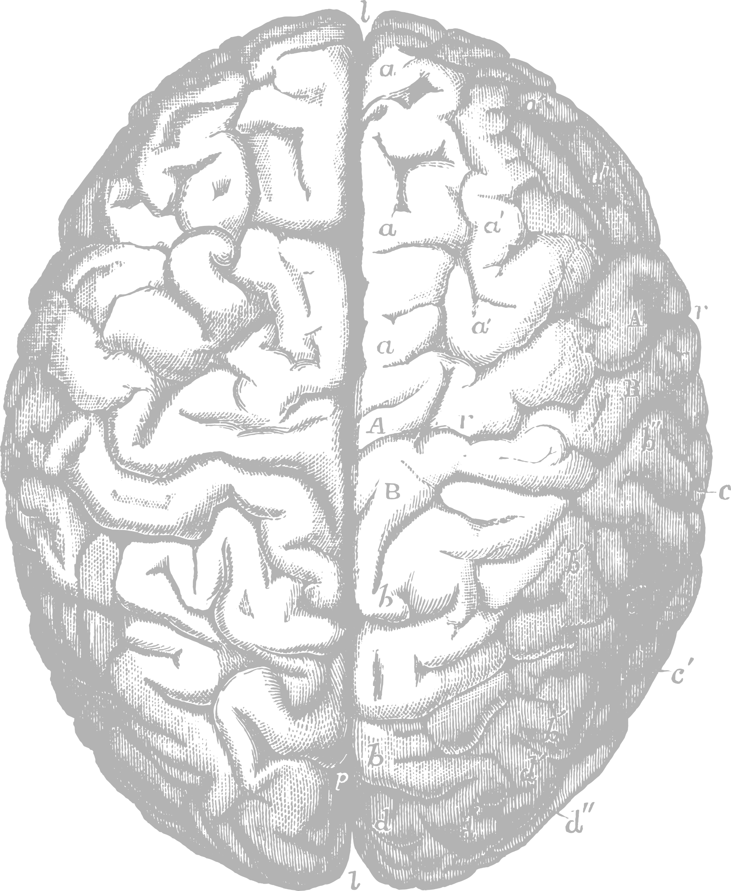
Morphosyntactic type
Taboo domain
Taboo type
Tabooness
Context dependence
Intention and effect
<headwordType>
<subword>
-tard: libtard, fucktard, Bushtard, Trumptard
Taboo language features
Notes:
The first one is morphosyntactic type, which simply refers to the fact that we need to capture not only words, but also:
sub-word constructions, like the libfix –tard in words like libtard, fucktard, Bushtard, Trumptard, etc.

Slide 26
Morphosyntactic type
Taboo domain
Taboo type
Tabooness
Context dependence
Intention and effect
<headwordType>
<reductionForm>
MILF, DILF, WTF, LMAO
Taboo language features
Notes:
Reduced forms like MILF and DILF, or WTF and LMAO

Slide 27
Morphosyntactic type
Taboo domain
Taboo type
Tabooness
Context dependence
Intention and effect
<headwordType>
<MWE>
[X the fuck]
X = what, who, where, …
Taboo language features
Notes:
Multiword expressions and constructional idioms like, X the fuck, for what the fuck, who the fuck, where the fuck, etc.

Slide 28
Morphosyntactic type
Taboo domain
Taboo type
Tabooness
Context dependence
Intention and effect
event; relation; state; entity; locale; process
Taboo language features
<sense>
<denotatum>
poop = process [body] [substance] [excretion]
poop = entity [body] [substance] [excretion]
Notes:
The next feature relates to the semantic domain of the construction’s source or reference domains, such as religion, sex, scatology, animals, death, disease, etc.
This information will be declared as part of the <denotatum> element, which is a child element of the <sense> element
See for example poop which can be both a process or an entity.

Slide 29
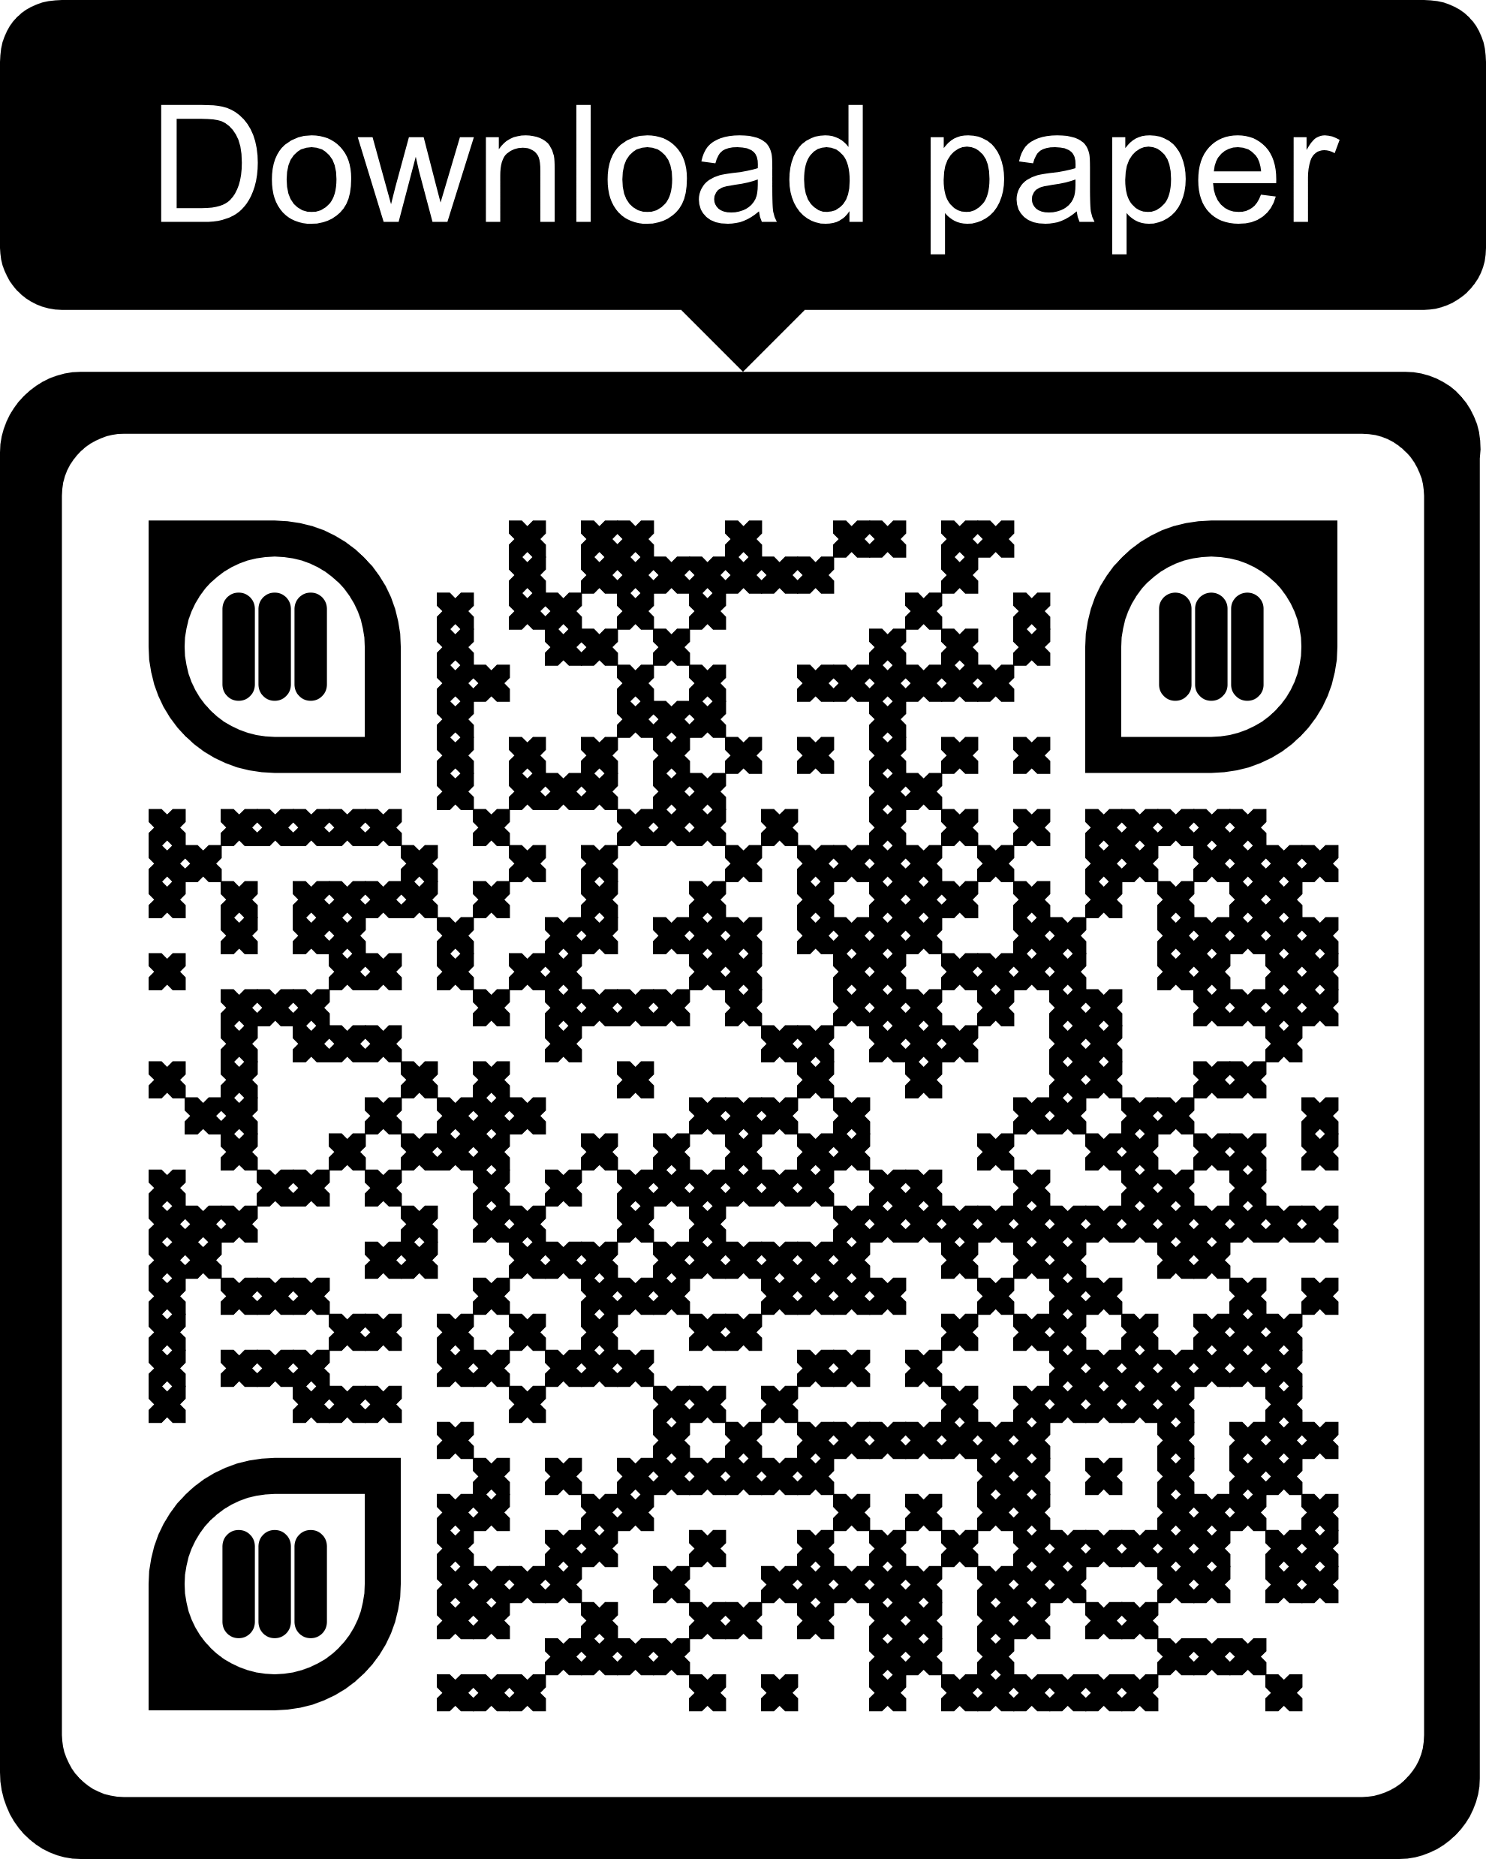
Morphosyntactic type
Taboo domain
Taboo type
Tabooness
Context dependence
Intention and effect
Taboo language features
Notes:
The first version of our domain taxonomy, is available where this presentation and supplementary material is available.

Slide 30
= orthophemism (e.g., penis)
= euphemism (e.g., John Thomas)
Morphosyntactic type
Taboo domain
Taboo type
Tabooness
Context dependence
Intention and effect
= dysphemism (e.g., cock)
Taboo language features
<tabooType>
= witticism (e.g., joystick)
= rudeImperative (e.g., go suck a dick!)
Notes:
The next feature relates to the taboo type, where we distinguish five superordinate categories:
Orthophemisms
Euphemisms
Dysphemisms
Witticisms
Rude imperatives

Slide 31
= highlyTaboo (e.g., faggot)
Morphosyntactic type
Taboo domain
Taboo type
Tabooness
Context dependence
Intention and effect
= moderatelyTaboo (e.g., fudge packer)
= slightlyTaboo (e.g., poofter)
= notTaboo (e.g., gay man)
Taboo language features
<tabooValue>
Notes:
With regard to tabooness, we assign four possible taboo values as it generally applies to these constructions:
highlyTaboo
moderatelyTaboo
slightlyTaboo
notTaboo

Slide 32
= alwaysTaboo (e.g., to fuck)
Morphosyntactic type
Taboo domain
Taboo type
Tabooness
Context dependence
Intention and effect
= oftenTaboo (e.g., to shag)
= sometimesTaboo (e.g., to serve)
= rarelyTaboo (e.g., to squeak)
Taboo language features
<tabooPrototypicality>
Notes:
In our definition of taboo language, we made it clear that taboo words are very much context dependent: What is taboo in one context, is not necessarily taboo in another context. Since the probability of a construction being taboo or not, is reflected in the construction’s degree of prototypicality, we express this with four values:
alwaysTaboo
oftenTaboo
sometimesTaboo
rarelyTaboo
Note that we don’t include a value like “neverTaboo”, since the database should only include items that are potentially taboo.

Slide 33
<speechAct>
32 values, e.g., blasphemy (oh my God!); comparison (X as fuck), agreement (fuck on)
Morphosyntactic type
Taboo domain
Taboo type
Tabooness
Context dependence
Intention and effect
<illocution>
60 values, e.g., disbelief (oh my God!); emphasis (X as fuck), satisfaction (fuck on)
Taboo language features
<perlocution>
16 values, e.g., offensive (oh my God!); intensifying (X as fuck), endearing (fuck on)
Notes:
Lastly, since our definition of taboo language is solidly embedded in pragmatics, we capture this with numerous values for speech acts, potential illocutionary intentions, and perlocutionary effects. Although these features are optional, they could be very useful in applications for sentiment analysis, hate speech detection, etc.
NOTE: A construction can have multiple values. For example, to say “fuck on” as a way to show agreement, it could of course also be offensive to some people. We therefore foresee that these three features will be the most difficult to assign values objectively to.

Slide 34
Lexical databases of taboo language
TaboeLex
Dutch resources
Taboo language
Notes:
Since we have already gave our basic definition of taboo language earlier, we will now only look at … ≫≫

Slide 35
Lexical databases of taboo language
TaboeLex
Dutch resources
Taboo language
Notes:
To end this presentation: A brief look at the current state of our project, and the immediate steps ahead.

Slide 36
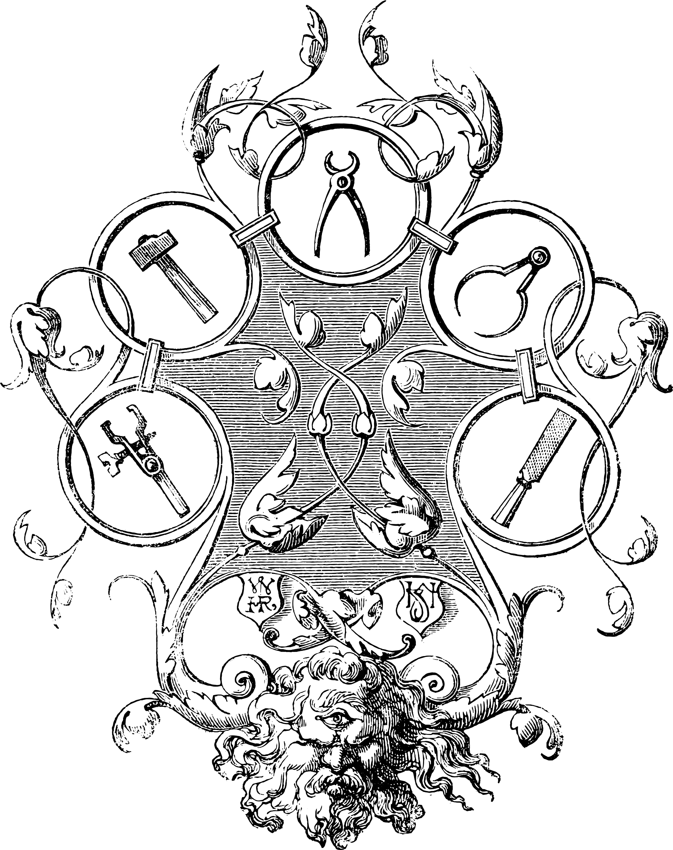
Data extraction
Two dictionaries + Wikipedia + Wiktionary = 5,295 unique lemmas (see Table 1)
XML schema
Experimenting with DMLex (see Figure 1)
Extension
Other dictionaries, corpus validation
Ontology
Available for comments and critique
Lexicographic editing
TaboeLex
Notes:
What have we completed thus far?
The ontology we concisely discussed here today. This ontology is now on our project website available for public scrutiny; so please be in contact with us if you have comments or questions.
We have completed our XML schema, but it is not finalised yet. We are currently experimenting with the DMLex framework, and as you will know, this framework is not mature yet. We therefore still expect many changes and fine tuning.
We have extracted a candidate list of lemmas from four available resources: The two dictionaries mentioned earlier, and lists from Wikipedia and Wiktionary. This resulted in a list of almos 5,300 candidate lemmas, as described in detail in the paper. What we found very interesting, was that there was very little overlap between these lists – something that we need to investigate further.

Slide 37
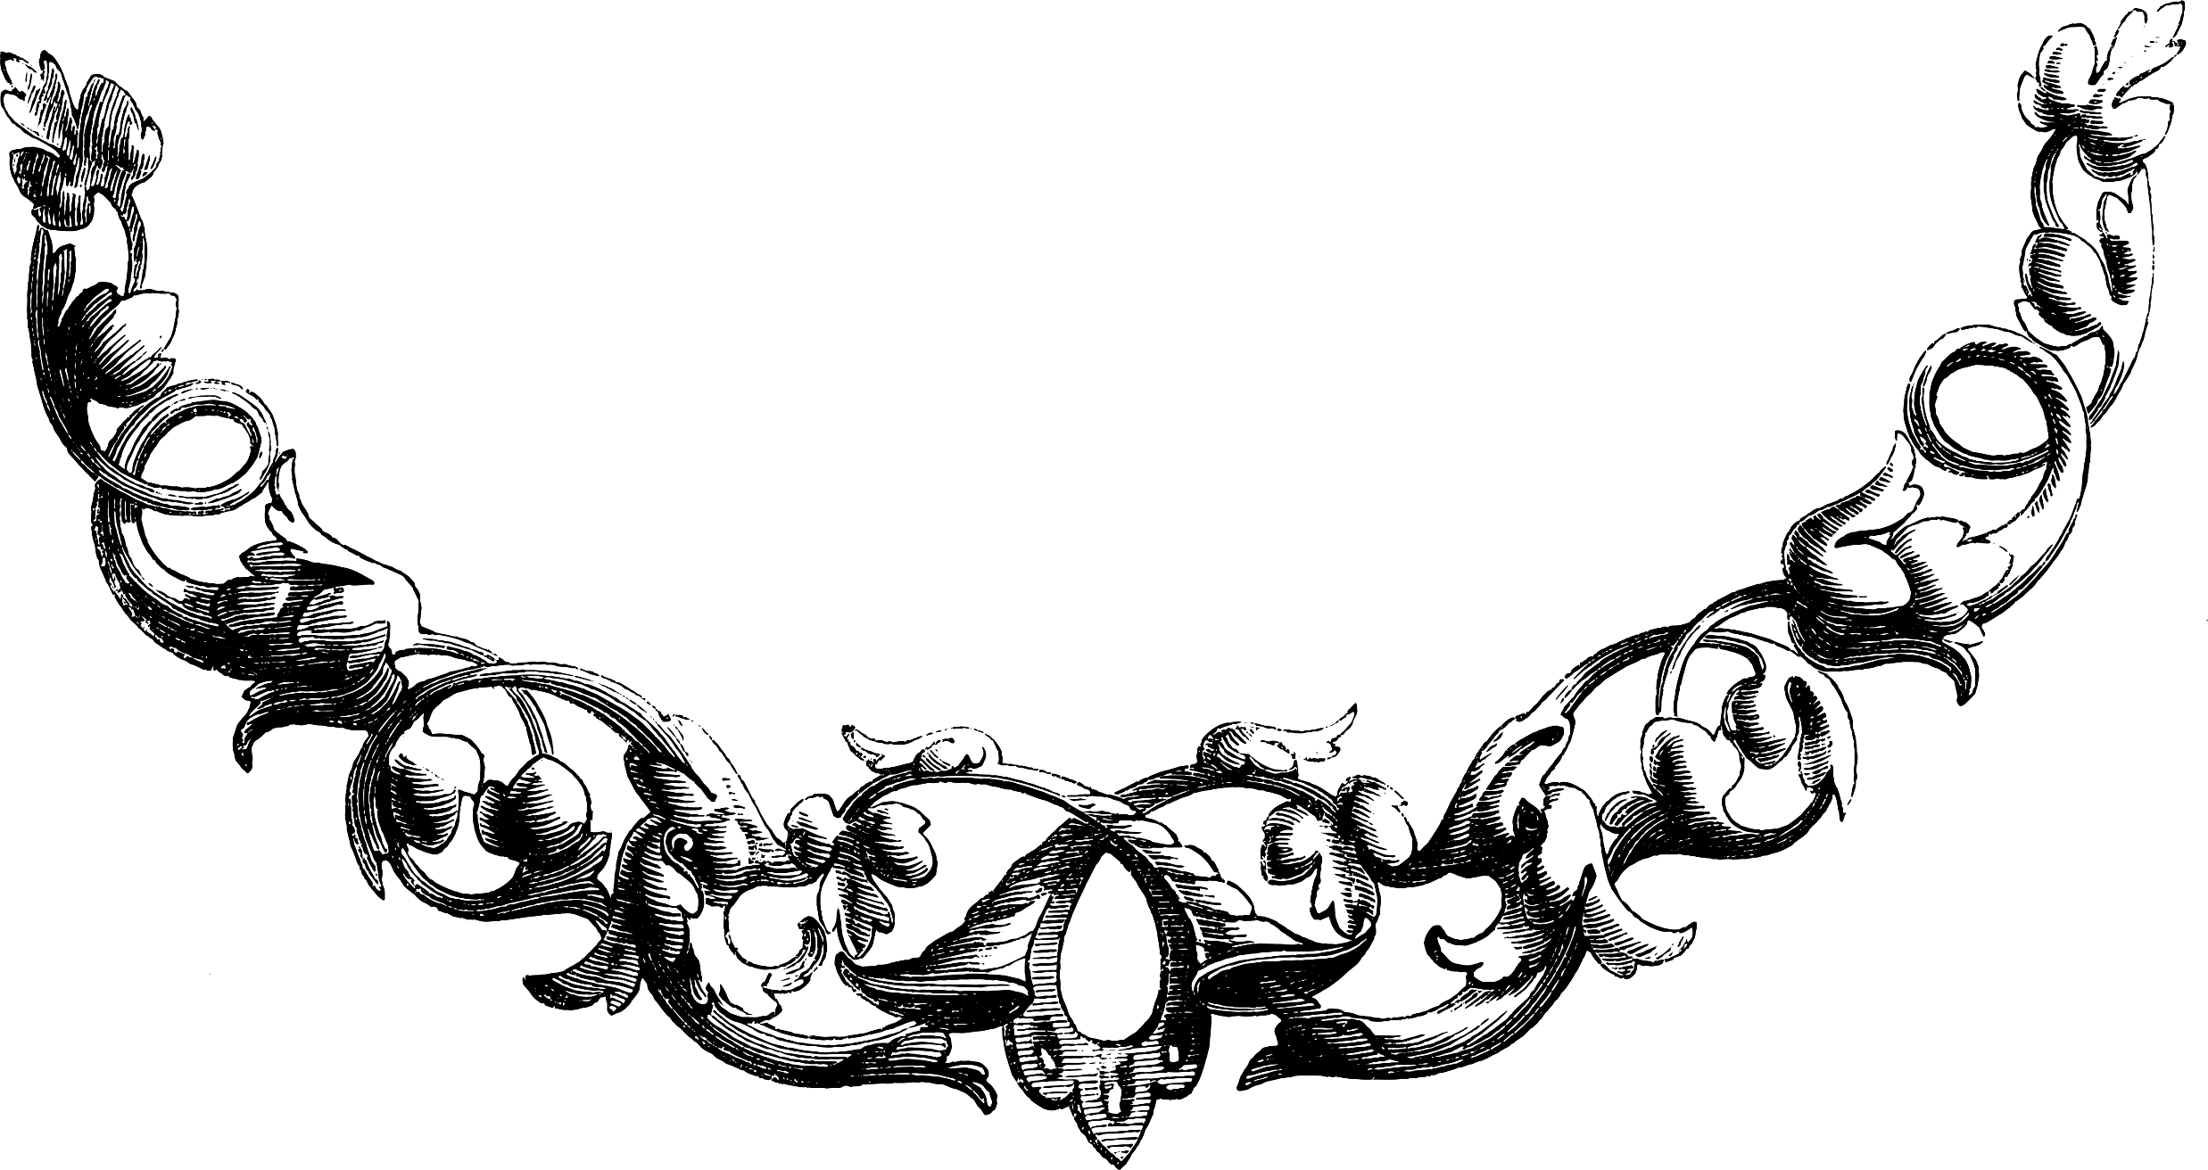
Gerhard.VanHuyssteen@nwu.ac.za
Carole.Tiberius@ivdnt.org

