Slide 1
Virtual Lexicographic Laboratory in Linguistic Researches Based on the Dictionary Content
Ukrainian Lingua-Information Foundation of NAS of Ukraine
National Technical University “Kharkiv Polytechnic Institute”
Yevhen Kupriianov, Iryna Ostapova, Volodymyr Shyrokov, Mykyta Yablochkov
eugeniokuprianov@gmail.com, irinaostapova@gmail.com, vshirokov48@gmail.com, gezartos@gmail.com
Elex 2023, June 27‒29, Brno, Chech Republic

Slide 2
Introduction
Computer lexicography appeared intersection of linguistics and computer science.
Research area that studies the problems of applying computer science methods for building a wide range of systems to create, support and work with lexicographic resources in digital environment.
A branch of computer industry that develops the systems based on lexicographic description as an efficient way to obtain and transfer knowledge.

Slide 3
Introduction
Some well-known dictionaries that have been traditionally made in paper are gradually changing to digital format.
Explanatory dictionary is considered as a comprehensive source of information to be used for language researches.
Research potential of dictionary is fully developed in digital environment.
This sets a problem of providing dictionaries with appropriate tools.

Slide 4
Spanish Language dictionary (DLE 23)
For the purposes of our research we have selected Spanish Language Dictionary entitled “Diccionario de la lengua española. 23ª edición” (shortly DLE 23), which has been published by the Academia Real Española (Spanish Royal Academy).
The DLE 23 is the most comprehensive and representative explanatory dictionary of the Spanish language.
The 23rd edition was published in October 2014.
The year later DLE 23 was made available on CD-ROM and then online at www.dle.rae.es.
Now the Academy is working on a 24th edition, which is supposed to be digital only

Slide 5
Introduction
Title: Diccionario de la lengua española.
Edition: 23.
Publisher: Real Academia Española.
Year: 2014.
Volume: 93111.
The task of our project is to design and implement linguistic tools for analyzing digital dictionary text.

Slide 6
Spanish Language dictionary (DLE 23)
Our interest in DLE 23 is arisen by the following reasons:
1) international status of the Spanish language;
2) credibility and academic status of the dictionary;
3) school of lexicography.
In addition, the dictionary in question is of interest to translation lexicography while creating translation systems: Spanish-Ukrainian and Ukrainian-Spanish.
Another and also important reason of choosing DLE 23 is the availability of its digital version that supports HTML5 format. This fact guarantees the authenticity of the dictionary text and allows us to focus our attention on the structure of dictionary entry.

Slide 7
Introduction
Successful implementation of this project, would be a great advance in:
- translation lexicography due to reliable language material;
- linguistics to study the principles of Spanish vocabulary presentation;
- developing new approaches to designing explanatory dictionary interfaces;

Slide 8
Method and technology
As a theoretical basis, we use the theory of lexicographic systems developed and proposed by the Ukrainian Academician Volodymyr Shyrokov.
Lexicographic system (L-system) is a special informational (semiotic and semantic) system, in which a lexicographic effect (or a combination of lexicographic effects) is induced.
We consider the dictionary as a lexicographic system of special type with a set of language units and a set of their descriptions.

Slide 9
Method and technology
$\{I\left(D\right),V\left(I\left(D\right)\right),β,σ\left[β\right],Red[V\left(I\left(D\right)\right)]\}$)
D - dictionary;
I(D) = {x_{i}} – set of language units;
V(I(D)) = {V(x_{i})} – set of lexicographical descriptions;
β – set of structures on V(I(D));
σ[β] – separate structure generated by the operator σ on β;
Red[V(I(D))] – mechanism of recursive reduction.

Slide 10
Method and technology
L-system architecture
ANSI/Х3/SPARK
Conceptual level
Internal level
External level
One of the main aspects in the definition of an L-system as an information system of a special type is the concept of its architecture.

Slide 11
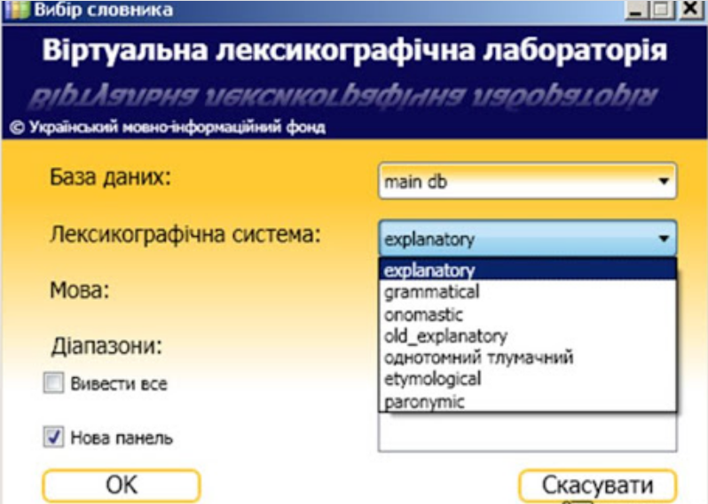
Method and technology
Ukrainian Lingua-Information Fund has developed the software systems to support creating, maintaining and functioning of the dictionaries in digital environment named virtual lexicographic laboratories (VLL).

Slide 12
VLL for Spanish language dictionary
Developing VLL
Building up conceptual model
Development of database
Making a Web application
Entry text analysis
Choosing database type
Entry structure determination

Slide 13
VLL for Spanish language dictionary
The project of VLL DLE 23 is planned to be implemented in two stages:
1) creating a shortened version of VLL with minimum interface elements to test some technological solutions and
2) developing fully functional application with expanded interface.
Currently VLL DLE 23 is at end of the first stage and it demonstrates more capabilities for working with the dictionary in digital environment than the original online version of DLE 23.

Slide 14
VLL for Spanish language dictionary
The current version of the VLL DLE 23 can be accessed at https://svc2.ulif.org.ua/Dics/ResIntSpanish

Slide 15
VLL for Spanish language dictionary
The interface of VLL allows the following modes to work with the dictionary:
Headword List with search filters like in original Spanish dictionary online (“contains”, “starts with”, “ends with” etc.).
Entry Profile for making a sample of entries which satisfy the parameters of entry elements.
Full-Text Search to select entries by specific meta-language elements of dictionary text.

Slide 16
Main window of DLL 23

Slide 17
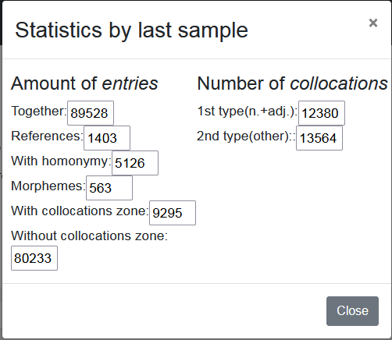

Slide 18
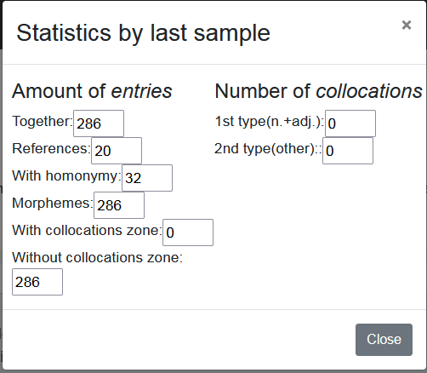
we have given a string of one character (-) which should be at the end

Slide 19
Entry Profile
The mode is activated by clicking the menu “Sample” after which the dialog box appears. The dialog box has two tabs “Headword” and “Entry”. In first the user can choose headword parameters by which the entries are to be selected:
1. Headword variants: lemma, masculine, feminine, regional variant, not defined.
2. Headword structure: word, collocation, morpheme, not defined.
3. Headword type: foreign word, abbreviation, acronym, not defined.
4. Homonymy: yes (≥1) / no (0).
The second tab is intended for selecting the entries which correspond to definition / collocation parameters:
5. Number of definitions: numerical value and additional options (>, ≥, = ≤, <).
6. Number of collocations “Noun + Adj.”: numerical value and additional options (>, ≥, = ≤, <).
7. Number of collocations of other types: numerical value and additional options (>, ≥, = ≤, <).
8. Number of cross-reference: numerical value and additional options (>, ≥, = ≤, <).

Slide 20
Entry profile

Slide 21
Entry profile

Slide 22
Let’s make a sample of the words borrowed from other languages. As a result, the laboratory selected 313 units from DLE 23

Slide 23
We may want to know the availability of monosemantic words among those selected in the example. The total of the words in the sample is 231.

Slide 24
Full-text search (Que siente)

Slide 25
Future works
In final version of VLL DLE 23 the structural profile of dictionary entry will be determined by all the structural elements of the conceptual model.
The user will be able to select the entries by indicating obligatory presence or absence of a structural element.
Additionally the user will have the possibility of specifying specific content of the structural elements.

Slide 26
Thank you for your attention

