Slide 1
Going Beyond Standard Ukrainian: How a Corpus Informs an E-Dictionary
Maria Shvedova (University of Jena; National University "Lviv Polytechnic")
Vasyl Starko (Ukrainian Catholic University)
Andriy Rysin (independent researcher)

Slide 2
General Regionally Annotated Corpus of Ukrainian (GRAC): uacorpus.org - 1.9 bln tokens, >120,000 texts - 1816-2022 - morphological annotation - regional annotation - genre and style variety Maria Shvedova, Ruprecht von Waldenfels, Serhij Yaryhin, Andry Rysin, Vasyl Starko, Tymofij Nikolaenko et al. (2017-2023) Kyiv, Lviv, Jena

Slide 3
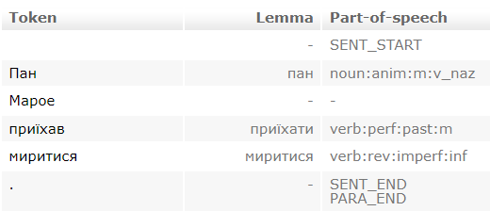
Morphological analysis
Morphological dictionary VESUM, over 418,000 lemmas (by Andriy Rysin, Vasyl Starko): https://r2u.org.ua/vesum/
Morphological analysis (R2U group: Andriy Rysin, Vasyl Starko et al.): https://github.com/brown-uk/corpus
VESUM-based morphological analysis system lemmatizes 99% of standard text

Slide 4
The Ukrainian language
High degree of grammatical variation
Historical regional variants
Spoken dialects and regional linguistic features
This complicates the task of high-quality computer processing of Ukrainian texts.

Slide 5
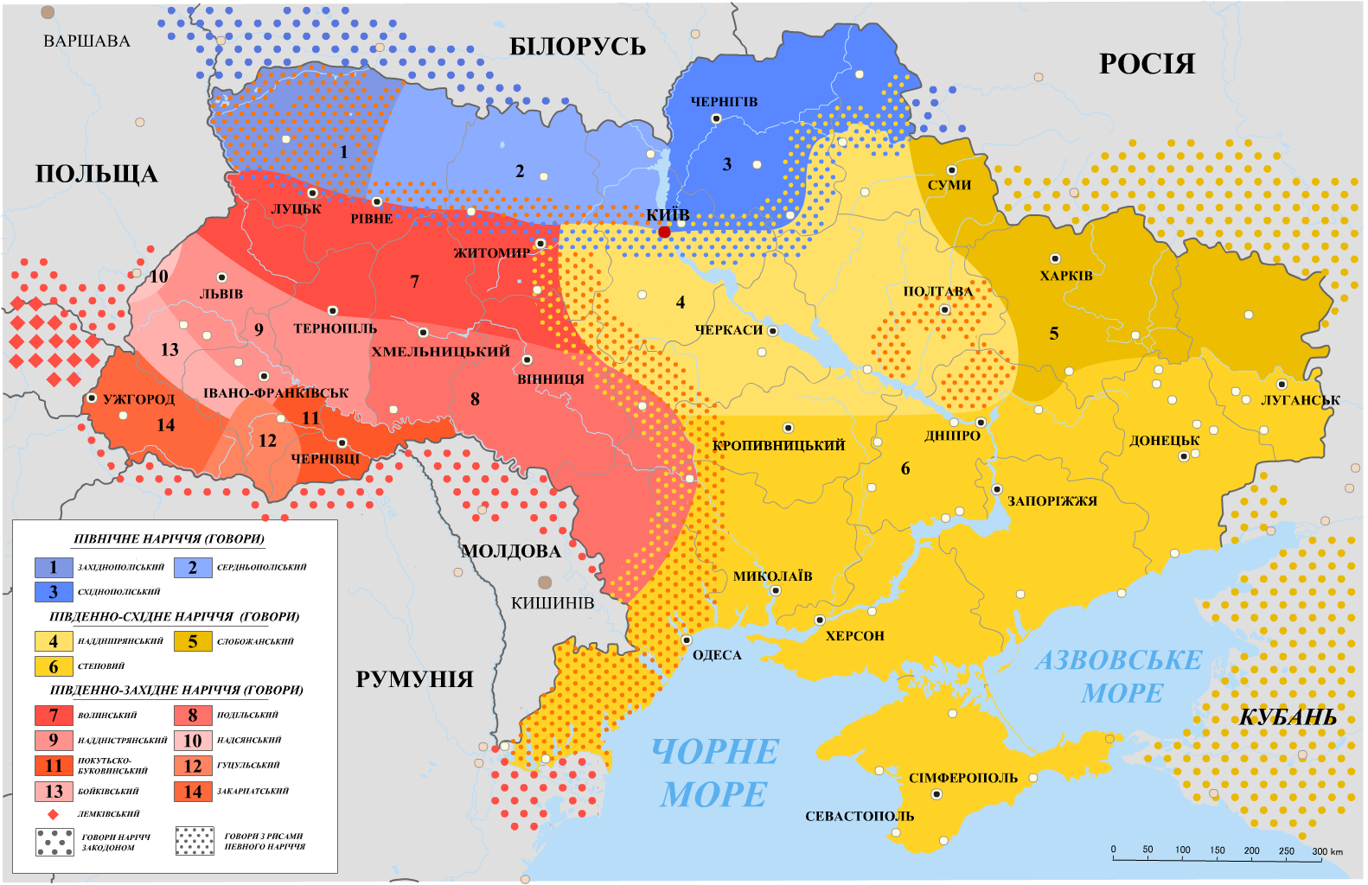
Ukrainian dialectal groups

Slide 6
Political divisions of the Ukrainian ethnic territory, before and between the world wars

Slide 7
Different norms of Standard Ukrainian
Convergence of norms (1920s) => “united” Standard Ukrainian; later the Russification of the norms, especially in the 1930-1950s
Many local differences (between the East, the West and the diaspora) are still present today.
Lexical doublets: журнал – часопис (magazine) чемодан – валіза (suitcase) чай – гербата (tea) бутерброд – канапка (sandwich) лимон – цитрина (lemon) чашка – філіжанка (cup) клейонка – церата (oilcloth) etc.

Slide 8
Variant norms in the "Ukrainian Orthography" (2019)
Genitive case endings of feminine singular nouns with final –ть: Радості / радости
Transliteration of the sound [g] in foreign words: Георг / Ґеорґ
Transliteration of the sound [θ] in words of Greek origin: міф / міт ефір / етер
Transliteration of [au] in words of ancient Greek and Latin origin: аудиторія / авдиторія пауза / павза

Slide 9
A non-standard grammatical form in a newspaper
Standard third person plural form: xočut' 'want'
Form in the newspaper text: xotjat'
Novyny Zakarpattja, 1994, №147

Slide 10
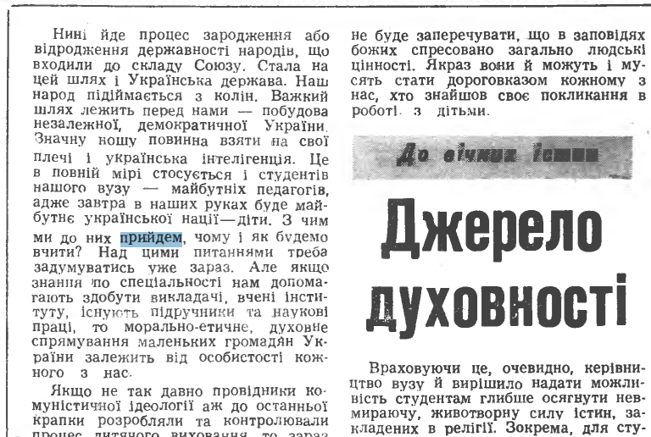
A non-standard grammatical form in a newspaper
Standard first person plural form: pryjdemo 'will come'
Form in the newspaper text: pryjdem
Pedahoh Prykarpattja, 1991, № 19

Slide 11
Electronic Grammatical Dictionary of the Ukrainian Literary Language (Word Change) vs. VESUM

Slide 12
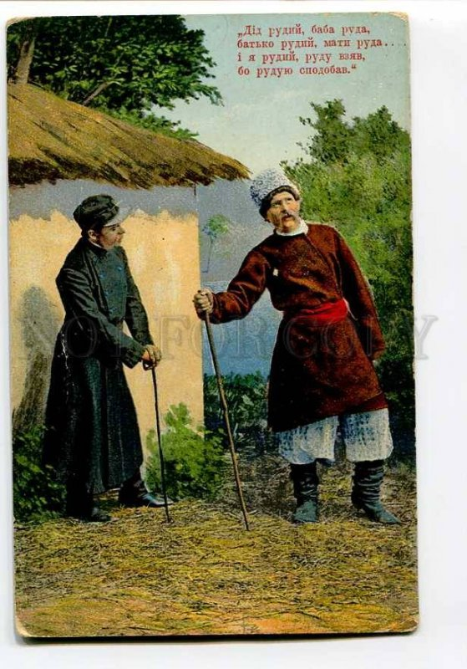
Variant forms of an adjective in a Ukrainian folk song
Did rudyj, baba ruda,
Bat'ko rudyj, maty ruda…
I ja rudyj, rudu (Akk., sg.) vzjav,
Bo ruduju (Akk., sg.) spodobav.

Slide 13
Adjective forms (VESUM)

Slide 14
VESUM: beyond the literary standard
bad: incorrect
9,012 lemmas and word forms (for example, the genitive singular form of dialohu, ‘dialog’, which is non-normative, cf. the standard one dialoha).
The most frequent of these are the following: ïx ‘their’ (an indeclinable variant of the third-person plural possessive pronoun; stylistically, the declinable variant ïxnij is considered preferable), čolovík ‘people’ after numerals (5 čolovik cf. standard 5 osib), policejs'kyj ‘policeman’ (the recommended option: policijant), postavka ‘supply’, da ‘yes’, isnujučyj ‘existing’, etc.
Many of the words on this list are not recommended from a stylistic point of view, but they are not non-standard.

Slide 15
VESUM: beyond the literary standard
subst: vernacular form
41 items, including lemmas and some grammatical forms:
šo ‘that’, šob ‘in order to’, vs'o ‘everything’, zara ‘now’, štani ‘pants’ (cf. standard ščo, ščob, vse, zaraz, štany),
possessive pronouns in the dative case: tvomu ‘yours’, svomu, svojomu ‘somebody's own’, mojomu ‘mine’ (cf. standard tvojemu, svojemu, mojemu),
verb forms: xotjat’ (cf. standard xočut'), možem, skažem, ljubym (cf. standard možemo, skažemo, ljubymo), xode, robe (cf. standard xodyt', robyt'), etc.

Slide 16
Orthoepic and orthographic variants

Slide 17
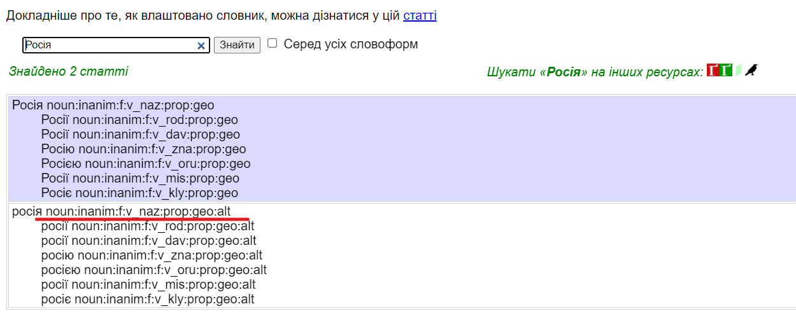
Modern orthographic variants

Slide 18
Grammatical variants

Slide 19
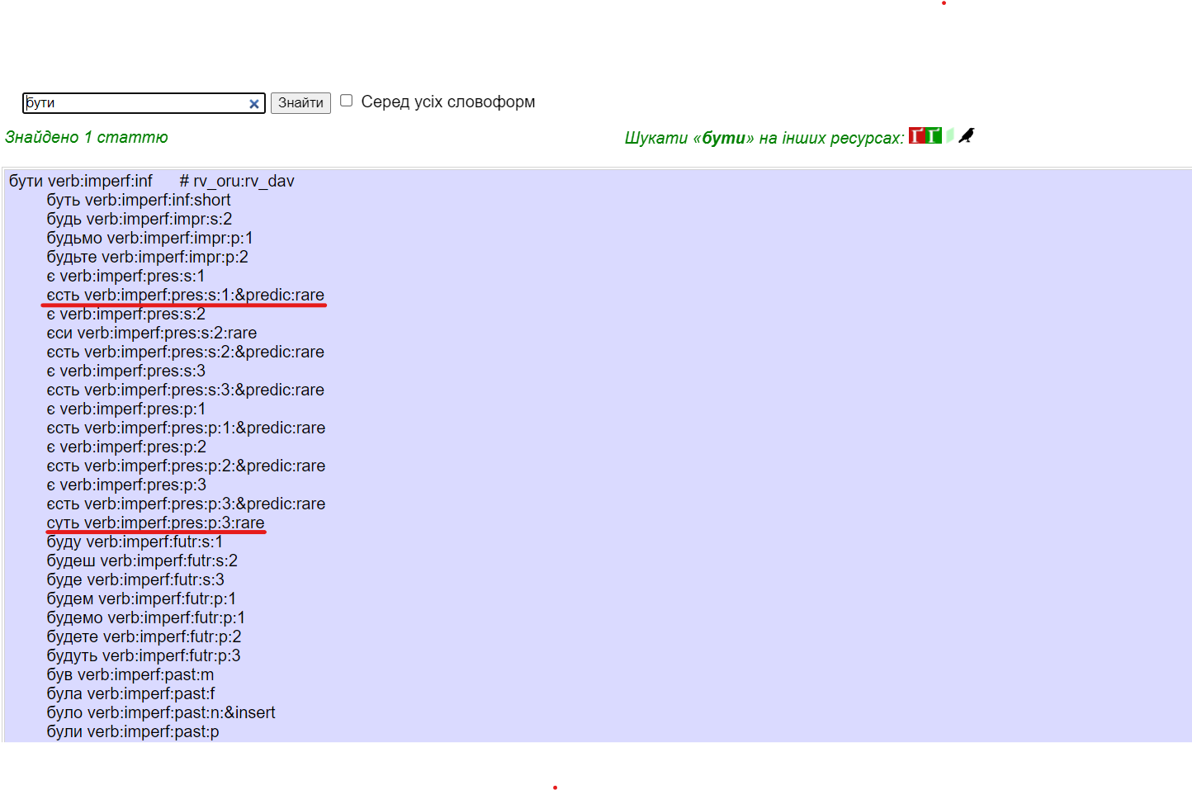
Rarely used forms

Slide 20
> 1,600 lemmas with the prefix od- and the preposition od

Slide 21
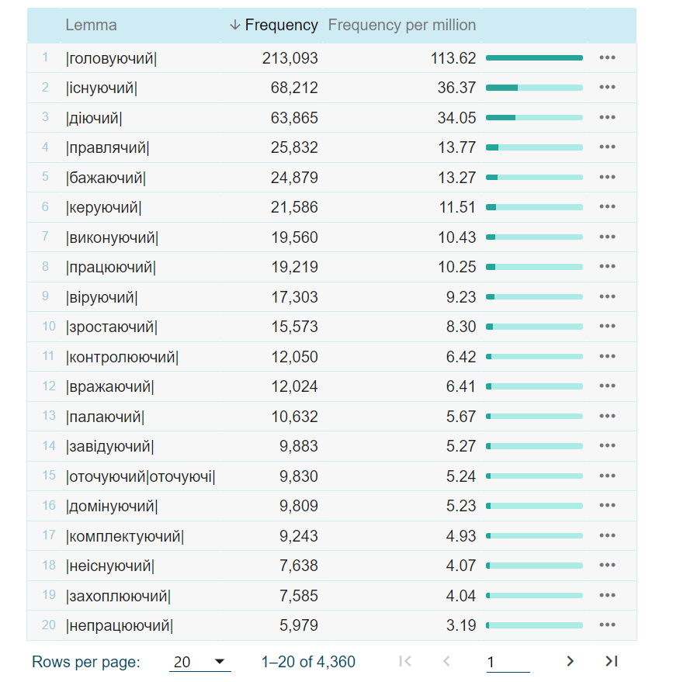
> 4,300 lemmas with the suffixes -ač(jač), -uč(juč)

Slide 22
Thank you for your attention!

