Slide 1
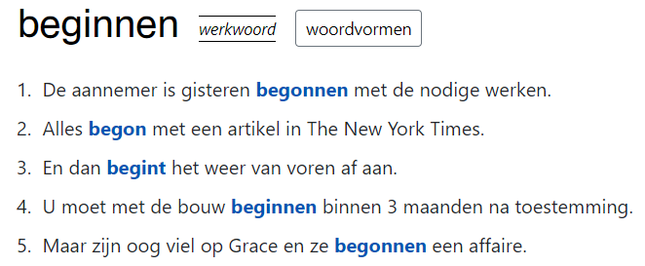
https://woordcombinaties.ivdnt.org
Reference work for using and understanding words in context
Advanced learners of Dutch; native speakers
Sketch engine: GDEX, word sketches, corpus pattern analysis (CPA)
Lut Colman & Carole Tiberius

