Slide 1
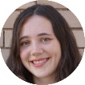
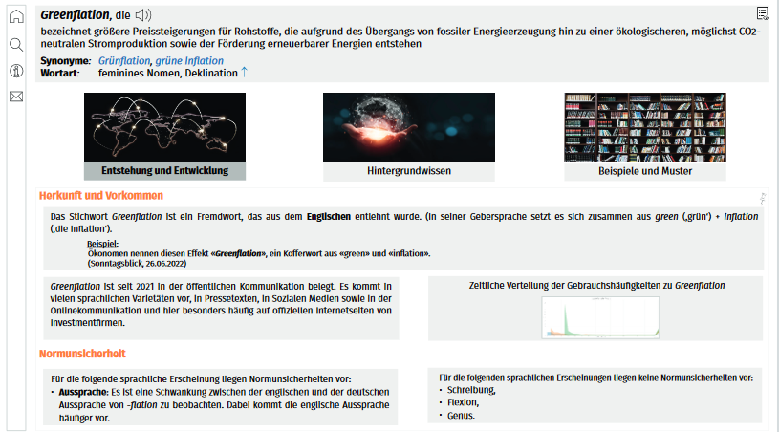
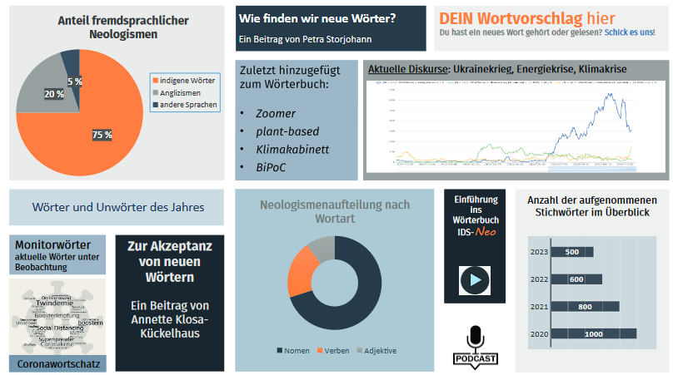
Project: „Lexicography of Linguistic Change“
Merle Benter
Julia Pawels
Dr. Petra Storjohann
Objective: Innovative, Interactive and Flexible Resource for German Neologisms
(informative, with reliable information and fun to browse in)
❶ customizable dictionary with lexical and encyclopaedic details ❷ selecting and combining specific information ❸ two different view options (tile view vs. text view) ❹ authentic examples and interactive illustrations
Neo-Dictionary
❶ (interactive) charts/graphs/figures ❷ academic papers
❸ podcasts, introductory tutorial ❹ new words under observation
Neo-Dashboard
+
Come and visit me!

